Slide 1
MLOPs-Machine learning operations
Vibhuti Duggal
Computer Division
BARC

Slide 2
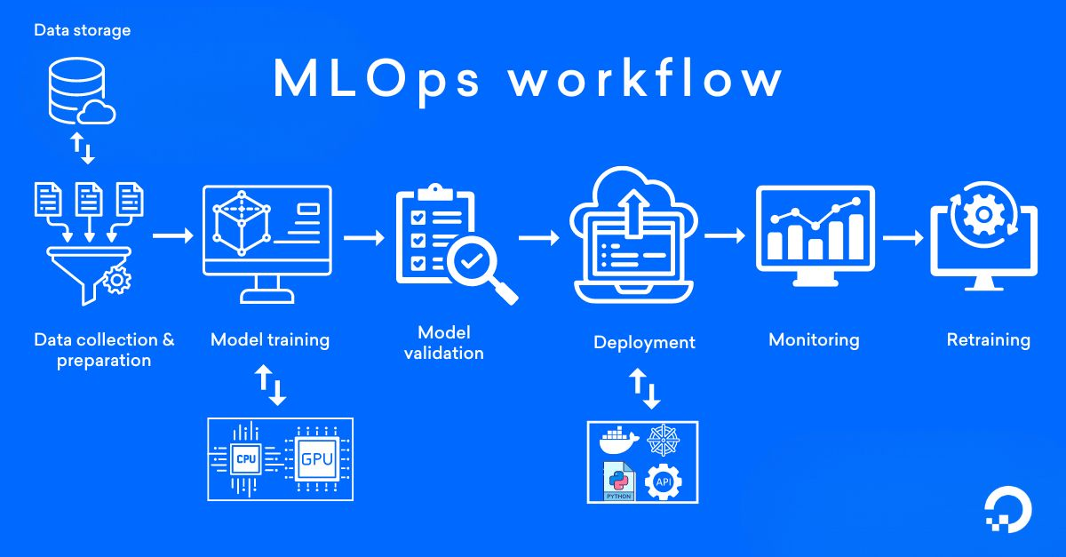
MLOPs
End-to-end machine learning development process to design, build and manage reproducible, testable, and evolvable ML-powered software.

Slide 3
1st Step- Data collection and preparation
Collect relevant data from multiple sources, such as internal systems, public datasets, or IoT devices
Clean it by removing errors, duplicates, or irrelevant data and transform data by normalizing values, creating features, or encoding categories, making it suitable for machine learning models

Slide 4

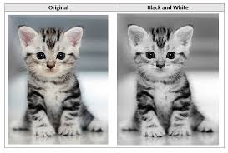

Normalization(Feature Scaling)
Ensuring every feature contributes equally
Gradient descent converges much faster
Data Normalization Techniques
Standardization
Rescale input: zero mean and unit standard deviation
Min-max Scaling
Notes:
For example, you might think well let's collect more data, more training data.
Or you might say,
maybe your training set isn't diverse enough yet,
you should collect images of cats in more diverse poses,
or maybe a more diverse set of negative examples.
Well maybe you want to train the algorithm longer with gradient descent.
Or maybe you want to try a different optimization algorithm,
like the Adam optimization algorithm.
Or maybe trying a bigger network or a smaller network or maybe you want
to try to dropout or maybe L2 regularization.
Or maybe you want to change
the network architecture such as changing activation functions,
changing the number of hidden units and so on and so on.

Slide 5
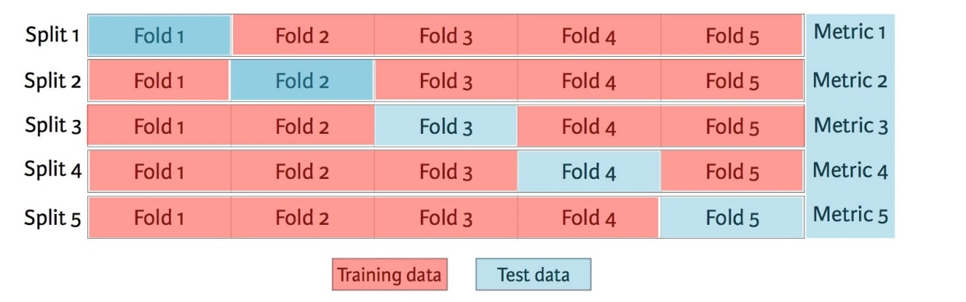
Train/Dev/Test Set
Training set: a set of examples used for learning
Validation set: a set of examples used to find which model performs best
Holdout method
K-fold cross validation
Test set: a set of examples used to assess the performance of a fully-trained classifier
Unbiased estimate of performance
Shuffle Total Data | Train | Dev | Test
10,000 | 60% | 20% | 20%
1 Million | 98% | 1% | 1%

Slide 6
2nd & 3rd Step- Model Training & Validation
Build and train models by applying algorithms (e.g., regression, decision trees, or neural networks) using programming languages like Python or R, along with libraries such as TensorFlow and PyTorch
How to choose Model?
Use pretrained Model
Transfer Learning
Fine Tuning
Hyperparameter tuning of pretrained model
Train from scratch
Model versioning - keep track of different versions using tools like Git, MLflow, or Data Version Control (DVC), which log each version of the model, including changes in code, data, and hyperparameters to ensure reproducibility and traceability

Slide 7
4th Step- Model Deployment
Continuous integration (CI) & continuous deployment (CD)
CI automates the process by detecting code changes in the version control system and triggering a build, which compiles the code and executes automated tests to ensure functionality and compatibility
Once the CI process is successful, CD takes over by deploying the new build to a staging environment for acceptance testing; if tests pass, the application is automatically released to production, ensuring that updates are delivered efficiently and reliably.

Slide 8
5th Step - Monitoring
Tools like Prometheus, Grafana, or custom dashboards, which are connected to deployed models.
To identify when retraining is required, it tracks
Accuracy - Compares model predictions to actual outcomes on new data in real-time
Latency - Monitors how fast the model responds to requests
Concept Drift - Detects change in the relationship between data inputs and outputs over time
Data Drift - Detects by comparing current input data distributions with the training data to identify changes

Slide 9
6th Step- Model retraining and updates
Models are retrained to maintain performance as data evolves. MLOps retrain by scheduling regular updates based on data changes or performance triggers, minimizing downtime and performance drops

Slide 10
THANK YOU
Questions?

