Slide 1
Federated Learning
Pritam Prakash Shete
Computer Division, BARC
Centre for Excellence in Basic Sciences

Slide 2
Topics
Traditional Machine Learning
What is Federated Learning?
How Federated Learning Works?
Types of Federated Learning
Application of Federated Learning
Advantages of Federated Learning
Disadvantages of Federated Learning

Slide 3
Traditional Machine Learning
Relies on large datasets stored in centralized locations (data centers)
Focuses on achieving accurate predictions and generating insights

Slide 4
Challenges in Traditional ML
Data Storage Issues
Handling massive volumes of data is difficult
Privacy Concerns
Centralized storage increases risk of data breaches
Processing Overhead
High data transfer, computation cost, and latency

Slide 5
Emergence of Federated Learning
A modern approach to machine learning
Enables decentralized training across multiple devices
Keeps data on local devices instead of sharing it centrally

Slide 6
Why Federated Learning Matters?
Improves data privacy and security
Reduces need for large scale data transfer
Offers scalable and efficient learning across distributed systems

Slide 7
Traditional ML v/s Federated Learning
Traditional Machine Learning faces limitations in privacy, storage, and efficiency
Federated Learning provides a powerful and innovative solution
Represents a significant shift toward privacy preserving AI

Slide 8
What is Federated Learning?
Federated Learning is a machine learning technique
Trains models on decentralized data
Data is distributed across multiple devices or nodes
Devices include smartphones, IoT devices, and edge devices
Data remains on local devices (not centralized)

Slide 9
How Federated Learning Works?
Model is sent to multiple devices
Each device trains the model locally using its own data
Local model updates (not raw data) are generated
Updates are sent to a central server
Server aggregates updates from multiple devices
A global model is updated and redistributed

Slide 10
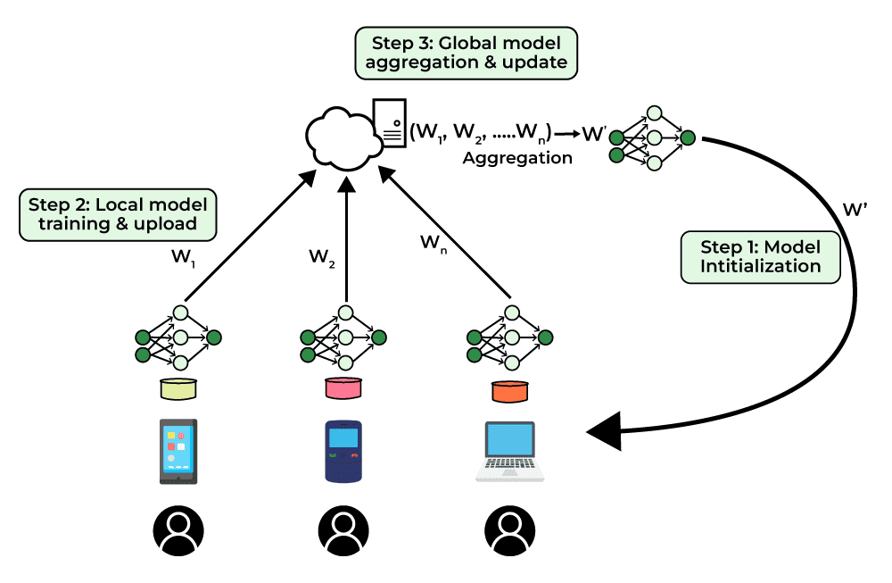
How Federated Learning Works?
Image ack – Google

Slide 11
How Federated Learning Works?
Data remains on local devices
Only model updates are shared
Enables collaborative learning without compromising data privacy

Slide 12
Types of Federated Learning
Federated Learning can be implemented using different strategies
These approaches vary based on system architecture and communication style

Slide 13
Types of Federated Learning
Centralized Federated Learning
Decentralized Federated Learning
Heterogeneous Federated Learning

Slide 14
Centralized Federated Learning
Uses a central server to manage the training process
Server responsibilities:
Select participating devices (nodes)
Aggregate model updates from all devices
All nodes send updates to the central server
Limitation:
Can become a bottleneck
Single point of failure

Slide 15
Decentralized Federated Learning
No central server involved
Devices (nodes) communicate and share updates among themselves
Eliminates single point of failure
Reduces bottleneck issues
Key consideration:
Performance depends on network topology

Slide 16
Heterogeneous Federated Learning
Involves diverse clients such as:
Smartphones
IoT devices
Devices differ in hardware and software capabilities
Challenges:
Varying computation power
Communication constraints

Slide 17
Types of Federated Learning
Different Federated Learning types address different system challenges
Centralized Federated Learning
Simpler but prone to bottlenecks
Decentralized Federated Learning
More robust but complex
Heterogeneous Federated Learning
Realistic but requires adaptive methods

Slide 18
Application of Federated Learning
Google Keyboard (Gboard)
Federated Learning is widely used in Google Keyboard (Gboard)
Enhances typing suggestions and predictions
Learns from user behavior while preserving privacy

Slide 19
Gboard – Data Collection
Gboard collects user data
Search history
Typing patterns
Data remains stored on the user’s device

Slide 20
Gboard – Model Training
Model is trained locally using the local data
No raw data is sent to a central server

Slide 21
Gboard – Model Updates
Local model updates are generated on the device
Updates are encrypted and sent to a central server
Server aggregates updates from multiple users
Builds an improved global model

Slide 22
Gboard – Improved User Experience
Model continuously improves with more updates
Provides better typing predictions
Suggests more accurate words and phrases
Adapts to individual user behavior

Slide 23
Gboard – Privacy and Efficiency
Personal data never leaves the device
Only model updates are shared
Reduces bandwidth usage
Ensures efficient and scalable learning

Slide 24
Advantages of Federated Learning
Reduced Power Usage
Reduced data size means reduced computation time and hence less power usage.
Guarantees Privacy
Data stays on the device, maintaining privacy without loss of training.
No Device Performance Impact
Training is done only when the device is in idle or charging state, hence no impact on performance.

Slide 25
Advantages of Federated Learning
Scalability
Scales with big, distributed datasets across multiple devices.
Better Model Performance
Uses heterogeneous data from various devices to improve model accuracy.
Real-time Updates
Allows real-time model updates on each device.

Slide 26
Disadvantages of Federated Learning
Network Latency
The communication between the devices and the central server can be a bottleneck and may add latency to the training process.
Heterogeneous devices
The devices can be heterogeneous in terms of hardware and software, which can make it difficult to ensure the compatibility and consistency of the models.
Data Quality
The quality of data can vary across the devices, which can lead to poor model performance.

Slide 27
Questions?
Thank you

