Slide 1
Graphics Processing Unit
Computer Division
Bhabha Atomic Research Centre

Slide 2
Topics
Evolution of Performance
Applications of GPU
CPU v/s GPU
GPU as a Co-processor
Heterogeneous Computing
GPU Architecture
Streaming Multiprocessor
Memory Hierarchy
Thread Hierarchy

Slide 3
Evolution of Performance (1)
Early Processors:
Single core
Increase clock speed
Number of cycles per second
Number of instructions per second
Faster execution of individual instructions
Limitations of Clock Speed
Physical limits on clock speeds
Power or heat dissipation

Slide 4
Evolution of Performance (2)
Multi Core Architecture:
Multiple cores on Single chip
Parallel execution of tasks
Significant overall performance improvement
Multiple cores – Different threads – Simultaneous execution
Multi threaded tasks – Performance improvement
Power Efficiency:
Individual cores
Lower clock speed
Better power efficiency

Slide 5
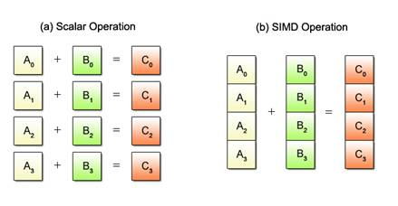
Evolution of Performance (3)
Heterogeneous Computing
GPU – Graphics Processing Unit
Specialized processor
Process large amounts of data
High performance
Many core processors
Very high memory bandwidth
TeraFLOPs peak performance
Single Instruction Multiple Data (SIMD)
Offload computationally intensive tasks to GPU

Slide 6
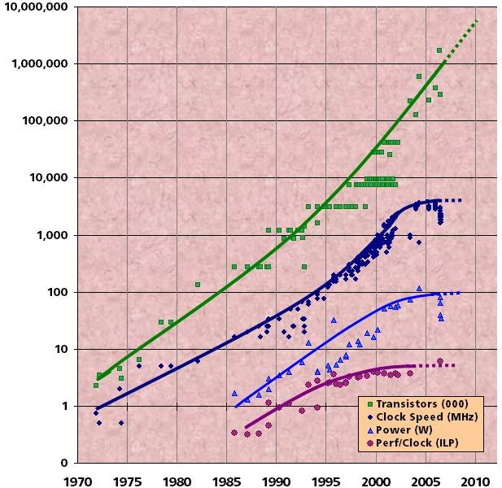
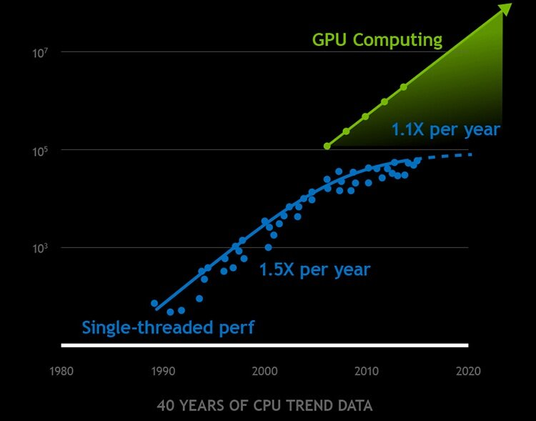
Evolution of Performance (4)

Slide 7
Applications of GPU
Computer Graphics – Image Synthesis
Generates images – Video games, Animated movies
X-ray computed tomography
Image Processing
Image analysis – Template matching, SURF features
High Performance Computing
Computational Fluid Dynamics (CFD), Molecular Dynamics
AI/ML
Deep Learning – Object detection, object recognition, image segmentation
Large Language Models (LLM) – ChatGPT, Llama

Slide 8
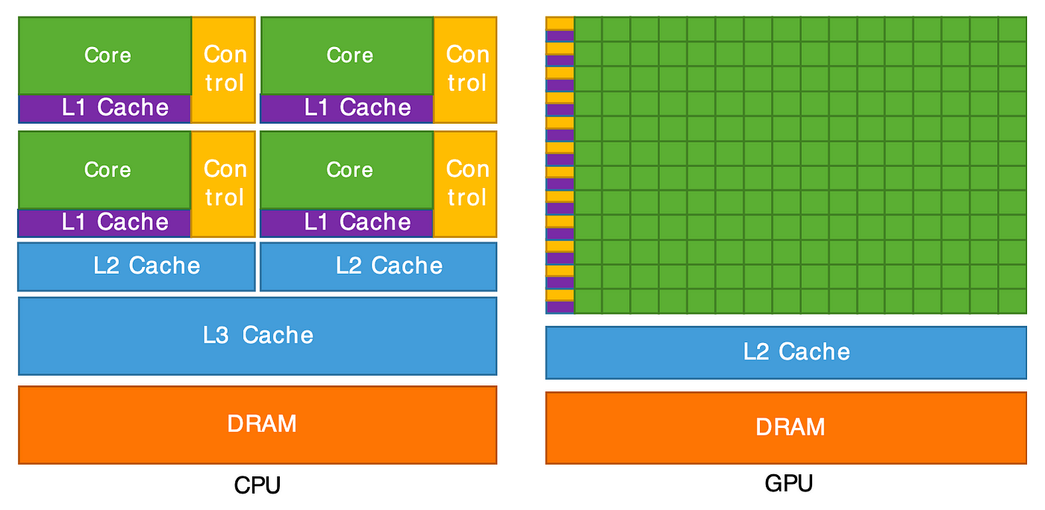
CPU v/s GPU

Slide 9
CPU v/s GPU
Central Processing Unit – CPU
Less number of cores (~100)
Low compute density
Low latency
Higher clock speed
Powerful cores
Serial instruction processing
Handful of operations at once
Suitable for serial instruction processing
Versatility - Can be used for tasks such as OS or I/O etc
Graphics Processing Unit – GPU
Large number of cores (~5000)
High compute density
High throughput
Lower clock speed
Weak cores
Parallel instruction processing
Thousands of operations at once
Not suitable for serial instruction processing
Not Versatile – Cannot be used for tasks such as OS or I/O etc

Slide 10
GPU as Co-processor
GPU as Compute device
Has its own DRAM
Can run multiple threads in parallel
Application runs on host
The compute intensive, data-parallel part is sent to GPU
Written as C functions called kernel
The kernel is executed on device simultaneously by multiple threads

Slide 11
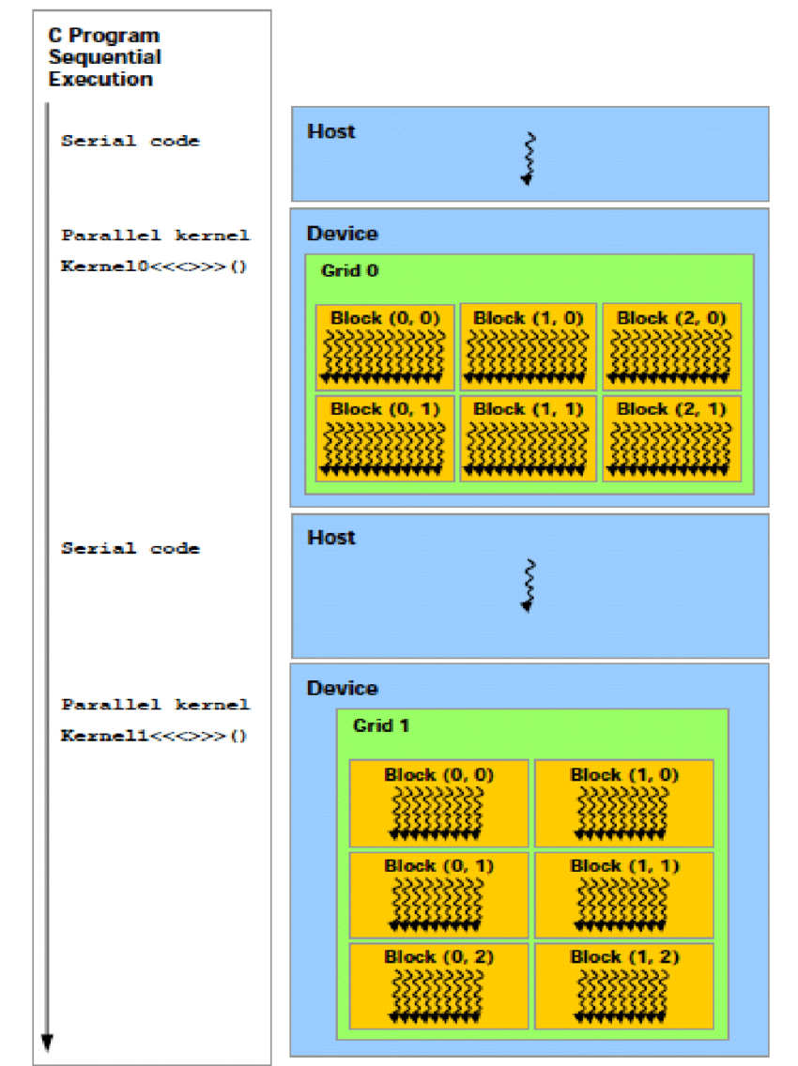
Heterogeneous Computing
Serial Code
Executed on CPU
Host Code
Parallel Code
Executed on GPU
Device Code
Kernel
CPU – Host
GPU – Co–processor

Slide 12
Heterogeneous Computing
Step 1: Initialize the memories on both CPU and GPU.
Step 2: Transfer the data to a GPU.
Step 3: Do the computation on a GPU.
Step 4: Transfer the data back to a CPU.
Step 5: Delete the memories on both CPU and GPU.

Slide 13





Typical Execution
Host (CPU)
2
Host launches kernel on the device
The kernel is executed by multiple threads concurrently
3
Device (GPU)
Host Memory
PCIe
Device Memory
4
The data within the device is accessed by threads through memory hierarchy
1
Data is copied from the host memory to the device memory via PCIe Bus
5
The results are moved back to the device memory and are transferred back to the host via PCIe bus

Slide 14



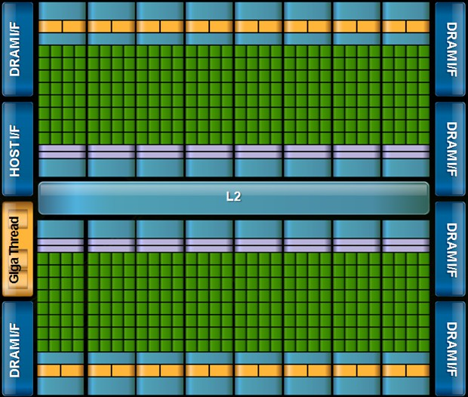

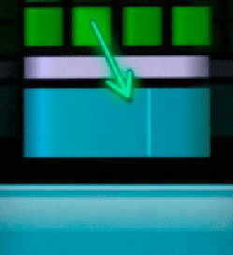


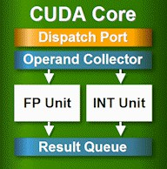

GPU Architecture
16 Stream Multiprocessors (SM) 512 CUDA cores (32/SM)
IEEE 754-­‐2008 floating point (DP and SP)
6 GB GDDR5 DRAM (Global Memory)
ECC Memory support
Two DMA interface
SM
Reconfigurable L1 Cache and Shared Memory
48 KB / 16 KB
L2 Cache 768 KB
L1
Shared Memory
L2
Load/Store address width 64 bits. Can calculate addresses of 16 threads per clock.
NVIDIA FERMI

Slide 15
Streaming Multiprocessor
Streaming or Thread Processor
8 or 32 cores per SM
Double Precision Unit
Special Function Unit
Shared Memory
Cache memory – L1 and L2 cache

Slide 16





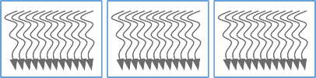


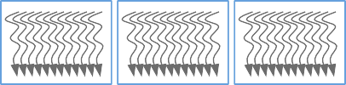

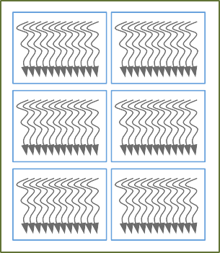
Memory Hierarchy
Private memory
Visible only to the thread
Registers
Local Memory per Thread
Shared memory
Visible to all the threads in a block
Thread
Block
Shared Memory per Block
Global Memory
Constant Memory
Global memory
Visible to all the threads Visible to host
Accessible to multiple kernels
Data is stored in row major order
Constant memory (Read Only)
Visible to all the threads in a block
Grid 0
Grid 1

Slide 17
Host Accessible Memory
(Device) Grid
Block (0, 0)
Block (1, 0)
Shared Memory
Shared Memory
Host have access to
Global memory
Constant memory
Texture memory
Registers
Registers
Registers
Registers
Thread (0, 0)
Thread (1, 0)
Thread (0, 0)
Thread (1, 0)
Local
Memory
Local
Memory
Local
Memory
Local
Memory
Host
Global
Memory
Constant
Memory
Texture
Memory
Notes:
Texture caches are designed for graphics applications where memory access patterns exhibit a great deal of spatial locality. In a computing application, this roughly implies that a thread is likely to read from an address “near” the address that nearby threads read

Slide 18
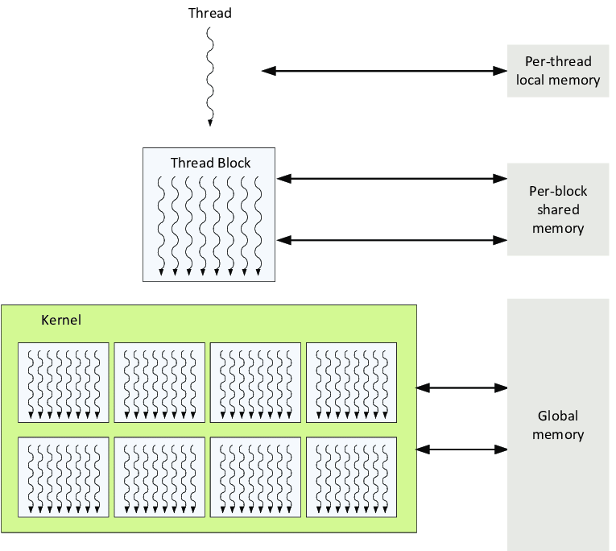
Thread Hierarchy

Slide 19
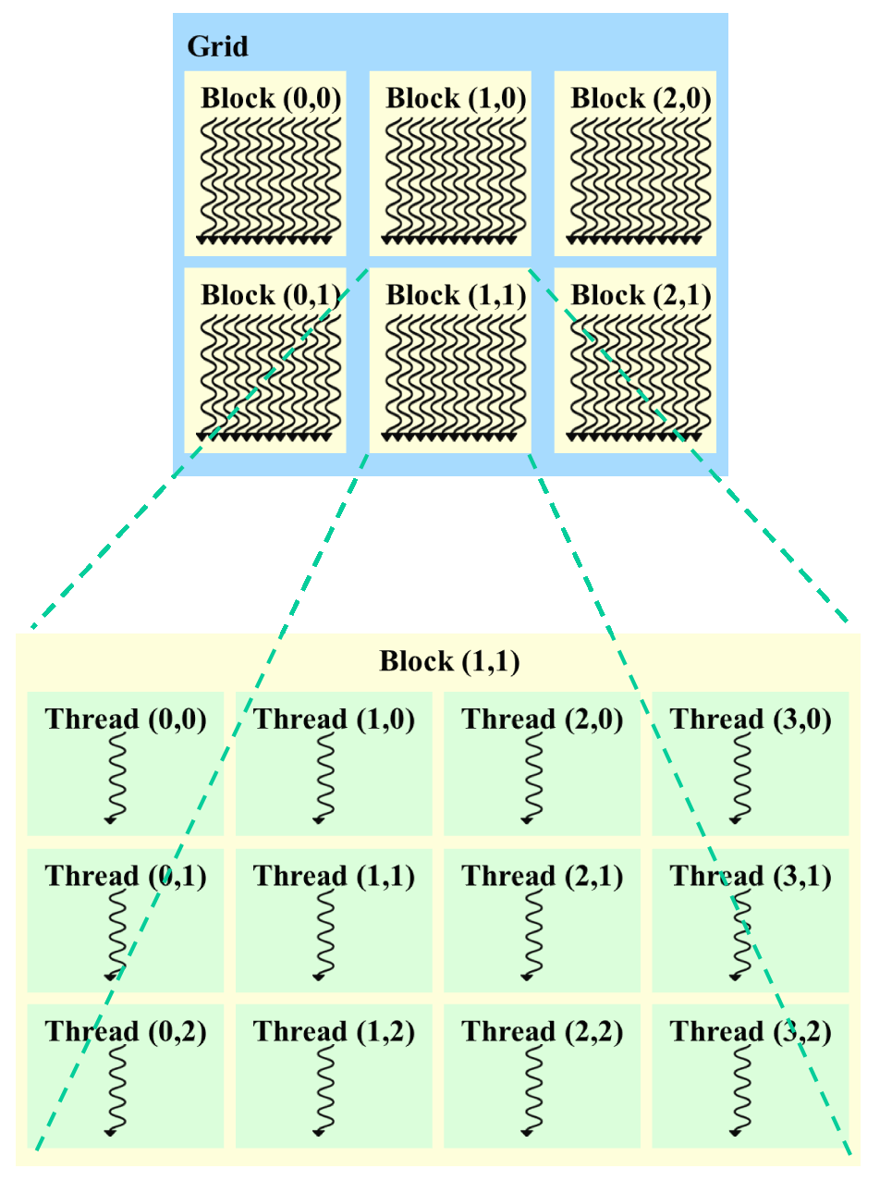
Thread Hierarchy
Threads
Thread Block
Grid of Thread Blocks

Slide 20
Questions?
Thank you

