Slide 1
CUDA Computer Division Bhabha Atomic Research Centre
Notes:
1

Slide 2
CUDA
Compute Unified Device Architecture
NVIDIA GPU
Allows developers to use GPUs for general-purpose computing
Write code that can be executed in parallel across multiple GPU cores
Speeds up compute-intensive applications for parallelizable parts of a computation
High level Language
Extended C
Notes:
2

Slide 3
GPU as Co–processor
GPU as Compute device
Own Memory
Run multiple threads in parallel
Application runs on host
The compute intensive, data-parallel part is sent to GPU
Written as C functions – Kernel
Kernel is executed on device simultaneously by multiple threads
Notes:
3

Slide 4


GPU Execution
Host application
GPU kernel
Process Input
Data and
Write to
output
Load/Initialize
Input Data
Copy Input Data
from Host to
GPU Memory
Copy Output
from GPU to
Host Memory
Main Memory
GPU Memory

Slide 5
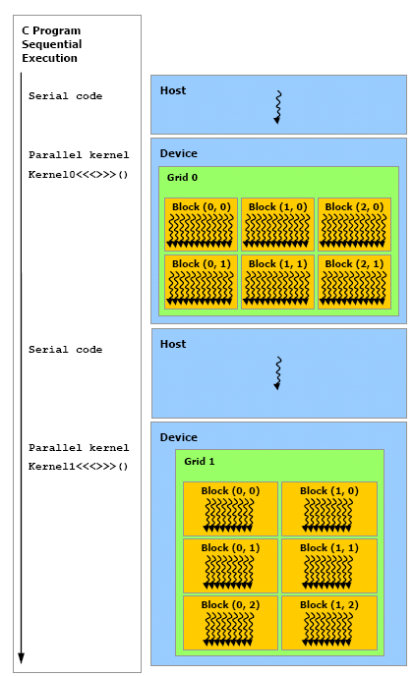
Heterogeneous Programming
Serial Code
Executed on CPU
Host Code
Parallel Code
Executed on GPU
Device Code
CUDA Kernel
CPU = Host
GPU = Co-processor
Notes:
5

Slide 6
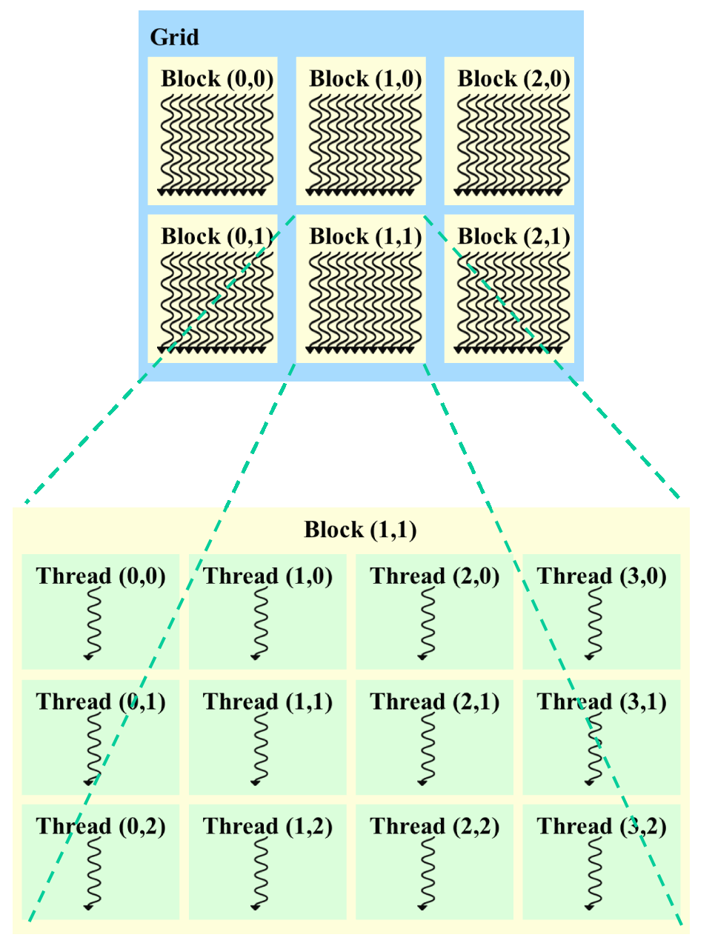
Thread Hierarchy
Threads
Thread Block
Grid of Thread Blocks

Slide 7
CUDA Kernel
C function
Executed N times in parallel by N CUDA threads
Execution configuration syntax
kernel_name<<< grid_size, block_size >>>(….)
"grid_size": Represents the total number of thread blocks that will be launched on the GPU.
"block_size": Indicates the number of threads within each individual thread block.
Notes:
7

Slide 8
CUDA Example
C
CUDA
void vecAdd(float A[],
float B[],
float C[])
{
for(int i = 0; i < n; i++)
{
C[i] = A[i] + B[i];
}
}
int main()
{
// Declare A,B,C
// Assign values to A and B
vecAdd(A, B, C);
}
// Kernel definition
__global__ void vecAdd(float* A, float* B, float* C)
{
int i = threadIdx.x;
C[i] = A[i] + B[i];
}
int main()
{
// Kernel invocation
vecAdd<<<1, n>>>(A, B, C);
}
Kernel invocation from host
Number of CUDA threads specified using <<<…>>>

Slide 9
CUDA Kernel
Each thread has a unique thread ID
__global__ void vecAdd(float* A, float* B, float* C)
{
int i = threadIdx.x;
C[i] = A[i] + B[i];
}
Unique Thread ID
Accessible within the kernel through the built-in threadIdx variable
Function Qualifier
“__global__” qualifier declares a function as a Kernel
Notes:
Code in a Kernel function is executed by all the threads invoked in a GPU.

Slide 10
Thread Hierarchy
Thread block – Organized threads
Block – 1D, 2D or 3D array of threads
Specified during kernel invocation
threadIdx
3 component vector
Specify ids in 3D
Invoke kernels on 2D & 3D matrices
Block
Thread
(0, 0)
Thread
(1, 0)
Thread
(2, 0)
Thread
(3, 0)
Thread
(4, 0)
Thread
(0, 1)
Thread
(1, 1)
Thread
(2, 1)
Thread
(3, 1)
Thread
(4, 1)
Thread
(0, 2)
Thread
(1, 2)
Thread
(2, 2)
Thread
(3, 2)
Thread
(4, 2)

Slide 11
dim3 Type
CUDA defined structure of unsigned integers
struct dim3 {x; y; z};
Specify dimensions of
Thread blocks
Grid of thread blocks
Unspecified component – Initialized to 1
dim3(100) – dim3(100, 1, 1)
Used both in Host side code & Kernel side code

Slide 12
Thread Block
Threads within a block can share data among themselves through shared memory.
All threads within a block are expected to run on single Stream Multiprocessor (SM).
Number of threads per block is restricted by memory resource of single SM.
Limit of 1024 threads in a block on current GPUs
How to run more than 1024 threads?
Grid of Thread Blocks
Notes:
12

Slide 13
Grid of Thread Blocks
Device
Thread blocks are equally shaped.
Multiple thread blocks execute kernel in parallel.
Thread blocks are arranged in grid
Grid can be 1D, 2D or 3D.
Grid 1
Block
(0, 0)
Block
(1, 0)
Block
(2, 0)
Block
(0, 1)
Block
(1, 1)
Block
(2, 1)
Block
Thread
(0, 0)
Thread
(1, 0)
Thread
(2, 0)
Thread
(3, 0)
Thread
(4, 0)
Thread
(0, 1)
Thread
(1, 1)
Thread
(2, 1)
Thread
(3, 1)
Thread
(4, 1)
Thread
(0, 2)
Thread
(1, 2)
Thread
(2, 2)
Thread
(3, 2)
Thread
(4, 2)

Slide 14
Grid of Thread Blocks
blockIdx
Identify block within grid
1D, 2D or 3D index
Thread block dimensions – blockDim
Grid of Thread Blocks dimension – gridDim

Slide 15
1D Thread Block Example
int i = blockIdx.x * blockDim.x + threadIdx.x;
blockIdx.x =0
blockIdx.x =1
blockIdx.x =2
a[0]
a[63]
a[64]
a[127]
a[128]
a[191]
….
….
….
threadIdx.x 0
threadIdx.x 63
threadIdx.x 0
threadIdx.x 63
threadIdx.x 0
threadIdx.x 63
i = 0
i = 63
i = 64
i = 127
i = 128
i = 191
Assuming blockDim.x = 64

Slide 16
1D Thread Block Example
__global__ void addition (float *A, float * B, float *C, int iSize)
{
// Calculate vector index.
int i = blockIdx.x * blockDim.x + threadIdx.x;
if (i < iSize) // index within vector size
C[i] = A[i] + B[i];
}

Slide 17
2D Thread Block Example
2D array
Rows
Columns
1D array
Index
2D array – 1D array
Row No* Total Columns + Column No
R-1 and C-2
1*3 + 2 = 5
R-2 and C-1
2*3 + 1 = 7
 | C-0 | C-1 | C-2 | Column
R-0 | 1 | 2 | 3
R-1 | 4 | 5 | 6
R-2 | 7 | 8 | 9
Row
1D Index
0 | 1 | 2 | 3 | 4 | 5 | 6 | 7 | 8
1 | 2 | 3 | 4 | 5 | 6 | 7 | 8 | 9

Slide 18
2D Thread Block Example
Example of 2D block
// Add two matrices A and B of
//dimension NxN and store the
// result into matrix C
__global__ void matAdd(int N, float* A, float* B, float* C)
{
int i = threadIdx.x;
int j = threadIdx.y;
C[j * N + i] = A[j * N + i] + B[j * N + i];
// C[i][j] = A[i][j] + B[i][j];
}
// host code
int main()
{
// Declare, allocate and initialize
// device memory A, B & C
// Kernel invocation
dim3 Block(N, N);
matAdd<<<1, Block>>>(N, A, B, C);
}

Slide 19
Execution Configuration Syntax
// Define a logical thread block.
dim3 Block(…);
eg dim3 Block(N, N, N);
// Define a logical grid.
dim3 Grid(…);
eg dim3 Grid(N, N, N);
// Launch CUDA kernel.
kernel<<<Grid, Block>>>(…);
eg matadd<<< Grid, Block>>>(N,A,B,C);

Slide 20
Managing Device Memory
cudaMallocManaged
cudaDeviceSynchronize
cudaFree

Slide 21
Device Memory Allocation
cudaMallocManaged()
Allocates object in device’s Global Memory and host Memory
Pool of managed memory is created
It is shared between CPU and GPU
Accessible to both CPU and GPU using single pointer
Two parameters
Address of a pointer to allocated object
Size of allocated object

Slide 22
Free Device Memory
cudaFree()
Free object from device’s and host’s Memory
Parameter – Pointer to object to be freed

Slide 23
Device Memory Allocation
Example code:-
Allocate and free an array of 256 floating point elements in device memory as well as on the host
float* Ptr;
cudaMallocManaged((void**)&Ptr, 256 * sizeof (float));
// free this memory
cudaFree(Ptr);
We cast it into double pointer because it's a pointer to the pointer. It has to point to a pointer in GPU memory.
Notes:
What cudaMalloc() does is that it allocates a memory pointer on GPU, which is then pointed by the first argument we give.

Slide 24
Synchronize Device Memory
cudaDeviceSynchronize()
Forces the GPU to complete all pending operations, including kernel launches and memory transfers, before the host program proceeds.
Ensures host program does not attempt to access data on the GPU until all previous operations have been completed, preventing potential data corruption or inconsistencies.

Slide 25
CUDA Matrix Addition Example
// Add two matrices A and B
// Dimension NxN
// Store the result into C
__global__ void matAdd(int N, float* A, float* B,
float* C)
{
int i = threadIdx.x;
int j = threadIdx.y;
C[j * N + i] = A[j * N + i] + B[j * N + i];
// C[i][j] = A[i][j] + B[i][j];
}

Slide 26
CUDA Matrix Addition Example
// host code
int main()
{
// Declare, allocate and
// initialize host data pointer.
float *A, *B, *C;

Slide 27
CUDA Matrix Addition Example
// Allocate unified memory
cudaMallocManaged((void**)&A, N * N * sizeof (float));
cudaMallocManaged((void**)&B, N * N * sizeof (float));
cudaMallocManaged((void**)&C, N * N * sizeof (float));

Slide 28
CUDA Matrix Addition Example
// Assign values to matrices A and B
// Kernel invocation
dim3 dimBlock(N, N);
matAdd<<<1, dimBlock>>>(N, A, B, C);
cudaDeviceSynchronize();
// Print out the results here

Slide 29
CUDA Matrix Addition Example
cudaFree(A);
cudaFree(B);
cudaFree(C);
}

Slide 30
Memory Hierarchy
(Device) Grid
Block (0, 0)
Block (1, 0)
Registers
Local memory
Shared memory
Global memory
Read only constant memory
Read only texture memory
Shared Memory
Shared Memory
Registers
Registers
Registers
Registers
Thread (0, 0)
Thread (1, 0)
Thread (0, 0)
Thread (1, 0)
Local
Memory
Local
Memory
Local
Memory
Local
Memory
Global
Memory
Constant
Memory
Texture
Memory

Slide 31
Host Accessible Memory
(Device) Grid
Global memory
Constant memory
Texture memory
Block (0, 0)
Block (1, 0)
Shared Memory
Shared Memory
Registers
Registers
Registers
Registers
Thread (0, 0)
Thread (1, 0)
Thread (0, 0)
Thread (1, 0)
Local
Memory
Local
Memory
Local
Memory
Local
Memory
Host
Global
Memory
Constant
Memory
Texture
Memory
Notes:
Texture caches are designed for graphics applications where memory access patterns exhibit a great deal of spatial locality. In a computing application, this roughly implies that a thread is likely to read from an address “near” the address that nearby threads read

Slide 32
Parallel Computing using CUDA
Allocate device memory for input data
Copy input data from host memory to device memory
Allocate device memory for output data
for each logical block within data do
for each thread within logical block do
calculate output value in device memory
Synchronize threads
Copy results from device memory to host memory
Free device memory allocated for input & output data
Notes:
32

Slide 33
CUDA Installation
CUDA Toolkit
Develop CUDA application
Super user
CUDA SDK
Sample projects
Regular user
Notes:
33

Slide 34
CUDA Code Compilation
Host code
C, C++ code – .c, .cxx, or .cpp extension
Native compiler – gcc, nmake
Device code
Extended C – .cu extension
nvcc compiler
Example
nvcc -o matrixAddition matrixAddition.cu
Notes:
34

Slide 35
CUDA Matrix Multiplication Example
//Header Files
#include <stdio.h>
#include <math.h> // math functions
#include <cuda_runtime_api.h> // CUDA runtime API
// define logical thread block size
#define N 40
#define BLOCK_SIZE 10
Notes:
35

Slide 36
CUDA Matrix Multiplication Example
//CUDA KERNEL
__global__ void mul (float *A, float * B, float *C, int size)
{
int ROW = blockIdx.y*blockDim.y+threadIdx.y;
int COL = blockIdx.x*blockDim.x+threadIdx.x;
// Calculate matrix multiplication of 1 row
if (ROW < size && COL < size) {
float sum=0.0;
for (int i = 0; i < size; i++) {
sum += A[ROW * size + i] * B[i * size + COL];
}
C[ROW * size + COL]=sum;
}
}
Notes:
36

Slide 37
CUDA Matrix Multiplication Example
// Vectors Using Unified Memory
// Create float pointers.
float *A, *B, *C;
// Calculate data size in no of bytes.
int iByteSize= N * N *sizeof(float);
// Allocate Unified Memory
// Accessible from CPU or GPU.
cudaMallocManaged(&A, iByteSize);
cudaMallocManaged(&B, iByteSize);
cudaMallocManaged(&C, iByteSize);
Notes:
37

Slide 38
CUDA Matrix Multiplication Example
// Initialize Vectors
for(int i=0; i < N * N; i++)
{
// Initialize vectors.
A[i] = (float) rand() / (float) rand();
B[i] = (float) rand() / (float) rand();
C[i]=0.0;
}
Notes:
38

Slide 39
CUDA Matrix Multiplication Example
// Execution Configuration Syntax
//N=40, BLOCK_SIZE=10
// Define a logical block size.
dim3 Block(BLOCK_SIZE, BLOCK_SIZE);
// Define a logical grid size.
dim3 Grid(ceil(N/BLOCK_SIZE), ceil(N/BLOCK_SIZE));
// Launch CUDA kernel.
mul<<<Grid,Block>>>(A, B, C, N);
Notes:
39

Slide 40
CUDA Matrix Multiplication Example
// Wait for GPU to finish before accessing on host.
cudaDeviceSynchronize();
//Print Results
for (long i = 0; i < N; i++) {
for (long j = 0; j < N; j++) {
printf("%f ", C[i * N + j]);
}
printf("\n");
}
// Free memory.
cudaFree(A);
cudaFree(B);
cudaFree(C);
Notes:
40

Slide 41
Questions?
Thank you

