Slide 1
Graphics Processing Unit
Pritam Prakash Shete
Computer Division
Bhabha Atomic Research Centre

Slide 2
Topics
Introduction
CPU v/s GPU
Heterogeneous Computing
GPU Architecture
Streaming Multiprocessor
Memory Hierarchy
Thread Hierarchy

Slide 3
Introduction
Computer graphics – Image synthesis
Image processing – Image analysis
GP-GPU – General Purpose computation on GPU
Graphics Processing Unit – GPU
High performance
Many core processors
Very high memory bandwidth
TeraFLOPs peak performance
Single Instruction Multiple Data parallelism
Offload computationally intensive tasks to GPU

Slide 4
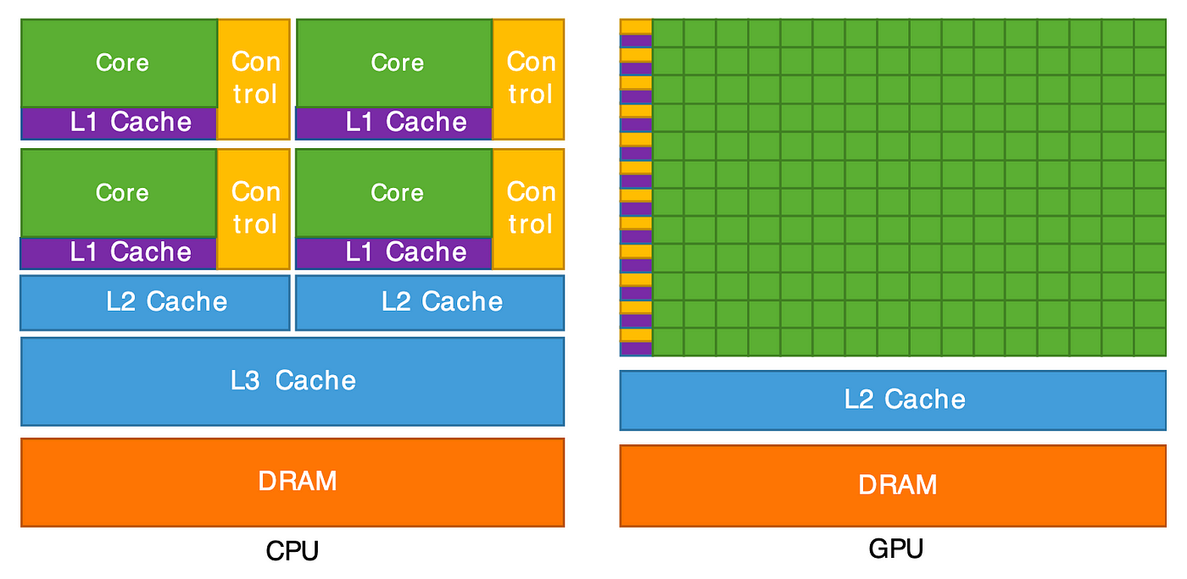
CPU v/s GPU
Image ack – Google

Slide 5
CPU v/s GPU
Central Processing Unit – CPU
Less number of cores (~100)
Low compute density
Low latency
Higher clock speed
Powerful cores
Serial instruction processing
Handful of operations at once
Graphics Processing Unit – GPU
Large number of cores (~1000)
High compute density
High throughput
Lower clock speed
Weak cores
Parallel instruction processing
Thousands of operations at once

Slide 6
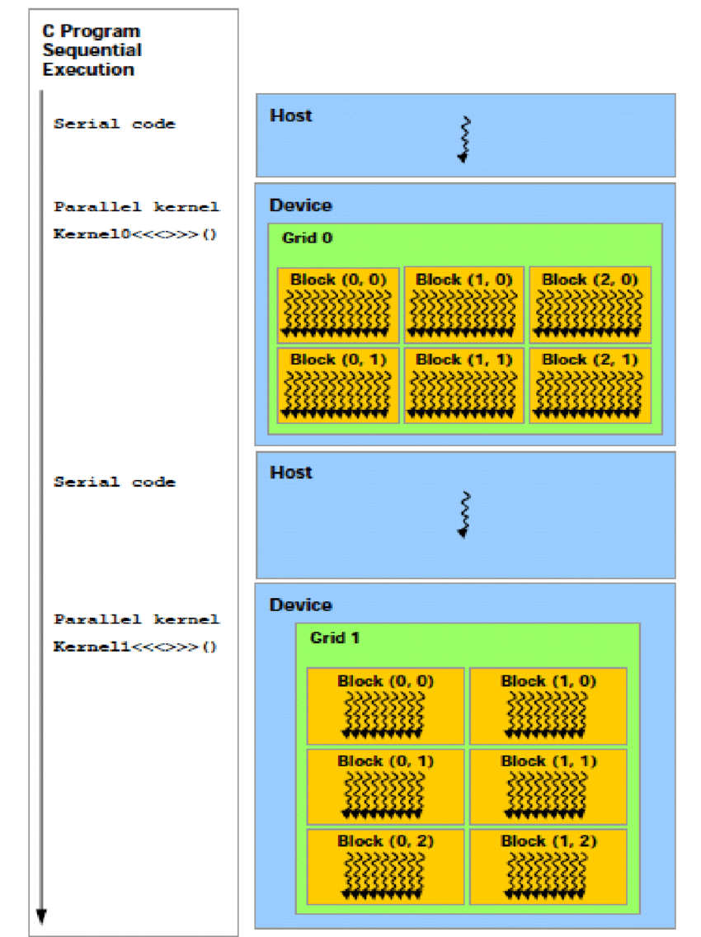
Heterogeneous Computing
Serial Code
Executed on CPU
Host Code
Parallel Code
Executed on GPU
Device Code
Kernel
CPU – Host
GPU – Co–processor
Image ack – Google

Slide 7
Heterogeneous Computing
Step 1: Initialize the memories on both CPU and GPU.
Step 2: Transfer the data to a GPU.
Step 3: Do the computation on a GPU.
Step 4: Transfer the data back to a CPU.
Step 5: Delete the memories on both CPU and GPU.

Slide 8
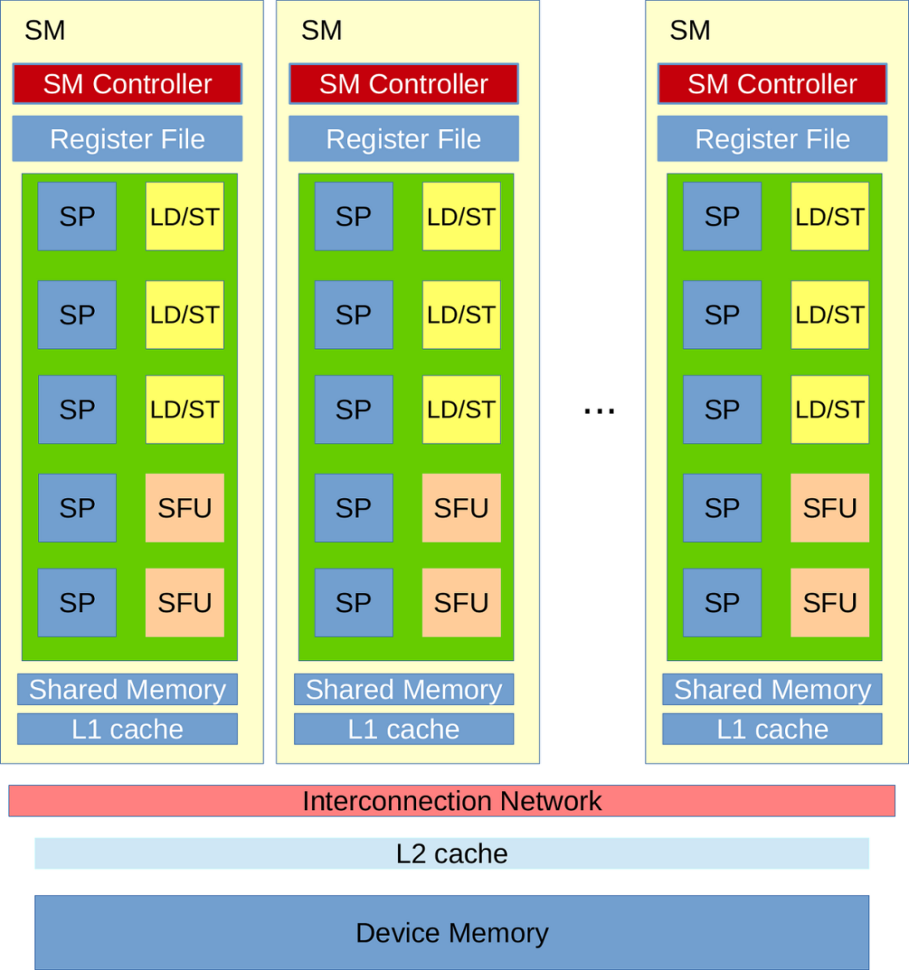
GPU Architecture
Streaming Multiprocessor – SM
Number of SMs
Shared memory
Cache memory – L1 and L2 cache
Device memory
Image ack – Google

Slide 9
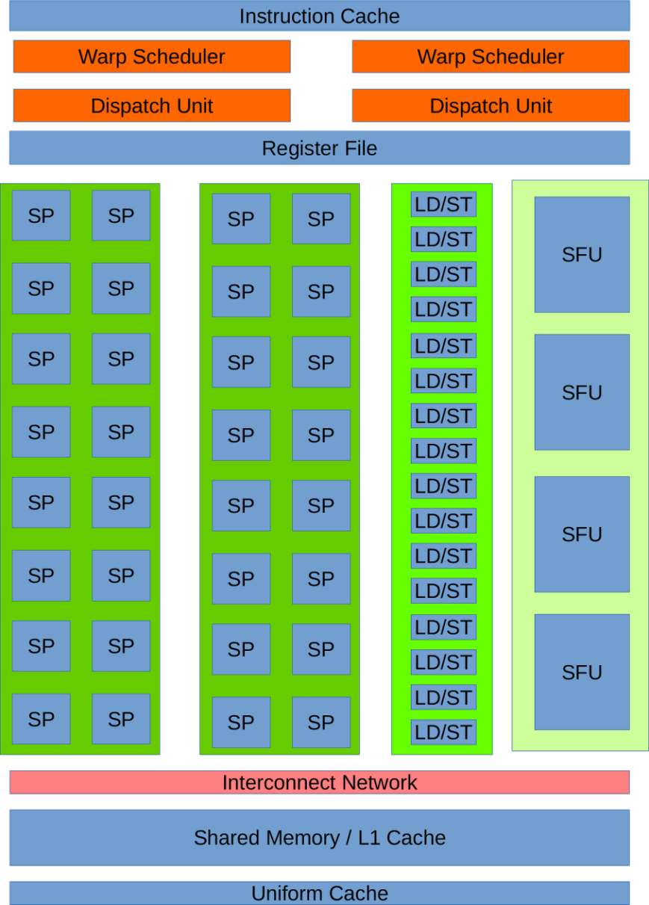
Streaming Multiprocessor
Streaming or Thread Processor
8 or 32 cores per SM
Double Precision Unit
Special Function Unit
Shared Memory
Image ack – Google

Slide 10
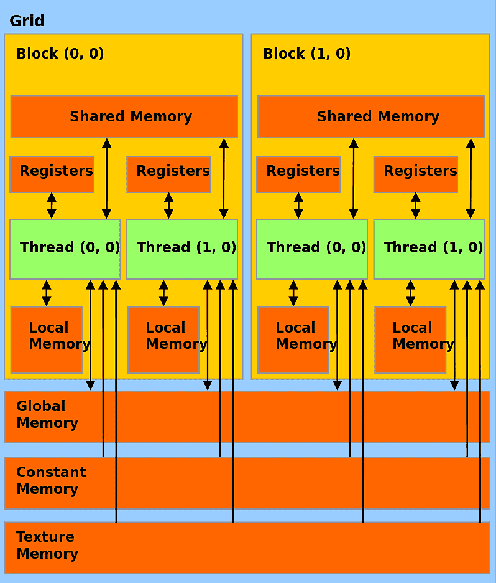
Memory Hierarchy
Local memory
Register memory
Shared memory
Global memory
Constant memory
Texture memory
Image ack – Google

Slide 11
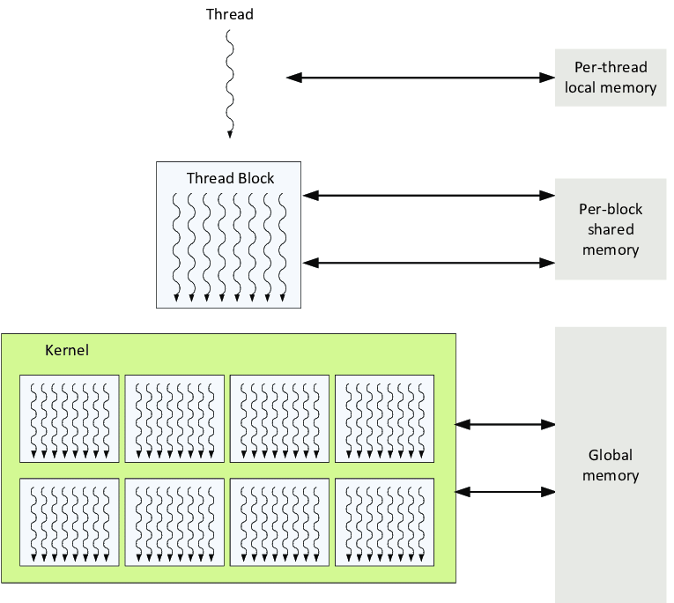
Thread Hierarchy
Image ack – Google

Slide 12
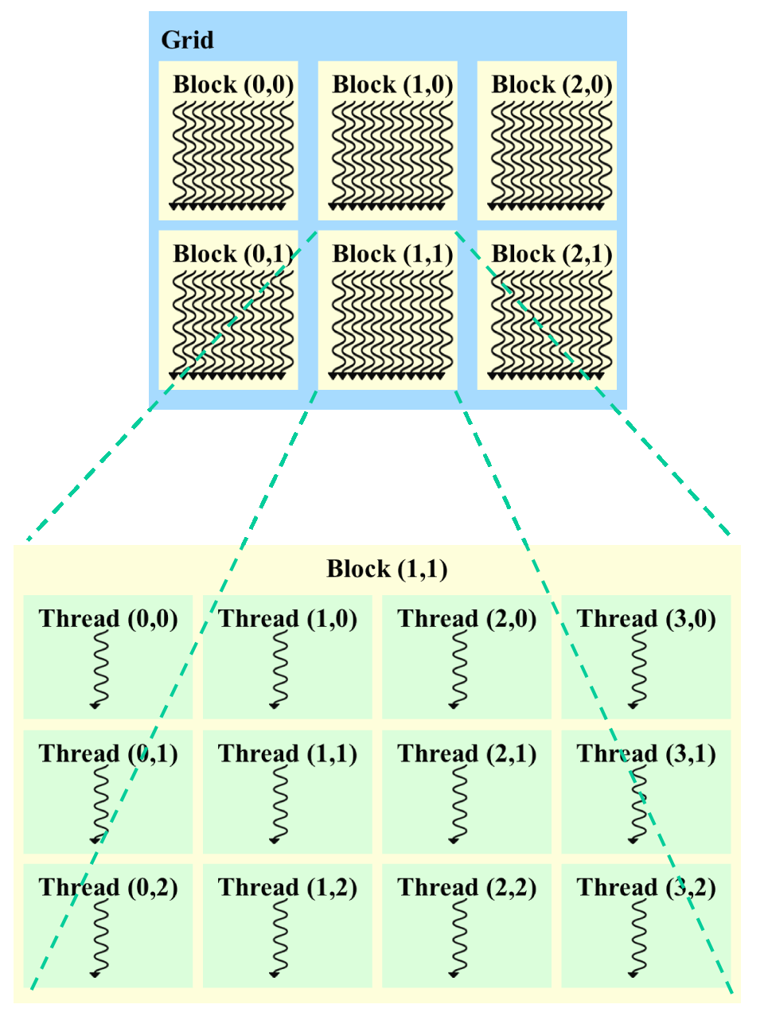
Thread Hierarchy
Grid of Thread Blocks
Logical Grid
Logical Thread Block
Threads
Image ack – Google

Slide 13
Questions?
Thank you

