Slide 1
Genetic Algorithms
Pritam Prakash Shete
Computer Division, BARC
Centre for Excellence in Basic Sciences

Slide 2
Topics
Genetic Algorithms
Core Components
Fitness Function
Selection
Crossover
Mutation
Advantages
Disadvantages
Applications

Slide 3
Genetic Algorithms
Genetic Algorithm (GA) is a population based optimization and search technique.
It is inspired by natural selection and biological evolution.
GA evolves a population of candidate solutions over successive generations.
Better solutions receive a greater opportunity to contribute to future generations.
The objective is to find a high quality solution within a practical computational budget.

Slide 4
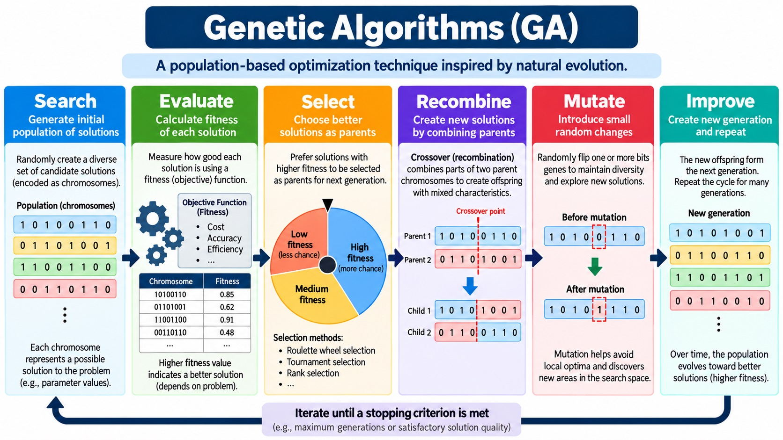

Slide 5
Evolution and Genetic Algorithms
Genetic Algorithms are inspired by the process of biological evolution.
  Population
  Selection
  Reproduction
  Mutation
  New generation
The analogy is useful because GA repeatedly preserves useful information, recombines it, introduces variation, and evaluates the resulting solutions.

Slide 6
Genetic Algorithms – Core Components
Population – Candidate solutions
Representation – Chromosome and Genes
Fitness – Evaluate solution quality
Selection – Choose parents
Crossover – Combine parents
Mutation – Introduce variation
Replacement – Form next generation
Termination – Decide when to stop

Slide 7
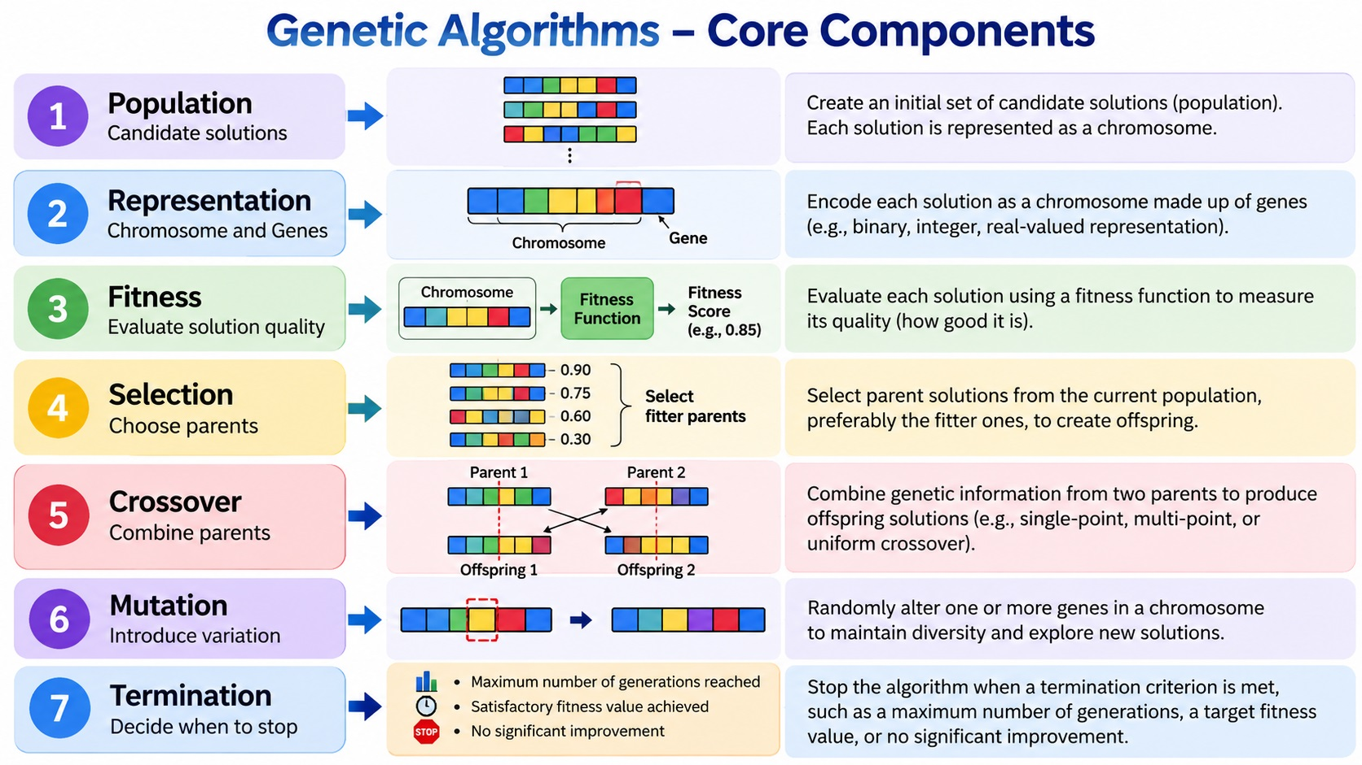

Slide 8
Genetic Algorithms – Population
Population – Set of candidate solutions
Example:
  10110
  01101
  11001
  00111
  10010

Slide 9
Genetic Algorithms – Population
A population provides diversity
  Multiple solutions can be evaluated simultaneously.
  Good solutions can be selected.
  Different solutions can be recombined.
  Mutation can explore new regions of the search space.

Slide 10
Genetic Algorithms – Population
Population size
  Small population
    Lower computational cost
    Less diversity
    Less exploration
  Large population
    More diversity
    More exploration
    Higher computational cost
Goal – Balance exploration and computation.

Slide 11
Genetic Algorithms – Chromosome and Gene
Chromosome – One complete candidate solution
Example:
  Chromosome – 10110
Each position represents a gene.
Genes are the components of a chromosome.
The meaning of a gene depends on the chosen representation.

Slide 12
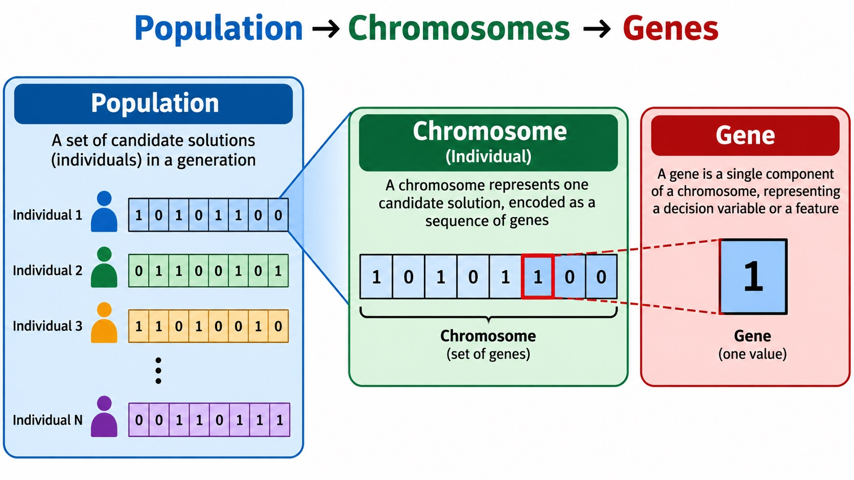

Slide 13
Questions?
Thank you

