Slide 1
Knowledge Distillation
Pritam Prakash Shete
Bhabha Atomic Research Centre &
Centre for Excellence in Basic Sciences

Slide 2
Topics
Knowledge Distillation – What ?
Knowledge Distillation – Why ?
Knowledge Distillation – How ?
Knowledge Distillation Types
Knowledge Distillation Schemes
Knowledge Distillation Algorithms
Knowledge Distillation – Applications
Conclusions

Slide 3
Knowledge Distillation – What ?
Knowledge transfer
Large pre-trained model or set of models
Teacher model or ensemble of models
Single smaller model
Student model
Model compression

Slide 4
Knowledge Distillation – What ?
Small student model
Learn to emulate
Large teacher model
Leverage teacher knowledge
Emulate thought process
Obtain similar or higher accuracy

Slide 5
Knowledge Distillation – Why ?
Smaller models
Faster – Low latency
Less computationally expensive
Real time deployment
Edge AI deployment
Edge AI
Limited memory
Limited computational capacity

Slide 6
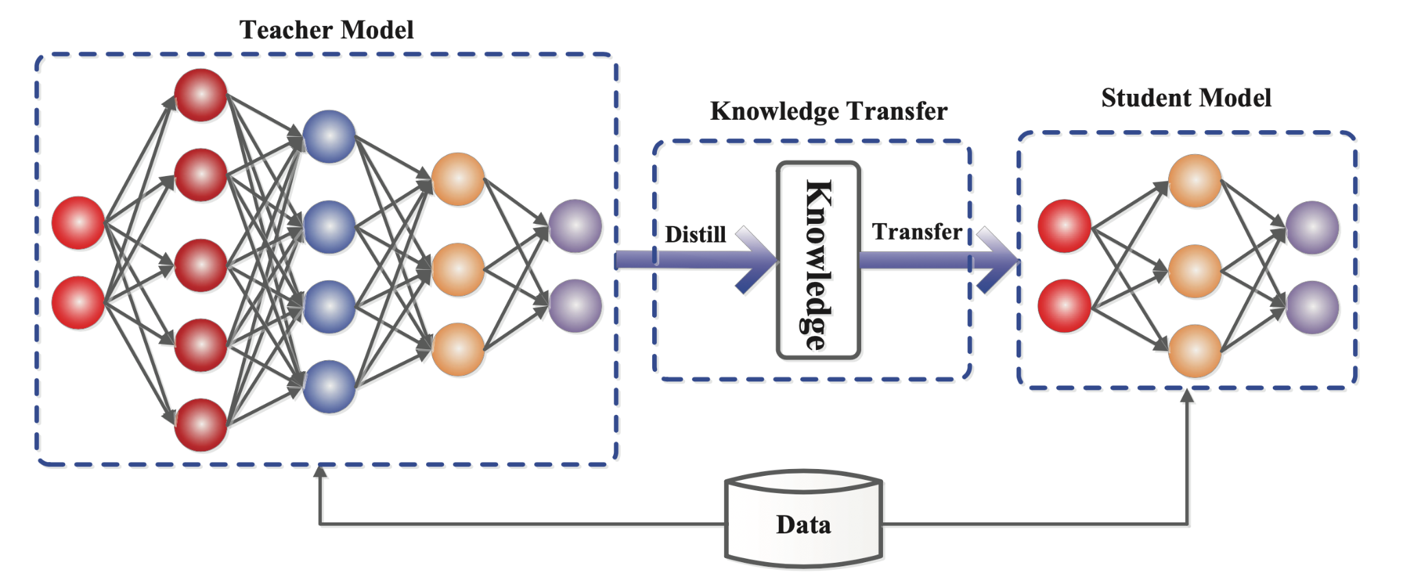
Knowledge Distillation – How ?
Image ack – Google

Slide 7
Knowledge Distillation – How ?
Artificial neural networks
Universal approximation
Model knowledge
Learned input to output mapping
Emulate thought process

Slide 8
Knowledge Distillation – How ?
Hard targets
Final predictions
Soft targets
Intermediate predictions
Individual class wise predictions
Valuable insight – Generalization

Slide 9
Knowledge Distillation – How ?
Standard Loss
Hard Loss
Ground truth predictions
Student model predictions
Distillation Loss
Soft Loss
Teacher model predictions
Student model predictions

Slide 10
Knowledge Distillation – How ?
Training example
Multiple soft targets
Distillation loss
Difference between
Probability distribution of teacher’s soft targets
Probability distribution of student’s predictions
Kullback – Leibler divergence – KL divergence

Slide 11
Knowledge Distillation – Types
Response based knowledge distillation
Feature based knowledge distillation
Relation based knowledge distillation

Slide 12
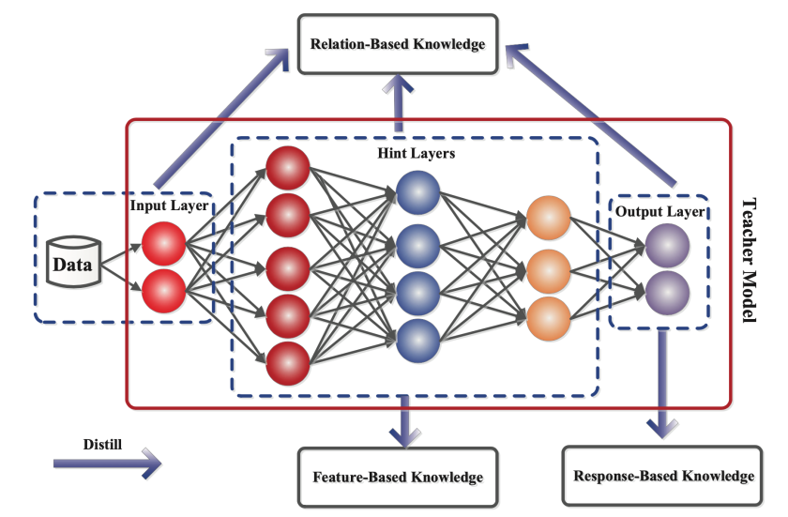
Knowledge Distillation – Types
Image ack – Google

Slide 13
Response Based Knowledge Distillation
Teacher model predictions – Soft targets
Student model predictions
Soft targets with low entropy
Extremely confident predictions
Solution
Use high temperature value
Increase entropy of model predictions
More variable probability distribution
More quantity of information

Slide 14
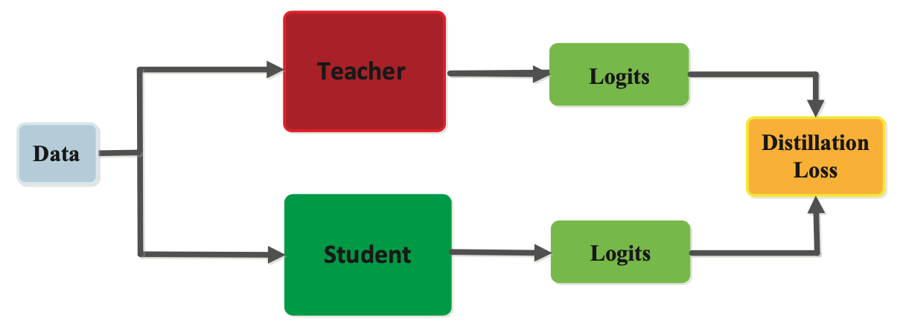
Response Based Knowledge Distillation

Slide 15
Feature Based Knowledge Distillation
Intermediate layers – Patterns of input data
Feature extraction
Discriminate specific features
Capture knowledge – Intermediate layers
Teacher model – Student model
Learn feature activations
Minimize difference – Feature activations

Slide 16
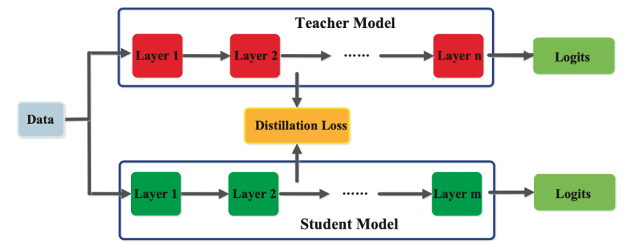
Feature Based Knowledge Distillation

Slide 17
Relation Based Knowledge Distillation
Relationships between
Different layers
Feature maps
Model relationship as
Correlation
Similarity matrix
Probability distribution
Emulate thought process

Slide 18
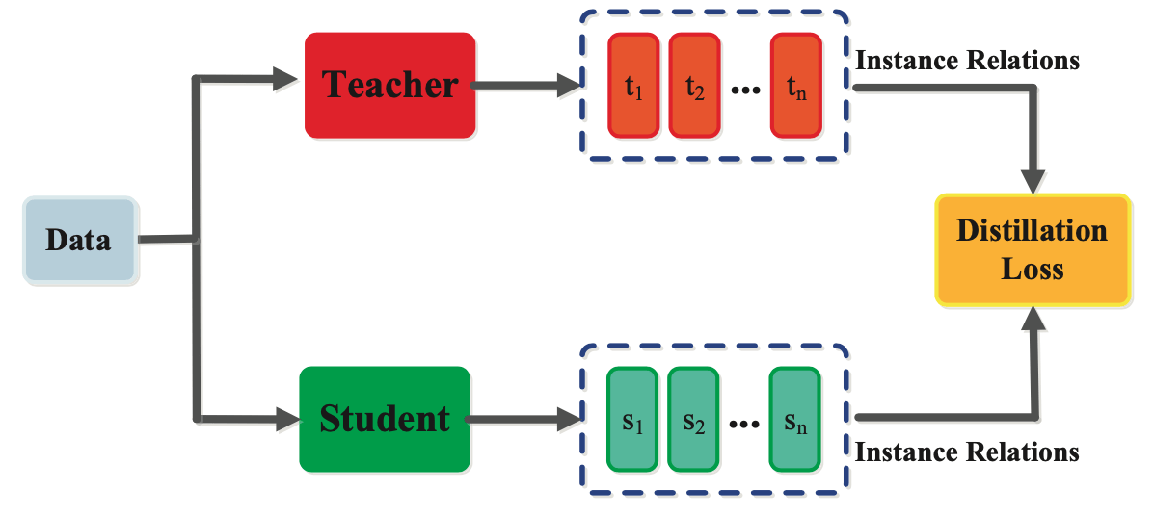
Relation Based Knowledge Distillation

Slide 19
Knowledge Distillation – Schemes
Offline distillation
Teacher – Pre-trained
Student – Trained
Online distillation
Teacher – Trained
Student – Trained
Self distillation

Slide 20
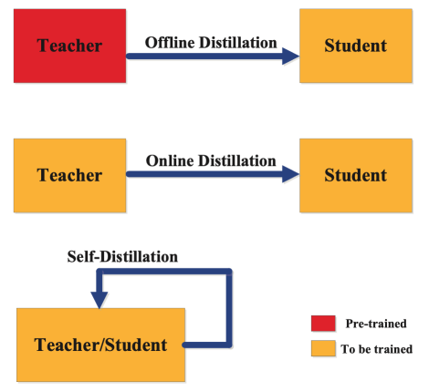
Knowledge Distillation – Schemes

Slide 21
Offline Distillation
Established technique
Easy to implement
Train teacher model on training dataset
Available pre-trained teacher models
Teacher model knowledge
Knowledge Distillation
Update student model
Freeze teacher model

Slide 22
Online Distillation
Highly efficient method – Parallel computing
Pre-trained teacher model
Not available
Specific use case
Solution – Online distillation
End–to–end training process
Update simultaneously
Teacher model
Student model

Slide 23
Self Distillation
One network
Teacher model
Student model
Knowledge transfer from
Deeper layers to shallow layers
epoch (t-1) – Teacher model – Soft targets
epoch (t) – Student model – Distillation loss

Slide 24
Knowledge Distillation – Algorithms
Adversarial Distillation
Multi-Teacher Distillation
Cross-modal Distillation

Slide 25
Applications
Natural Language Processing
Speech Recognition
Image Recognition
Object Detection
Large Language Models

Slide 26
Conclusions
Large pre-trained teacher model
Ensemble of teacher models
Smaller student model
Distillation loss
Model compression
Emulate thought process

Slide 27
Questions?
Thank you

