Slide 1
Knowledge Distillation
Pritam Prakash Shete
Computer Division, BARC
Centre for Excellence in Basic Sciences

Slide 2
Topics
Knowledge Distillation
Teacher Model
Student Model
Model Compression

Slide 3
Knowledge Distillation
Knowledge transfer
Large model or set of models
Single smaller model
Edge AI deployment
Limited memory
Limited computational capacity
Model compression

Slide 4
Knowledge Distillation
A small student model learns to mimic
A large teacher model
Leverage the knowledge of the teacher model
Obtain similar or higher accuracy

Slide 5
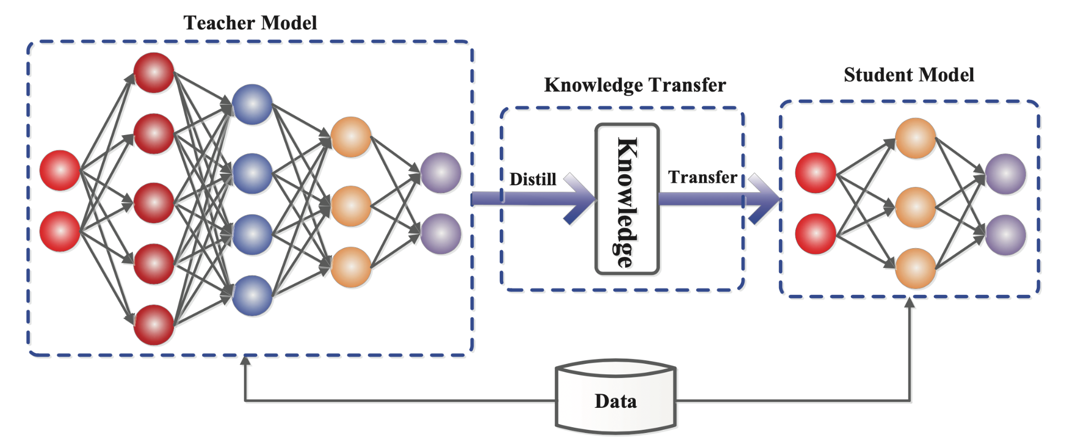
Knowledge Distillation Process

Slide 6
Knowledge Distillation Process
Knowledge

Slide 7
Knowledge
Response based knowledge
Feature based knowledge
Relation based knowledge

Slide 8
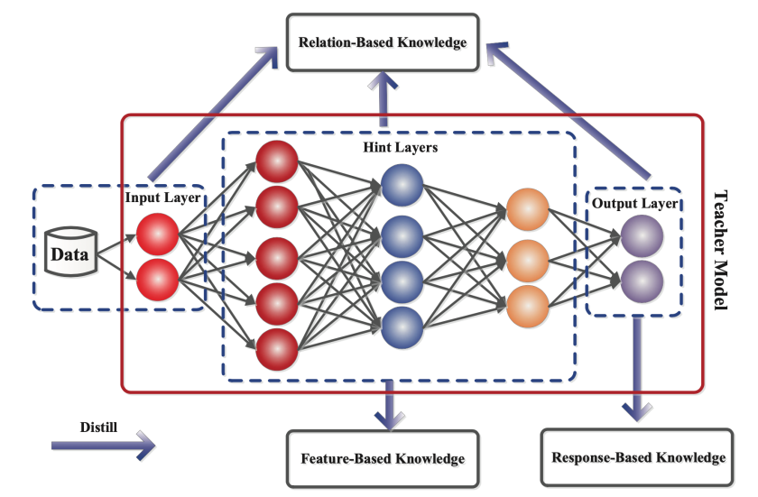
Knowledge

Slide 9
Response Based Knowledge

Slide 10
Response Based Knowledge
Distillation loss

Slide 11
Questions?
Thank you

