Slide 1
Knowledge Distillation
Pritam Prakash Shete
Computer Division, BARC
Centre for Excellence in Basic Sciences

Slide 2
Topics
Knowledge Distillation
Process
Training
Algorithms
Applications
Conclusions

Slide 3
Knowledge Distillation
Knowledge transfer
Large model or set of models
Single smaller model
Edge AI deployment
Limited memory
Limited computational capacity
Model compression

Slide 4
Knowledge Distillation
A small student model learns to mimic
A large teacher model
Leverage the knowledge of the teacher model
Obtain similar or higher accuracy

Slide 5
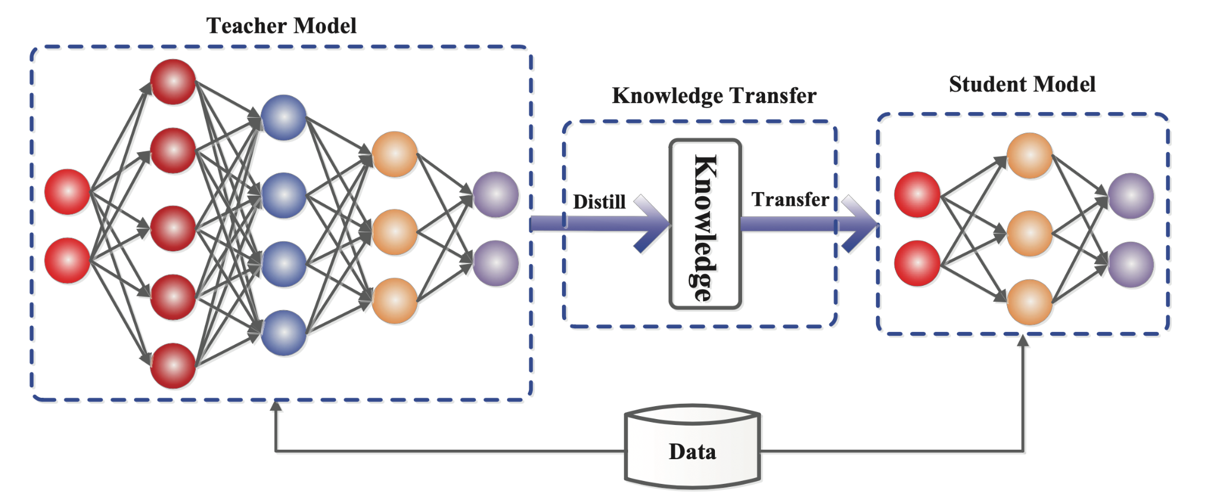
Knowledge Distillation Process

Slide 6
Knowledge Distillation Process
Knowledge

Slide 7
Knowledge
Response based knowledge
Feature based knowledge
Relation based knowledge

Slide 8
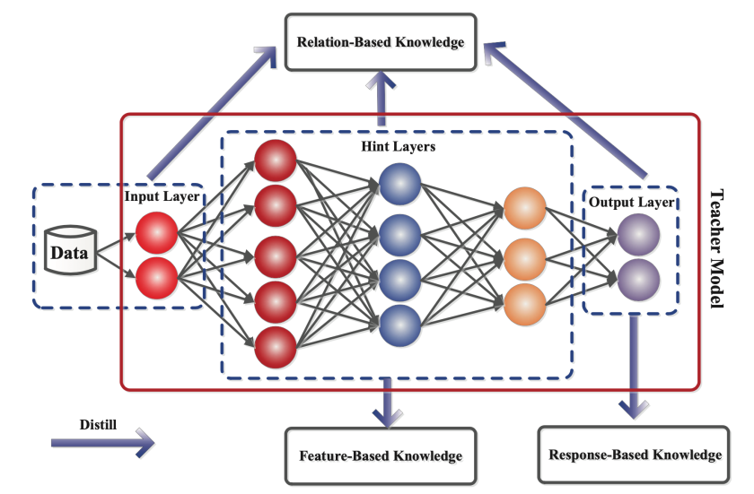
Knowledge

Slide 9
Response Based Knowledge

Slide 10
Response Based Knowledge
Distillation loss

Slide 11
Feature Based Knowledge

Slide 12
Feature Based Knowledge

Slide 13
Relation Based Knowledge

Slide 14
Relation Based Knowledge

Slide 15
Knowledge Distillation Training
Offline distillation
Teacher – Pre-trained
Student – Trained
Online distillation
Teacher – Trained
Student – Trained
Self distillation

Slide 16
Offline Distillation

Slide 17
Online Distillation

Slide 18
Self Distillation

Slide 19
Knowledge Distillation Algorithms
Adversarial Distillation
Multi-Teacher Distillation
Cross-modal Distillation

Slide 20
Applications

Slide 21
Conclusions

Slide 22
Questions?
Thank you

