Slide 1
Introduction to Large Language Models From Foundation to Real World Applications Pritam Prakash Shete Scientific Officer G Computer Division, BARC

Slide 2
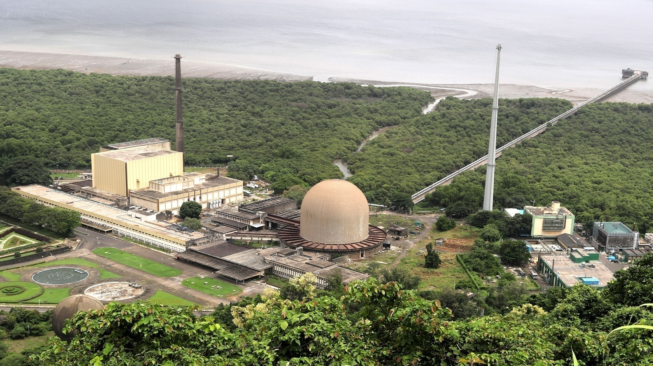

Slide 3
Agenda
Introduction
Large Language Models
Prompt Engineering
In Context Learning
Training LLMs
LLM Applications
Deploying LLMs
Conclusions

Slide 4
Introduction
OpenAI
GPT 3.5, GPT 4
GPT 4o, GPT o1
Access – API
Multimodal
Text, Image
Google
Gemini 1
Gemini 1.5
Access – API
Multimodal
Text, Image

Slide 5
Introduction
Meta
Llama 2, Llama 3
Llama 3.1, Llama 3.2
Access – Open Source
Multimodal
Text, Image
Google
Gemma
Gemma 2
Access – Open Source
Multimodal
Text, Image

Slide 6
Large Language Models
Next word or token prediction
I love eating ice
I love eating ice cream
I love eating ice cream with
I love eating ice cream with my
I love eating ice cream with my friends
I love eating ice cream with my friends at
I love eating ice cream with my friends at beach.

Slide 7
Word v/s Token
Token – Word or sub-word
LLM inference cost
Number of tokens
Input tokens
Less cost
Output tokens
More cost
Words with single token
Atomic or Primitive tokens
yes, no, run, red, blue, love
Words with two tokens
Compound words
unhappy, dislike, replay, sunset
300 Words – 400 Tokens

Slide 8
Large Language Models
Natural Language Processing (NLP)
Understand, Interpret, and Generate human language
Sentiment analysis
Text summarization
Machine translation

Slide 9
Large Language Models
Large number of parameters
ChatGPT–4 – ~1.8 Trillion parameters
Trained using large amount of dataset
ChatGPT–4 – 570 GB or 300 Billion words
*OpenAI ChatGPT 4

Slide 10
Large Language Models
Model name
Company
Access
Number of parameters
Context size
LLM type
Llama 3.1 405B Instruct
Meta
Open source
405 Billion parameters
128,000 (128K) tokens
Instruction fine-tuned
*Meta Llama 3.1 405B Instruct

Slide 11
Sentiment Analysis
Identify sentiment of following sentence as either positive or negative.
I like “Harry Potter and the Goblet of Fire” book very much.
The sentiment of the sentence “I like ‘Harry Potter and the Goblet of Fire’ book very much” is Positive.
The word “like” and the phrase “very much” both indicate a strong positive sentiment, suggesting that the speaker has a very positive opinion of the book.
*Meta-Llama-3.1-8B-Instruct

Slide 12
Summarization
Summarize the following paragraph.
A chemical reaction is a process that leads to the chemical transformation of one set of chemical substances to another. When chemical reactions occur, the atoms are rearranged and the reaction is accompanied by an energy change as new products are generated. Classically, chemical reactions encompass changes that only involve the positions of electrons in the forming and breaking of chemical bonds between atoms, with no change to the nuclei (no change to the elements present), and can often be described by a chemical equation.
A chemical reaction transforms one set of substances into another by rearranging atoms and changing energy levels. This process typically involves changes in electron positions and chemical bonds without altering the elements themselves, and is often represented by a chemical equation.
*Meta-Llama-3.1-8B-Instruct

Slide 13
Machine Translation
Translate following English sentences in Hindi sentences.
Particle accelerator is a machine that uses electromagnetic fields to propel charged particles to very high speeds and energies to contain them in well defined beams.
कण त्वरक एक मशीन है जो विद्युत चुम्बकीय क्षेत्रों का उपयोग करके आवेशित कणों को बहुत अधिक गति और ऊर्जा प्रदान करती है और उन्हें अच्छी तरह से परिभाषित किरणों में सीमित रखने के लिए।
*Meta-Llama-3.1-8B-Instruct

Slide 14
Code Generation
Write Python function to find a factorial of an input number.
def factorial(n):
if n < 0:
raise ValueError("Factorial is not defined for negative numbers")
elif n == 0 or n == 1:
return 1
else:
return n * factorial(n-1)
*Meta-Llama-3.1-8B-Instruct

Slide 15
Code Generation
Correct following Python code.
def factorial(n):
if n == 0 or n == 1:
return 1
else:
result = 1
for i in range(2, n + 1):
result *= i
return result
def factorial(n):
if n < 0:
raise ValueError("Factorial is not defined for negative numbers")
elif n == 0 or n == 1:
return 1
else:
return n * factorial(n-1)
*Meta-Llama-3.1-8B-Instruct

Slide 16
Code Generation
Mistral AI
Mistral 7B and Mixtral 8X7B
Meta
CodeLlama, CodeLlama-Python, CodeLlama-Instruct
Phind
Phind-CodeLlama-34B, Phind-CodeLlama-34B-Python
BigCode Project
StarCoder, StarCoder2

Slide 17




Virtual Assistants
Simulate human like conversations
Answer questions
Provide information
Complete simple tasks

Slide 18
Medical Diagnosis
Symptom analysis
Disease identification
Treatment recommendations
Medical literature analysis
Medical question answering
Medical imaging analysis
Google Med–PaLM 2
Medical question answering
Google Med-Gemini
Medical question answering
BiomedGPT
Vision language model
Visual question answering

Slide 19
Creative Writing
Write a story on chemical bond for fifth standard student.
The Story of Chemical Bond
Once upon a time, in a world made up of tiny particles called atoms, there lived two friends named Hydrogen and Oxygen.
...
The Moral of the Story
Chemical bonds are like friendships between atoms.
...
So, the next time you see a glass of water, remember Hydrogen and Oxygen, the two friends who formed a chemical bond to become a single molecule, Water.
*Meta-Llama-3.1-8B-Instruct

Slide 20
Creative Writing
Write a story on atom for first standard student.
The Adventures of Atom
Once upon a time, in a tiny world, there was a tiny creature named Atom. Atom was so small that you needed a special tool to see him.
...
One day, Atom decided to go on an adventure. He packed a small bag and said goodbye to his family.
...
The End
This story is designed to be simple and easy to understand for a first standard student.
*Meta-Llama-3.1-8B-Instruct

Slide 21
Education and Training
In six sentences, explain the role of catalyst to first standard student.
Here's an explanation of the role of a catalyst that a first standard student can understand:
A catalyst is a special helper that makes a chemical reaction happen faster. It's like a friend who helps you build a tower with blocks, but they don't build it by themselves. The catalyst doesn't change the blocks or the tower, it just helps you build it faster. Imagine you're trying to mix two colours of paint together, but it's hard to get them to mix. A catalyst is like a special tool that helps the paint mix together quickly and easily. It's a helper that makes things happen faster and easier!
*Meta-Llama-3.1-8B-Instruct

Slide 22
Education and Training
In six sentences, explain the role of catalyst to fifth standard student.
Here's an explanation of the role of a catalyst that a fifth standard student can understand:
A catalyst is a special helper that makes a chemical reaction happen faster. It's like a tool that helps mix two things together, but it doesn't change the things themselves. The catalyst helps the reaction happen by making it easier for the things to mix together. For example, in a car engine, a catalyst helps convert bad air into good air, making the engine run better. The catalyst doesn't get used up in the process, it just helps the reaction happen faster. It's like a special assistant that makes things happen more quickly and easily!
*Meta-Llama-3.1-8B-Instruct

Slide 23
Education and Training
In six sentences, explain the role of catalyst to tenth standard student.
Here's an explanation of the role of a catalyst that a tenth standard student can understand:
A catalyst is a substance that speeds up a chemical reaction without being consumed or altered in the process. It's like a key that unlocks the reaction, allowing it to happen faster and more efficiently. The catalyst works by lowering the activation energy required for the reaction to occur, making it easier for the reactants to convert into products. This means that the catalyst doesn't change the reaction itself, but rather helps it happen faster. For example, in a car engine, a catalyst is used to convert pollutants into harmless gases, making the engine run more efficiently. The catalyst plays a crucial role in many industrial and biological processes, and its use can have a significant impact on the environment and our daily lives.
*Meta-Llama-3.1-8B-Instruct

Slide 24
Keyword Identification
List top ten keywords for following paragraph.
Image captioning models automatically generate image descriptions using semantics of the input image. ... In our current research work, we focus on designing and developing a fashion image captioning model for automating the generation of descriptive captions for fashion items. We call it the Fashion Vision-Language Model (FashionVLM) to capture the multi-modality nature of the model. We utilize a frozen large language model as a text decoder and a vision transformer as an image encoder, connecting these models with a comparatively smaller Querying Transformer. Fashion Captioning Dataset (FACAD) is one of the biggest datasets of fashion items. For fine-tuning on FACAD, we utilize BLIP-2 pretrain stage two and MS COCO fine-tuned models in three different stages. ... The OPT-6.7 based Stage Three FashionVLM achieves the best performance compared to the state-of-the-art for fashion captioning on FACAD, providing +4.281 points, + 39.015 points, +5.667 points, and + 3.519 points improvements for BLEU-4, CIDEr, ROUGE-L, and METEOR performance metrics respectively.
Here are the top ten keywords for the paragraph:
1. Fashion image captioning
2. Fashion Vision-Language Model (FashionVLM)
3. Large language model
4. Vision transformer
5. Querying Transformer
6. Fashion Captioning Dataset (FACAD)
7. BLIP-2
8. MS COCO
9. OPT-6.7
10. Fine-tuning
*Meta Llama 3.1 405B Instruct

Slide 25
Prompt Engineering
Prompt
Inference
Completion

Slide 26
Prompt
Instructions to LLM
Context for Question
Question
Answer following question using given context.
Context: Everyday examples of particle accelerators are cathode ray tubes found in television sets and X-ray generators. These low energy accelerators use a single pair of electrodes with a DC voltage of a few thousand volts between them.
Question: Give examples of low energy accelerators.
*Meta-Llama-3.1-8B-Instruct

Slide 27
Inference
Large Language Model
Model prediction
Translate following English sentences in Hindi sentences.
Particle accelerator is a machine that uses electromagnetic fields to propel charged particles to very high speeds and energies to contain them in well defined beams.
कण त्वरक एक मशीन है जो विद्युत चुम्बकीय क्षेत्रों का उपयोग करके आवेशित कणों को बहुत अधिक गति और ऊर्जा प्रदान करती है और उन्हें अच्छी तरह से परिभाषित किरणों में सीमित रखने के लिए।
*Meta-Llama-3.1-8B-Instruct

Slide 28
Prompt Completion
Inference without context
कण त्वरक एक मशीन है जो विद्युत चुम्बकीय क्षेत्रों का उपयोग करके आवेशित कणों को बहुत अधिक गति और ऊर्जा प्रदान करती है और उन्हें अच्छी तरह से परिभाषित किरणों में सीमित रखने के लिए।
*Meta-Llama-3.1-8B-Instruct

Slide 29
In Context Learning
Context window
Task example/s
Zero shot inference
One shot inference
Few shot inference

Slide 30
Context Window
Window size
ChatGPT 4 Turbo – 128K
Llama 3.1 405B – 128K
Answer following question using given context.
Context: The Large Hadron Collider (LHC) particle collider is the world's largest and highest-energy particle accelerator. It was built by the European Organization for Nuclear Research (CERN).
Question: What is the Large Hadron Collider?
*OpenAI ChatGPT 4 & Meta Llama 3.1 405B Instruct

Slide 31
Task Examples
One or more examples
In context learning
Align LLM with task
Identify sentiment of following sentence as either positive or negative.
Sentence: I like book very much.
Sentiment: Positive
Sentence: I do not like book.
Sentiment: Negative
Sentence: Harry Potter and the Goblet of Fire book is good for readers.
*Meta-Llama-3.1-8B-Instruct

Slide 32
Zero Shot Inference
No examples
Identify sentiment of following sentence as either positive or negative.
Sentence: Harry Potter and the Goblet of Fire book is good for readers.
*Meta-Llama-3.1-8B-Instruct

Slide 33
One Shot Inference
One example
Identify sentiment of following sentence as either positive or negative.
Sentence: I like book very much.
Sentiment: Positive
Sentence: Harry Potter and the Goblet of Fire book is good for readers.
*Meta-Llama-3.1-8B-Instruct

Slide 34
Few Shot Inference
Two or more examples
Identify sentiment of following sentence as either positive or negative.
Sentence: I like book very much.
Sentiment: Positive
Sentence: I do not like book.
Sentiment: Negative
...
Sentence: Harry Potter and the Goblet of Fire book is good for readers.
*Meta-Llama-3.1-8B-Instruct

Slide 35
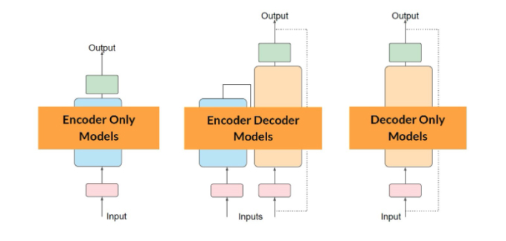
Large Language Model Architectures
* Source: Vijay Chaudhary

Slide 36
Training Large Language Models
Model Pre-training
Instruction Fine Tuning
Reinforcement Learning from Human Feedback (RLHF)

Slide 37
Model Pre-training
Self supervised learning
Next word or token prediction
Self annotations – (X – y)
I love ice cream
X = I love ice
y = cream
Learn language syntax
Master language grammar
Large corpus of text data
Books, articles, and websites
Web scraping
Vocabulary size
Number of tokens
15.6 Trillion tokens
Clean dataset
1% – 3% original tokens

Slide 38
Model Pre-training
Encoder only LLM
Auto–encoding models
Masked Language Modeling
Reconstruct text
De–noising objective
Bidirectional context
Applications
Sentiment analysis
Word classification
Examples
BERT model
ROBERTA model

Slide 39
Model Pre-training
Decoder only LLM
Autoregressive models
No encoder model
Causal Language Modeling
Predict next token
Unidirectional context
Statistical representation of language
Applications
Text generation
Zero–shot inference
Examples
OpenAI GPT
Meta Llama

Slide 40
Model Pre-training
Encoder–Decoder LLM
Encoder and Decoder
Sequence-to-sequence models
Span corruption – T5 model
Mask random input tokens
Reconstruct masked input tokens
Bidirectional context
Applications
Machine translation
Text summarization
Question & Answering
Examples
Text-to-Text Transfer Transformer – T5 model

Slide 41
Instruction Fine Tuning
Supervised learning
Specific down stream task
Instructions and Responses
Question and Answer
Text and Summary
English and Hindi sentences
Text and Sentiment
Generate accurate responses
Generate specific responses
Specific domain knowledge
Source code
Medical documents
Legal documents
Financial documents

Slide 42
Reinforcement Learning
Agent
Environment
Action
State
Reward or Penalty
Maximize reward
Agent
State
Reward
Action
Environment

Slide 43
Reinforcement Learning
Playout or Rollout
Exploration
Exploitation
Reward hacking

Slide 44
Reinforcement Learning from Human Feedback
Align model with human values
Reinforcement learning
3H – Helpful, Honest, Harmless
Helpful answer
Honest answer
Harmless answer
Responsible AI
Agent
Instruct LLM model
Environment
LLM context
Objective
Generate aligned text
Reward model
Supervised learning

Slide 45
Mixture of Experts – (MoE)
Multiple specialized models
Work together
Gating model
Select best expert
Examples
Doctor for medical issues
Mechanic for car problems
Chef for cooking
Train Large Language Model
Computational resources
Mixture of Experts
Break down large model
Smaller specialized models

Slide 46
LLM – Computational Challenges
LLM inference
1 parameter – float 32 – 4 bytes
1B parameters – 10⁹ parameters
1B parameters – 4 x 10⁹ bytes
1B parameters – 4 GB memory
LLM training
1 parameter – float 32 – 4 bytes
Model parameters – 4 bytes
Optimizer – Two states – 8 bytes
Gradients – 4 bytes
Activations – 4 bytes
Temporary variables – 4 bytes
20 times number of parameters

Slide 47
Retrieval Augmented Generation
Retrieval
Retrieve relevant information from source documents
Augmented
Augment input query with retrieved relevant information
Generation
Generate response using augmented input and LLM

Slide 48
Retrieval Augmented Generation
Improve accuracy
Closed book test v/s Open book text with Index page
Increase transparency
Source references – Retrieved documents
Reduce hallucination
Augmentation – Retrieval + Generation
Up to date information
Ingest documents – No expensive model training

Slide 49
Sahaayak – Retrieval Augmented Generation
Document Sources
Load Sources
Transform
Sources
Compute
Embeddings
Store
xxxxx xxxxx
xxxxx xxxxx
xxxxx xxxxx
xxxxx xxxxx
xxxxx xxxxx
xxxxx xxxxx
xxxxx xxxxx
xxxxx xxxxx
xxxxx xxxxx
xxxxx xxxxx
{0.25, 0.12, 0.56, 0.78}
xxxxx xxxxx
xxxxx xxxxx
{0.46, 0.23, 0.79, 0.68}
Vector
Database
xxxxx xxxxx
xxxxx xxxxx
{0.78, 0.43, 0.34, 0.84}
xxxxx xxxxx
xxxxx xxxxx
{0.68, 0.24, 0.98, 0.01}
* Sahaayak – Gaurika Gupta, Mohini Laghate & Pritam Shete

Slide 50
Sahaayak – Retrieval Augmented Generation
Question
Prompt
Response
LLM
Retrieval
Query
Retrieved
Texts
Vector
Database
* Sahaayak – Gaurika Gupta, Mohini Laghate & Pritam Shete

Slide 51
Sahaayak – BARC Documents
[INST]
<<SYS>> You are a helpful, respectful, and honest assistant. … If you don't know the answer to a question, please don't share false information. <</SYS>>
CONTEXT:
Magnesium -18's Unique Decay Process: …
provides not only new academic insights but also practical solutions …
Collaboration Identifies Rare Nuclear Decay in Long -Lived …
Question: Describe decay process of Magnesium-18.
[/INST]
Sure! Based on the provided context, Magnesium-18 undergoes a unique multi-proton decay process, where it sequentially emits two proton pairs. …
This process differs from traditional radioactive decay and highlights a complex phenomenon in the quantum world. …
The study, published in the journal Nuclear Science and Techniques, provides …
To summarize, Magnesium-18 decays through a chain of events, starting with the emission of two proton pairs, followed by the decay of Neon -16, …
* TheBloke/Llama-2-13B-chat-GPTQ

Slide 52
Sahaayak – BARC Documents
Q1. What is PWR?
Based on the context text provided, PWR stands for Pressurized Water Reactor.
Q2. What is PHWR?
Based on the context text provided, PHWR stands for Pressurized Heavy Water Reactor.
Q3. What is AHWR?
Based on the context text provided, AHWR stands for Advanced Heavy Water Reactor.
Q4. What is MSBR?
Based on the context provided, MSBR stands for Molten Salt Breeder Reactor.
* TheBloke/Llama-2-13B-chat-GPTQ

Slide 53
Pragya – Machine Learning Cluster
12 workstations
Each workstation
Dual AMD EPYC Processors – 48 cores
4 NVIDIA A100 GPUs
6400 GB NVMe SSD storage
1TB Memory
NVIDIA A100 GPU
6912 CUDA cores
80 GB memory

Slide 54
Falcon 180B On Pragya
Falcon 180B Chat GPTQ
180 Billion parameters
Instruction fine-tuned model
Model compression
180B parameters – 16 bit float – 360 GB memory
180B parameters – 4 bit precision – ~94 GB memory
Model parallelization
Divide model among multiple GPUs
~24 GB – 4 A100 GPUs – ~94 GB / 4 GPUs
* TheBloke/Falcon-180B-Chat-GPTQ

Slide 55
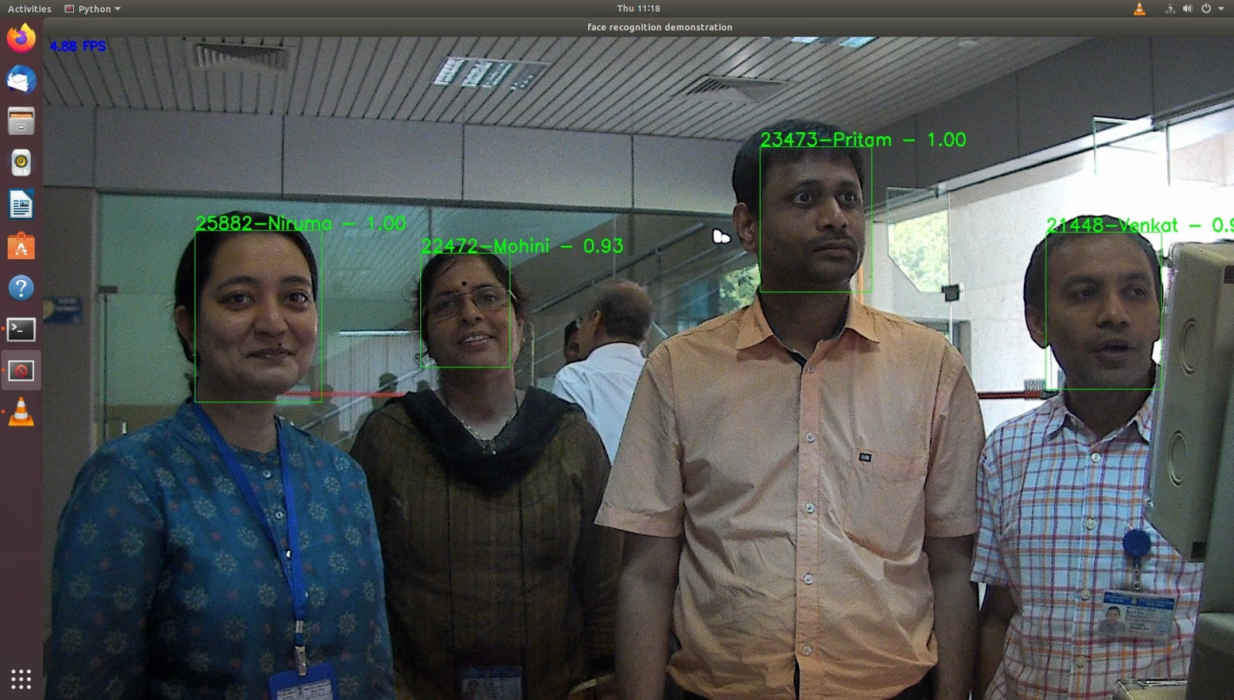
Pehchaan – AI based Face Recognition System

Slide 56
Talaash – Multimodal Query and Retrieval
Query & retrieval system
Natural language
Input image
Search & track users
User attire
Facial features
Vision Language Models
Text & image embeddings
FashionVLM
Vector database
Efficient storage
Retrieval of images

Slide 57
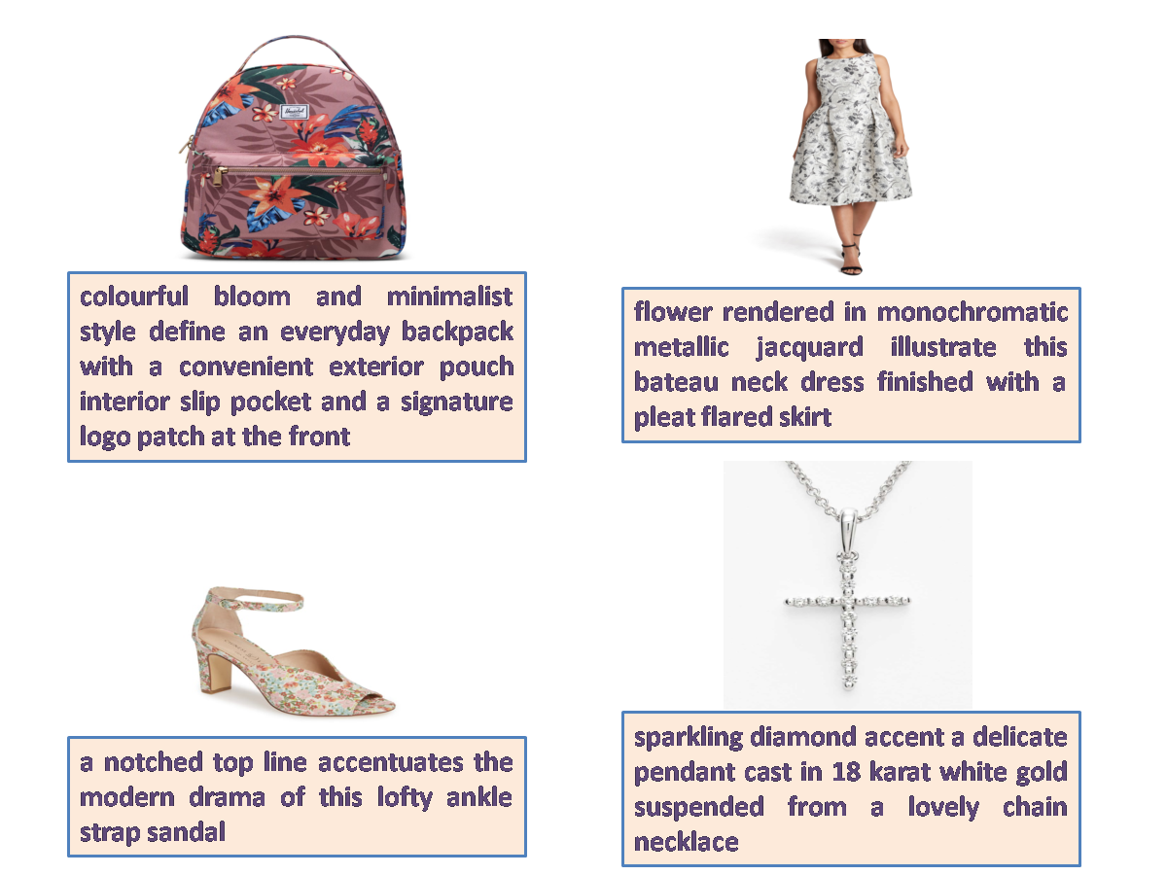
Fashion Captioning Dataset (FACAD)
Largest dataset of fashion items
130K fashion item captions
993K images
990 attributes
78 different categories
Rich captions
Expressive vocabulary
Different age groups
Different seasons
* FACAD – Xuewen Yang et. al. – ECCV 2020

Slide 58
Image Captioning Models
Model | Encoder | Decoder | Q-Former | Number of Parameters
CNN–LSTM | CNN (VGG) | LSTM | No | 138 Million
CLIP | ResNet / ViT | Transformer | No | 33 Million
BLIP | ViT | Transformer | No | 583 Million
BLIP-2 | ViT | OPT / FLAN T5 | Yes | 188 Million

Slide 59
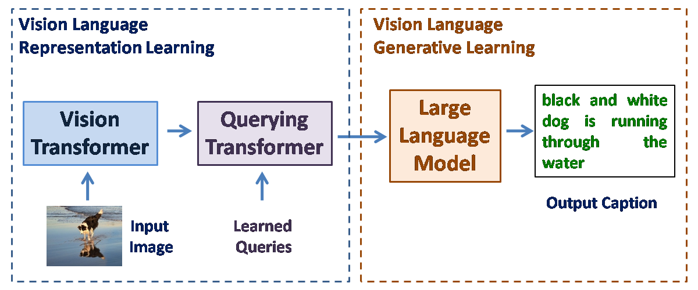
BLIP2 Architecture

Slide 60
FashionVLM
BLIP-2
Bootstrapping Language Image Pre–training
Image encoder
Vision Transformer (ViT)
Text encoder
Large Language Model (LLM)
Connect Image and Text encoders
Querying Transformer (Q-Former)
* FashionVLM (2024) – Gaurika Gupta & Pritam Shete

Slide 61
FashionVLM – Evaluation on FACAD
Models | Evaluation Metrics (%)
 | BLEU-4 | CIDEr | ROUGE-L | METEOR
Tang (2023) | 10.0 | 81.8 | 23.0 | 11.9
Moratelli (2023) | 10.6 | 84.5 | 22.4 | 11.6
OPT-6.7 Stage One | 12.331 | 101.205 | 26.746 | 14.279
OPT-6.7 Stage Two | 13.409 | 111.396 | 27.756 | 14.946
OPT-6.7 Stage Three | 14.881 | 123.515 | 28.667 | 15.419
* FashionVLM (2024) – Gaurika Gupta & Pritam Shete

Slide 62
Talaash – Image Registration
Input images
Load images
Transform images
Compute image embeddings
Store embeddings in vector database

Slide 63
Talaash – Multimodal Search and Retrieval
FashionVLM
Image / Text Query
Retrieved Images
Text / Image
Embeddings
Retrieved
Documents
Vector
Database

Slide 64
Chain-of-Thought Prompting
Break down complex task into series of steps
Focus on one step of task at a time
Include responses to intermediate steps leading to final answer
Improve accuracy of LLM's responses
Improve relevance of LLM's responses
Reduce hallucination

Slide 65
Chain-of-Thought Prompting
Let us solve this step-by-step.
What information do we need to find?
What operations might help us to solve this?
Explain your reasoning and prove the answer.
If there are 10 birds on a branch and 3 birds fly away. How many birds are remaining?
Let's break down the problem step-by-step.
What information do we need to find? We need to find the number of birds remaining on the branch after 3 birds fly away.
What operations might help us to solve this? To solve this problem, we can use a simple subtraction operation. We know the initial number of birds (10) and the number of birds that fly away (3). By subtracting the number of birds that fly away from the initial number, we can find the number of birds remaining.
Why subtraction? Subtraction is the correct operation because we are removing a certain number of birds (3) from the initial total (10). By subtracting 3 from 10, we are essentially "taking away" 3 birds from the branch, leaving us with the remaining number of birds.
Let's calculate! 10 (initial number of birds) - 3 (number of birds that fly away) = 7
Therefore, there are 7 birds remaining on the branch.
*Meta-Llama-3.1-8B-Instruct

Slide 66
Deploying Large Language Models
GPU | CUDA Cores | Memory | FP32 FLOPS | Power | Cost
NVIDIA H100 | 14,592 | 80 GB | 67 TFLOPS | 700W | $30,000
NVIDIA A100 | 6,912 | 80 GB | 19.5 TFLOPS | 500W | $15,000
NVIDIA L40 | 18,176 | 48 GB | 90.5 TFLOPS | 300W | $10,000
NVIDIA RTX 4090 | 16,384 | 24 GB | 82.58 TFLOPS | 450W | $3,000
NVIDIA RTX 4080 | 10,240 | 16 GB | 48.74 TFLOPS | 320W | $1,000

Slide 67
Knowledge Distillation
Knowledge transfer
Large pre-trained model
Set of models
Teacher model
Ensemble of models
Single smaller model
Student model
Model compression
Small student model
Learn to emulate
Large teacher model
Leverage teacher knowledge
Emulate thought process
Obtain similar / higher accuracy

Slide 68
Conclusions
Large Language Models
Prompt Engineering
In Context Learning
Training Large Language Models
Large Language Model Applications
Deploying Large Language Models

Slide 69
Thank you
Pritam Prakash Shete
Telephone - 022-25595212
Email - ppshete@barc.gov.in

Slide 70
Retrieval Augmented Generation – Evaluation
Ground Truth (GT) by Human
Character based evaluation
Edit distance
Word based evaluation
WER, BLEU
Embedding based evaluation
BERT score, Mover score
Ground Truth (GT) by LLM
Mathematical Framework
RAGAS framework
Experimental based Framework
Number of tasks and datasets
Number of aspects
GPT score

