Slide 1
Linear Regression
Pritam Prakash Shete
Computer Division, BARC
Centre for Excellence in Basic Sciences

Slide 2
Topics
Supervised learning – Regression model
Linear regression
Least squares
R²
Adjusted R²
Applications
Advantages
Disadvantages

Slide 3
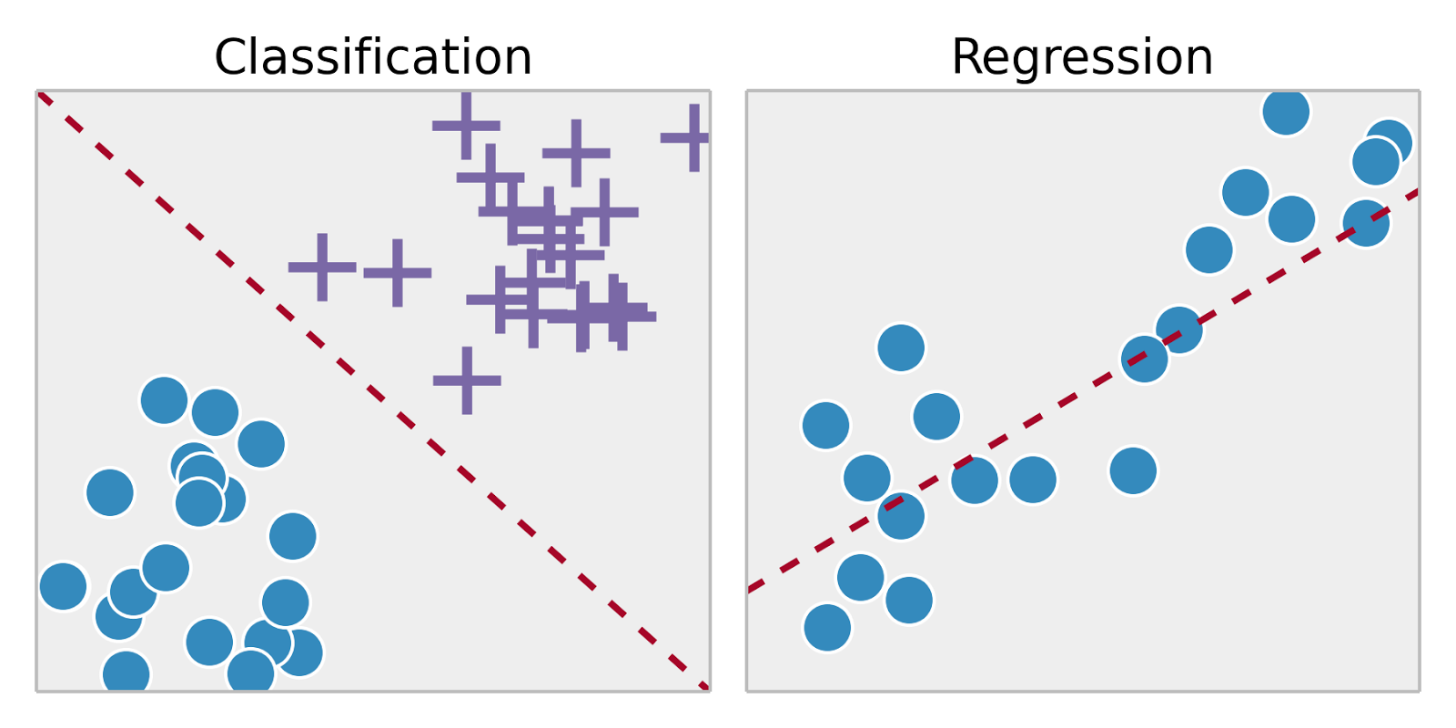
Supervised Learning
Training set – { (x⁽¹⁾,y⁽¹⁾), (x⁽²⁾,y⁽²⁾), …, (x^{(m)},y^{(m)})}
Labeled dataset
Image ack – Google

Slide 4
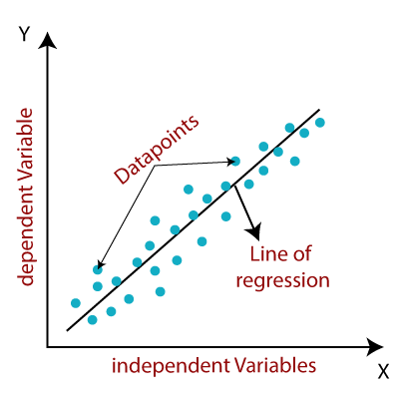
Linear Regression
Independent variable – X axis
Dependent variable – Y axis
Data points – Samples
Relationship
Line of regression
Image ack – Google

Slide 5
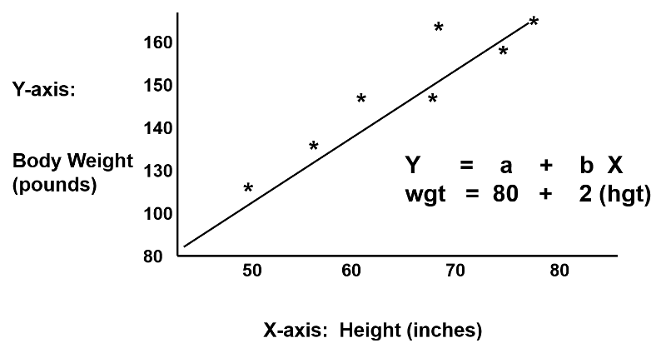
Linear Regression
Image ack – Google

Slide 6
Linear Regression
Input – X
Vector
X ε R
Dimension – n_{X}
Output – y
Scalar
y ε R

Slide 7
Linear Regression
Weights – W – (W₁, W₂, W₃, …, W_{nx})
Vector
W ε R
Dimension – n_{X}
Bias – b – W₀
Scalar
b ε R
y = W^{T}X + b

Slide 8
Linear Regression
Positive correlation
Independent variable increases
Dependent variable increases
Negative correlation
Independent variable increases
Dependent variable decreases
No correlation
Independent variable increases
Dependent variable no change

Slide 9
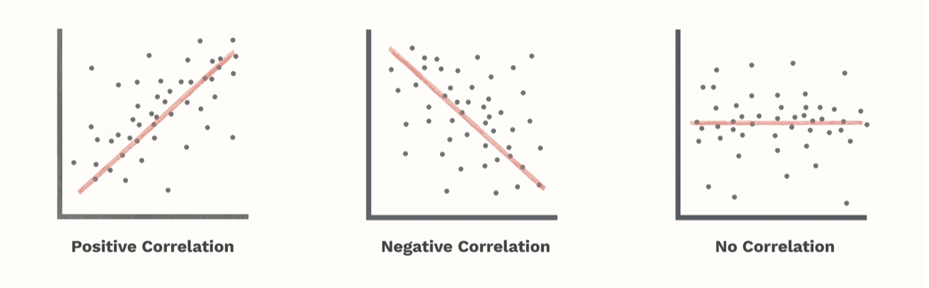
Linear Regression
Image ack – Google

Slide 10
Linear Regression – Types
Simple linear regression
Single independent variable
Multiple linear regression
More than one independent variable

Slide 11
Least Squares
Linear regression – Least squares
Actual value – Observed value
Estimated value – Predicted value
Error value
Sum of squared residuals
Mean Squared Error – MSE
Minimize error value
Generic equation of line

Slide 12
Least Squares
X_{i} – Independent variable
y_{i} – Dependent variable
W₀ – Y axis intercept
W₁ – Slope of line
ŷ_{i} – Estimated value
Ɛ_{i} – Random error
Mean Squared Error – MSE
J – Cost function – Minimize cost function

Slide 13
Loss Function
Loss function
One sample – i^{th} sample
L(y^{(i)}, ŷ^{(i)})= (y^{(i)} – ŷ^{(i)} )²
Cost function
Average of loss function for all samples

Slide 14
Gradient Descent
Input dataset – { (x⁽¹⁾,y⁽¹⁾), (x⁽²⁾,y⁽²⁾), …, (x^{(m)},y^{(m)}) }
Equations – ŷ = W^{T}X + b
Loss function – L(ŷ, y) = (y- ŷ)²
Cost function –
Output
ŷ^{(i)} ~ y^{(i)}
W and b – Minimize J(W, b)

Slide 15
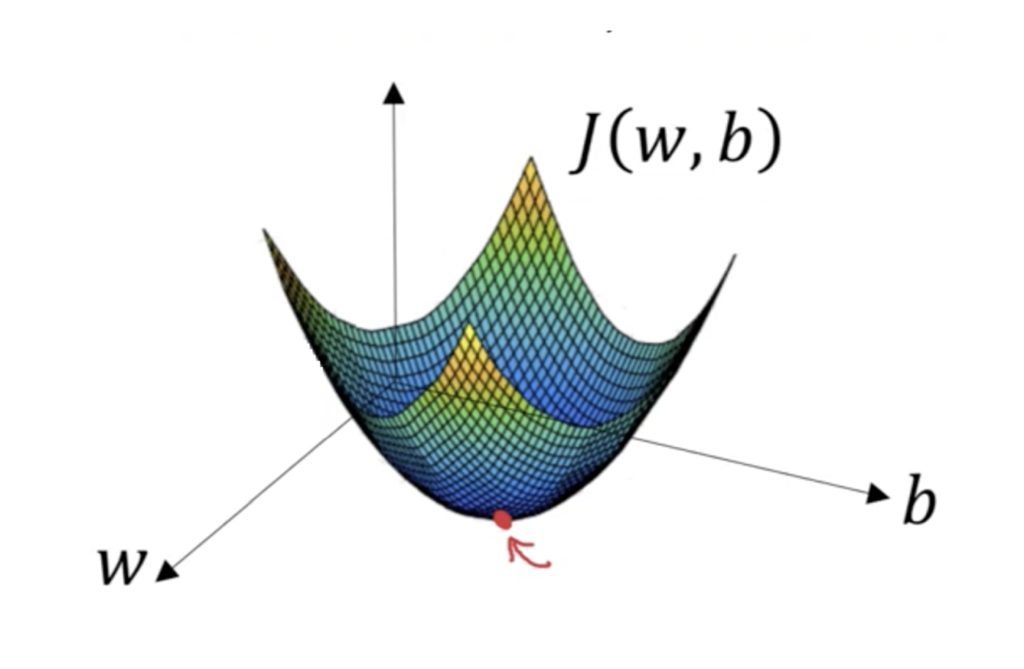
Gradient Descent
Convex function
Global optimum

Slide 16
Gradient Descent
Forward pass
ŷ = W^{T}X + b
L(y^{(i)}, ŷ^{(i)})
J(W, b)
Backward pass

Slide 17
Gradient Descent
Forward pass
ŷ = W^{T}X + b
L(y^{(i)}, ŷ^{(i)})
J(W, b)
Backward pass

Slide 18
Gradient Descent
Forward pass
ŷ = W^{T}X + b
L(y^{(i)}, ŷ^{(i)})
J(W, b)
Backward pass

Slide 19
Gradient Descent
Forward pass
ŷ = W^{T}X + b
L(y^{(i)}, ŷ^{(i)})
J(W, b)
Backward pass

Slide 20
Gradient Descent
Forward pass
ŷ = W^{T}X + b
L(y^{(i)}, ŷ^{(i)})
J(W, b)
Backward pass

Slide 21
Gradient Descent
Forward pass
ŷ = W^{T}X + b
L(y^{(i)}, ŷ^{(i)})
J(W, b)
Backward pass

Slide 22
R²
Coefficient of determination
Coefficient of multiple determination
Strength of relationship
Value between 0.0 – 1.0
Percentage value
Independent variable explains p percent of variation in dependent variable
Independent variable reduces p percent of variation in dependent variable

Slide 23
Adjusted R²
R²
Increase independent variables – Increase R²
Increase independent variables – Constant R²
Adjusted R²
Increase independent variables (then)
Increase model accuracy (then only)
Increase Adjusted R2

Slide 24
Applications
Inputs to response mapping
Error reduction
Prediction
House price prediction from observed dataset
Forecasting
Weather forecasting from observed dataset

Slide 25
Regularization
Lasso regression
Ridge regression
Elastic net regression

Slide 26
Lasso Regression
Least Absolute Shrinkage Selector Operator
L1 regularization technique
Reduce coefficients
Feature selection
Select important features
Reduce coefficients of others to zero
Suitable for more number of features

Slide 27
Ridge Regression
L2 regularization technique
Reduce coefficients
Reduce model complexity
Prevent multicollinearity

Slide 28
Elastic Net Regression
L1 and L2 regularization technique

Slide 29
Advantages
Good for linearly separable data
Easier to implement and interpret
Efficient to train
Handle over-fitting
Dimensionality reduction techniques
Cross validation
Regularization
Extrapolation of dataset

Slide 30
Disadvantages
Assumption of linearity
Independent variables
Dependent variables
Prone to noise
Sensitive to outliers
Prone to multicollinearity

Slide 31
Multicollinearity
Correlated independent variables
Example
Independent variables
Radius of a circle
Circumference of a circle
Radius and circumference – Correlated

Slide 32
Questions?
Thank you

