Slide 1
Word Embeddings
Pritam Prakash Shete
Computer Division, BARC
Centre for Excellence in Basic Sciences

Slide 2
Topics
Word representation
Featurized representation
Visualizing word embeddings
Using word embeddings
Embedding matrix
Learning word embeddings

Slide 3
Word representation – Vocabulary
Word dictionary
Top common words
Dictionary size
Small – 10000
Common – 50000
a
...
capital
…
is
…
Maharashtra
…
Mumbai
…
of
...
Zurich
1
...
300
…
501
…
2001
…
2301
…
2401
...
10000

Slide 4
Word representation – Vocabulary
One hot encoding
Example
Word – capital
1 at 300th location
0 everywhere
One hot vector – O₃₀₀
…
0
1
0
…
…
…
…
…
…
…
...
…
a
...
capital
…
is
…
Maharashtra
…
Mumbai
…
of
...
Zurich
1
...
300
…
501
…
2001
…
2301
…
2401
...
10000

Slide 5
Word representation – Vocabulary
One hot encoding
Example
Word – is
1 at 501st location
0 everywhere
One hot vector – O₅₀₀
…
…
…
0
1
0
…
…
…
…
…
...
…
a
...
capital
…
is
…
Maharashtra
…
Mumbai
…
of
...
Zurich
1
...
300
…
501
…
2001
…
2301
…
2401
...
10000

Slide 6
Word representation – Vocabulary
One hot encoding
Example
Word – Maharashtra
1 at 2001st location
0 everywhere
One hot vector – O₂₀₀₁
…
...
…
…
…
0
1
0
…
…
…
...
…
a
...
capital
…
is
…
Maharashtra
…
Mumbai
…
of
...
Zurich
1
...
300
…
501
…
2001
…
2301
…
2401
...
10000

Slide 7
Word representation – Vocabulary
Boy₅₂₁
Girl₅₄₁
Apple₅₁₁
Orange₅₃₁
...
…
…
…
0
1
0
…
…
…
...
…
...
…
…
…
…
0
1
0
…
…
...
…
...
…
…
…
0
1
0
…
…
…
...
…
...
…
…
…
…
0
1
0
…
…
...
…

Slide 8
Word representation – Vocabulary
Boy₅₂₁
Girl₅₄₁
Apple₅₁₁
Orange₅₃₁
A ___ reads a book.
...
…
…
…
0
1
0
…
…
…
...
…
...
…
…
…
…
0
1
0
…
…
...
…
...
…
…
…
0
1
0
…
…
…
...
…
...
…
…
…
…
0
1
0
…
…
...
…

Slide 9
Word representation – Vocabulary
Boy₅₂₁
Girl₅₄₁
Apple₅₁₁
Orange₅₃₁
A boy reads a book.
...
…
…
…
0
1
0
…
…
…
...
…
...
…
…
…
…
0
1
0
…
…
...
…
...
…
…
…
0
1
0
…
…
…
...
…
...
…
…
…
…
0
1
0
…
…
...
…

Slide 10
Word representation – Vocabulary
Boy₅₂₁
Girl₅₄₁
Apple₅₁₁
Orange₅₃₁
A girl reads a book.
...
…
…
…
0
1
0
…
…
…
...
…
...
…
…
…
…
0
1
0
…
…
...
…
...
…
…
…
0
1
0
…
…
…
...
…
...
…
…
…
…
0
1
0
…
…
...
…

Slide 11
Word representation – Vocabulary
Boy₅₂₁
Girl₅₄₁
Apple₅₁₁
Orange₅₃₁
A boy reads a book.
...
…
…
…
0
1
0
…
…
…
...
…
...
…
…
…
…
0
1
0
…
…
...
…
...
…
…
…
0
1
0
…
…
…
...
…
...
…
…
…
…
0
1
0
…
…
...
…
A girl reads a book.

Slide 12
Word representation – Vocabulary
Boy₅₂₁
Girl₅₄₁
Apple₅₁₁
Orange₅₃₁
An ___ is a fruit.
...
…
…
…
0
1
0
…
…
…
...
…
...
…
…
…
…
0
1
0
…
…
...
…
...
…
…
…
0
1
0
…
…
…
...
…
...
…
…
…
…
0
1
0
…
…
...
…

Slide 13
Word representation – Vocabulary
Boy₅₂₁
Girl₅₄₁
Apple₅₁₁
Orange₅₃₁
An apple is a fruit.
...
…
…
…
0
1
0
…
…
…
...
…
...
…
…
…
…
0
1
0
…
…
...
…
...
…
…
…
0
1
0
…
…
…
...
…
...
…
…
…
…
0
1
0
…
…
...
…

Slide 14
Word representation – Vocabulary
Boy₅₂₁
Girl₅₄₁
Apple₅₁₁
Orange₅₃₁
An orange is a fruit.
...
…
…
…
0
1
0
…
…
…
...
…
...
…
…
…
…
0
1
0
…
…
...
…
...
…
…
…
0
1
0
…
…
…
...
…
...
…
…
…
…
0
1
0
…
…
...
…

Slide 15
Word representation – Vocabulary
Boy₅₂₁
Girl₅₄₁
Apple₅₁₁
Orange₅₃₁
An apple is a fruit.
...
…
…
…
0
1
0
…
…
…
...
…
...
…
…
…
…
0
1
0
…
…
...
…
...
…
…
…
0
1
0
…
…
…
...
…
...
…
…
…
…
0
1
0
…
…
...
…
An orange is a fruit.

Slide 16
Featurized representation
Features
Boy₅₂₁
Girl₅₄₁
Apple₅₁₁
Orange₅₃₁

Slide 17
Featurized representation
Features
Boy₅₂₁
Girl₅₄₁
Apple₅₁₁
Orange₅₃₁
Age
0.2
0.2
0.005
0.002

Slide 18
Featurized representation
Features
Boy₅₂₁
Girl₅₄₁
Apple₅₁₁
Orange₅₃₁
Age
0.2
0.2
0.005
0.002
Fruit
0.0001
0.0002
0.8
0.77

Slide 19
Featurized representation
Features
Boy₅₂₁
Girl₅₄₁
Apple₅₁₁
Orange₅₃₁
Age
0.2
0.2
0.005
0.002
Fruit
0.0001
0.0002
0.8
0.77
Gender
-1
+1
0.002
0.003
Living
0.9
0.88
0.0001
0.0002

Slide 20
Featurized representation
Features
Boy₅₂₁
Girl₅₄₁
Apple₅₁₁
Orange₅₃₁
Age
0.2
0.2
0.005
0.002
Fruit
0.0001
0.0002
0.8
0.77
Gender
-1
+1
0.002
0.003
Number of features
Living
0.9
0.88
0.0001
0.0002

Slide 21
Featurized representation
Features
Boy₅₂₁
Girl₅₄₁
Apple₅₁₁
Orange₅₃₁
Age
0.2
0.2
0.005
0.002
Fruit
0.0001
0.0002
0.8
0.77
Gender
-1
+1
0.002
0.003
Number of features ~ 300
Living
0.9
0.88
0.0001
0.0002

Slide 22
Featurized representation
Features
Boy₅₂₁
Girl₅₄₁
Apple₅₁₁
Orange₅₃₁
Age
0.2
0.2
0.005
0.002
Fruit
0.0001
0.0002
0.8
0.77
Gender
-1
+1
0.002
0.003
Living
0.9
0.88
0.0001
0.0002
e₅₂₁

Slide 23
Featurized representation
Features
Boy₅₂₁
Girl₅₄₁
Apple₅₁₁
Orange₅₃₁
Age
0.2
0.2
0.005
0.002
Fruit
0.0001
0.0002
0.8
0.77
Gender
-1
+1
0.002
0.003
Living
0.9
0.88
0.0001
0.0002
e₅₄₁

Slide 24
Featurized representation
Features
Boy₅₂₁
Girl₅₄₁
Apple₅₁₁
Orange₅₃₁
Age
0.2
0.2
0.005
0.002
Fruit
0.0001
0.0002
0.8
0.77
Gender
-1
+1
0.002
0.003
Living
0.9
0.88
0.0001
0.0002
e₅₁₁

Slide 25
Featurized representation
Features
Boy₅₂₁
Girl₅₄₁
Apple₅₁₁
Orange₅₃₁
Age
0.2
0.2
0.005
0.002
Fruit
0.0001
0.0002
0.8
0.77
Gender
-1
+1
0.002
0.003
Living
0.9
0.88
0.0001
0.0002
An apple is a fruit.
An orange is a fruit.

Slide 26
Featurized representation
Features
Boy₅₂₁
Girl₅₄₁
Apple₅₁₁
Orange₅₃₁
Age
0.2
0.2
0.005
0.002
Fruit
0.0001
0.0002
0.8
0.77
Gender
-1
+1
0.002
0.003
Living
0.9
0.88
0.0001
0.0002
An apple is a fruit.
An orange is a fruit.
Similar features

Slide 27
Featurized representation
Features
Boy₅₂₁
Girl₅₄₁
Apple₅₁₁
Orange₅₃₁
Age
0.2
0.2
0.005
0.002
Fruit
0.0001
0.0002
0.8
0.77
Gender
-1
+1
0.002
0.003
Living
0.9
0.88
0.0001
0.0002
A boy reads a book.
A girl reads a book.

Slide 28
Featurized representation
Features
Boy₅₂₁
Girl₅₄₁
Apple₅₁₁
Orange₅₃₁
Age
0.2
0.2
0.005
0.002
Fruit
0.0001
0.0002
0.8
0.77
Gender
-1
+1
0.002
0.003
Living
0.9
0.88
0.0001
0.0002
A boy reads a book.
A girl reads a book.
Similar features

Slide 29
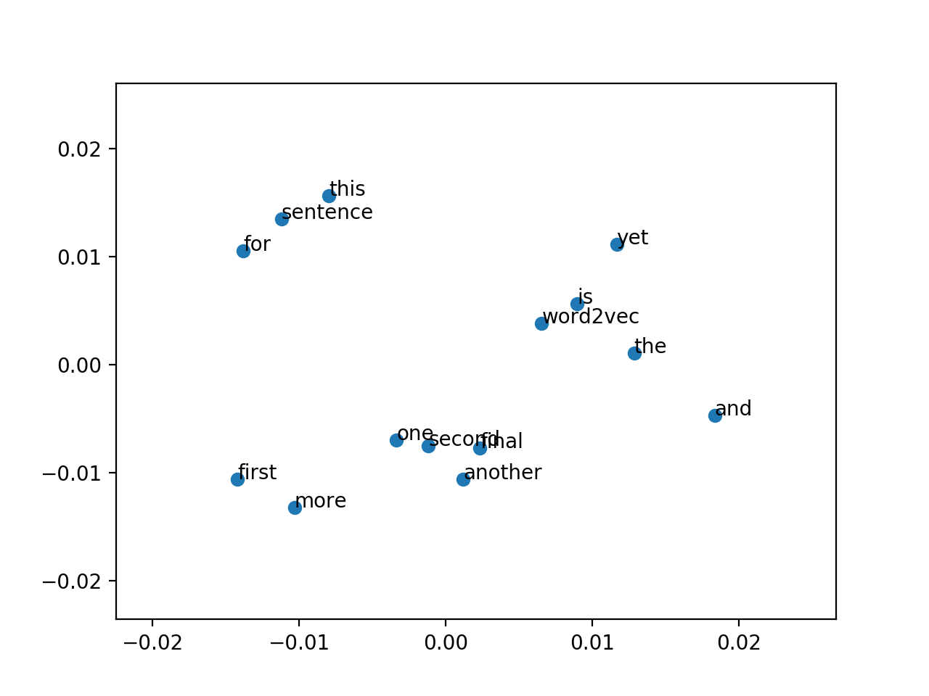
Visualizing word embeddings
Embeddings – 300 dimensional or more
Visualization – 300D to 2D
Image ack – Google

Slide 30
Using word embeddings
Name entity recognition
Input – Mumbai is capital of Maharashtra.
Output – 1 0 0 0 1
Input – Bangalore is capital of Karnataka.
Output – 1 0 0 0 1

Slide 31
Using word embeddings
Name entity recognition
Input – Mumbai is capital of Maharashtra.
Output – 1 0 0 0 1
Input – Bangalore is capital of Karnataka.
Output – 1 0 0 0 1

Slide 32
Using word embeddings
Name entity recognition
Input – Mumbai is capital of Maharashtra.
Output – 1 0 0 0 1
Input – Bangalore is capital of Karnataka.
Output – 1 0 0 0 1

Slide 33
Embedding matrix
...
…
…
…
0
1
0
…
…
…
…
Number of features ~ 300
Embedding matrix - E
=
Number of words in vocabulary ~ 10000
Embedding
vector
~300
One hot vector
~10000

Slide 34
Learning word embeddings
Input – I take a glass of ?

Slide 35
Learning word embeddings
Input – I take a glass of ?
Index – 52 556 1 234 67

Slide 36
Learning word embeddings
Input – I take a glass of ?
Index – 52 556 1 234 67
One hot – O₅₂ O₅₅₆ O₁ O₂₃₄ O₆₇

Slide 37
Learning word embeddings
Input – I take a glass of ?
Index – 52 556 1 234 67
One hot – O₅₂ O₅₅₆ O₁ O₂₃₄ O₆₇
Embeddings – e₅₂ e₅₅₆ e₁ e₂₃₄ e₆₇

Slide 38
Learning word embeddings
Input – Word embedding
Output – One hot vector
Train neural network
Artificial neural network
Convolutional neural network
Recurrent neural network
Word embeddings
Back propagation

Slide 39
Questions?
Thank you

