Slide 1
Surrogate Model
Pritam Prakash Shete
Computer Division, BARC
Centre for Excellence in Basic Sciences

Slide 2
Topics
Introduction
Computer Simulations
Surrogate Model – What?
Surrogate Model – Why?
Surrogate Model – Advantages
Surrogate Model – How?
Applications
Conclusions

Slide 3
Introduction
Engineering design
Computer simulations
Simulations evaluate
Performance
Design parameters
Problem
High computational cost
Time consuming
Need faster alternatives

Slide 4
Computer Simulations
Simulations are required for
Sensitivity analysis
Optimization
Risk analysis
Each scenario requires multiple simulation runs
Computer simulations are accurate.

Slide 5
Surrogate Model - What?
A data driven approximation model
Mimics expensive simulations
Surrogate model is built using
Input parameters (X)
Simulation outputs (y)
Replaces simulation with a fast predictive model.

Slide 6
Surrogate Model - Why?
Simulation runs are often
Expensive
Takes days per run
Computer simulations are costly and impractical at scale.

Slide 7
Surrogate Model – Advantages
Huge reduction in computation time
Real time analysis
Large scale optimization
Makes expensive tasks affordable
Thousands of evaluations become feasible.

Slide 8
Surrogate Model – How?
Run a few simulations
Train a statistical or machine learning model
Use model for predictions
Surrogate model approximates simulation output and replaces it.

Slide 9
Surrogate Model – How?
Inputs
Design parameters (X₁, X₂, …, X_{n})
Simulation
Expensive
f(X) = y
Surrogate
Learned model
f'(X) ≈ y
Surrogate model is faster, cheaper, and scalable.

Slide 10
Surrogate Model – Characteristics
Surrogate model
Metamodel
Emulator
Built using sampled data
Requires:
Careful data collection
Model validation

Slide 11
Surrogate Model – How?
Sampling – Design of Experiments
Run simulations
Train surrogate model
Improve using active learning

Slide 12
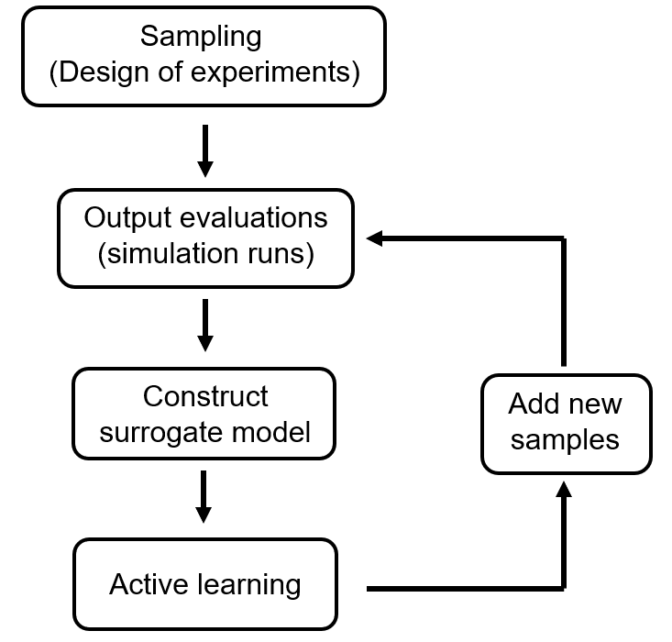
Surrogate Model – How?
Image ack – Google

Slide 13
Surrogate Model – Sampling
Select input points carefully
Goal
Cover entire parameter space
Ensure representative dataset

Slide 14
Surrogate Model – Simulations
Run simulations for selected inputs
Collect
Input and Output pairs (X, y)
Simulation dataset

Slide 15
Surrogate Model – Model Construction
Train Machine Learning model on dataset
Use
Validation
Model selection
Improve using
Bagging
Boosting

Slide 16
Surrogate Model – Active Learning
Add new samples iteratively
Focus on
Uncertain regions
Optimum zones
Model improves progressively

Slide 17
Surrogate Model – Dataset Enrichment
Add new simulation results
Retrain model
Repeat until
Desired accuracy achieved

Slide 18
Surrogate Model – Takeaways
Simulations are expensive but essential
Surrogate models
Approximate simulations
Reduce cost drastically
Based on
Machine learning
Active learning
Enable
Faster design cycles

Slide 19
Applications
Aerospace design
Automotive engineering
Product optimization
Risk analysis
Scientific computing

Slide 20
Conclusions
Surrogate model bridges
Simulation and Machine Learning
Critical for
Modern engineering design
High performance computing problems
Surrogate model – Speed and Scalability
Enable real time decision making
Essential for modern AI-driven engineering

Slide 21
Questions?
Thank you

