Slide 1
Full Stack Blog App
Raghav Aggarwal
Aditi Aggarwal

Slide 2
Abstract
Blog, in full Web log or Weblog, online journal where an individual, group, or corporation presents a record of activities, thoughts, or beliefs. Some blogs operate mainly as news filters, collecting various online sources and adding short comments and Internet links.
Blog is a communication tool that plays a key role in a web application. Use of blogs has resulted in a paradigm shift in the way a web application interacts with the customer.
A blog app can make your posts more easily accessible. Instead of loading your blog URL, users can simply find your latest content on the app. An app will also make it easier for users to share your content with others.
During the development of web application, there is a need to elicit and specify the requirements for the blogging functionality.
In this we present a some requirements for the blog, from the perspective of integrating the blog in a web application.

Slide 3
Scope of the Project
Functional Requirements
Blogs should be categorized.
Post their own blogs.
Supports publishing in different Languages.
Authentication security for editing or deleting blogs.

Slide 4
Scope of the Project
Non-Functional Requirements
Performance
Speed
Scalability
Security
Block abusive content
Reusability
Flexibility

Slide 5
Scope of the Project
List of Modules
Authentication module
Reading Module
Writing Module
Filter Module
Context (React) Module
Database connection Module
NavBar & Footer Modules

Slide 6
Tools and Technologies Used
Front-End
HTML
CSS
JavaSctipt
React
NodeJs
Back-End
NodeJs
MySQL
XAMPP

Slide 7
External Packages Used
server-side (npm) -
"bcryptjs": "^2.4.3",
"cookie-parser": "^1.4.6",
"express": "^4.18.2",
"jsonwebtoken": "^8.5.1",
"multer": "^1.4.5-lts.1",
"mysql": "^2.18.1",
"mysql2": "^2.3.3",
"nodemon": "^2.0.20"
client-side (react) -
"axios": "^1.1.3",
"dompurify": "^2.4.0",
"moment": "^2.29.4",
"react": "^18.2.0",
"react-dom": "^18.2.0",
"react-quill": "^2.0.0",
"react-router-dom": "^6.4.3",
"react-scripts": "5.0.1",
"sass": "^1.56.0"

Slide 8
Design Of the Project
Goal :
The purpose of a blog is to create a more engaging website for your brand. Along with using your website to teach users about your products and services, you can also include a blog section to teach consumers about topics that are relevant to your field. We used ReactJs to design frontend because of its fast user interface.

Slide 9
WHY did we choose this project?
The project is a real world case and would be helpful for further projects to be taken up from customers who wish to use it for their marketing purpose and increase the reach of their brand.
The database connected to it would help the servicemen to better analyze their customer’s behaviour and enhance and improve their shop on the basis of that conclusion.

Slide 10
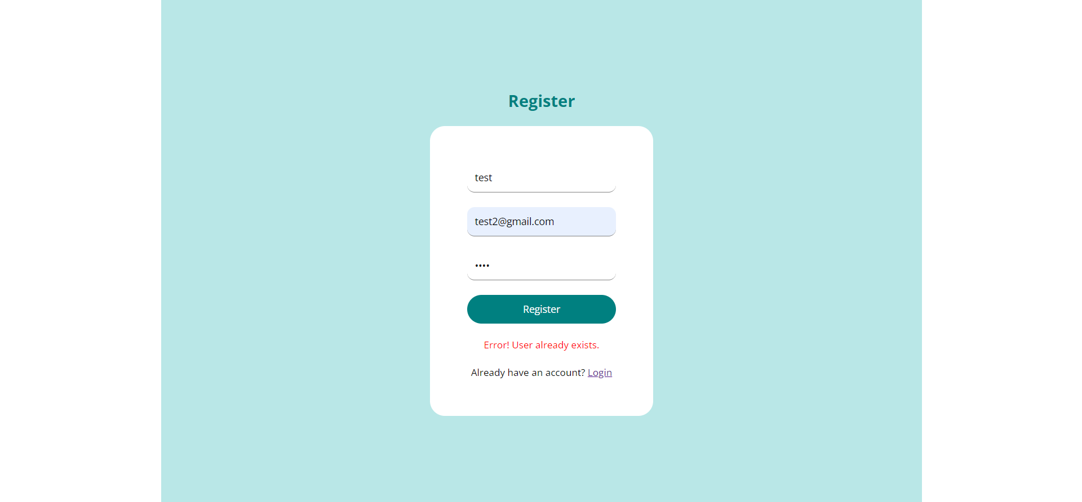
IMPLEMENTATION & RESULTS
REGISTRATION PAGE :

Slide 11
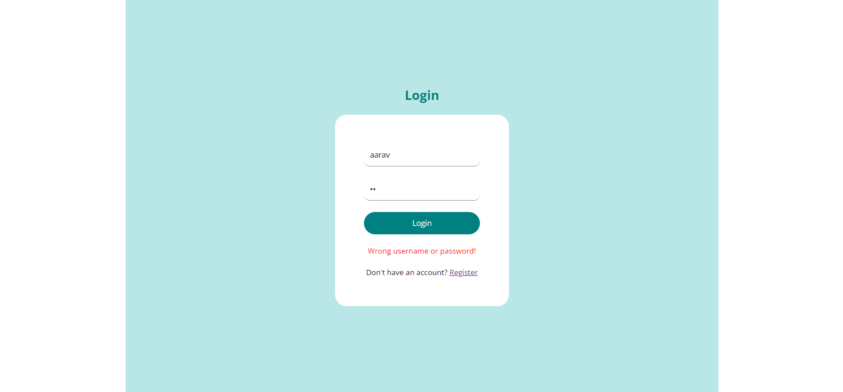
LOGIN PAGE:

Slide 12
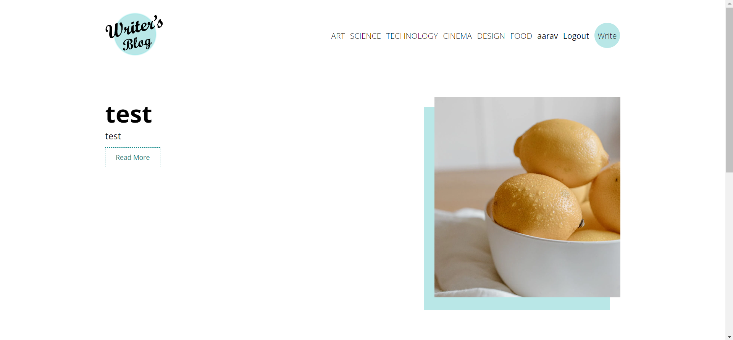
HOME PAGE:

Slide 13
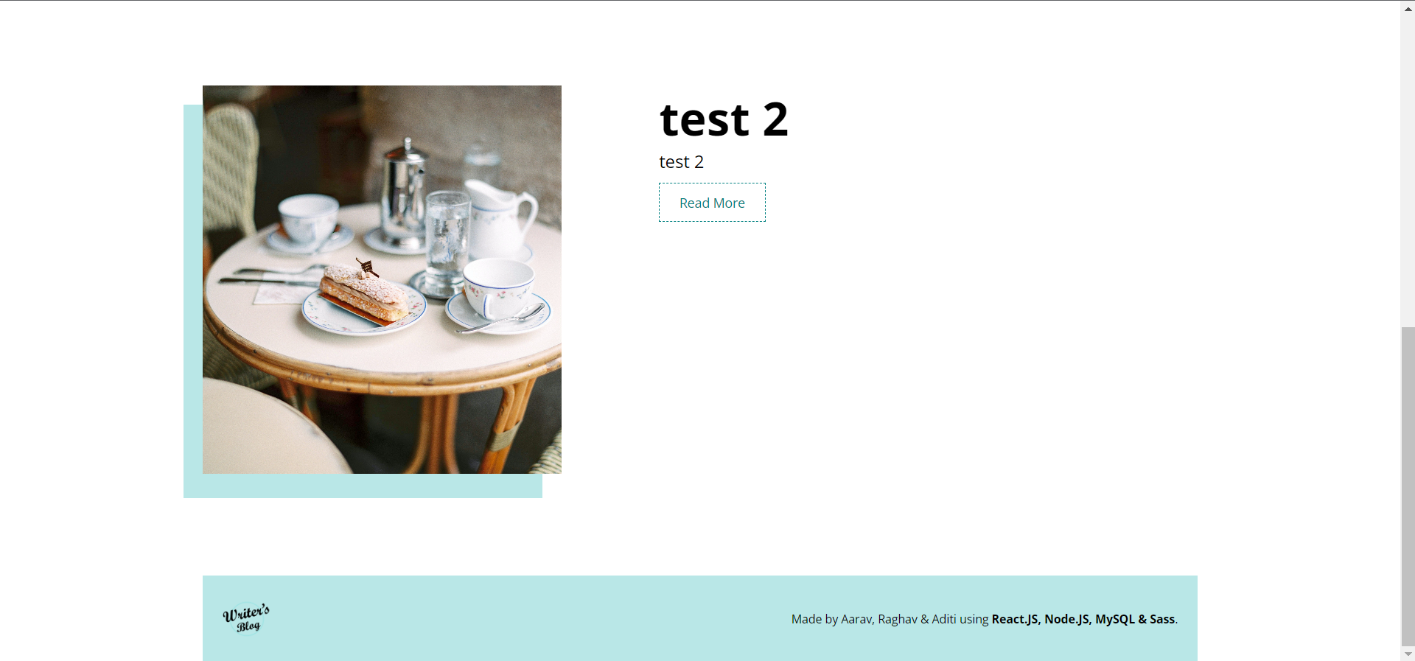

Slide 14
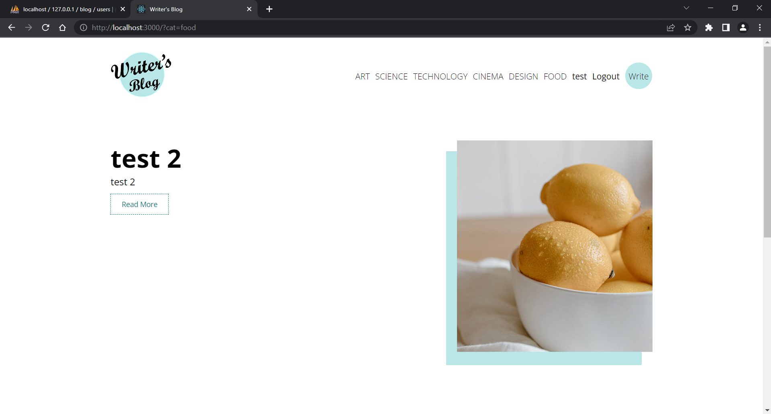
Browsing via categories:

Slide 15
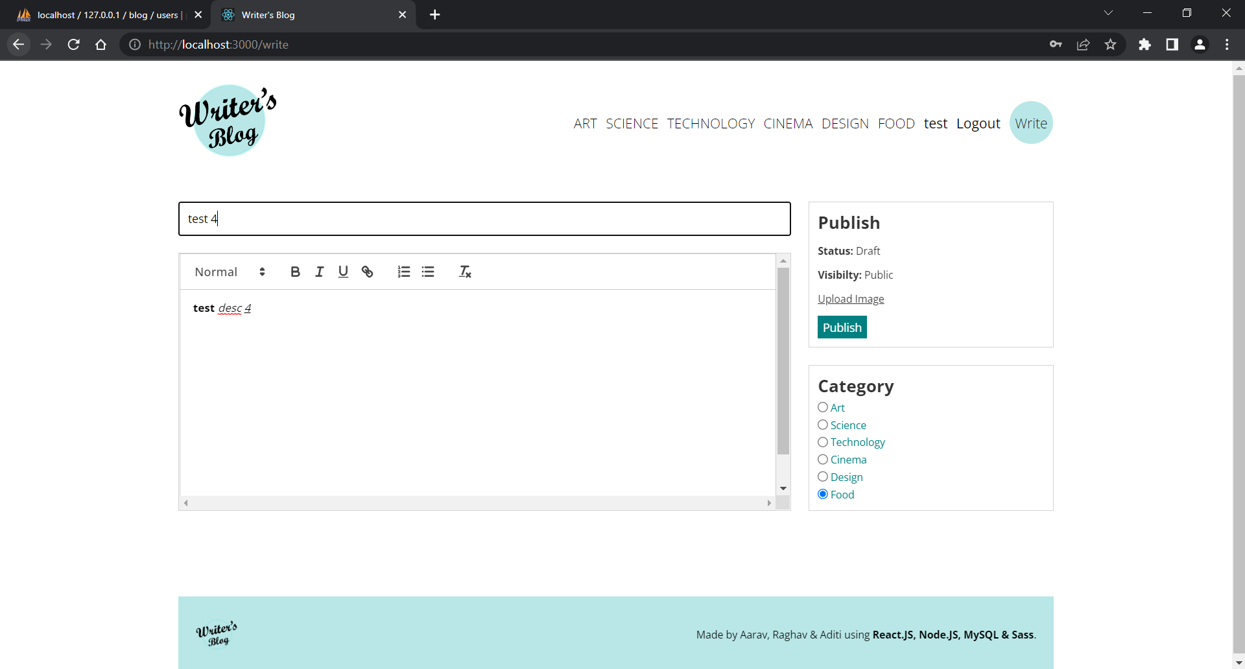
WRITE PAGE :

Slide 16
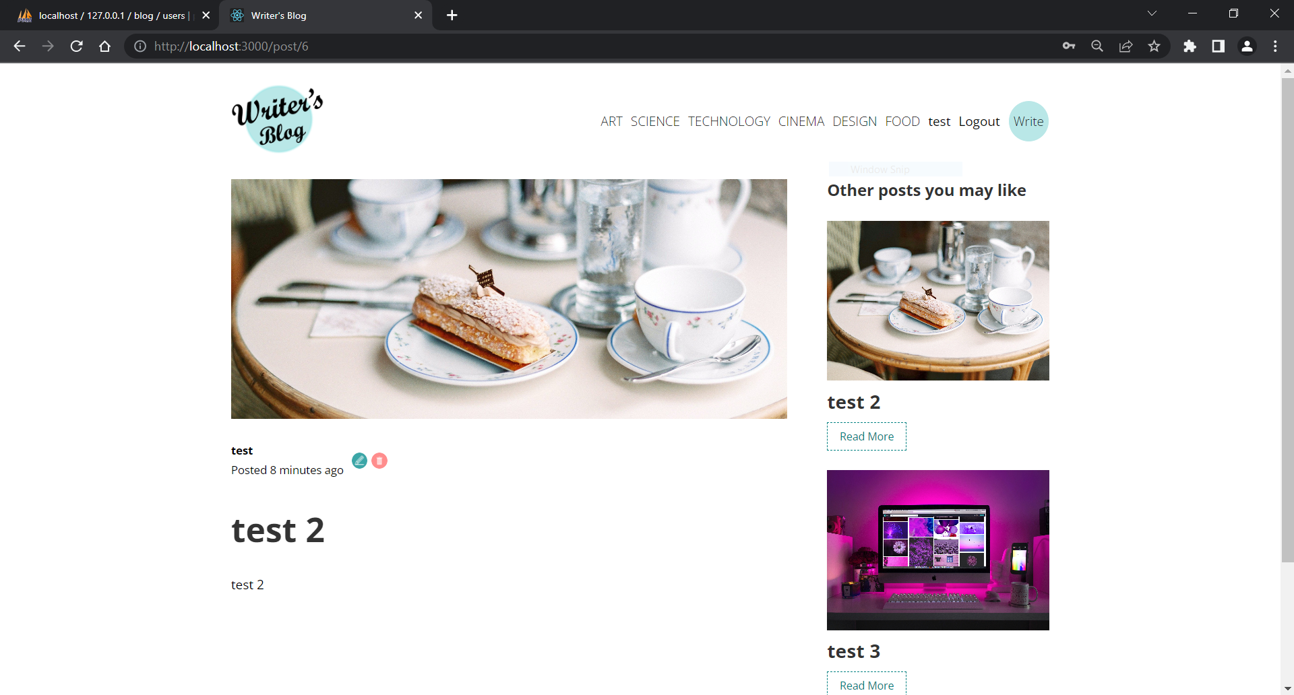
READ POST :

Slide 17

UPDATE :

Slide 18
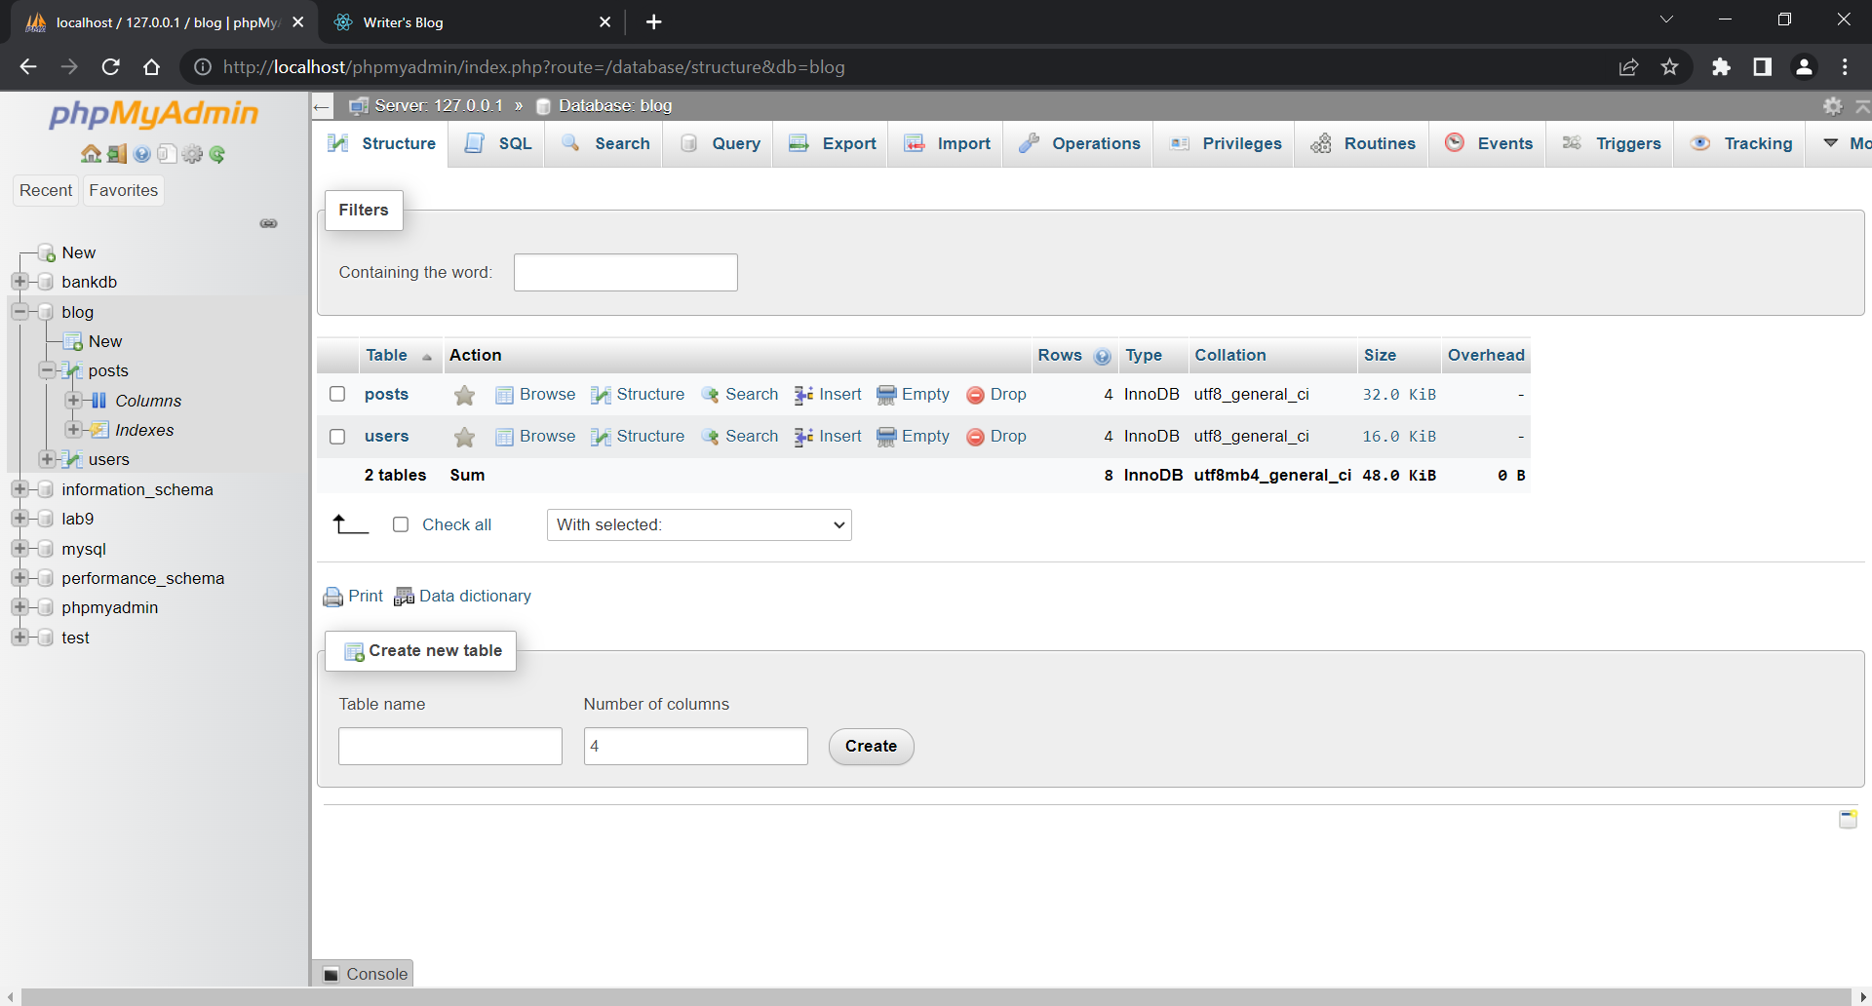
PHP MY ADMIN :

Slide 19
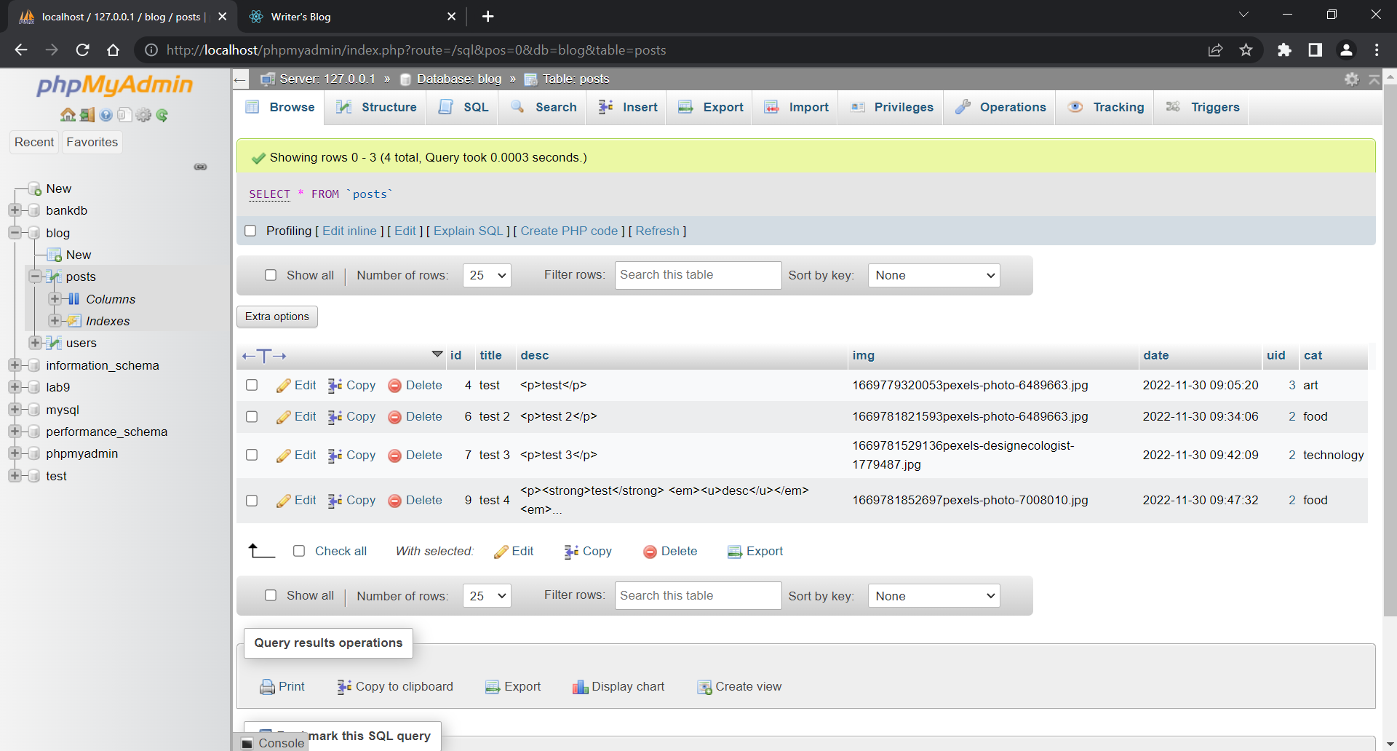
POSTS TABLE:

Slide 20
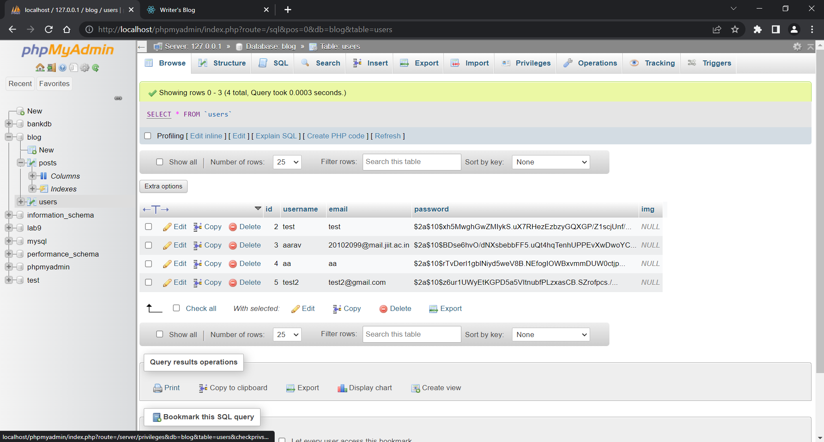
USERS TABLE :

Slide 21
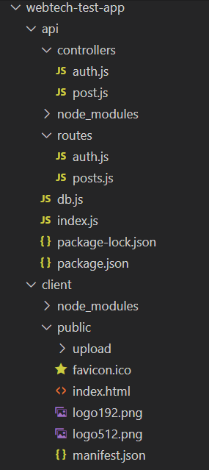
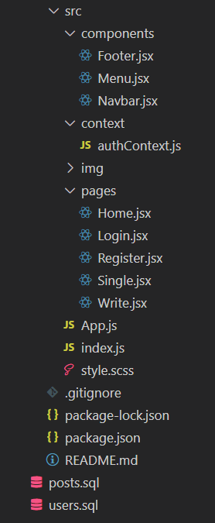
App Directory
api - contains all files that work at
the backend i.e. CRUD operations
on individual blog posts.
client - contains all files that make
up the front-end of the project.

Slide 22
List of Features
Fetch all posts and user info from database.
Show preview of each post on home page.
login or register to read, create, update or delete posts.
Show similar posts in a sidebar when reading a post.
categorize posts when publishing or editing posts.
Author security on all posts i.e. a user cannot edit or delete any post that they are not an author of.

Slide 23
References:
https://reactjs.org/docs/getting-started.html
https://www.npmjs.com/
https://reactrouter.com/en/main/start/tutorial
https://youtube.com
https://www.apachefriends.org/
https://www.w3schools.com/nodejs/nodejs_mysql.asp

