Slide 1

Introduction to “R” Tool
Dr. Parvathi.R
VIT University
Chennai

Slide 2
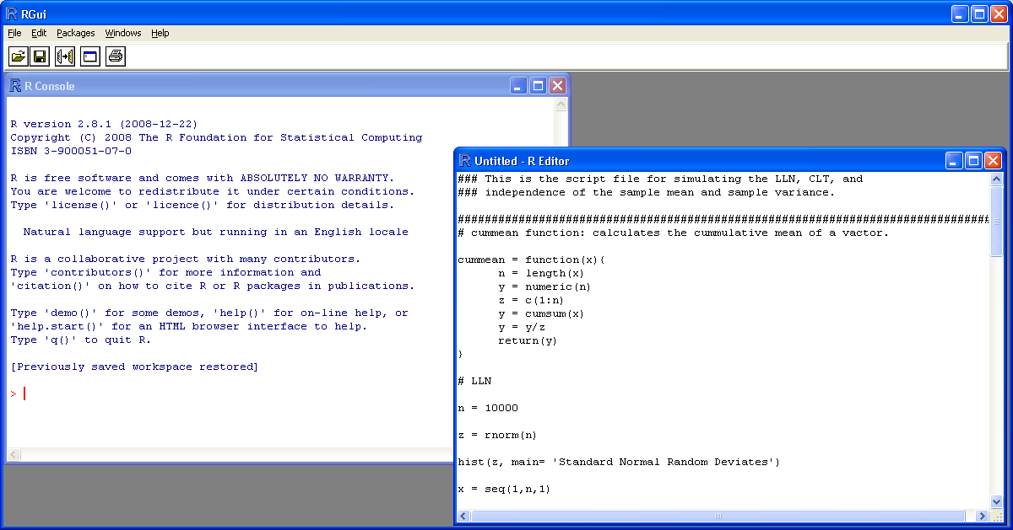
R Software

Slide 3
R code
> 2+2
[1] 4
> 2+2^2
[1] 6
> (2+2)^2
[1] 16
> sqrt(2)
[1] 1.414214
> log(2)
[1] 0.6931472
> x = 5
> y = 10
> z <- x+y
> z
[1] 15

Slide 4
R Code
> seq(1,5, by=.5)
[1] 1.0 1.5 2.0 2.5 3.0 3.5 4.0 4.5 5.0
> v1 = c(6,5,4,3,2,1)
> v1
[1] 6 5 4 3 2 1
> v2 = c(10,9,8,7,6,5)
>
> v3 = v1 + v2
> v3
[1] 16 14 12 10 8 6

Slide 5
R code
> max(v3);min(v3)
[1] 16
[1] 6
> length(v3)
[1] 6
> mean(v3)
[1] 11
> sd(v3)
[1] 3.741657

Slide 6
Objects
names
types of objects: vector, factor, array, matrix, data.frame, ts, list
attributes
  mode: numeric, character, complex, logical
  length: number of elements in object
creation
  assign a value
  create a blank object

Slide 7
Naming Convention
must start with a letter (A-Z or a-z)
can contain letters, digits (0-9), and/or periods “.”
case-sensitive
  mydata different from MyData
do not use use underscore “_”

Slide 8
Assignment
“<-” used to indicate assignment
  x<-c(1,2,3,4,5,6,7)
  x<-c(1:7)
  x<-1:4
note: as of version 1.4 “=“ is also a valid assignment operator

Slide 9
Frequently used functions
c | Concatenate
cbind,rbind | Concatenate vectors
min | Minimum
max | Maximum
length | # values
dim | # rows, cols
floor | Max integer in
which | TRUE indices
table | Counts
summary | Generic stats
Sort, order, rank | Sort, order, rank a vector
print | Show value
cat | Print as char
paste | c() as char
round | Round
apply | Repeat over rows, cols

Slide 10
Statistical functions
rnorm, dnorm, pnorm, qnorm | Normal distribution random sample, density, cdf and quantiles
lm, glm, anova | Model fitting
loess, lowess | Smooth curve fitting
sample | Resampling (bootstrap, permutation)
.Random.seed | Random number generation
mean, median | Location statistics
var, cor, cov, mad, range | Scale statistics
svd, qr, chol, eigen | Linear algebra

Slide 11
Graphical functions
plot | Generic plot eg: scatter
points | Add points
lines, abline | Add lines
text, mtext | Add text
legend | Add a legend
axis | Add axes
box | Add box around all axes
par | Plotting parameters (lots!)
colors, palette | Use colors

Slide 12
Let’s look at R

Slide 13
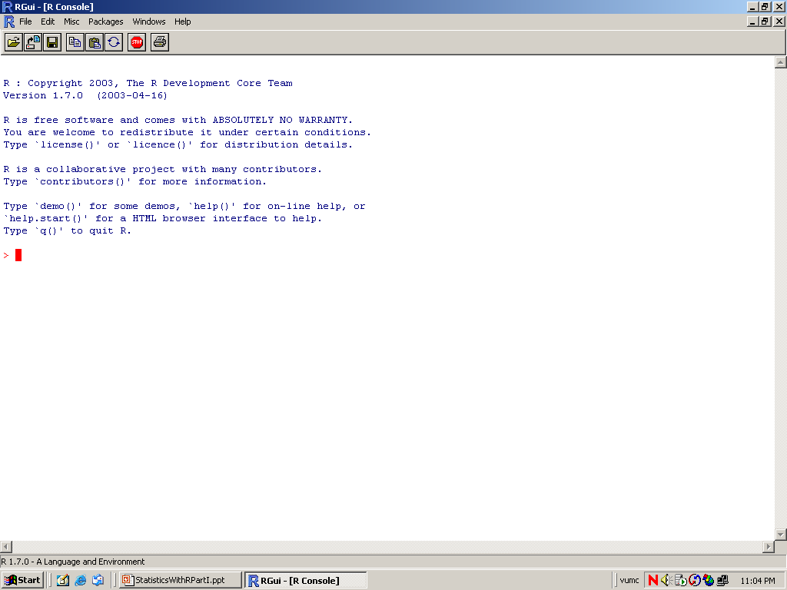

Slide 14
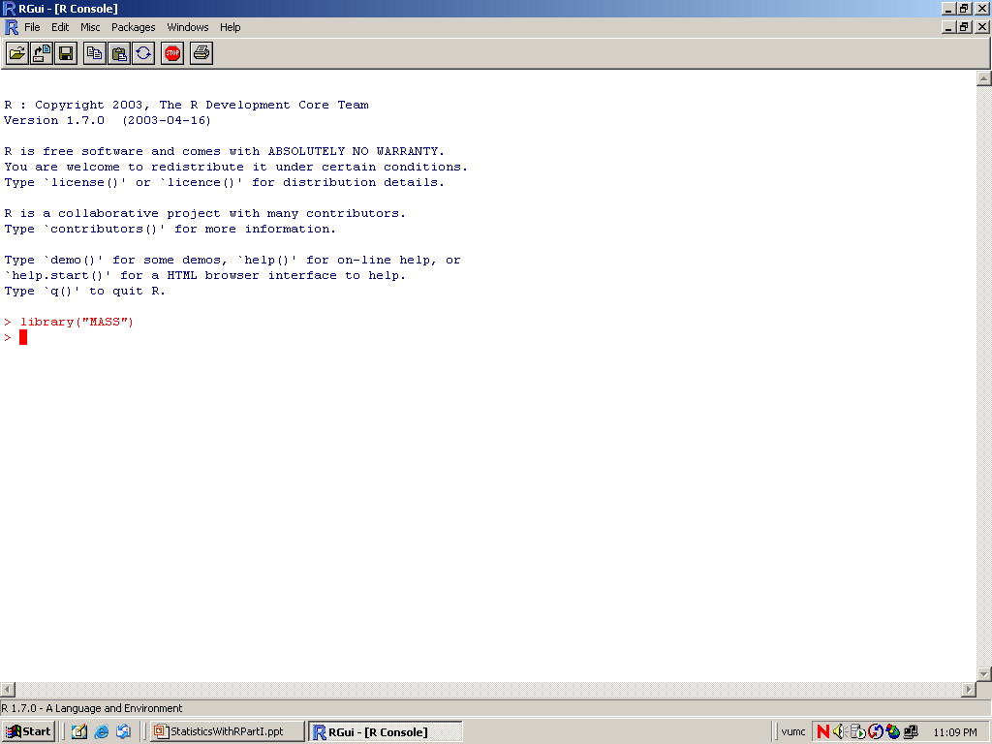

Slide 15
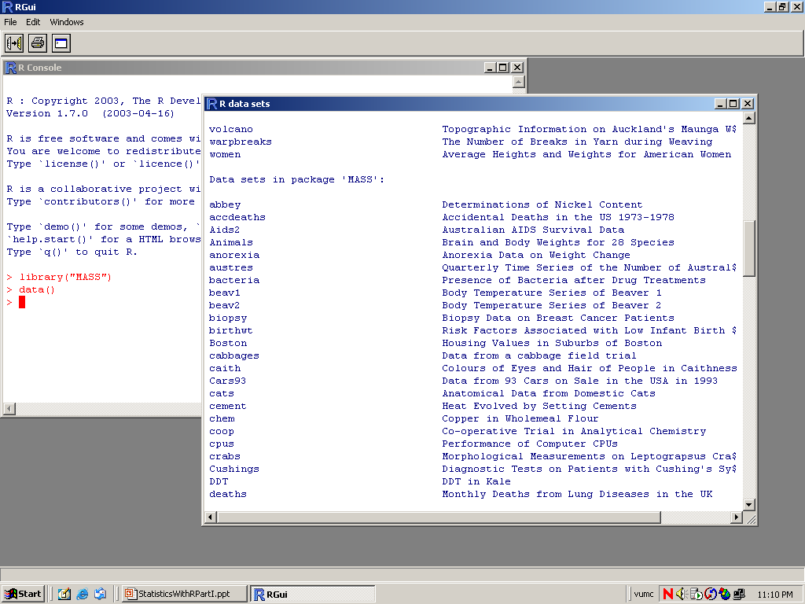

Slide 16
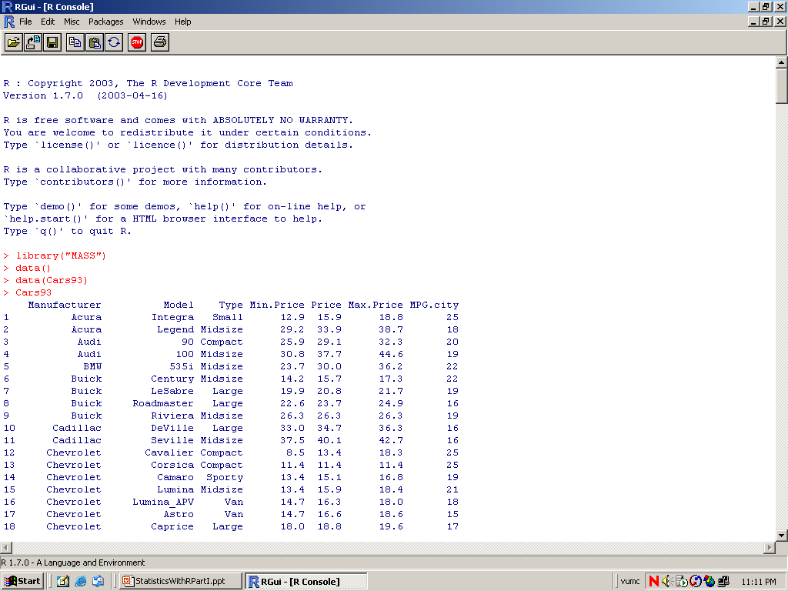

Slide 17
Dataframe
Dataset | data.frame
columns | variables
rows | observations
age insulin
50 16.5
62 10.8
60 32.3
40 19.3
48 14.2
47 11.3
57 15.5
70 15.8
Data frame: ins
Variables: age, insulin
Number of observations: 8

Slide 18
Data entry by c()
age insulin
50 16.5
62 10.8
60 32.3
40 19.3
48 14.2
47 11.3
57 15.5
70 15.8
48 16.2
67 11.2
age <- c(50,62,60,40,48,47,57,70,48,67)
insulin <- c(16.5,10.8,32.3,19.3,14.2,11.3,
15.5,15.8,16.2,11.2)
ins <- data.frame(age, insulin)
attach(ins)
ins
age insulin
1 50 16.5
2 62 10.8
3 60 32.3
4 40 19.3
5 48 14.2
6 47 11.3
7 57 15.5
8 70 15.8
9 48 16.2
10 67 11.2

Slide 19
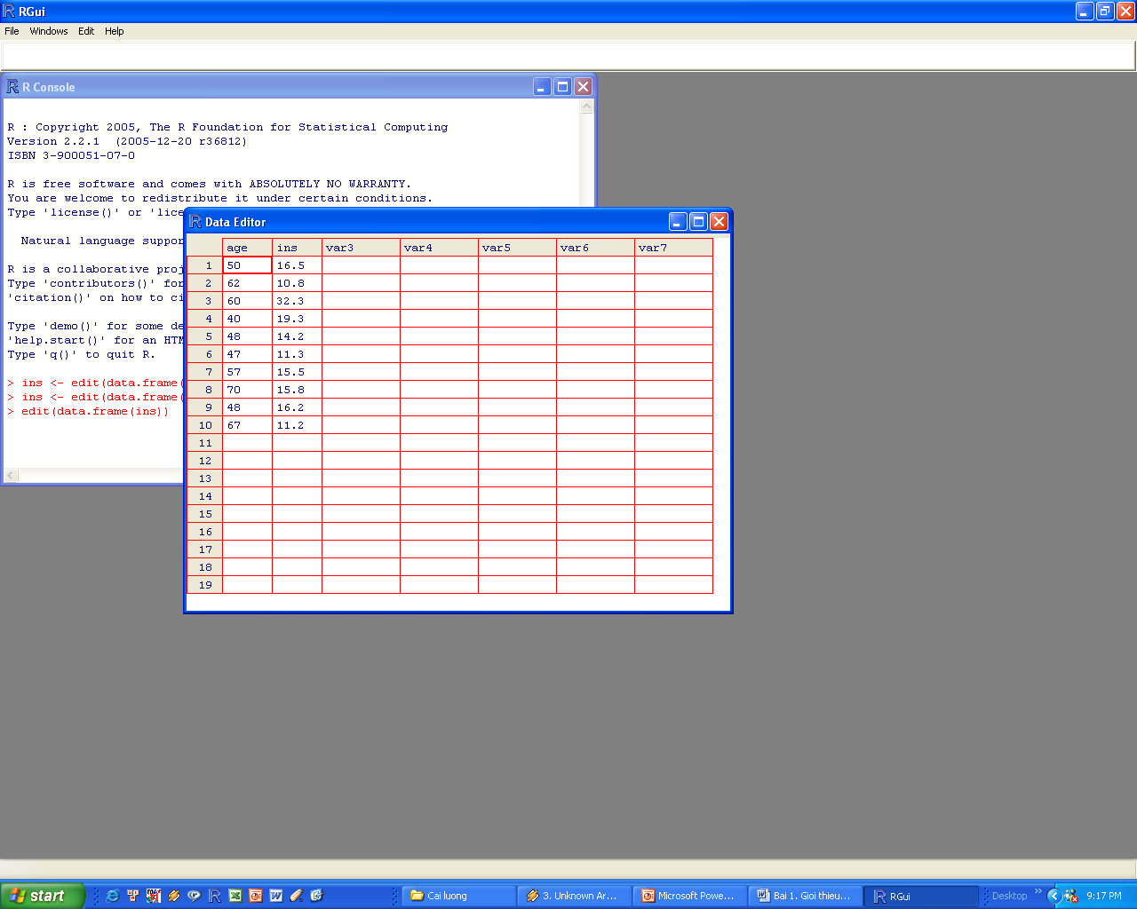
Data entry by edit(data.frame())
ins <- edit(data.frame())

Slide 20
Read data from external file: read.table()
id sex age bmi hdl ldl tc tg
1 Nam 57 17 5.000 2.0 4.0 1.1
2 Nu 64 18 4.380 3.0 3.5 2.1
3 Nu 60 18 3.360 3.0 4.7 0.8
4 Nam 65 18 5.920 4.0 7.7 1.1
5 Nam 47 18 6.250 2.1 5.0 2.1
6 Nu 65 18 4.150 3.0 4.2 1.5
7 Nam 76 19 0.737 3.0 5.9 2.6
8 Nam 61 19 7.170 3.0 6.1 1.5
9 Nam 59 19 6.942 3.0 5.9 5.4
10 Nu 57 19 5.000 2.0 4.0 1.9
...
46 Nu 52 24 3.360 2.0 3.7 1.2
47 Nam 64 24 7.170 1.0 6.1 1.9
48 Nam 45 24 7.880 4.0 6.7 3.3
49 Nu 64 25 7.360 4.6 8.1 4.0
50 Nu 62 25 7.750 4.0 6.2 2.5
setwd(“c:/works/r”)
chol <- read.table("chol.txt", header=TRUE)

Slide 21
Read data from an excel: read.csv()
Save excel file in .csv format
Use R to read the file:
setwd(“c:/works/r”)
gh <- read.csv ("excel.txt", header=TRUE)

Slide 22
Subsetting dataset
setwd(“c:/works/r”)
chol <- read.table(“chol.txt”, header=TRUE)
attach(chol)
nam <- subset(chol, sex==”Male”)
nu <- subset(chol, sex==”Female”)
old <- subset(chol, age>=60)
n60 <- subset(chol, age>=60 & sex==“Male”)

Slide 23
Data coding
bmd <- c(-0.92,0.21,0.17,-3.21,-1.80,-2.60,
-2.00,1.71,2.12,-2.11)
diagnosis <- bmd
diagnosis[bmd <= -2.5] <- 1
diagnosis[bmd > -2.5 & bmd <= 1.0] <- 2
diagnosis[bmd > -1.0] <- 3
data <- data.frame(bmd, diagnosis)
data
bmd diagnosis
1 -0.92 3
2 0.21 3
3 0.17 3
4 -3.21 1
5 -1.80 2
6 -2.60 1
7 -2.00 2
8 1.71 3
9 2.12 3
10 -2.11 2
diagnosis <- bmd
diagnosis <- replace(diagnosis, bmd <= -2.5, 1)
diagnosis <- replace(diagnosis, bmd > -2.5 & bmd <= 1.0, 2)
diagnosis <- replace(diagnosis, bmd > -1.0, 3)

Slide 24
R as a calculator
Arithmetic calculations
> -27*12/21
[1] -15.42857
> sqrt(10)
[1] 3.162278
> log(10)
[1] 2.302585
> log10(2+3*pi)
[1] 1.057848
> exp(2.7689)
[1] 15.94109
> (25 - 5)^3
[1] 8000
> cos(pi)
[1] -1
Permulation: 3!
prod(3:1)
[1] 6
# 10.9.8.7.6.5.4
> prod(10:4)
[1] 604800
> prod(10:4)/prod(40:36)
[1] 0.007659481
> choose(5, 2)
[1] 10
> 1/choose(5, 2)
[1] 0.1

Slide 25
R as a number generator
Sequence – seq(from, to, by= )
  Generate a variable with numbers ranging from 1 to 12:
> x <- (1:12)
> x
[1] 1 2 3 4 5 6 7 8 9 10 11 12
> seq(12)
[1] 1 2 3 4 5 6 7 8 9 10 11 12
> seq(4, 6, 0.25)
[1] 4.00 4.25 4.50 4.75 5.00 5.25 5.50 5.75 6.00

Slide 26
R as a number generator
Repetition – rep(x, times, …)
> rep(10, 3)
[1] 10 10 10
> rep(c(1:4), 3)
[1] 1 2 3 4 1 2 3 4 1 2 3 4
> rep(c(1.2, 2.7, 4.8), 5)
[1] 1.2 2.7 4.8 1.2 2.7 4.8 1.2 2.7 4.8 1.2 2.7 4.8 1.2 2.7 4.8

Slide 27
R as a number generator
Generating levels – gl(n, k, length = n*k)
> gl(2,4,8)
[1] 1 1 1 1 2 2 2 2
Levels: 1 2
> gl(2, 10, length=20)
[1] 1 1 1 1 1 1 1 1 1 1 2 2 2 2 2 2 2 2 2 2
Levels: 1 2

Slide 28
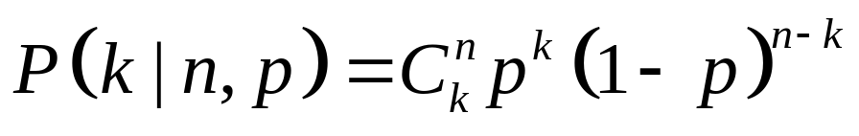
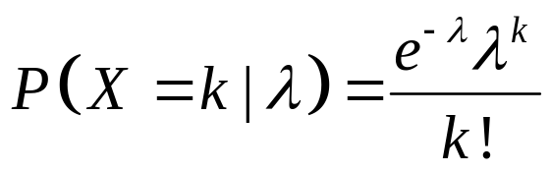
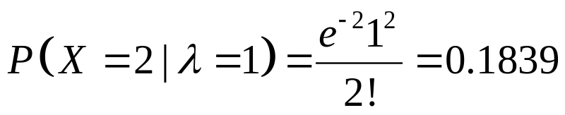
R as a probability calculator
Binomial probability
Poisson probability
dbinom(k, n, p)
dpois(k, λ)
> dbinom(2, 3, 0.60)
[1] 0.432
> dpois(2, 1)
[1] 0.1839397

Slide 29
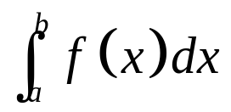
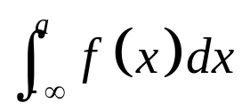
R as a probability calculator
Normal probability
P(a ≤ X ≤ b) =
pnorm (a, mean, sd) =
= P(X ≤ a | mean, sd)
Probability of height less than or equal to 150 cm, given that the distribution has mean=150 and sd=4.6
> pnorm(150, 156, 4.6)
[1] 0.0960575

Slide 30
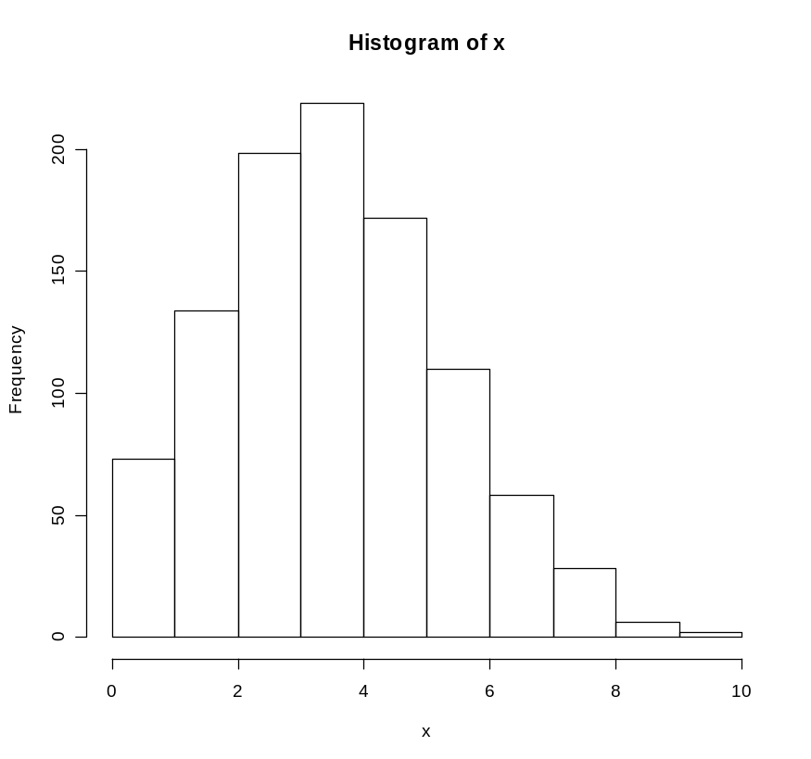
R as a simulator – Binomial distribution
In a population, 20% have a disease, if we do 1000 studies; each study selects 20 people from the population. In each study, we observe the number of people with disease. Let this number be x. What is the distribution of 1000 values of x ?
x <- rbinom(1000, 20, 0.20)
hist(x)

Slide 31
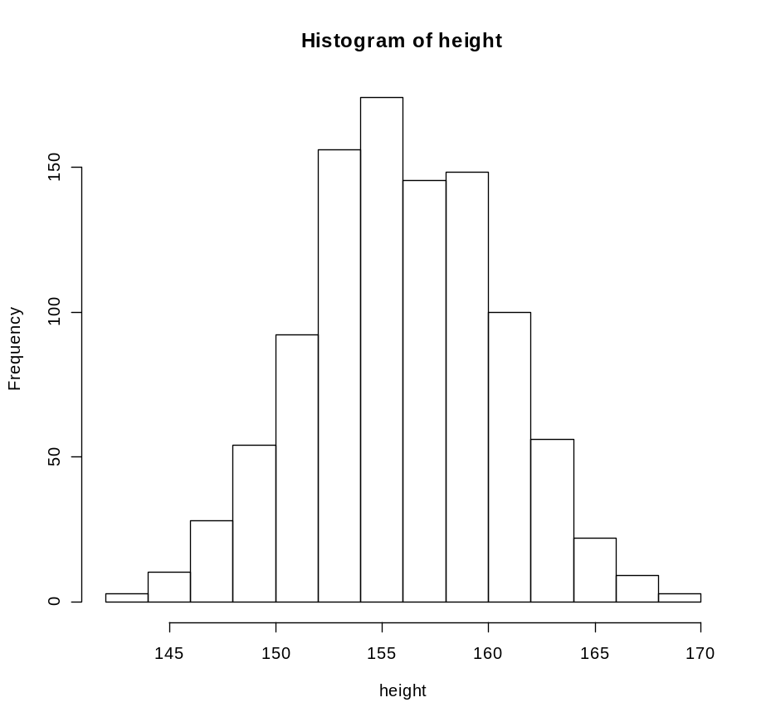
R as a simulator – Normal distribution
Average height of Vietnamese women is 156 cm, with standard deviation being 4.6 cm. If we randomly take 1000 women from this population, what is the distribution of height?
height <- rnorm(1000, mean=156, sd=4.6)
hist(height)

Slide 32
R as a sampler
We have 40 people (1,2,3,…,40). If we randomly select 5 people from the group, who would be selected?
sample(1:40, 5)
[1] 32 26 6 18 9
sample(1:40, 5)
[1] 5 22 35 19 4
sample(1:40, 5)
[1] 24 26 12 6 22
sample(1:40, 5)
[1] 22 38 11 6 18

Slide 33
Sampling with Replacement
Sampling with replacement: If we want to sample 10 people from a group of 50 people. However, each time we select one, we put the id back and select from the group again.
sample(1:50, 10, replace=T)
[1] 31 44 6 8 47 50 10 16 29 23

Slide 34
Data Exploration
> dim(iris)
[1] 150 5
> names(iris)
[1] "Sepal.Length" "Sepal.Width" "Petal.Length" "Petal.Width" "Species“
> str(iris)
'data.frame': 150 obs. of 5 variables:
$ Sepal.Length: num 5.1 4.9 4.7 4.6 5 5.4 4.6 5 4.4 4.9 ...
$ Sepal.Width : num 3.5 3 3.2 3.1 3.6 3.9 3.4 3.4 2.9 3.1 ...
$ Petal.Length: num 1.4 1.4 1.3 1.5 1.4 1.7 1.4 1.5 1.4 1.5 ...
$ Petal.Width : num 0.2 0.2 0.2 0.2 0.2 0.4 0.3 0.2 0.2 0.1 ...
$ Species : Factor w/ 3 levels "setosa","versicolor",..: 1 1 1 1 1 1 1 1 1 1 ...

Slide 35
Data Exploration
> attributes(iris)
$names
[1] "Sepal.Length" "Sepal.Width" "Petal.Length" "Petal.Width" "Species“
$class
[1] "data.frame“
> iris[1:5,]
Sepal.Length Sepal.Width Petal.Length Petal.Width Species
1 5.1 3.5 1.4 0.2 setosa
2 4.9 3.0 1.4 0.2 setosa
3 4.7 3.2 1.3 0.2 setosa
4 4.6 3.1 1.5 0.2 setosa
5 5.0 3.6 1.4 0.2 setosa

Slide 36
Data Exploration
> head(iris) – Fetches first row
Sepal.Length Sepal.Width Petal.Length Petal.Width Species
1 5.1 3.5 1.4 0.2 setosa
2 4.9 3.0 1.4 0.2 setosa
3 4.7 3.2 1.3 0.2 setosa
4 4.6 3.1 1.5 0.2 setosa
5 5.0 3.6 1.4 0.2 setosa
6 5.4 3.9 1.7 0.4 setosa
> tail(iris) – Fetches last row
Sepal.Length Sepal.Width Petal.Length Petal.Width Species
145 6.7 3.3 5.7 2.5 virginica
146 6.7 3.0 5.2 2.3 virginica
147 6.3 2.5 5.0 1.9 virginica
148 6.5 3.0 5.2 2.0 virginica
149 6.2 3.4 5.4 2.3 virginica
150 5.9 3.0 5.1 1.8 virginica

Slide 37
The 1st 10 values of Sepal.Length can be fetched with either of the codes below.
> iris[1:10, "Sepal.Length"] or
> iris$Sepal.Length[1:10]
[1] 5.1 4.9 4.7 4.6 5.0 5.4 4.6 5.0 4.4 4.9

Slide 38
Explore Individual Variables
Distribution of every numeric variable can be checked with function summary(), which returns the minimum, maximum, mean, median, and the first (25%) and third (75%) quartiles. For factors (or categorical variables), it shows the frequency of every level.
> summary(iris)
Sepal.Length Sepal.Width Petal.Length Petal.Width
Min. :4.300 Min. :2.000 Min. :1.000 Min. :0.100
1st Qu.:5.100 1st Qu.:2.800 1st Qu.:1.600 1st Qu.:0.300
Median :5.800 Median :3.000 Median :4.350 Median :1.300
Mean :5.843 Mean :3.057 Mean :3.758 Mean :1.199
3rd Qu.:6.400 3rd Qu.:3.300 3rd Qu.:5.100 3rd Qu.:1.800
Max. :7.900 Max. :4.400 Max. :6.900 Max. :2.500
Species
setosa :50
versicolor:50
virginica :50

Slide 39
Explore Individual Variables
The mean, median and range can also be obtained with functions with mean(), median() and range(). Quartiles and percentiles are supported by function quantile() as below.
> quantile(iris$Sepal.Length)
0% 25% 50% 75% 100%
4.3 5.1 5.8 6.4 7.9
> quantile(iris$Sepal.Length, c(.1, .3, .65))
10% 30% 65%
4.80 5.27 6.20

Slide 40
Explore Individual Variables
variance of Sepal.Length with var(), and also check its distribution with histogram and density using functions hist() and density().
var(iris$Sepal.Length)
[1] 0.6856935

Slide 41
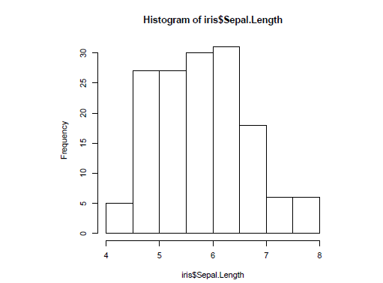
Histogram- > hist(iris$Sepal.Length)

Slide 42
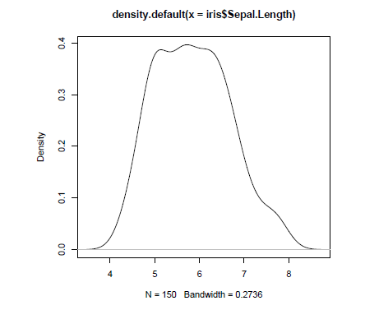
> plot(density(iris$Sepal.Length))

Slide 43
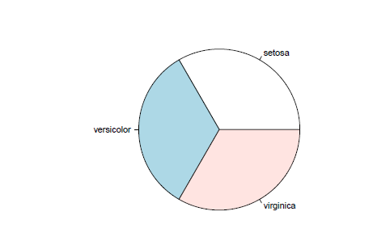
> pie(table(iris$Species)) : table function for finding the freqency of factor

Slide 44
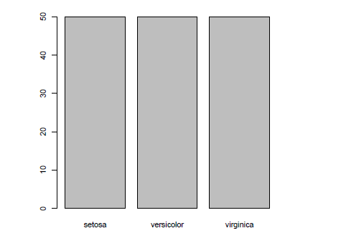
> barplot(table(iris$Species))

Slide 45
Explore Multiple Variables -covariance and correlation between variables
> cov(iris$Sepal.Length, iris$Petal.Length)
[1] 1.274315
> cov(iris[,1:4])
Sepal.Length Sepal.Width Petal.Length Petal.Width
Sepal.Length 0.6856935 -0.0424340 1.2743154 0.5162707
Sepal.Width -0.0424340 0.1899794 -0.3296564 -0.1216394
Petal.Length 1.2743154 -0.3296564 3.1162779 1.2956094
Petal.Width 0.5162707 -0.1216394 1.2956094 0.5810063

Slide 46
Correlation
> cor(iris$Sepal.Length, iris$Petal.Length)
[1] 0.8717538
> cor(iris[,1:4])
Sepal.Length Sepal.Width Petal.Length Petal.Width
Sepal.Length 1.0000000 -0.1175698 0.8717538 0.8179411
Sepal.Width -0.1175698 1.0000000 -0.4284401 -0.3661259
Petal.Length 0.8717538 -0.4284401 1.0000000 0.9628654
Petal.Width 0.8179411 -0.3661259 0.9628654 1.0000000

Slide 47
Aggregate
aggregate(Sepal.Length ~ Species, summary, data=iris)
Species Sepal.Length.Min. Sepal.Length.1st Qu. Sepal.Length.Median
1 setosa 4.300 4.800 5.000
2 versicolor 4.900 5.600 5.900
3 virginica 4.900 6.225 6.500
Sepal.Length.Mean Sepal.Length.3rd Qu. Sepal.Length.Max.
1 5.006 5.200 5.800
2 5.936 6.300 7.000
3 6.588 6.900 7.900

Slide 48
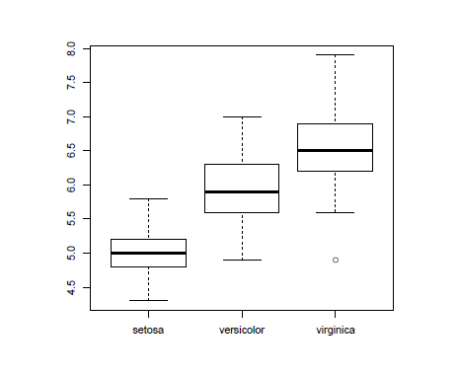
> boxplot(Sepal.Length~Species, data=iris)

Slide 49
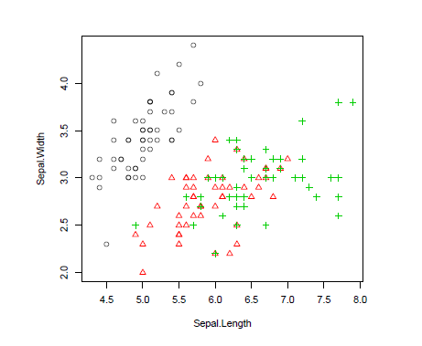
> with(iris, plot(Sepal.Length, Sepal.Width, col=Species, pch=as.numeric(Species)))

Slide 50
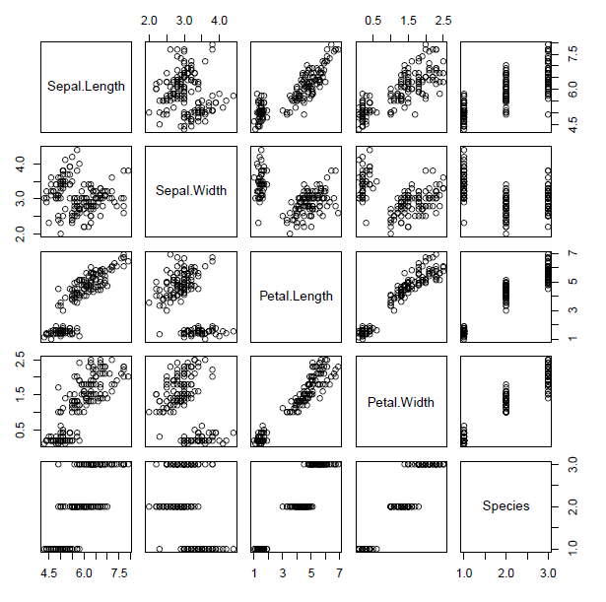
> pairs(iris)- matrix of plots

Slide 51
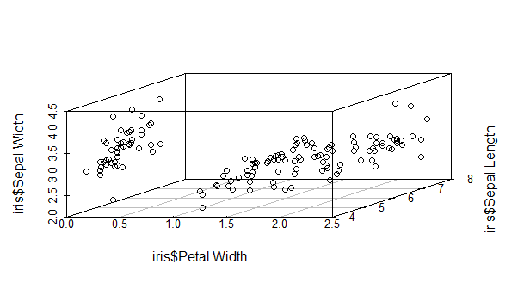
A 3D scatter plot can be produced with package scatterplot3d
> library(scatterplot3d)
> scatterplot3d(iris$Petal.Width, iris$Sepal.Length, iris$Sepal.Width)

Slide 52
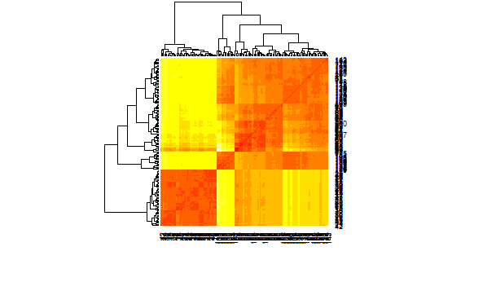
Heat Map
A heat map presents a 2D display of a data matrix, which can be generated with heatmap() in R. With the code below, we can calculate the similarity between different flowers in the iris data
> distMatrix <- as.matrix(dist(iris[,1:4]))
> heatmap(distMatrix)

Slide 53
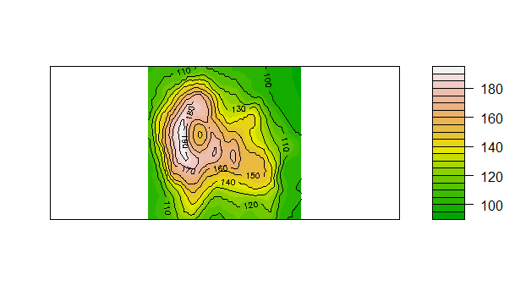
Contour
>filled.contour(volcano, color=terrain.colors, asp=1,plot.axes=contour(volcano, add=T))

Slide 54
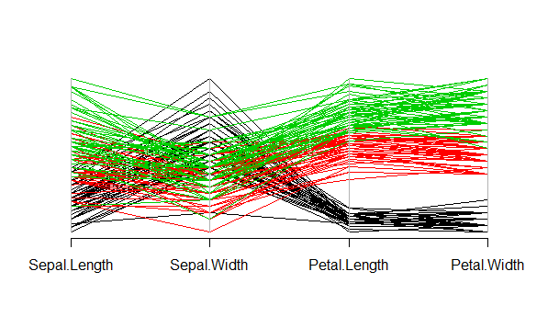
Parallel Co-ordinates
>library(MASS)
> parcoord(iris[1:4], col=iris$Species)

Slide 55
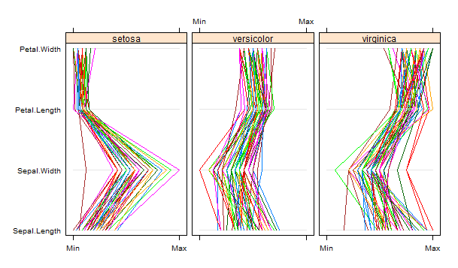
Parallel plot
>library(lattice)
> parallelplot(~iris[1:4] | Species, data=iris)

Slide 56
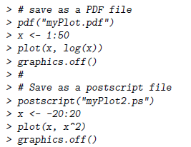
Save your charts as pdf

Slide 57
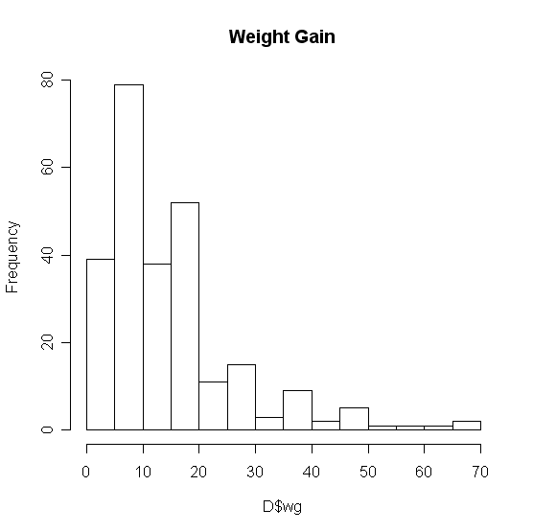
Basic Graphics
Add a title…
  The “main” statement will give the plot an overall heading.
  hist(D$wg , main=‘Weight Gain’)

Slide 58
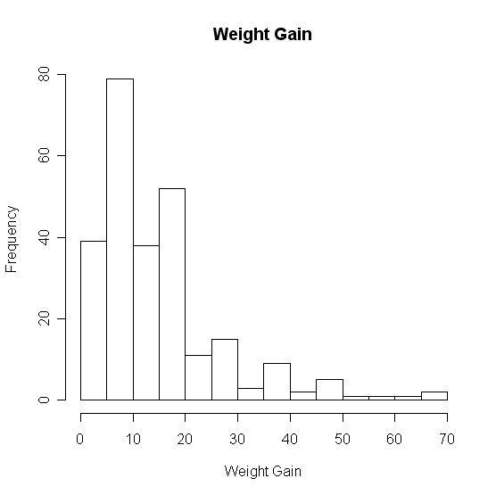
Basic Graphics
Adding axis labels…
Use “xlab” and “ylab” to label the X and Y axes, respectively.
hist(D$wg , main=‘Weight Gain’,xlab=‘Weight Gain’, ylab =‘Frequency’)

Slide 59
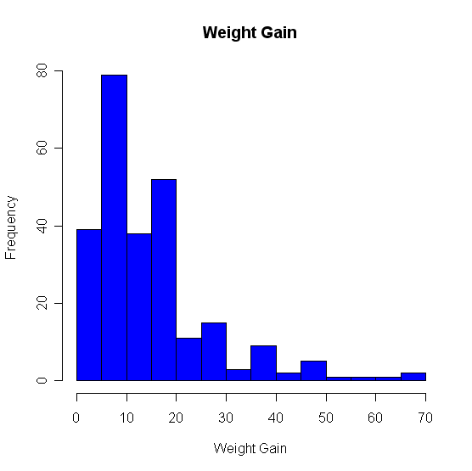
Basic Graphics
Changing colors…
Use the col statement.
  ?colors will give you help on the colors.
  Common colors may simply put in using the name.
  hist(D$wg, main=“Weight Gain”,xlab=“Weight Gain”, ylab =“Frequency”, col=“blue”)

Slide 60
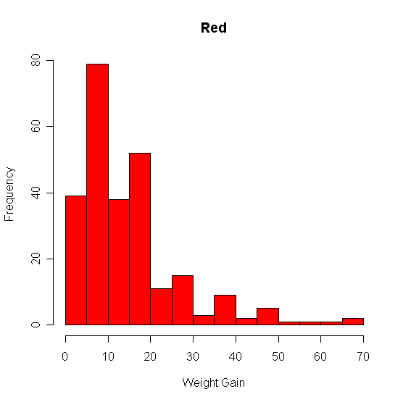
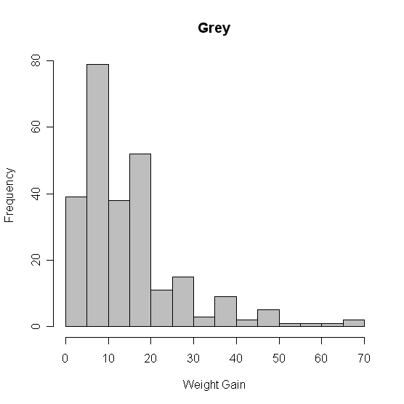
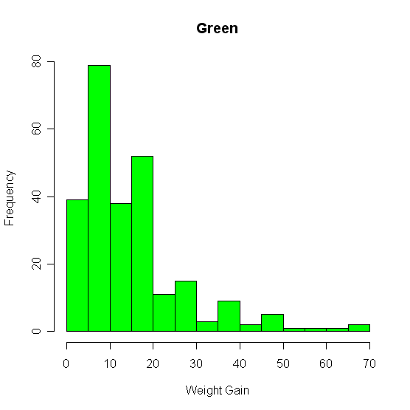
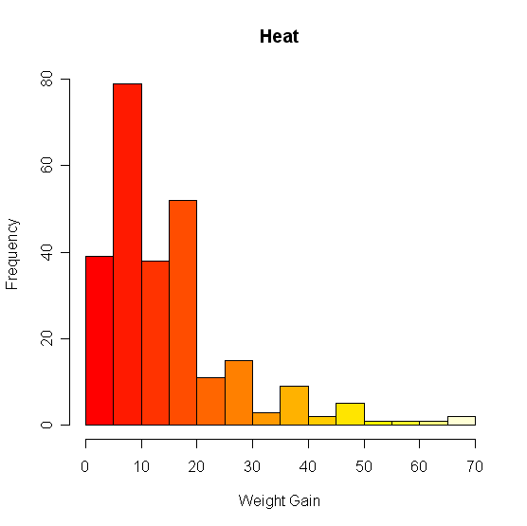
Basic Graphics – Colors

Slide 61
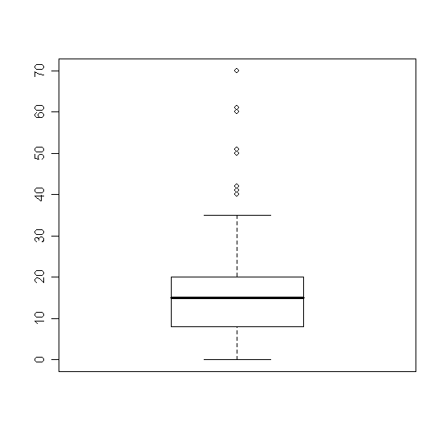
Basic Plots
Box Plots
boxplot(D$wg)

Slide 62
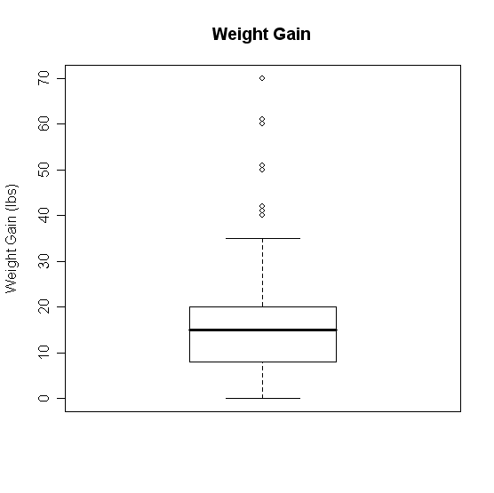
Boxplots
Change it!
boxplot(D$wg,main='Weight Gain',ylab='Weight Gain (lbs)')

Slide 63
Box-Plots - Groupings
What if we want several box plots side by side to be able to compare them.
First Subset the Data into separate variables.
  wg.m <- D[D$Gender=="M",]
  wg.f <- D[D$Gender=="F",]
Then Create the box plot.
  boxplot(wg.m$wg,wg.f$wg)

Slide 64
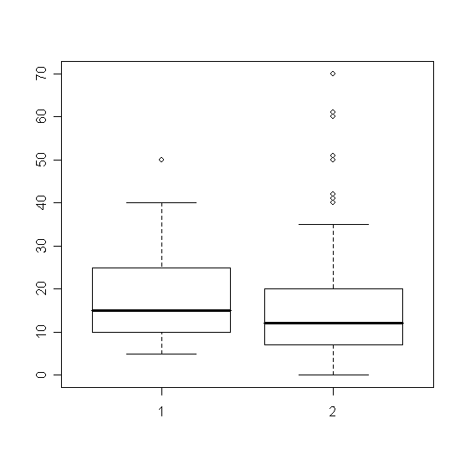
Boxplots – Groupings

Slide 65
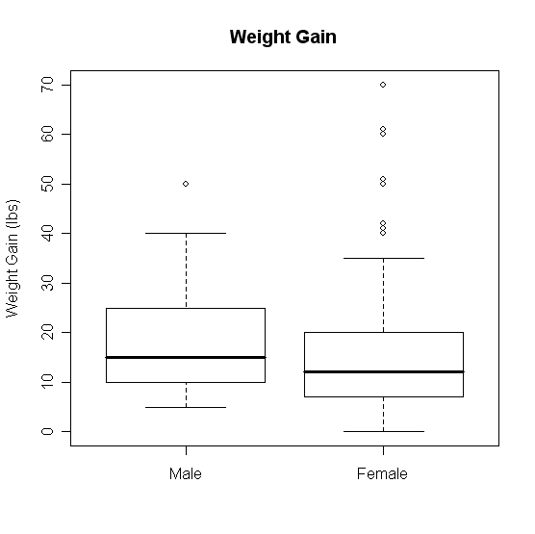
Boxplots - Groupings
boxplot(wg.m$wg, wg.f$wg, main='Weight Gain (lbs)', ylab='Weight Gain', names = c('Male','Female'))

Slide 66
Boxplot Groupings
Do it by shift
  wg.7a <- D[D$Shift=="7am",]
  wg.8a <- D[D$Shift=="8am",]
  wg.9a <- D[D$Shift=="9am",]
  wg.10a <- D[D$Shift=="10am",]
  wg.11a <- D[D$Shift=="11am",]
  wg.12p <- D[D$Shift=="12pm",]
  boxplot(wg.7a$wg, wg.8a$wg, wg.9a$wg, wg.10a$wg, wg.11a$wg, wg.12p$wg, main='Weight Gain', ylab='Weight Gain (lbs)', xlab='Shift', names = c('7am','8am','9am','10am','11am','12pm'))

Slide 67
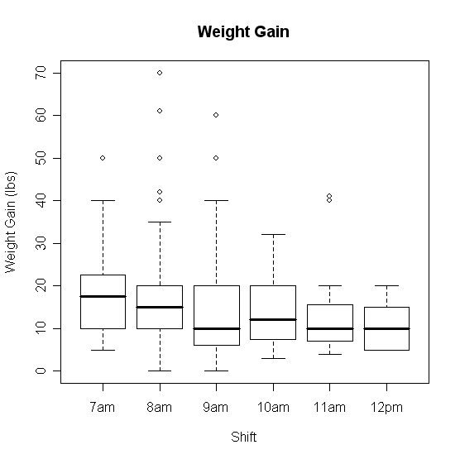
Boxplots Groupings

Slide 68
Scatter Plots
Suppose we have two variables and we wish to see the relationship between them.
A scatter plot works very well.
R code:
  plot(x,y)
Example
  plot(D$metmin,D$wg)

Slide 69
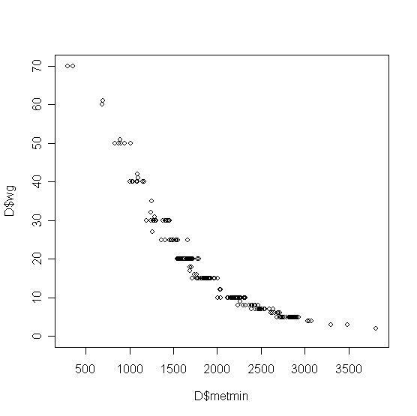
Scatterplots

Slide 70
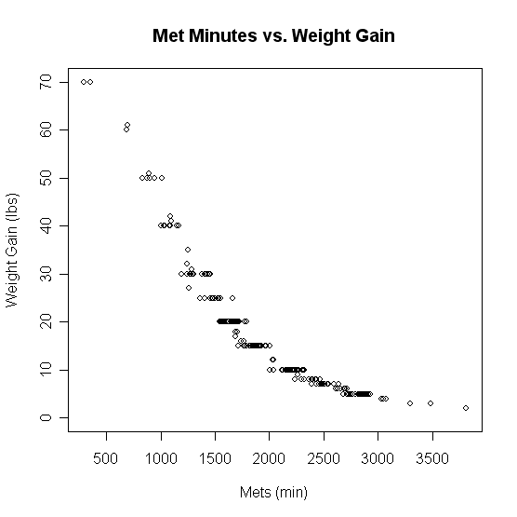
Scatterplots
plot(D$metmin,D$wg,main='Met Minutes vs. Weight Gain',
xlab='Mets (min)',ylab='Weight Gain (lbs)')

Slide 71
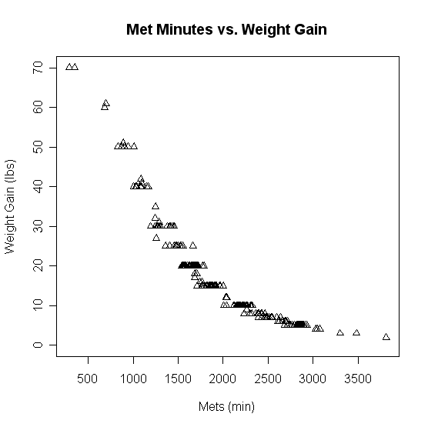
Scatterplots
plot(D$metmin,D$wg,main='Met Minutes vs. Weight Gain',
xlab='Mets (min)',ylab='Weight Gain (lbs)',pch=2)

Slide 72
Line Plots
Often data comes through time.
Consider Dell stock
  D2 <- read.csv("H:\\Dell.csv",header=TRUE)
  t1 <- 1:nrow(D2)
  plot(t1,D2$DELL)

Slide 73
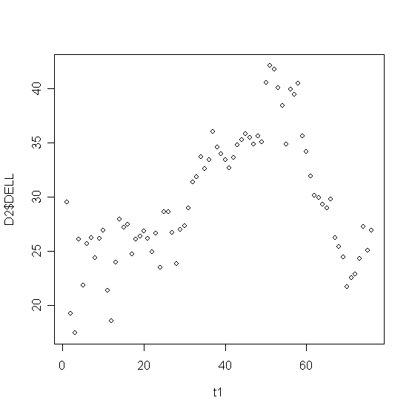
Line Plots

Slide 74
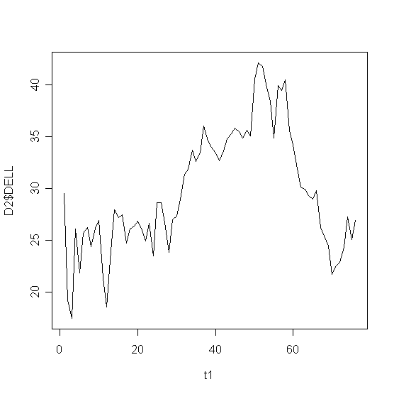
Line Plots
plot(t1,D2$DELL,type="l")

Slide 75
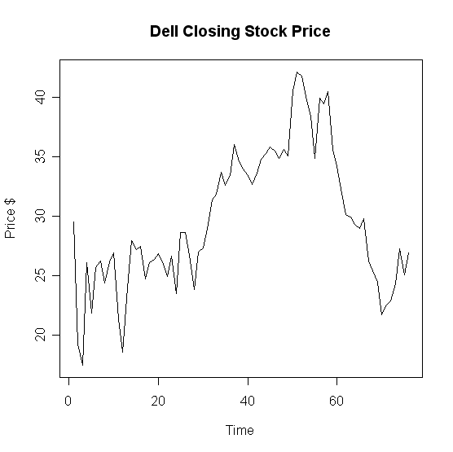
Line Plots
plot(t1,D2$DELL,type="l",main='Dell Closing Stock Price',
xlab='Time',ylab='Price $'))

Slide 76
Overlaying Plots
Often we have more than one variable measured against the same predictor (X).
  plot(t1,D2$DELL,type="l",main='Dell Closing Stock Price',xlab='Time',ylab='Price $'))
  lines(t1,D2$Intel)

Slide 77
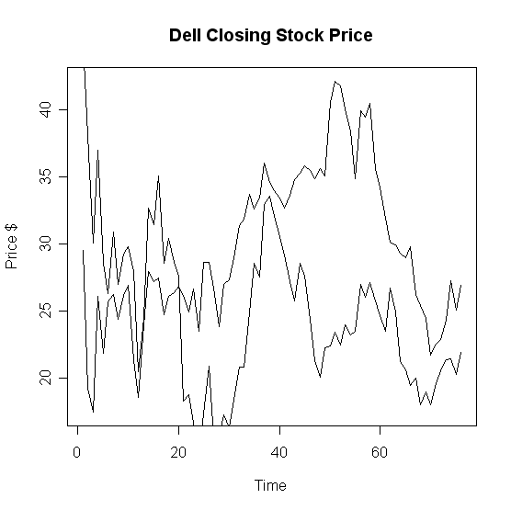
Overlaying Graphs

Slide 78
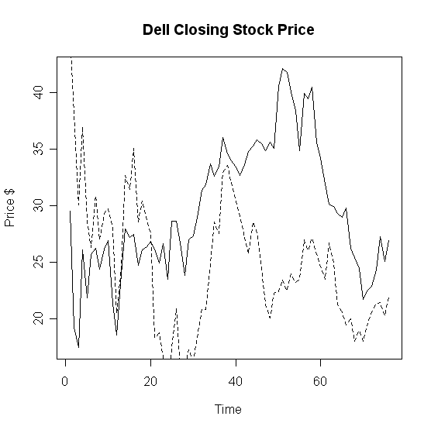
Overlaying Graphs
lines(t1,D2$Intel,lty=2)

Slide 79
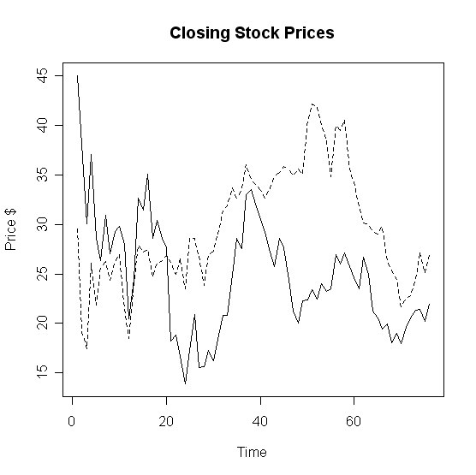
Overlaying Graphs

Slide 80
Adding a Legend
Adding a legend is a bit tricky in R.
Syntax
legend( x, y, names, line types)
X
coordinate
Y
coordinate
Names of series in column format
Corresponding line types

Slide 81
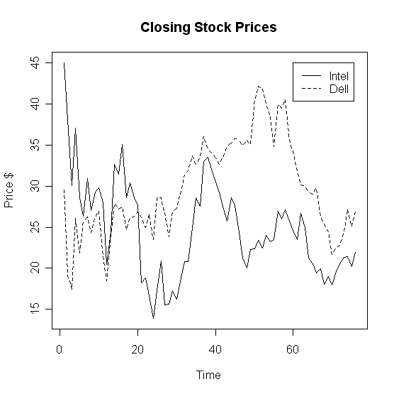
Adding a Legend
legend(60,45,c('Intel','Dell'),lty=c(1,2))

Slide 82
Paneling Graphics
Suppose we want more than one graphic on a panel.
We can partition the graphics panel to give us a framework in which to panel our plots.
par(mfrow = c( nrow, ncol))
Number of rows
Number of columns

Slide 83
Paneling Graphics
Consider the following
par(mfrow=c(2,2))
hist(D$wg, main='Histogram',xlab='Weight Gain', ylab ='Frequency', col=heat.colors(14))
boxplot(wg.7a$wg, wg.8a$wg, wg.9a$wg, wg.10a$wg, wg.11a$wg, wg.12p$wg, main='Weight Gain', ylab='Weight Gain (lbs)',xlab='Shift', names = c('7am','8am','9am','10am','11am','12pm'))
plot(D$metmin,D$wg,main='Met Minutes vs. Weight Gain', xlab='Mets (min)',ylab='Weight Gain (lbs)',pch=2)
plot(t1,D2$Intel,type="l",main='Closing Stock Prices',xlab='Time',ylab='Price $')
lines(t1,D2$DELL,lty=2)

Slide 84
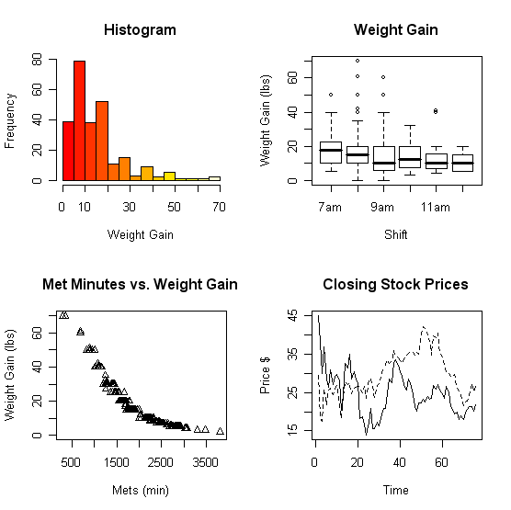
Paneling Graphics

Slide 85
Grouping, loops and conditional execution
Grouped expressions
  R is an expression language in the sense that its only command type is a function or expression which returns a result.
  Commands may be grouped together in braces, {expr 1, . . ., expr m}, in which case the value of the group is the result of the last expression in the group evaluated.
Control statements
  if statements
  The language has available a conditional construction of the form
  if (expr 1) expr 2 else expr 3
  where expr 1 must evaluate to a logical value and the result of the entire expression is then evident.
  a vectorized version of the if/else construct, the ifelse function. This has the form ifelse(condition, a, b)

Slide 86
Repetitive execution
for loops, repeat and while
  for (name in expr 1) expr 2
  where name is the loop variable. expr 1 is a vector expression, (often a sequence like 1:20), and expr 2 is often a grouped expression with its sub-expressions written in terms of the dummy name. expr 2 is repeatedly evaluated as name ranges through the values in the vector result of expr 1.
Other looping facilities include the
  repeat expr statement and the
  while (condition) expr statement.
  The break statement can be used to terminate any loop, possibly abnormally. This is the only way to terminate repeat loops.
  The next statement can be used to discontinue one particular cycle and skip to the “next”.

Slide 87
Branching
if (logical expression) {
statements
} else {
alternative statements
}
else branch is optional

Slide 88
Loops
When the same or similar tasks need to be performed multiple times; for all elements of a list; for all columns of an array; etc.
  Monte Carlo Simulation
  Cross-Validation (delete one and etc)
for(i in 1:10) {
print(i*i)
}
i=1
while(i<=10) {
print(i*i)
i=i+sqrt(i)
}

Slide 89
lapply, sapply, apply
When the same or similar tasks need to be performed multiple times for all elements of a list or for all columns of an array.
  May be easier and faster than “for” loops
lapply(li, function )
  To each element of the list li, the function function is applied.
  The result is a list whose elements are the individual function results.
> li = list("klaus","martin","georg")
> lapply(li, toupper)
> [[1]]
> [1] "KLAUS"
> [[2]]
> [1] "MARTIN"
> [[3]]
> [1] "GEORG"

Slide 90
lapply, sapply, apply
sapply( li, fct )
Like apply, but tries to simplify the result, by converting it into a vector or array of appropriate size
> li = list("klaus","martin","georg")
> sapply(li, toupper)
[1] "KLAUS" "MARTIN" "GEORG"
> fct = function(x) { return(c(x, x*x, x*x*x)) }
> sapply(1:5, fct)
[,1] [,2] [,3] [,4] [,5]
[1,] 1 2 3 4 5
[2,] 1 4 9 16 25
[3,] 1 8 27 64 125

Slide 91
apply
apply( arr, margin, fct )
Apply the function fct along some dimensions of the array arr, according to margin, and return a vector or array of the appropriate size.
> x
[,1] [,2] [,3]
[1,] 5 7 0
[2,] 7 9 8
[3,] 4 6 7
[4,] 6 3 5
> apply(x, 1, sum) - row sum
[1] 12 24 17 14
> apply(x, 2, sum) - column sum
[1] 22 25 20

Slide 92
k-Means Clustering
> iris2 <- iris
> # remove species from the data to cluster
> iris2$Species <- NULL
> (kmeans.result <- kmeans(iris2, 3))

Slide 93
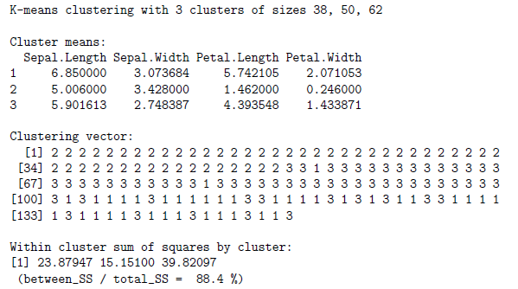
K-means result

Slide 94

Plot the clusters and their centers
> plot(iris2[c("Sepal.Length", "Sepal.Width")], col = kmeans.result$cluster)
>points(kmeans.result$centers[,c("Sepal.Length", "Sepal.Width")], col = 1:3,pch = 8, cex=2)

Slide 95
Hierarchical Clustering
Draw a sample of 40 records from iris data, and remove variable Species
> idx <- sample(1:dim(iris)[1], 40)
> irisSample <- iris[idx,]
> irisSample$Species <- NULL
> hc <- hclust(dist(irisSample), method="ave")
> plot(hc, hang = -1, labels=iris$Species[idx])

Slide 96

Result of hierarchical clustering

