Slide 1
Optimum design of optical filters and deposition monitoring methods
Dimitris Kouzis - Loukas
Supervisor: S. Maltezos
Support: M. Fokitis

Slide 2
Contents
Multilayer Notch Optical Filters
Applications
Optimum design
Deposition processes
Monitoring techniques
Conclusion and future work

Slide 3
Why is this an interesting technology?
It requires knowledge of several different sciences
  Optics
  Electronics and computer science
  Automatic control
  Mathematics and optimization algorithms
Relevant methods also apply
  Deposition of Integrated Circuits
Interesting commercial applications
Lack of knowledge in Greece and worldwide

Slide 4
Multilayer Notch Optical Filters
Their structure
Mathematical models

Slide 5
Categories
Multi layer thin films
Rugate filters

Slide 6
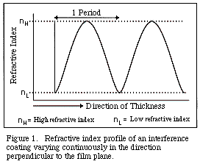
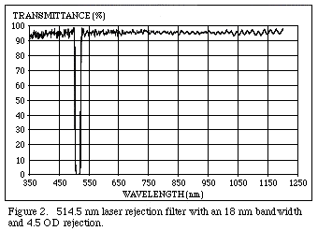
Rugate filters

Slide 7
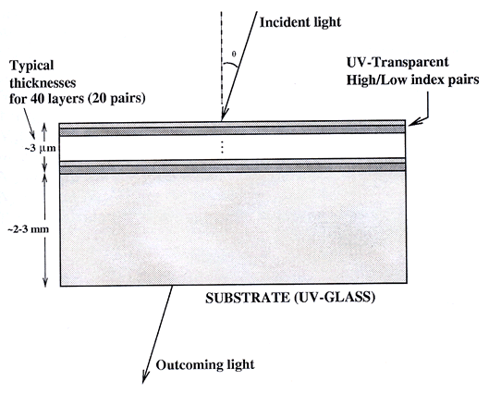
Multi layer thin films

Slide 8
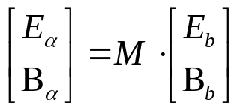
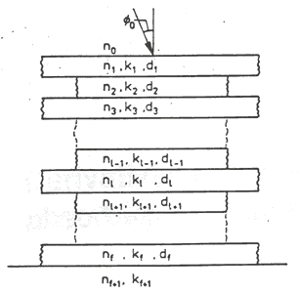

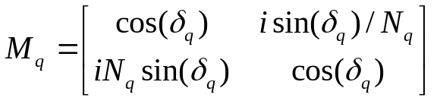
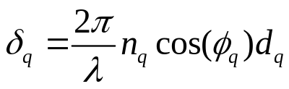

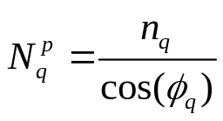
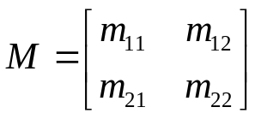


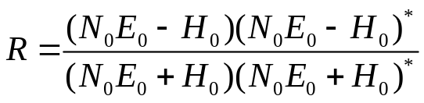
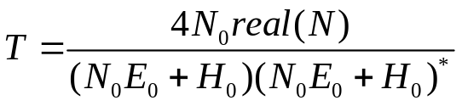
Mathematical models

Slide 9




Applications (1/2)
Remote Sensing
Avionics
Gas Analysis
Emission Analysis
Environmental Monitoring
Forgery detection

Slide 10




Applications (2/2)
Spectroscopy
Machine Vision
Raman Spectroscopy
Space Based Research & Astronomy
Medicine - Biology
Colour Correction
Optics and ophthalmic lenses

Slide 11
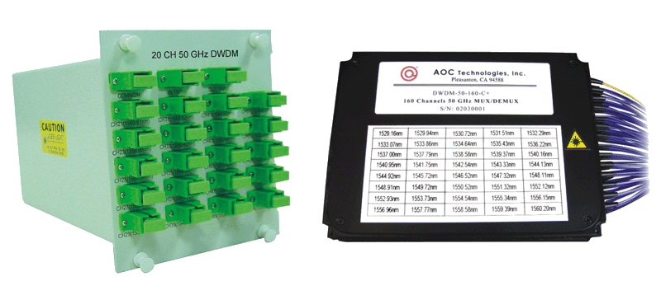
Dense Wavelength Division Multiplexers

Slide 12
Optimum design

Slide 13
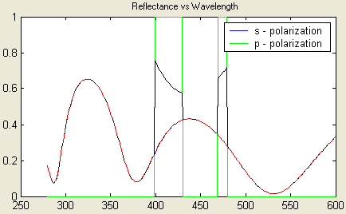
The problem that has to be solved

Slide 14
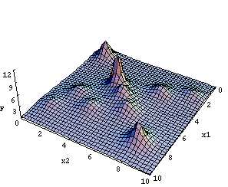
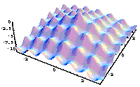
Local and global minimum/maximum

Slide 15
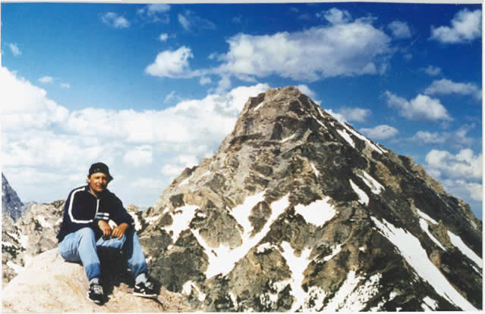
Trapped in a local maximum

Slide 16
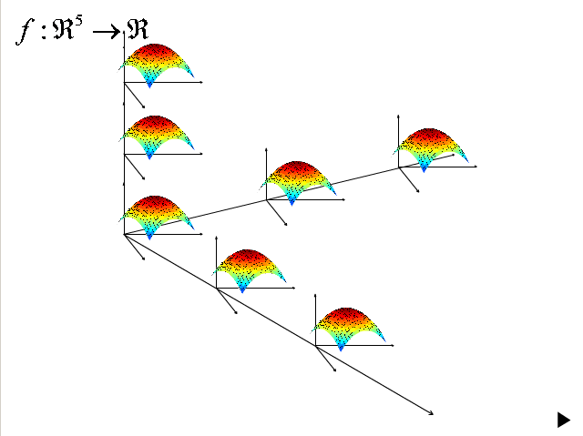
Complexity of multiple dimensions

Slide 17
Optimization techniques for multivariable functions
Gradient
Simplex
Needle
Damped lest-squares
Fuzzy logic
Genetic algorithms
Simulated annealing

Slide 18
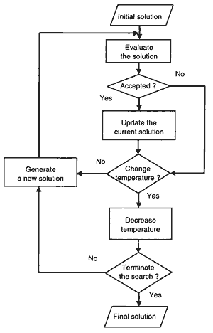

Simulated annealing (1/2)
Problem independent algorithm
Inspired from the equivalent physics problem
Monte Carlo technique
Algorithm
Better solutions get immediately accepted
Worse solutions get accepted according to the metropolis criterion:

Slide 19
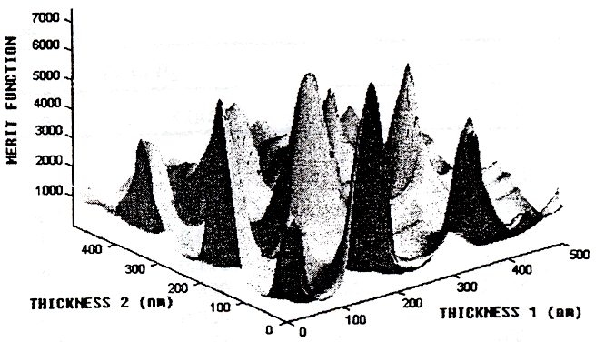
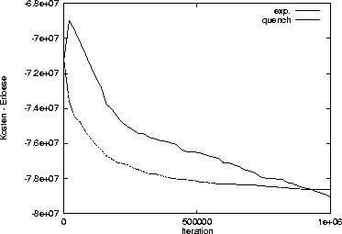
Simulated annealing (2/2)

Slide 20
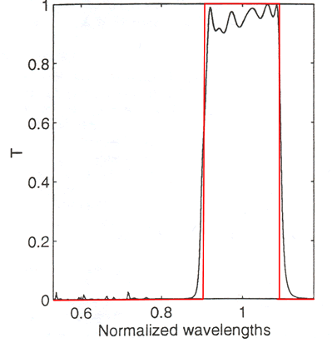
Results
50 layer bandpass filter (SiO₂ και TiO₂₎

Slide 21
Other applications of these algorithms
Alignment of set-ups
Financial sciences
Pattern matching - recognition
Image recognition
Fit of complex models – parameters estimation
Optimum route for VLSI design and CAD

Slide 22
Deposition Methods

Slide 23
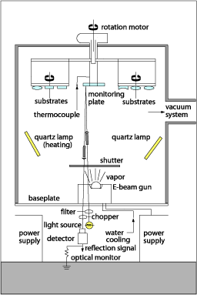
Sputtering deposition schematic

Slide 24
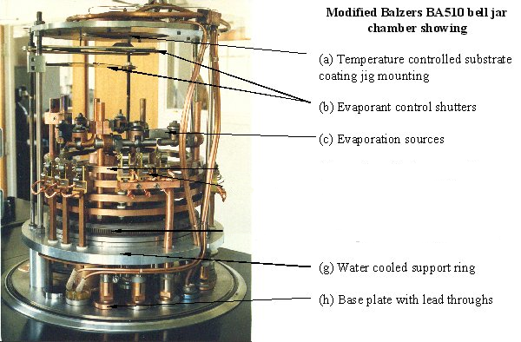
Sputtering deposition system

Slide 25
Sputtering techniques
Thermal Evaporation (Soft Films)
  Old fashioned technology
Electron Bombardment
  Widely accepted technology
Ion-Assisted Bombardment
  Cold evaporation
  Can be applied to lenses

Slide 26
Control techniques
What has to be monitored
Control methods and evaluation
Experimental setup
Experiment’s results

Slide 27
What has to be monitored
Real - time control
  Optimization of coating process
  Feedback – control
  Early error detection and possible repair
Post product control
  Evaluation of the product
  Life-cycle estimate
  Physical characteristics

Slide 28
Control methods and evaluation (1/2)
Indirect control
  “Blint” method
  Sensors have to be calibrated often
Pressure control
  Dangerous
  Less reliable
Quartz crystal
  Limited precision
  Crystals need to be replaced after some depositions

Slide 29
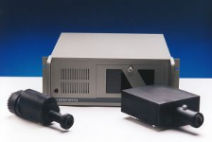
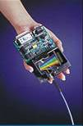
Control methods and evaluation (2/2)
Single band monitoring
  Average precision
  Good results
Wide band monitoring
  Best precision
  High quality filters
  Direct monitoring of spectrum characteristics

Slide 30
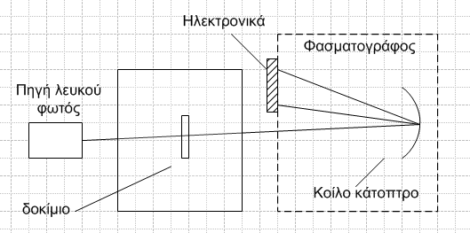
Experimental setup

Slide 31
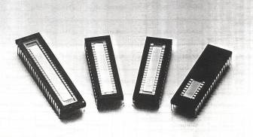
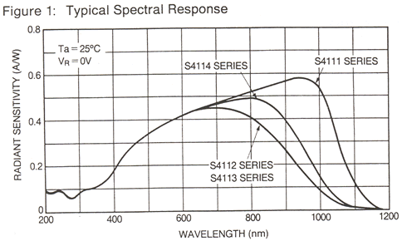
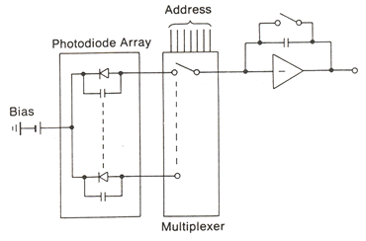
Photodiode array

Slide 32
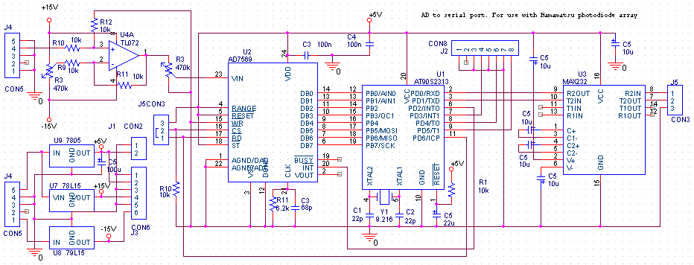
Ηλεκτρονικά της διάταξης

Slide 33
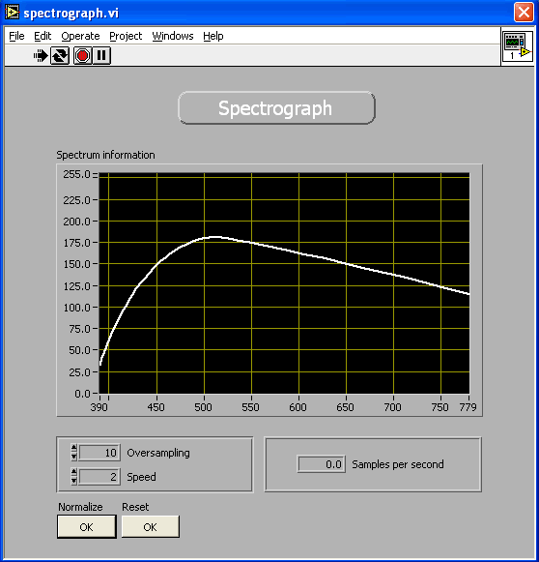
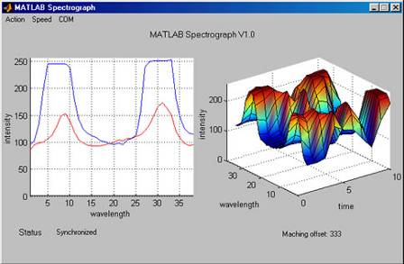
Data acquisition software
Matlab version
LabVIEW version

Slide 34
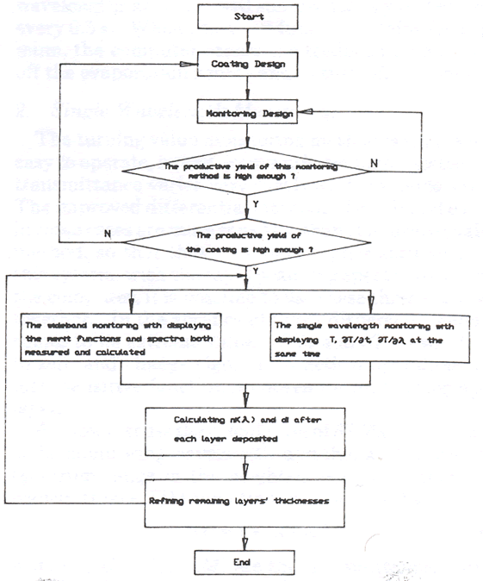
Monitoring algorithm

Slide 35
High quality optical filters
Telecommunications
Highest Energy Cosmic Ray Experiments
  AUGER
  EUSO
Trigger of fast scintillators

Slide 36
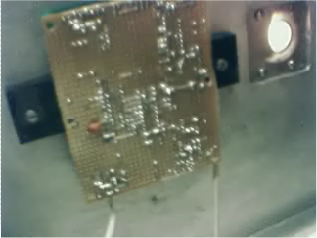
Experimental setup

Slide 37
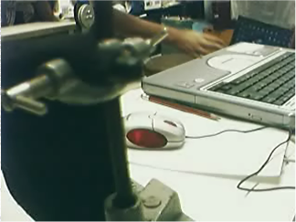
Spectrum of a single laser beam (used for calibration)

Slide 38
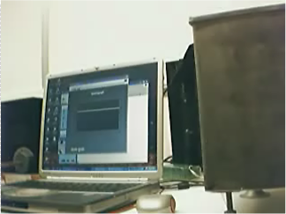
Demo spectrums

Slide 39
Conclusions
Design and deposition of high quality optical filters for special applications is feasible
It can be further improved by simulating and monitoring the forces of the substrate

Slide 40
Future work
Integration of the setup into a single compact design
Use the setup to certify – evaluate commercial deposition machines
Development of state of the art commercial applications

Slide 41
Thank you

Slide 42
Appendix

Slide 43
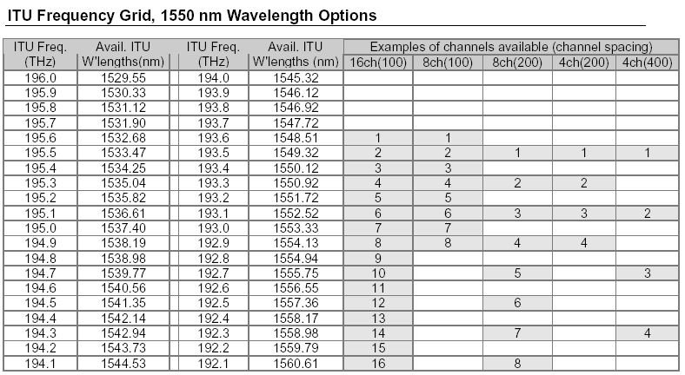
ITU Frequency Grid
ITU: International Telecommunication Union

Slide 44
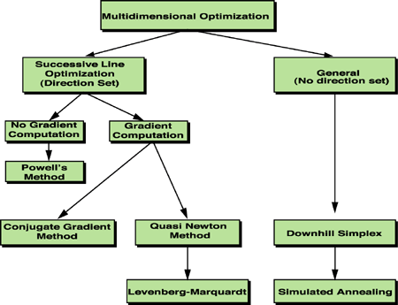
Multidimensional optimization

Slide 45
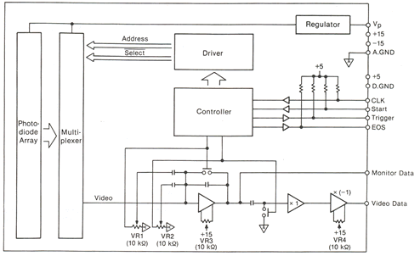
Block diagram

