Slide 1
Post-earthquake Serviceability Assessment of Water Distribution Networks based on Pressure Dependent Demand Model
Zhao HAN College of Architecture and Civil Engineering
Beijing University of Technology
May 26, 2018

Slide 2
CONTENTS
01 Post-earthquake serviceability assessment method
02 Resilience of Water Supply Network

Slide 3
01 Post-earthquake serviceability assessment method
The Procedure of Assessment Method
Earthquake Damaged Pipe Model
Pressure Driven Demand (PDD) Model

Slide 4
Procedure of the Assessment Method
step1. Calculate the seismic failure probabilities of pipelines (p_{f}); the RR stands for Repair Rate.
Step2. Generate a uniform distributed random number r∈[0,1]
Step3. Generate the damage locations in the pipeline.
A
Break node 1
Break node 2
Break node 3
B
L₁
L₂
L₃
L₄
L

Slide 5
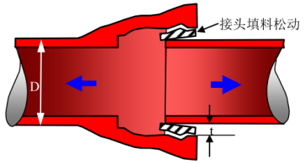
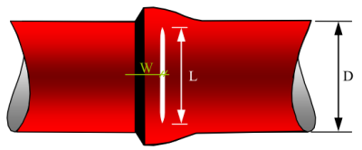
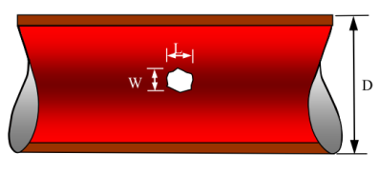
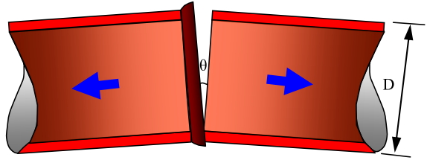
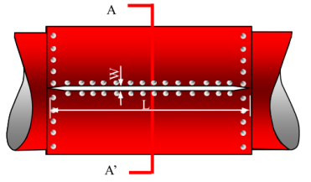
Procedure of the Assessment Method
step4. Identify the leak type
Step5. Generate the hydraulic model for breaks and leaks
Step6. Hydraulic analysis with epanet2.dll consider the PDD Model

Slide 6
Procedure of the Assessment Method
Step7. Calculate the serviceability index
the node serviceability index (SI)
the system serviceability index (SSI)

Slide 7
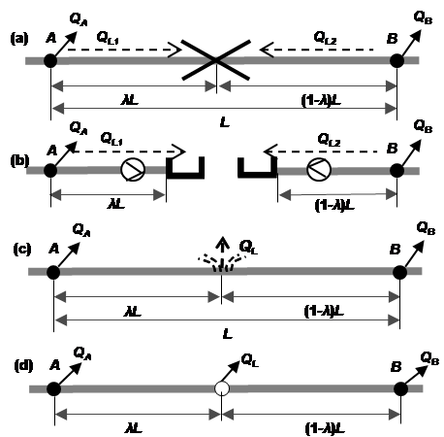
Earthquake Damaged Pipe Hydraulic Model
Virtual Reservoir
Pipe break
The complete separation of a pipeline
No flow will pass
Pipe leak
a small leak in a pipeline
water will continue to flow through the pipeline
flow being lost through the leak
Emitter

Slide 8
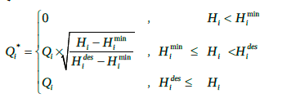
Pressure Driven Demand Model
Negative pressure node
NO change in the topology of the WDN
The water supply (Q_{i}*) in a node i
P12
P13
(a)
P9
(b)
P10
P11
P7
P8
P4
P5
P6
P1
P2
P3
Pressure deficient node

Slide 9
Case Study and Results
The Overview of the WDN
49 junctions
78 pipes
4 reservoirs

Slide 10
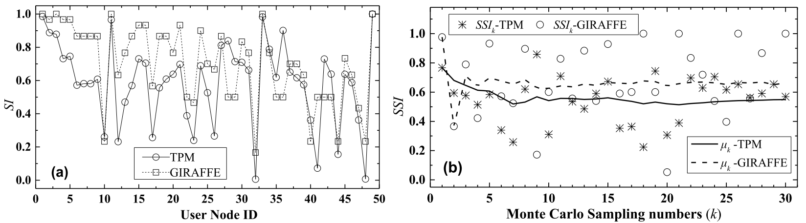
Case Study and Results
CONCLUSIONS:
The amount of water distributed changes in the same trend as the GIRAFFE
The convergence performance of the method is better than GIRAFFE

Slide 11
02 Resilience of Water Supply Network
Definition
the ability to resist the earthquake hazards, absorb the initial damage, and recover to the normal operation
Functionality(t)
Recovery path
100%
Failure path
Resilience Index
90%
time
t₀
t₁
t₂
t₃
t₄
t₅
Initial failure

Slide 12
02 Resilience of Water Supply Network
Some problems:
The definition of the resilience
How to definite the functionality of the water supply network ?
How to describe the recovery procedure of the water supply network after an earthquake?
The time needed to locate a pipe break.
The time needed to repair a pipe break.
cascading damage to interrelated systems

Slide 13
THE END
THANK YOU VERY MUCH

