Slide 1
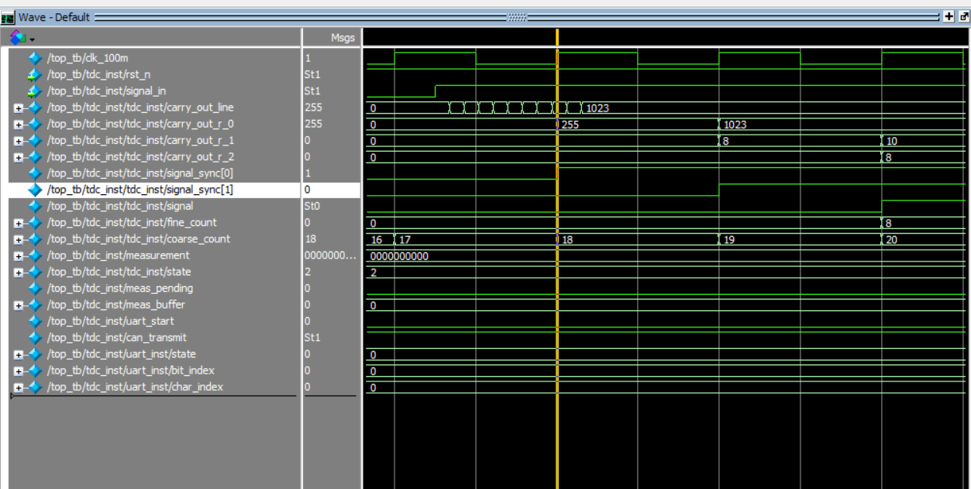
On the rising edge
course_count captured will be 17 (*10ns because we run at 100Mhz)
And we’ve already
propagated 8 stages
of carry chain each
with 900ps delay since
the pulse arrived
So the total delay should be 17*10ns + (10-8) *0.9ns = 171.8 ns

