Slide 1
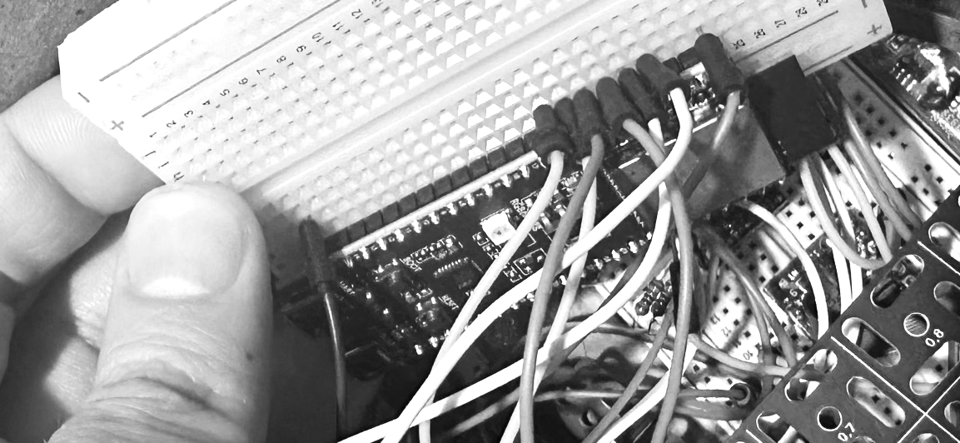
A
+
B
C
GND
ESP32-S3-DevKitC-1

