Slide 1
Survey of Datasets: Foundations for Bachelor Thesis Benchmarking State Space Models (SSMs) for Raw Audio Classification on diverse Datasets
Alexander Lukin, Matthias Bittner

Slide 2
Main topics of the thesis
Audio Signal Processing with Machine Learning
Audio Data in the Context of Machine Learning
Survey of Available Datasets for Audio Classification
Exploring Model Architectures for Audio Classification
State Space Model (SSM) evaluation

Slide 3
Survey of Available Audio Datasets

Slide 4

Overview
Total Datasets → 54
Key Attributes:
Citation Impact
Research Usage
Content Type
Original Use Case & Source Information
Dataset Size & Language
Accessibility & Downloadability
Benchmark Performance & Best Models

Slide 5
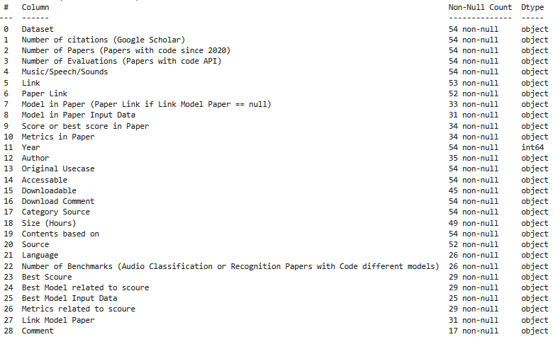
Explore Data

Slide 6
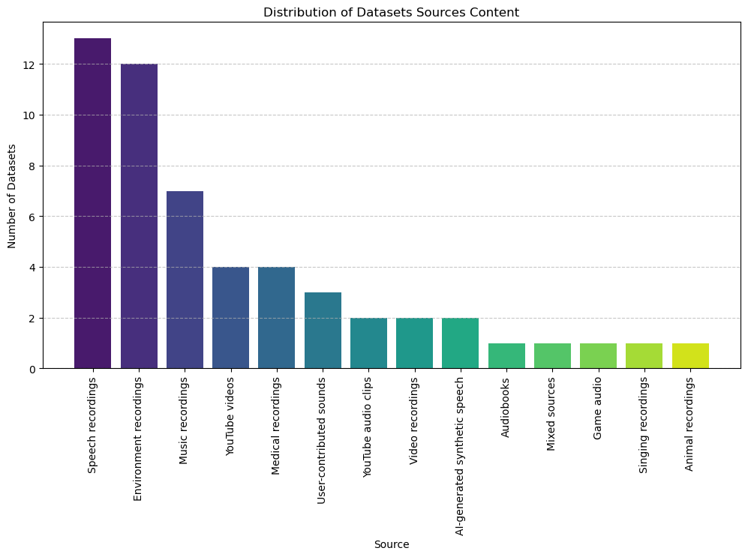

Slide 7
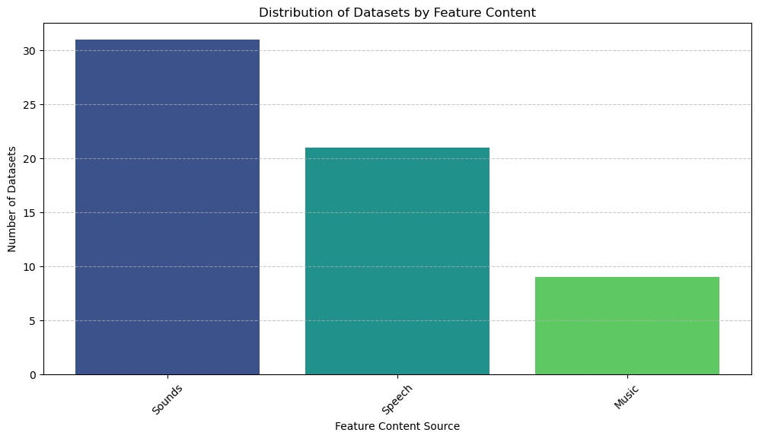

Slide 8
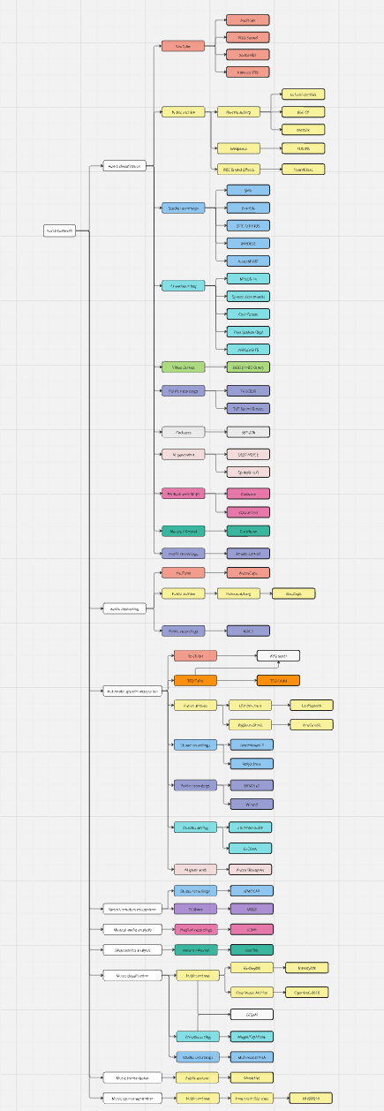
https://miro.com/app/board/uXjVITf0vUA=/

Slide 9
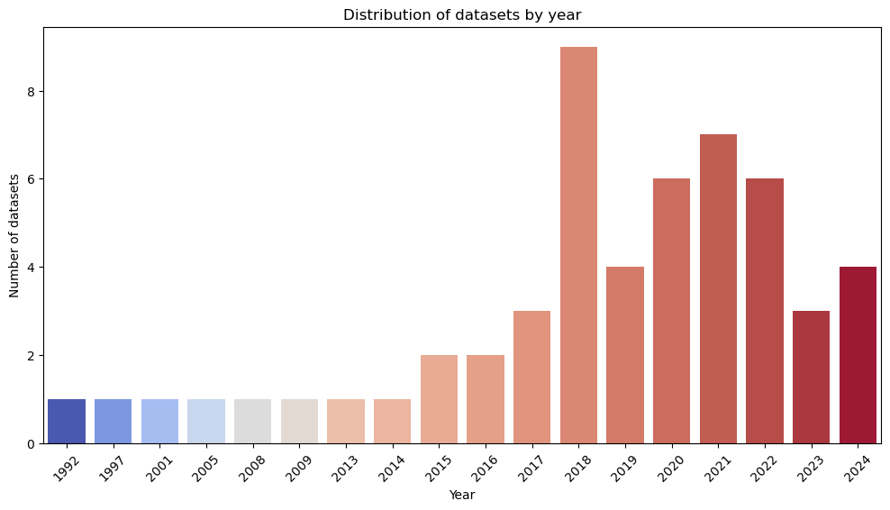

Slide 10
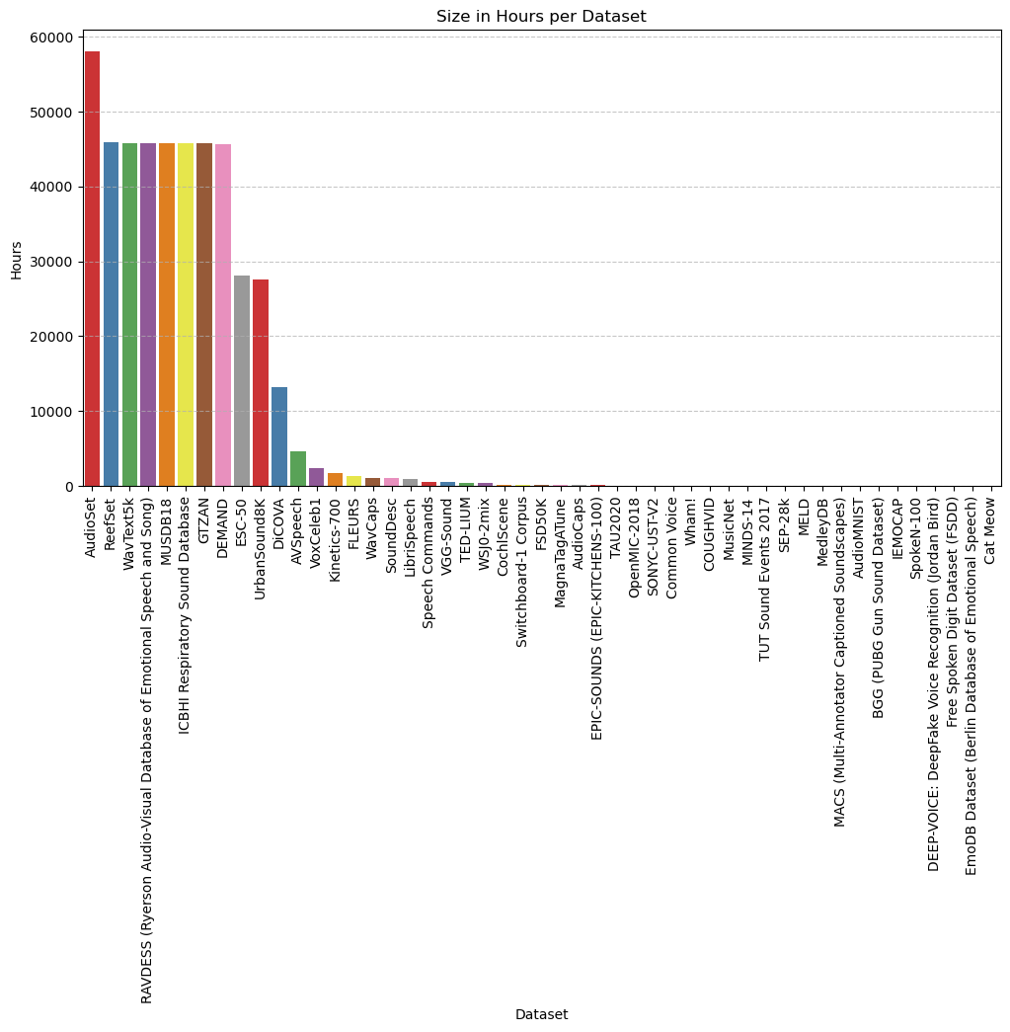
Dataset List without n/a Size
MusicNet
MINDS-14
TUT Sound Events
SEP-28k
MELD
MedleyDB
MACS
AudioMNIST
BGG
IEMOCAP
SpokeN-100
DEEP-VOICE
Free Spoken Digit
EmoDB
AudioSet
Reefset
WavText5k
RAVDESS
MUSDB18
ICBHI
GTZAN
DEMAND
ESC-50
UrbanSound8K
DiCOVA
AVSpeech
VoxCeleb1
Kinetics-700
FLEURS
WavCaps
SoundDesc
LibriSpeech
Speech Commands
VGG-Sound
TED-LIUM
WSj0-2mix
CochlScene
Switchboard-1
FSD50K
MagnaTagATune
AudioCaps
EPIC-SOUNDS
TAU2020
OpenMIC-2018
SONYC-USTV2
Common Voice
Wham!
COUGHVID

Slide 11
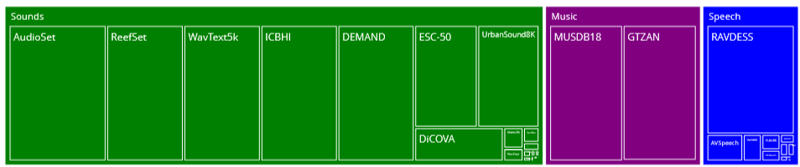
Hours in Dataset
45797
58000
45784

Slide 12
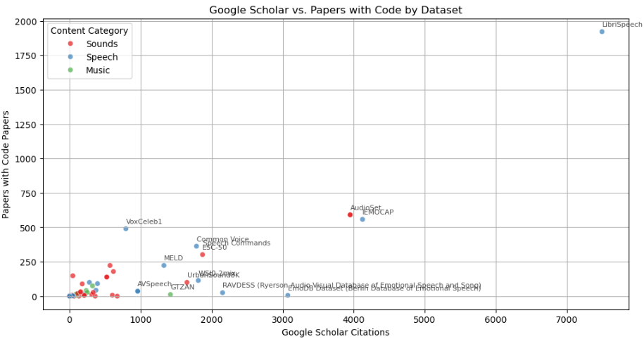
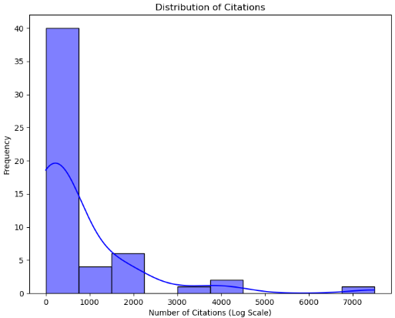

Slide 13
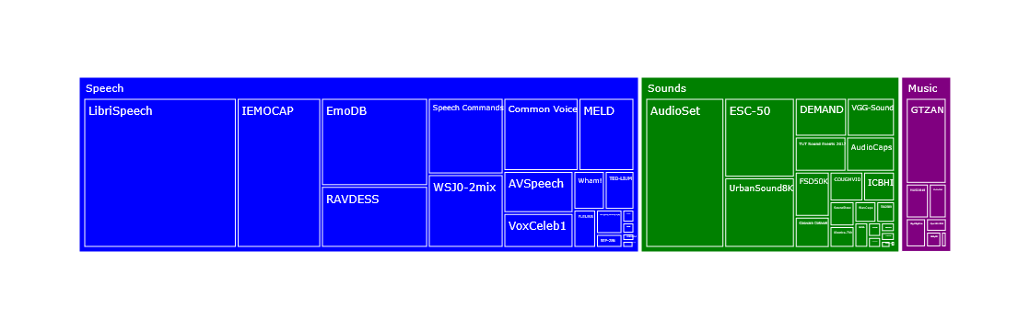
Number of Citations
1420
3950
7494

Slide 14
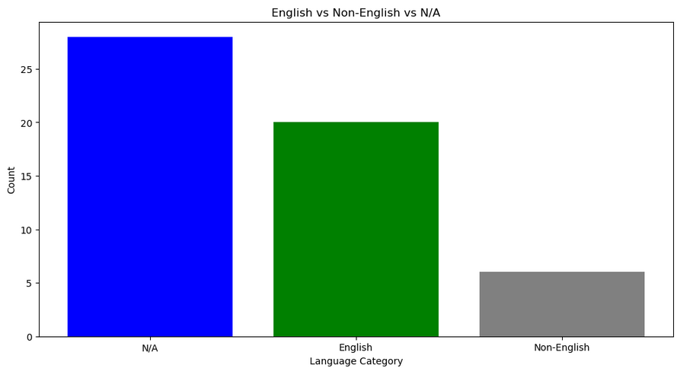

Slide 15
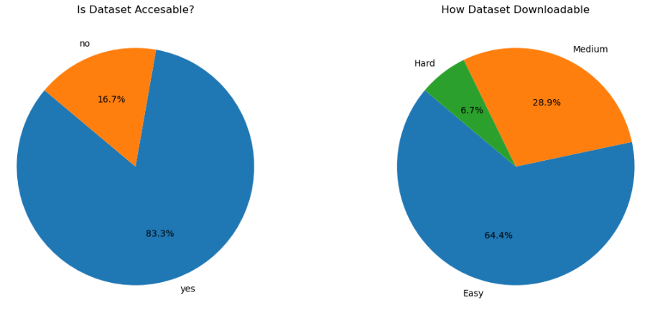

Slide 16
Explore Audio Classification Datasets

Slide 17
Some numbers
Top 5 Most Cited Datasets
AudioSet → 3950
EmoDB → 3072
RAVDESS → 2154
Speech Commands → 1882
ESC50 → 1872
Top 5 Papers in Papers with Code
AudioSet → 591
VoxCeleb1 → 490
Speech Commands → 336
ESC50 → 302
VGG-Sound → 179
Total content hours (All Datasets)→ 181242

Slide 18
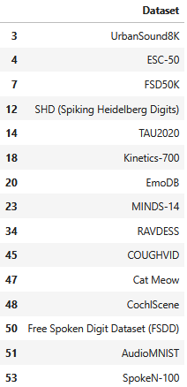
Selection criteria
Original Use Case → Audio classification
Accessable
Easy downloadable
Has a benchmark and paper
15 Datasets

Slide 19
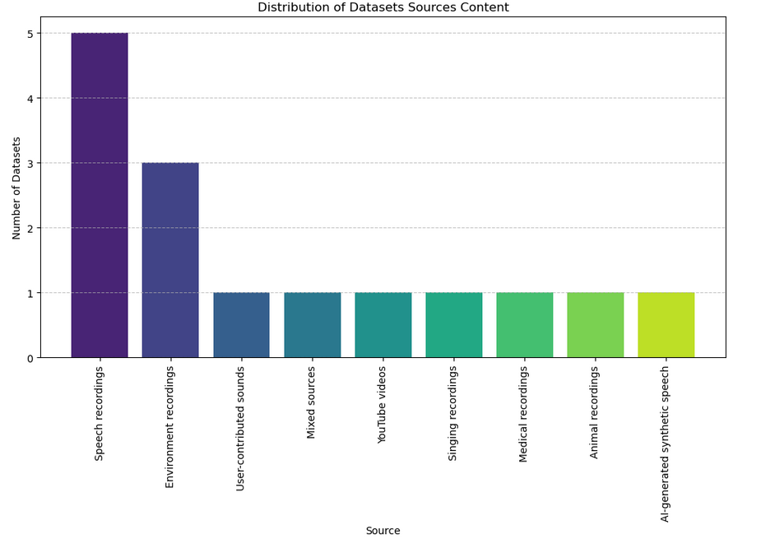
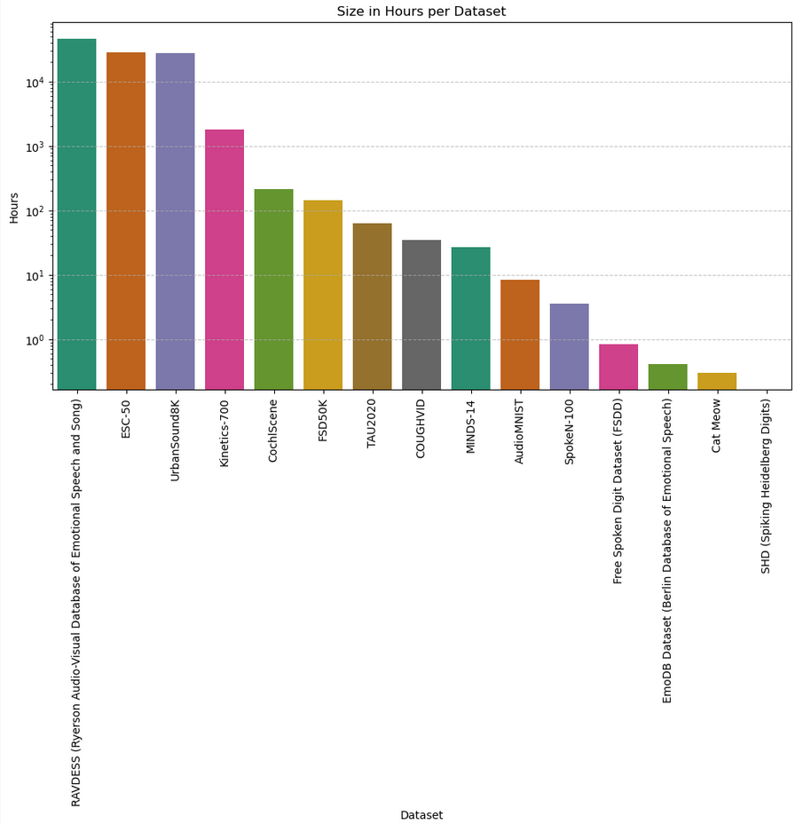
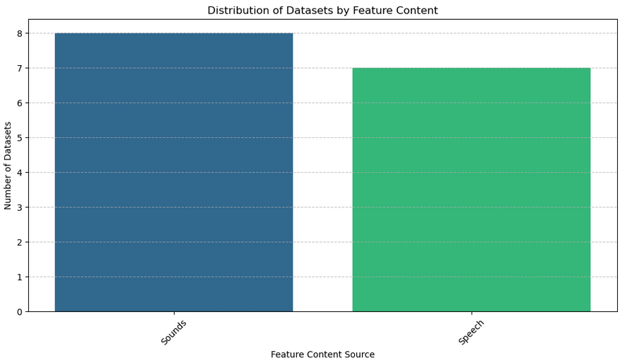
Some plots

Slide 20
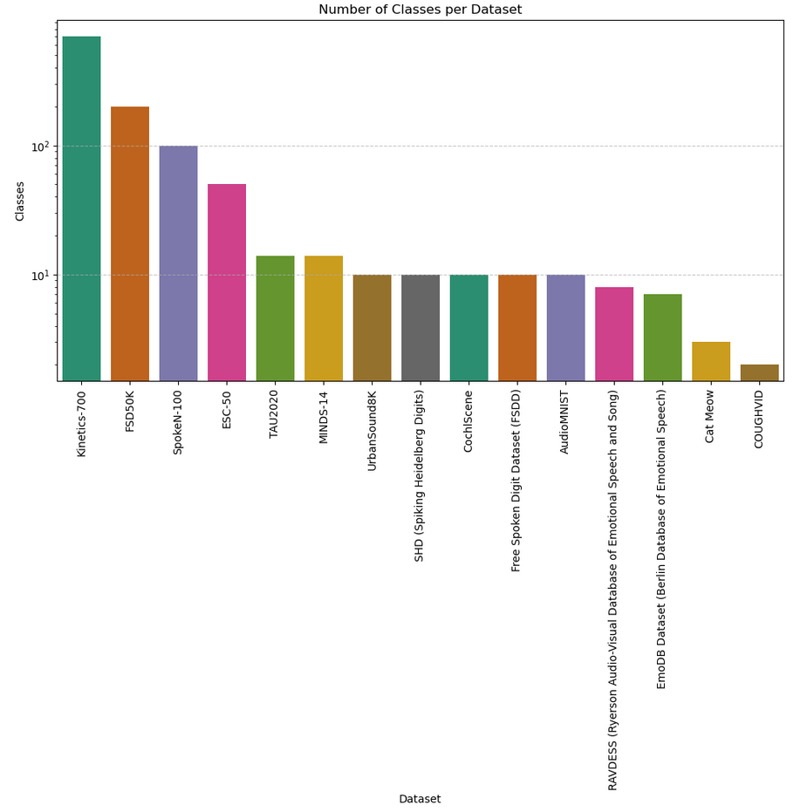
Number of Classes

Slide 21
Thank you for your attention!

