Slide 1
Survey of Datasets: Foundations for Bachelor Thesis
Alexander Lukin, Matthias Bittner

Slide 2
Analysis of the Influence of Dataset Characteristics and Architectural Configurations on State Space Models (SSMs) for Raw Audio Classification

Slide 3
Main topics of the thesis
Audio Signal Processing for Machine Learning
Audio Data in the Context of Machine Learning
Survey of Available Datasets for Audio Classification
Exploring Model Architectures for Audio Classification
State Space Model (SSM) evaluation

Slide 4
Survey of Available Audio Datasets

Slide 5

Overview
Total Datasets → 54
Key Attributes:
Citation Impact
Research Usage
Content Type
Original Use Case & Source Information
Dataset Size & Language
Accessibility & Downloadability
Benchmark Performance & Best Models

Slide 6
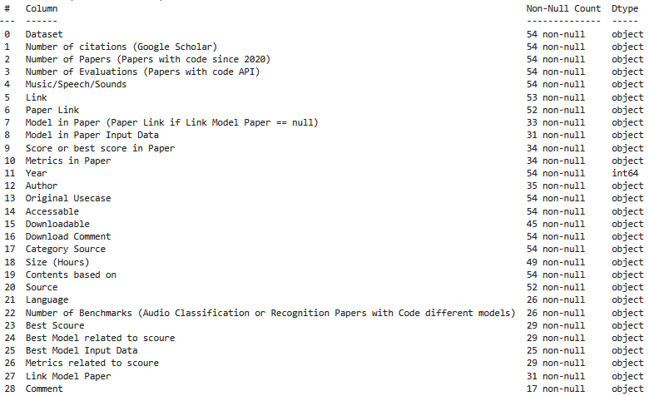
Explore Data

Slide 7
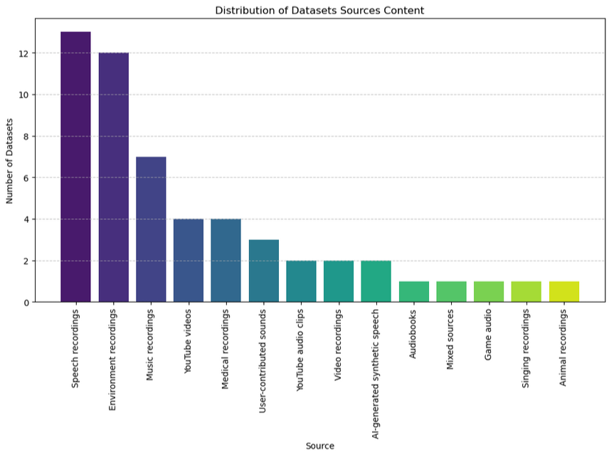

Slide 8
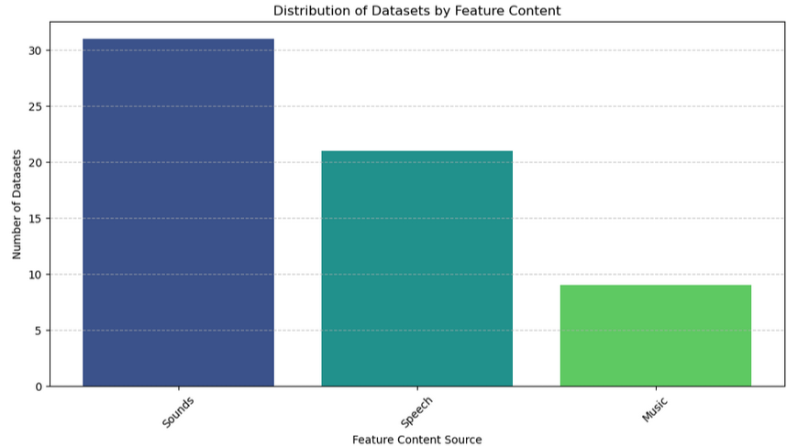

Slide 9
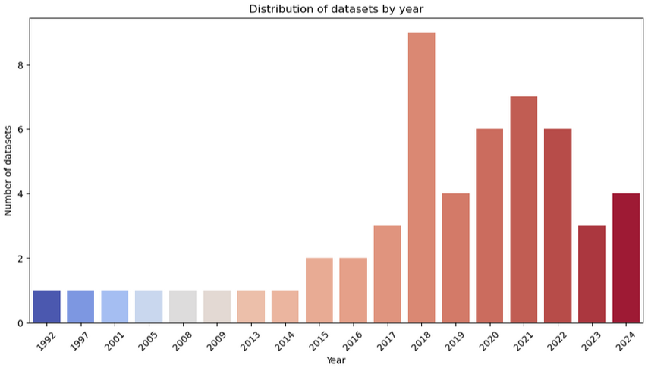

Slide 10
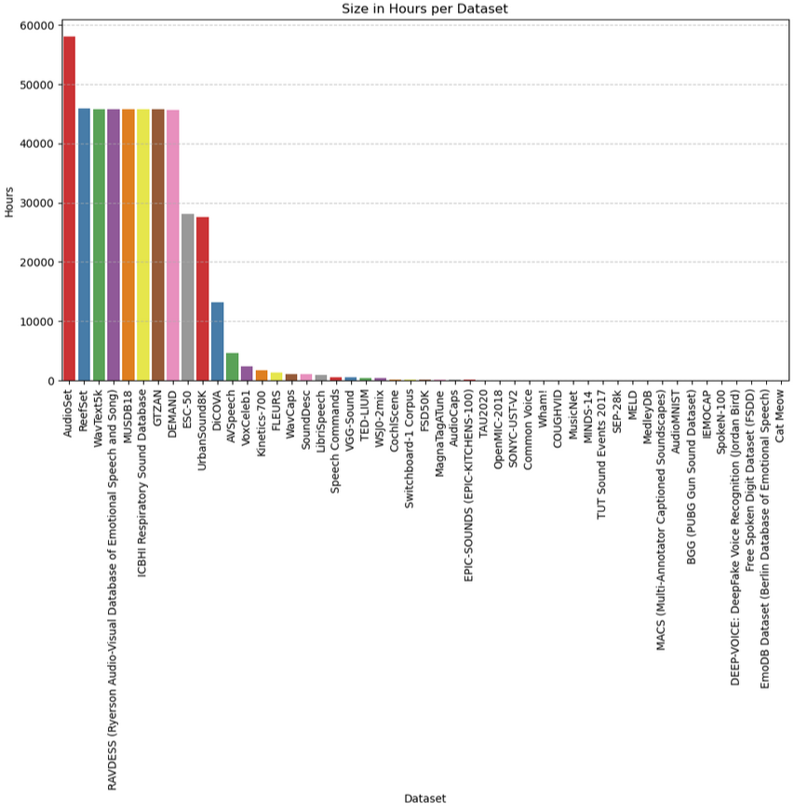
Dataset List
MusicNet
MINDS-14
TUT Sound Events
SEP-28k
MELD
MedleyDB
MACS
AudioMNIST
BGG
IEMOCAP
SpokeN-100
DEEP-VOICE
Free Spoken Digit
EmoDB
AudioSet
Reefset
WavText5k
RAVDESS
MUSDB18
ICBHI
GTZAN
DEMAND
ESC-50
UrbanSound8K
DiCOVA
AVSpeech
VoxCeleb1
Kinetics-700
FLEURS
WavCaps
SoundDesc
LibriSpeech
Speech Commands
VGG-Sound
TED-LIUM
WSj0-2mix
CochlScene
Switchboard-1
FSD50K
MagnaTagATune
AudioCaps
EPIC-SOUNDS
TAU2020
OpenMIC-2018
SONYC-USTV2
Common Voice
Wham!
COUGHVID

Slide 11
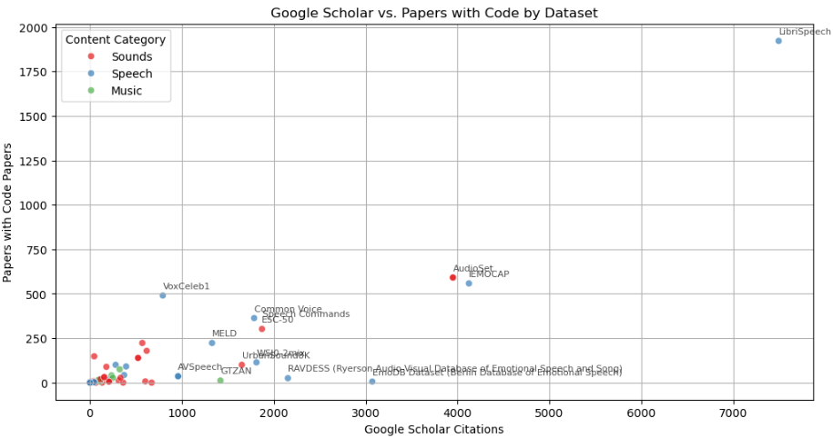
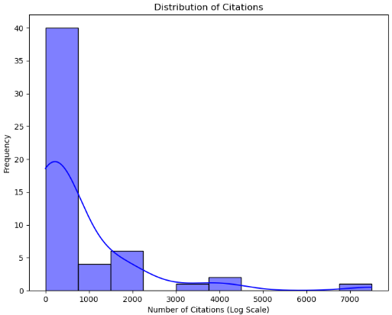

Slide 12
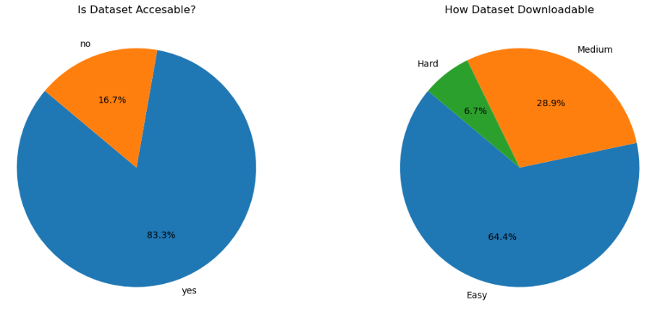

Slide 13
Explore Audio Classification Datasets

Slide 14
Thank you for your attention!

