Slide 1




Android Programming
DrawTalk

Slide 2
Live coding: DrawTalk
Creating a Speech Therapists app that helps people create sentences and stimulate word retrieval.
Now a Speech Therapist uses paper and a pencil to practise (see: example)
Notes:
Other examples of Speech Therapists app: http://www.speechdrive.net/ipad-apps-for-adult-therapy.html

Slide 3
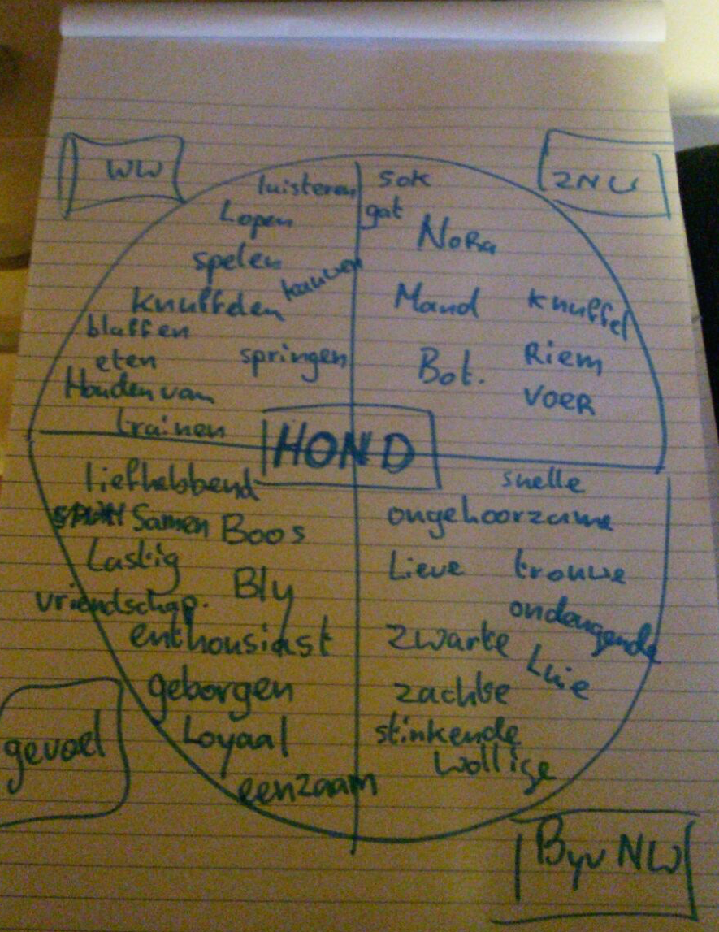
Example of end result:
1 main subject
4 parts of a pie
4 category names
10 words per part

Slide 4
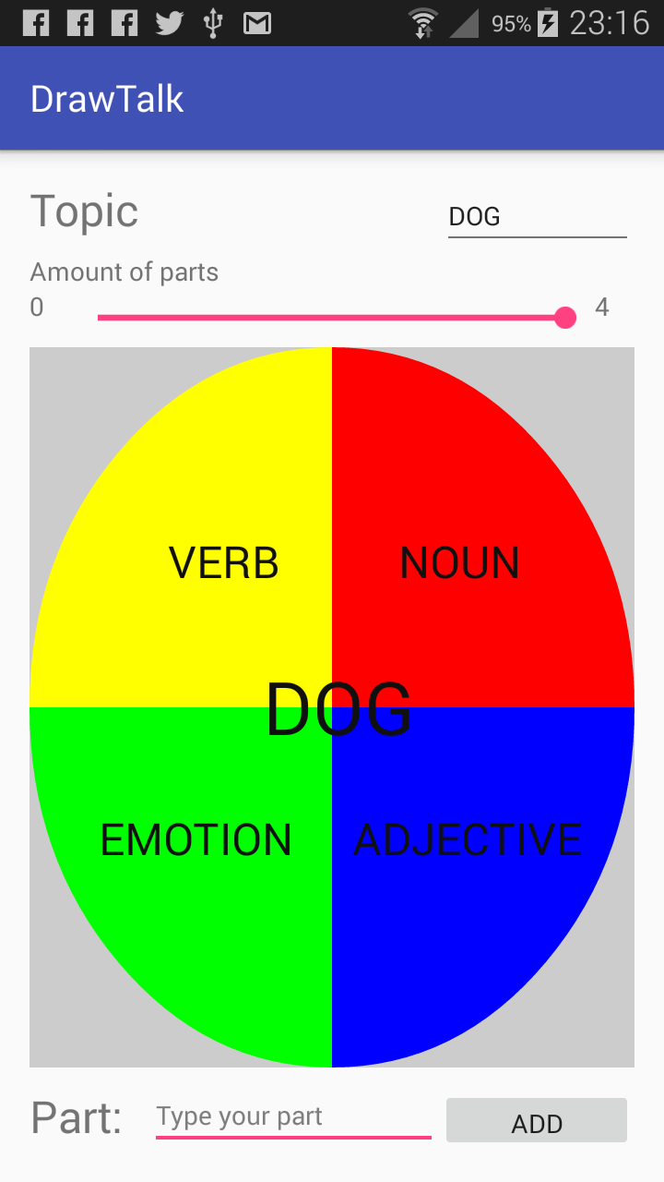
Example 1st step: Setup UI
Enter topic
Enter amount of parts
Enter parts
Draw the parts and labels

Slide 5
+ Challenges:
Use other design for parts,,
Like: square, puzzle piece, ….
Automatic positioning,
Note: Math required
Enter 10 words on parts

Slide 6
* Challenges:
Make words ‘draggable’
Zooming parts
Describe a Business Case
Try: Business Model Canvas

