Slide 1
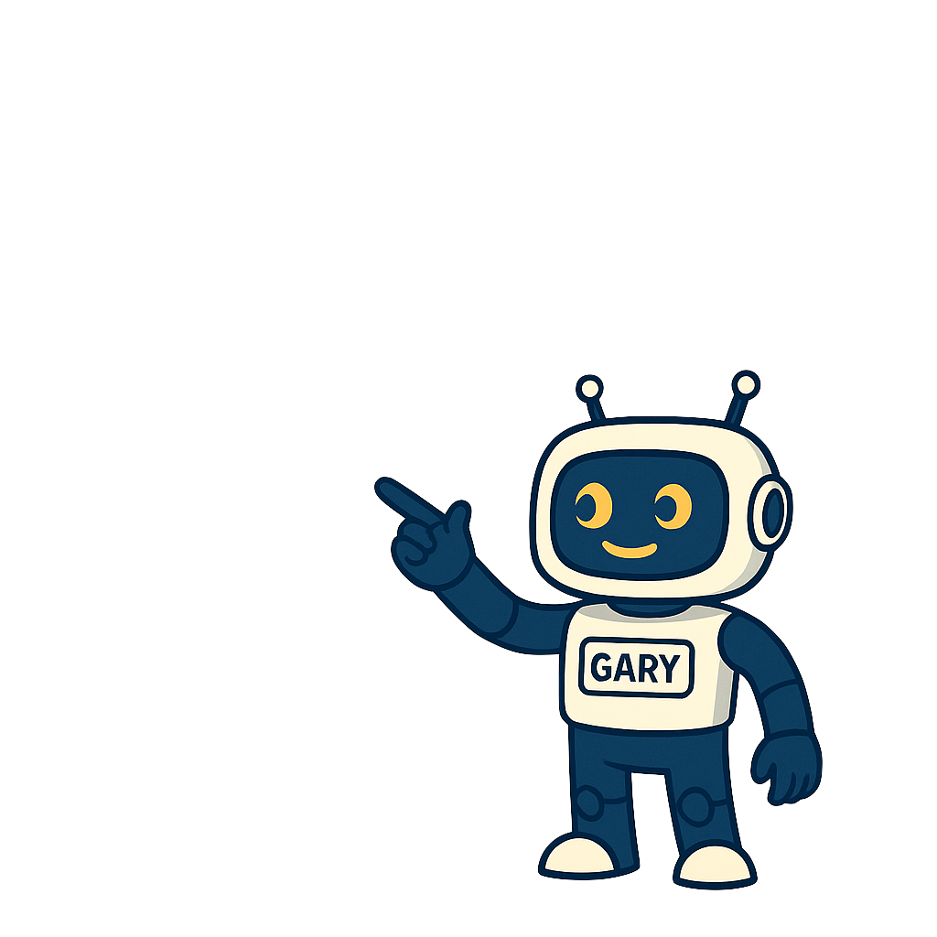
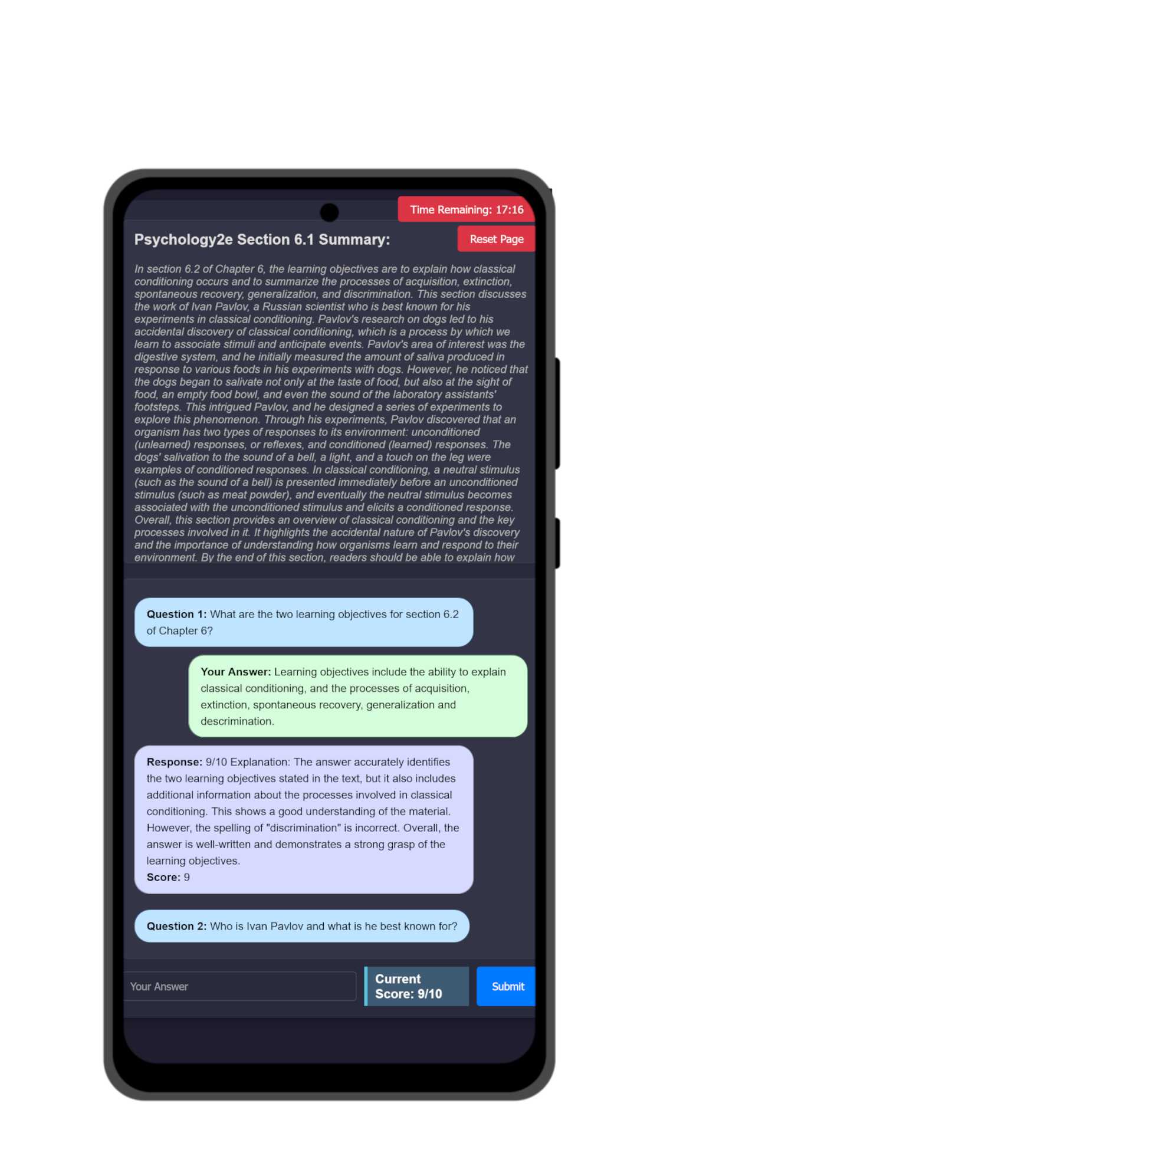
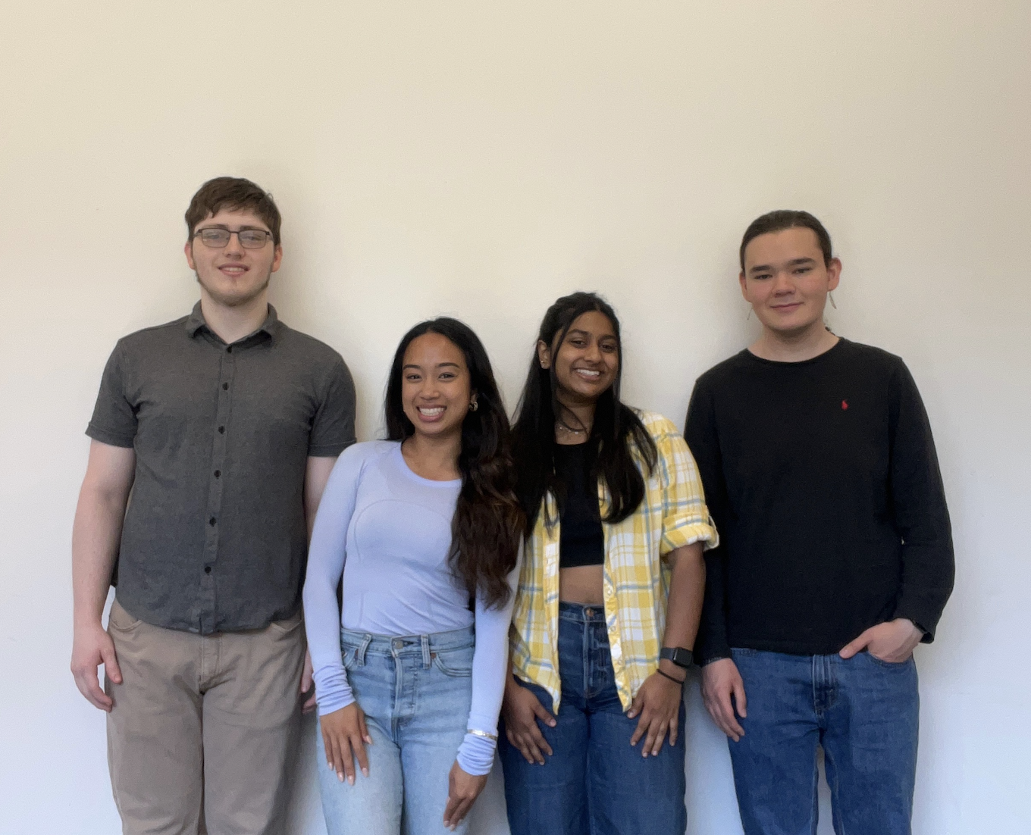
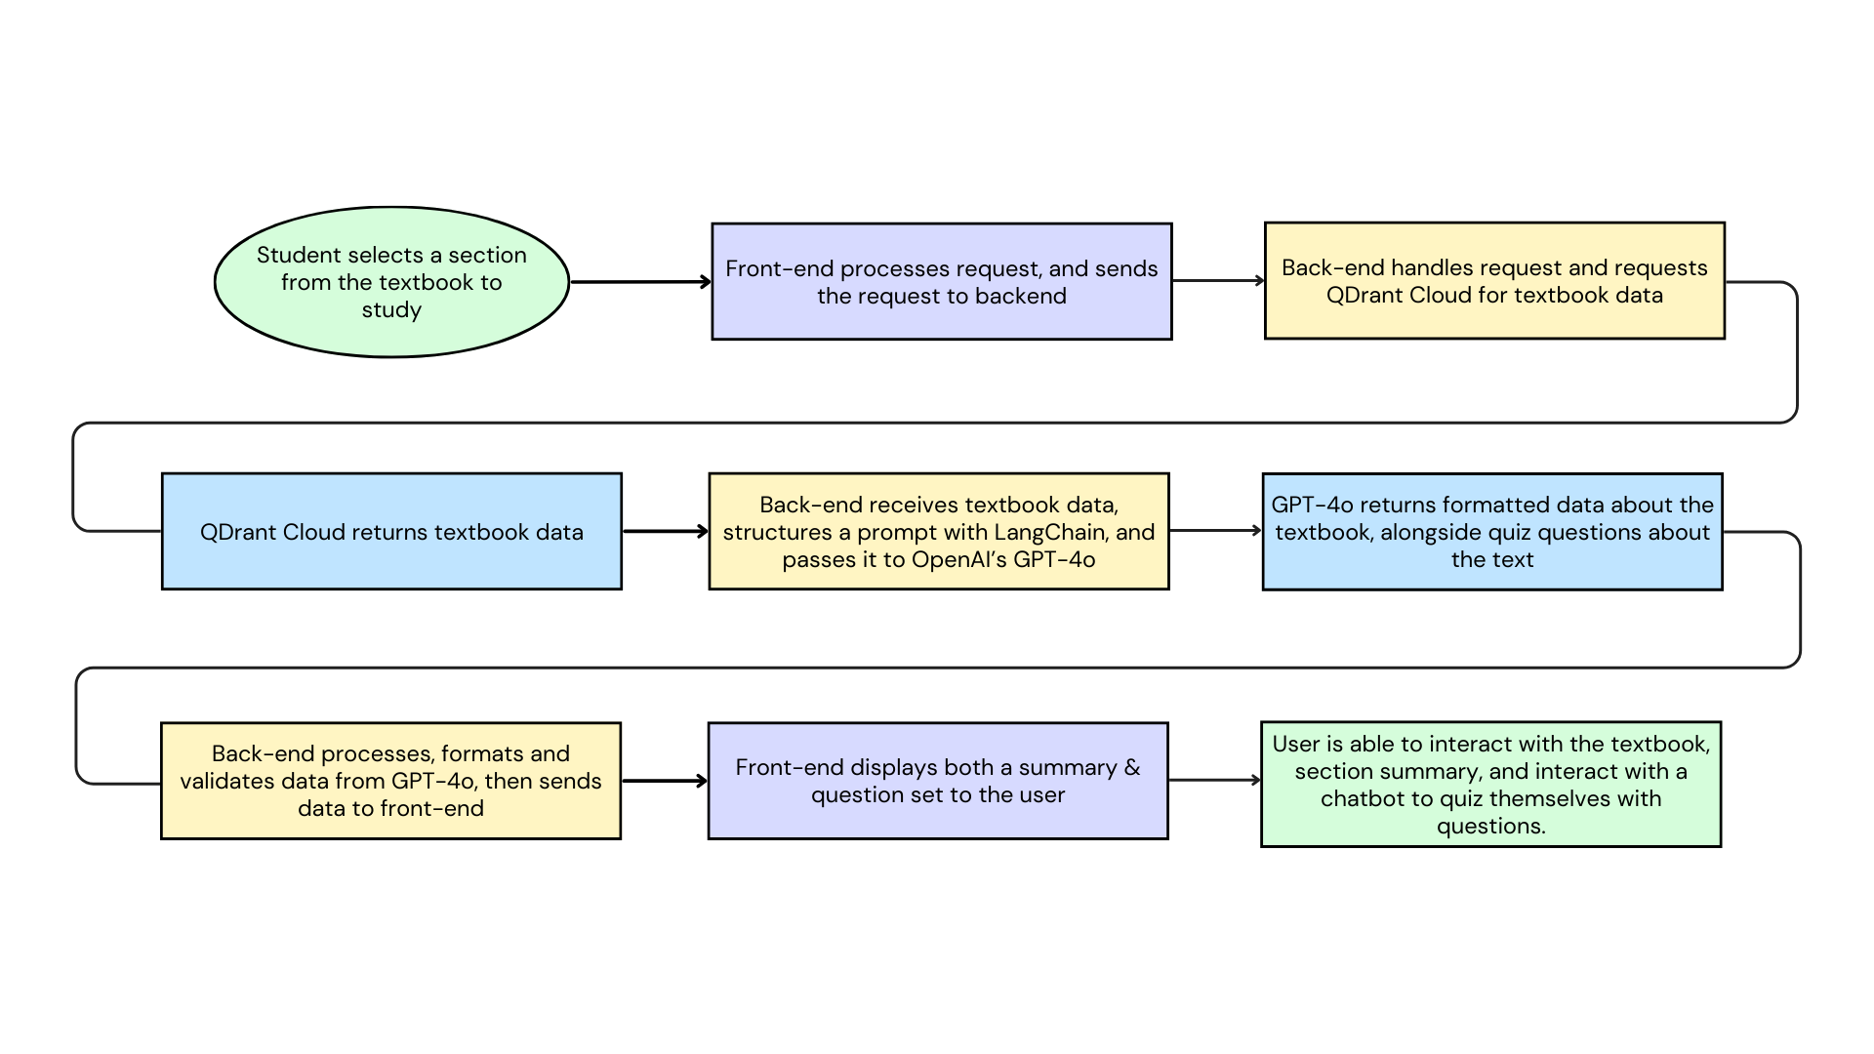

CS.035
Breaking Barriers: Rethinking
Traditional Learning Methods
G. A. R. Y.
Generative AI Reviewer for You
Acknowledgments
Traditional assignments in large courses often lack adaptability, failing to meet the diverse learning needs of students. This leads to low engagement, reduced motivation, and a disconnect between students and the material.
Without opportunities for reflection or feedback, students often complete tasks without fully understanding the concepts, which limits long-term retention and real-world application.
The Solution
Our project explores how AI can enhance learning by adapting to student input and providing dynamic personalized support throughout the assignment process. By comparing this method to traditional assignments, we evaluate whether generative AI can improve student understanding and engagement and support scalable personalized learning in large classes.
Special thanks to our Project Partner, Joe Slade, the visionary behind this project, for his guidance and inspiration. We also thank the OSU EECS Department for their support throughout the development process.
Authors
Steve Akiyama – akiyamas@oregonstate.edu
Maile Look – lookm@oregonstate.edu
Varsha Narayan – narayava@oregonstate.edu
Grant O’Connor – oconnorg@oregonstate.edu
GARY in Action
The image below shows GARY using AI to review a student’s response. It scores the answer, provides personalized feedback, and generates a follow-up question to encourage deeper thinking and reflection.
Tools & Tech Stack
Frontend: React, HTML/CSS
Backend: Python, FastAPI, LangChain
Database: Qdrant for vector storage
Model: OpenAI GPT-4
Infrastructure: Docker, AWS EC2
Version Control & Collaboration: GitHub, JIRA
Additional Features: RAG (Retrieval-Augmented Generation) for pulling real academic sources into prompts
GARY’s Review Process
Scan to use

