Slide 1
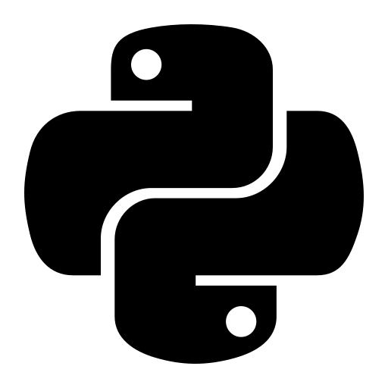
INTRODUCTION TO
Python Programming
A gentle, beginner-friendly first look at Python — what it is, where it
came from, and why the whole world is using it.
Lesson 1 · Getting Started
1

Slide 2
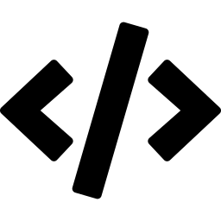
What Is Python?
THE THEORY, IN PLAIN WORDS
QUICK FACT
Beginner-Friendly by Design
Python's simple, English-like syntax is why it's the #1 recommended first language for new programmers worldwide.
Python is a programming language.
It is a set of instructions we write so a computer can understand us and perform tasks.
Python is a general-purpose language — it is not built for just one job. It can build websites, analyze data, automate tasks, and much more.
It is a high-level language, meaning it reads almost like plain English rather than complex machine code.
It is an interpreted language — the computer runs the code line by line, which makes testing and fixing code quick and easy.
Hello, World! in Python:
print("Hello, World!")
2

Slide 3

A Little History
WHO CREATED PYTHON — AND WHEN
1
1989
Guido van Rossum starts working on Python as a personal project, wanting a language that was easier to read and write.
2
1991
Python 0.9.0, the first public version, is officially released to the world.
Guido van Rossum
Creator of Python
3
2000s
Python 2 arrives and steadily grows a large, friendly, global community of developers.
A Dutch programmer who began writing Python as a hobby project during his Christmas holidays.
4
Today
Python is one of the most popular and widely-taught programming languages on Earth.
3

Slide 4
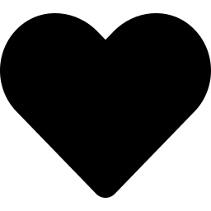

Why Is It Called "Python"?
A FUN FACT MOST BEGINNERS DON'T KNOW
WHY LEARN PYTHON?
Easy to read and write
Its syntax looks close to plain English.
Not the snake — a comedy show!
Free and open-source
Many beginners assume Python is named after the snake. In fact, Guido van Rossum named it after “Monty Python’s Flying Circus,” a British comedy series he enjoyed. He wanted the language to feel fun and a little unconventional — not stiff or overly serious.
Anyone can download and use it at no cost.
Huge community
Millions of learners and experts share help online.
Runs everywhere
Windows, Mac, Linux, and even the web.
4

Slide 5
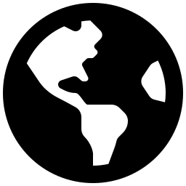
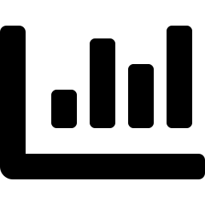
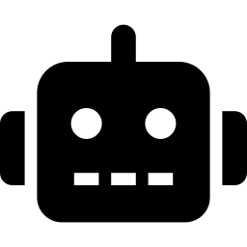
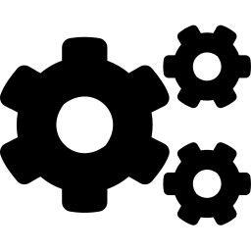
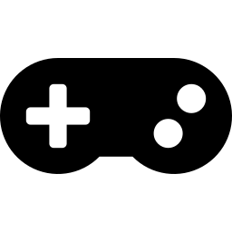
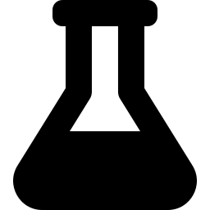
Where Is Python Used?
REAL-WORLD APPLICATIONS
Web Development
Data Science
AI & Machine Learning
Building websites and web apps (e.g. Instagram, Pinterest).
Analyzing data and creating charts to find insights.
Powering chatbots, recommendation systems, and more.
Automation
Game Development
Scientific Research
Automatically doing repetitive computer tasks.
Building simple 2D games and prototypes.
Used by scientists for research and simulations.
5

Slide 6
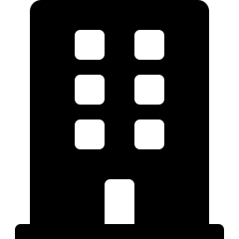
Who Uses Python?
TRUSTED BY THE WORLD'S BIGGEST ORGANIZATIONS
Google
Instagram
Netflix
Uses Python across many internal tools and services.
One of the largest websites built on Python.
Uses Python for backend systems and data analysis.
Spotify
NASA
YouTube
Uses Python to analyze data and recommend music.
Uses Python for scientific research and space missions.
Built several core features using Python.
6

Slide 7
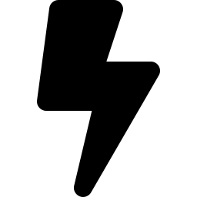
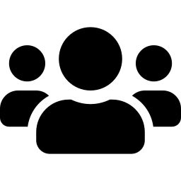
When Should You Use Python?
AND WHO IS IT FOR?
Good Situations to Use Python
Who Is Python For?
You are just starting to learn programming.
You want to quickly test or build an idea (a prototype).
You need to analyze or organize data.
You want to automate a repetitive, boring task.
You are exploring AI or machine learning.
Absolute beginners with no coding experience at all.
Students learning their very first programming language.
Working professionals who want to automate their daily tasks.
Anyone curious about data, AI, or building software.
7

Slide 8
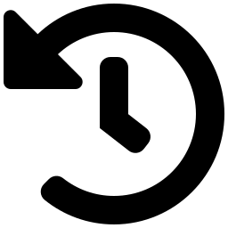

Let's Recap
WHAT WE LEARNED TODAY
What Python Is
Its History
Where It's Used
Who It's For
A simple, high-level, general-purpose programming language.
Created by Guido van Rossum, first released in 1991.
Web apps, data science, AI, automation, games, and research.
Perfect for absolute beginners and curious learners like you!
Coming up next: Variables in Python →
8

