Slide 1

Readit!

Slide 2
Group Members
D Mac
Sue
Rey
Madison
Alex

Slide 3
Idea/Concept
For people who want a way to keep track of books they want to read
The user can select a book by title
The user can save the book in the list of books to read
The user can delete the book from the list when they have read the book

Slide 4

Technologies Used
HTML 5
CSS 3
Handlebars
Sequelize
Javascript
Node
API: Google Books
Heroku

Slide 5
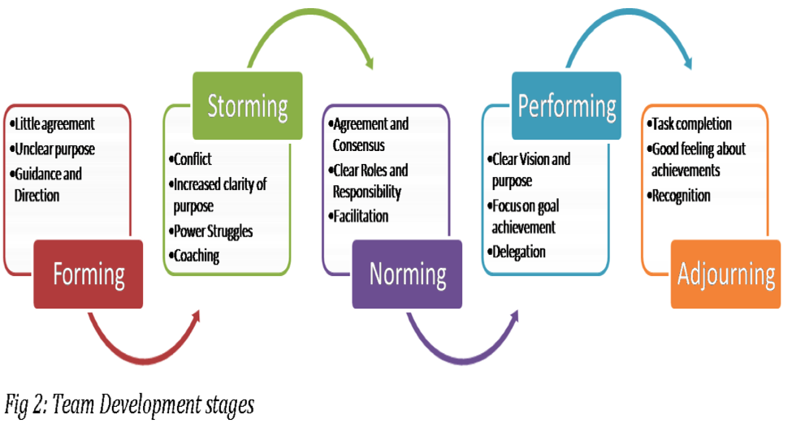
Challenges-Tuckman Stages of Team Development

Slide 6

This is our struggle…..4 out of 5 of us are currently in the middle of moving!!!

Slide 7
Demonstration

Slide 8
Future Modifications
Allow the user to add a search by Author
Add a user star rating scorecard
Add a link to Amazon Reviews to determine if the book is something you would be interested in reading
Add your own book review and link it to Good Reads
Option to order a book or read the book on the application

