Slide 1
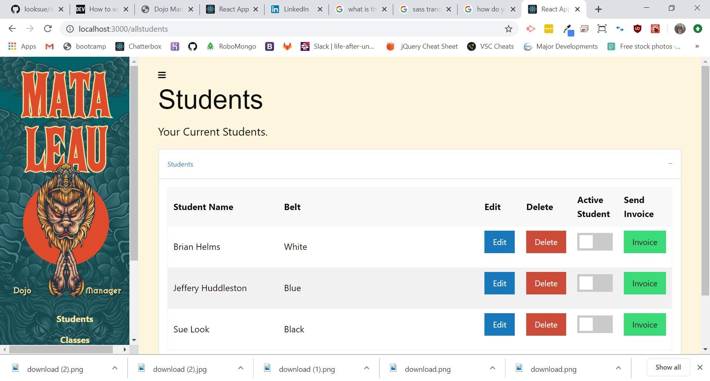
DojoBase

Slide 2

What is DojoBase?
DojoBase is classroom management system application designed to assist the teacher in the daily housekeeping items such as recording attendance, managing belt levels, a calendar of events, messaging, billing, and maintaining a student database.

Slide 3
Team Members
Tim -MySQL/Sequelize, Built React app on Express Server, React Rendoring
Jeff- MySQL/Sequelilze, Database Administrator
Dan-Frontend, UX/UI, SASS, React Component, Gatsby
Brian-Create Classes/ID’s, Assist UX/UI
Sue-Assist UX/UI, Create Classes/ID’s,Presentation

Slide 4







Technologies Used

