Slide 1
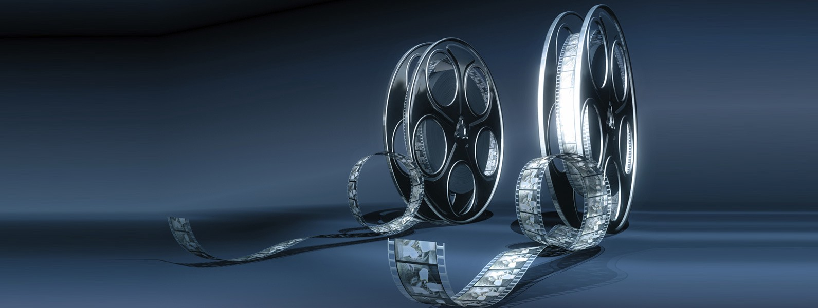
Microsoft Movie Analysis
Movies and the Generational Differences
Notes:
To change the image on this slide, select the picture and delete it. Then click the Pictures icon in the placeholder to insert your own image.

Slide 2
Summary: Designing an audience driven marketing strategy
What audience will Microsoft serve
For the first time in history, there are five generations going to the movies. They are:
Traditionalists—born 1925 to 1945
Baby Boomers—born 1946 to 1964
Generation X—born 1965 to 1980
Millennials—born 1981 to 2000
Generation Z—born 2001 to 2020
What kinds of challenges does this present for today’s movie makers?
How do generational differences affect which movies will be successful for the target audience?
And what genre has the most influence by generation?

Slide 3
Outline
● Business Problem
● Data
● Methods
● Results
● Conclusions

Slide 4
Title and Content Layout with Chart

Slide 5
Two Content Layout with Table
First bullet point here
Second bullet point here
Third bullet point here
Class | Group A | Group B
Class 1 | 82 | 95
Class 2 | 76 | 88
Class 3 | 84 | 90

Slide 6
Title and Content Layout with SmartArt
Step 1 Title
Step 2 Title
Step 3 Title
Step 4 Title

Slide 7
Add a Slide Title - 1

Slide 8
Add a Slide Title - 2

Slide 9
Add a Slide Title - 3

Slide 10
Add a Slide Title - 4

Slide 12
Add a Slide Title - 5

Slide 13
Add a Slide Title - 6

Slide 14
Add a Slide Title - 7

