Slide 1
GRADUATION PROJECT
Employee Burnout
Prediction
An AI-powered system that detects employees at risk of burnout before it's too late
NTI • Digital Egypt Pioneers Initiative

Slide 2
Our Team
Five contributors, one prediction pipeline
WO
ES
ZM
MF
YT
Walaa Omar
Esraa Sameh
Ziad Mohamed
Mahmoud Fawzy
Youssef Tarek
Data Cleaning
Linear Regression Model
Preprocessing
Bagging, AdaBoost,
GBoost, XGBoost
EDA
Polynomial Regression
KNN
SVM
Decision Tree
Random Forest

Slide 3
The Problem
Many companies lose valuable employees to psychological burnout — but the warning signs are usually noticed only after it's too late.
!
Burnout develops gradually and is easy to overlook in daily operations
Detected too late
Managers often lack a structured way to monitor employee wellbeing
Reactive HR processes catch burnout only after resignations, sick leave, or performance drops — not before.
By the time burnout is visible, resignation or performance loss has already begun

Slide 4
The Solution
A predictive system that flags at-risk employees early, before burnout takes hold
1
2
3
Employee Data
ML Prediction
Models
Risk Report
Workload, fatigue,
setup, tenure...
Trained classifiers
learn burnout patterns
Score, causes &
recommendations
Built with a mix of regression & ensemble models — Linear, Tree-based, Boosting & more — to maximize prediction accuracy.

Slide 5
The Dataset
Employee Burnout Analysis — real HR records power the model
22,750
8
Burn Rate
Employee
records
Predictive
features
Target
variable (0–1)
Feature groups
Demographics
Work Setup
Workload
Wellbeing
Tenure
Gender
Company Type, WFH Setup Available
Designation, Resource Allocation
Mental Fatigue Score
Date of Joining → Year / Month / Day

Slide 6
STEP 1
Data Cleaning
Turning raw HR records into a model-ready table
2,117
missing in
Mental Fatigue Score
1,381
missing in
Resource Allocation
1,124
missing target rows
(Burn Rate) — dropped
1
2
3
4
Handle Missing Values
Remove Duplicates
Feature Engineering
Encoding
Filled Resource Allocation & Mental Fatigue Score with the median; dropped rows with no Burn Rate
Checked the full dataset for duplicate rows and removed any found
Dropped Employee ID; split Date of Joining into Year, Month, and Day
One-hot encoded Gender, Company Type & WFH Setup Available

Slide 7
STEP 2
Exploratory Data Analysis
Visualizing distributions and relationships before modeling
01
Distributions
Gender, company type, WFH setup, designation, resource allocation
02
Score Distributions
Mental fatigue score and burn rate spread across employees
03
Burn Rate Drivers
How gender, company type and WFH availability relate to burnout
04
Correlations
Scatter plots, correlation matrix and pairplot linking features to burn rate

Slide 8
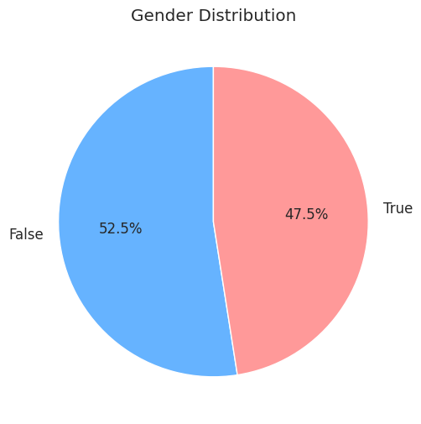
EDA 01/15
Gender Distribution
Pie chart of employee gender split
What it shows
● Employees split 52.5% female to 47.5% male — a near-balanced dataset.
● No major gender skew, so gender-based patterns seen later aren't driven by sample imbalance.

Slide 9
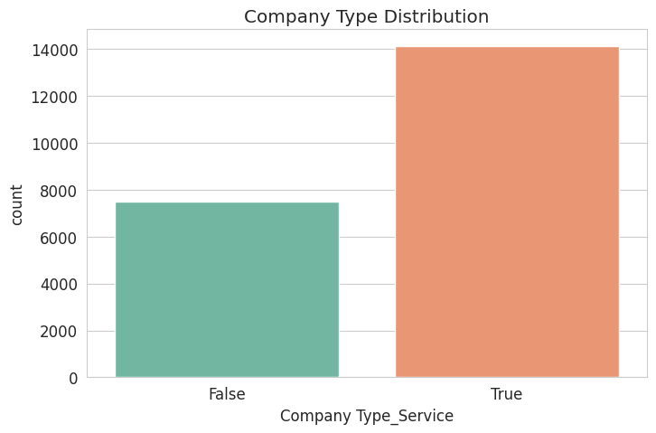
EDA 02/15
Company Type Distribution
Count plot: service vs product companies
What it shows
● About 65% of employees work at service-sector companies vs 35% at product companies.
● The dataset leans heavily toward service-sector roles.

Slide 10
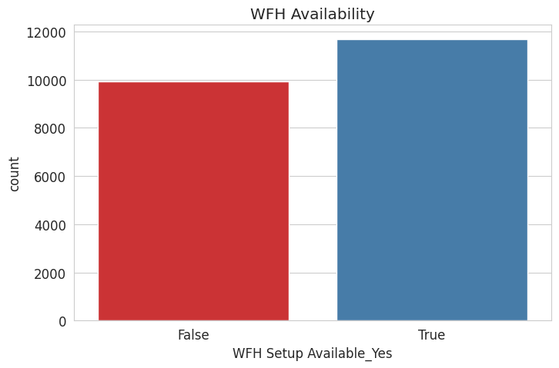
EDA 03/15
WFH Availability
Count plot: employees with work-from-home setup
What it shows
● ~54% of employees have a WFH setup available vs ~46% who don't.
● A fairly even split, useful for comparing burnout across both groups.

Slide 11
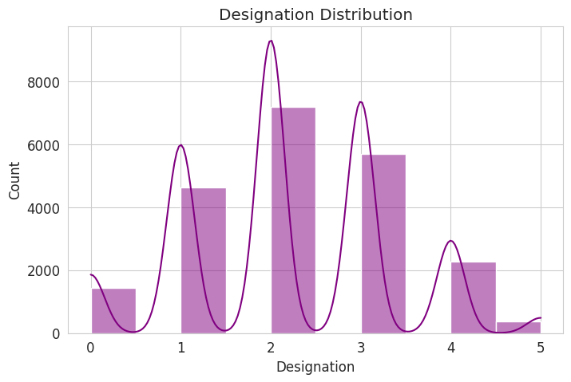
EDA 04/15
Designation Distribution
Histogram of job seniority levels (0–5)
What it shows
● Multi-modal shape: most employees sit at levels 2 and 3 (mid-level roles).
● Senior levels (4–5) are rare, so high-seniority burnout patterns rest on fewer data points.

Slide 12
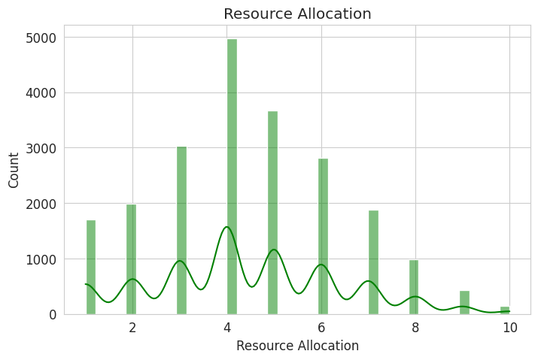
EDA 05/15
Resource Allocation
Histogram of hours/resources allocated per employee
What it shows
● Allocation clusters around 3–6 units, with a peak near 4.
● Very few employees are allocated at the extremes (1–2 or 9–10).

Slide 13
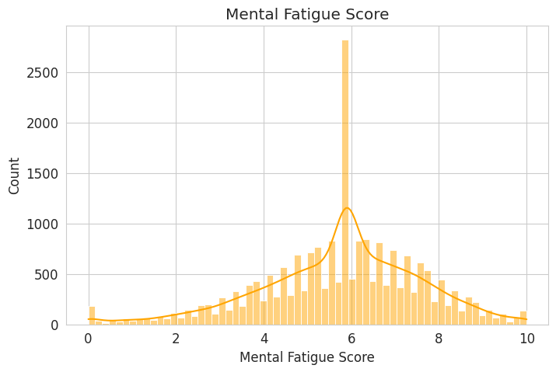
EDA 06/15
Mental Fatigue Score
Histogram with density curve (0–10 scale)
What it shows
● Roughly bell-shaped, centered around 5.5–6 with a sharp spike right at 6.
● Most employees report moderate-to-high fatigue rather than very low or very high.

Slide 14
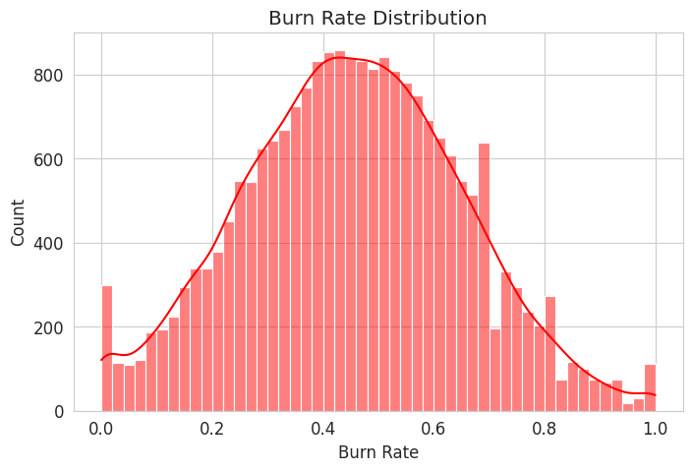
EDA 07/15
Burn Rate Distribution
Histogram of the target variable (0–1 scale)
What it shows
● Approximately normal, centered around 0.4–0.5.
● A symmetric, well-behaved target distribution — favorable for regression modeling.

Slide 15
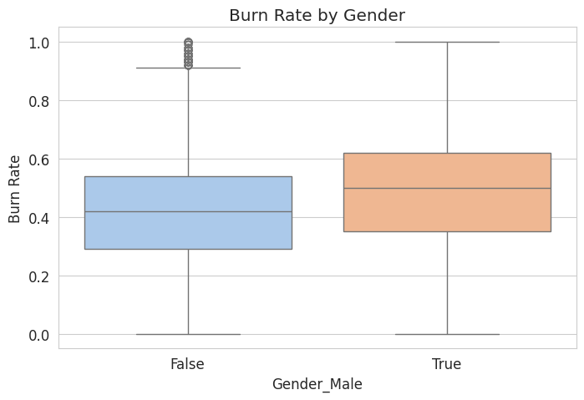
EDA 08/15
Burn Rate by Gender
Boxplot: burn rate across gender groups
What it shows
● Male employees show a higher median burn rate (~0.50) than female employees (~0.42).
● Matches the mild positive correlation (r ≈ 0.15) between gender and burn rate.

Slide 16
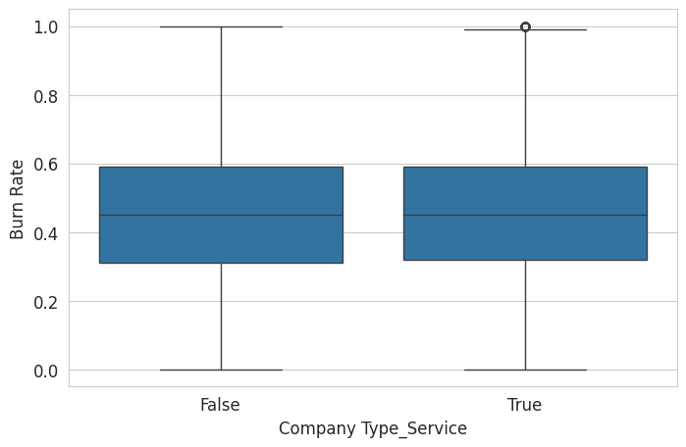
EDA 09/15
Burn Rate by Company Type
Boxplot: burn rate across service vs product companies
What it shows
● Medians are almost identical (~0.45–0.46) for both company types.
● Company type has virtually no effect on burn rate (r ≈ 0.00).

Slide 17
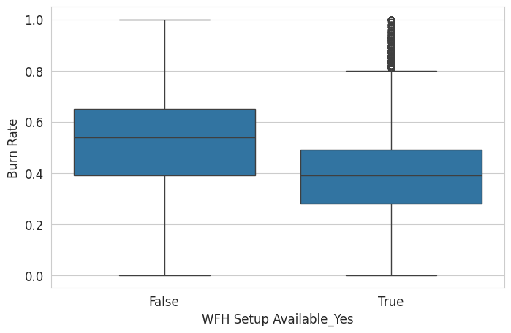
EDA 10/15
Burn Rate by WFH Availability
Boxplot: burn rate with vs without WFH setup
What it shows
● Employees WITH a WFH setup show a clearly lower median burn rate (~0.39) than those without (~0.54).
● The strongest negative correlation in the dataset (r ≈ -0.31) — WFH availability is protective against burnout.

Slide 18
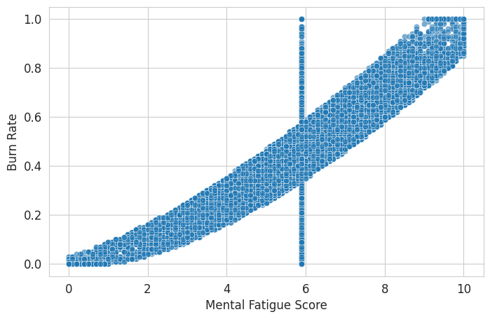
EDA 11/15
Mental Fatigue vs Burn Rate
Scatter plot of the two variables
What it shows
● A very strong, almost linear positive relationship.
● Highest correlation in the dataset (r ≈ 0.90) — mental fatigue is the top predictor of burn rate.

Slide 19
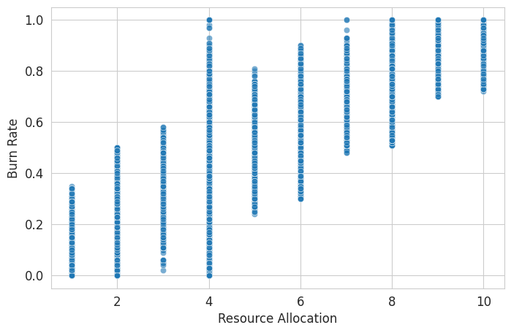
EDA 12/15
Resource Allocation vs Burn Rate
Scatter plot of the two variables
What it shows
● Clear upward trend: more allocated resources/hours track with higher burn rate.
● Strong positive correlation (r ≈ 0.83), the second-strongest predictor.

Slide 20
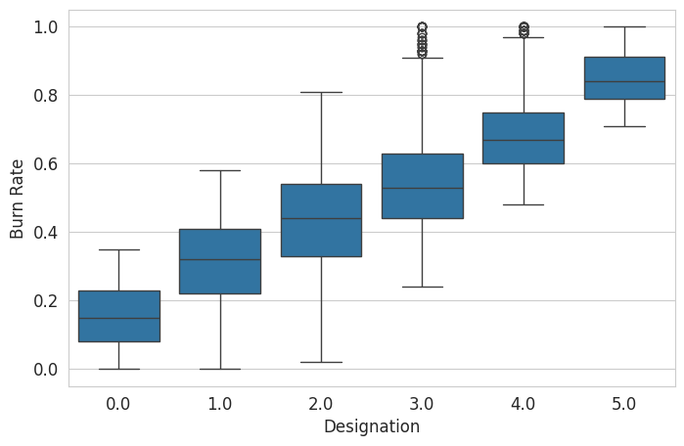
EDA 13/15
Burn Rate by Designation
Boxplot: burn rate across seniority levels 0–5
What it shows
● Median burn rate rises steadily with seniority — from ~0.15 at level 0 to ~0.85 at level 5.
● Strong positive correlation (r ≈ 0.74): more senior roles report more burnout.

Slide 21
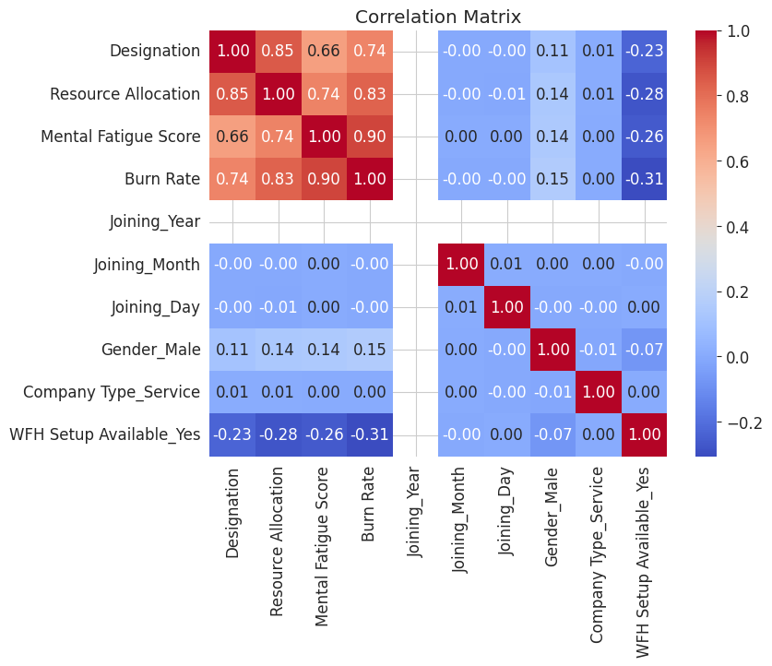
EDA 14/15
Correlation Matrix
Pairwise correlations across all numeric features
What it shows
● Burn rate correlates most with Mental Fatigue (0.90), Resource Allocation (0.83) and Designation (0.74).
● WFH availability is the only meaningful negative driver (-0.31); company type and joining date are near zero.

Slide 22
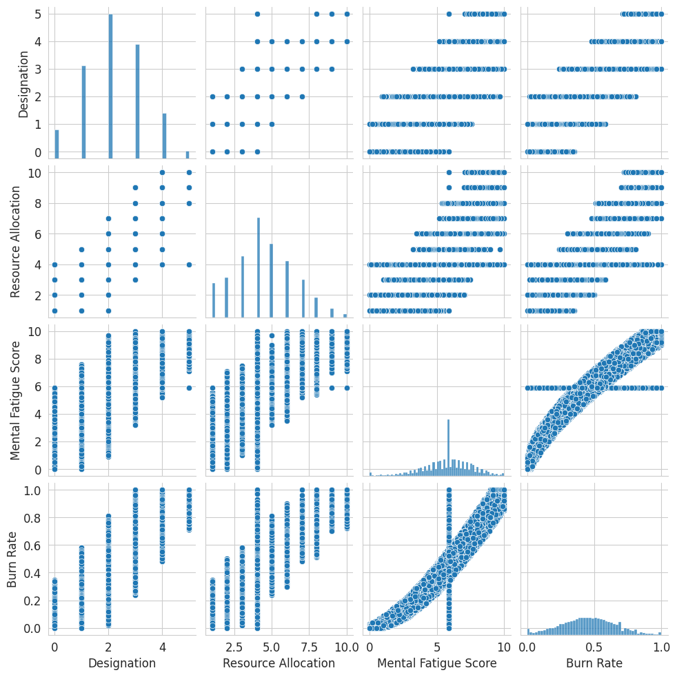
EDA 15/15
Pairplot of Key Features
Designation, Resource Allocation, Mental Fatigue Score, Burn Rate
What it shows
● Every pair against Burn Rate shows a clear increasing trend, confirming the heatmap.
● Designation, Resource Allocation and Mental Fatigue also move together, hinting at overlapping signal for the model.

Slide 23
STEP 3
Data Preprocessing
Turning the cleaned, encoded table into a model-ready pipeline
01
Split Features & Target
Separate predictors (X) from the Burn Rate target, and prepare the test set the same way
02
Feature Inventory
9 numerical features carried into the model; 0 categorical columns remain, since encoding already ran in Step 1
03
Scaling Pipeline
A ColumnTransformer applies StandardScaler to every numerical feature before it reaches the model

Slide 24
STEP 3
Splitting Features & Target
Predictors (X) are separated from the Burn Rate target before any scaling happens
21,626 × 9
X_train
rows × numerical features
21,626
y_train
Burn Rate values (the target)
12,250 × 9
X_test
rows × numerical features
How the split is built
X_train = train.drop("Burn Rate", axis=1)
y_train = train["Burn Rate"]
X_test = test.copy()

Slide 25
STEP 3
Feature Inventory & Scaling
Every remaining feature is numeric, so one scaler covers the whole feature set
9 numerical features → numerical_features
The scaling pipeline
● A ColumnTransformer wraps a single StandardScaler and applies it to all 9 numerical columns.
● StandardScaler centers each feature to mean 0 and scales it to unit variance, so no single feature dominates the model just by having a larger range.
● No categorical transformer is needed — get_dummies() already turned every category into 0/1 columns during data cleaning.
● The fitted preprocessor will be reused inside the model pipeline (Step 4) for both training and inference.
Designation
Resource Allocation
Mental Fatigue Score
Joining_Year
Joining_Month
Joining_Day
Gender_Male
Company Type_Service
WFH Setup Available_Yes
categorical_features = [] (already one-hot encoded in Step 1)

Slide 26
STEP 4
Model Training
Seven regression algorithms trained and validated on the same 80/20 split
01
Algorithms Tried
Bagging, AdaBoost, Gradient Boosting, XGBoost, Decision Tree, Random Forest and SVM (SVR)
02
Validation Setup
80/20 train-validation split; scored with R², MAE, MSE and RMSE on the held-out set
03
Best Result
XGBoost came out on top with R² = 0.9052 and the lowest RMSE (0.0601)

Slide 27
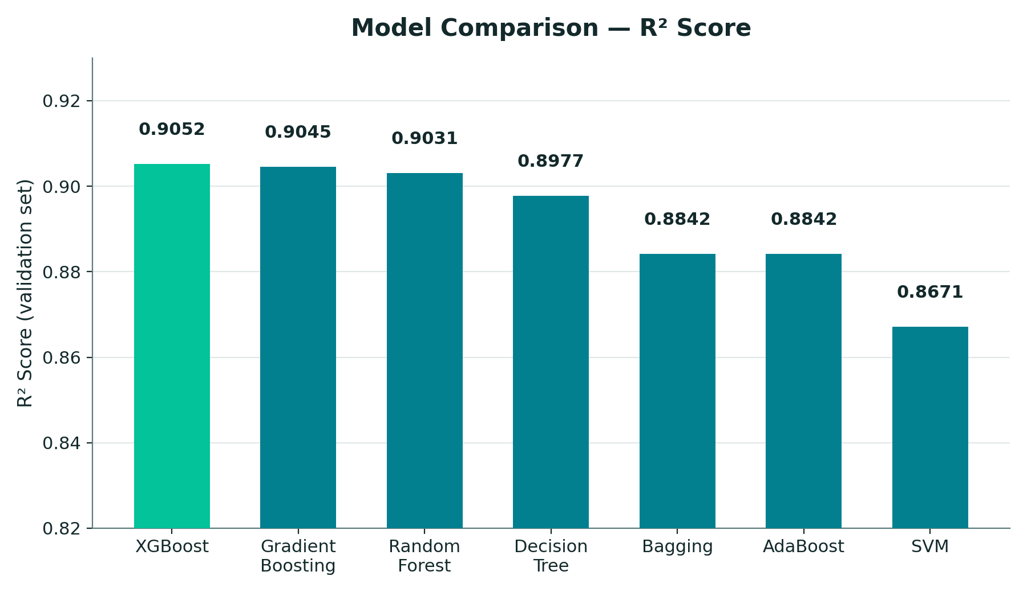
STEP 4
Comparing R² Across Models
Higher R² means more of the variance in Burn Rate is explained by the model
What it shows
● XGBoost and Gradient Boosting lead the pack (R² ≈ 0.90) — boosting handles this data best.
● Random Forest and a single Decision Tree trail close behind, both above 0.89.
● Bagging and AdaBoost tie at 0.8842 — weaker than the boosted models here.
● SVM (tuned via RandomizedSearchCV) scores lowest at 0.8671, still a solid baseline.

Slide 28
STEP 4
Validation Metrics by Model
R², MAE, MSE and RMSE on the held-out validation set, ranked by R²
Model
R² Score
MAE
MSE
RMSE
XGBoost ★ Best
0.9052
0.0471
0.0036
0.0601
Gradient Boosting
0.9045
0.0473
0.0036
0.0603
Random Forest
0.9031
0.0474
0.0037
0.0608
Decision Tree
0.8977
0.0486
0.0039
0.0624
Bagging
0.8842
0.0520
0.0044
0.0664
AdaBoost
0.8842
0.0520
0.0044
0.0664
SVM (SVR)
0.8671
0.0541
—
0.0712
AdaBoost's printed metrics match Bagging's exactly in the source notebook — worth a re-run to confirm its true score.

Slide 29
STEP 4
Which Model Wins?
Weighing accuracy, error and complexity across the seven candidates
★ WINNER
XGBoost
R² = 0.9052
RMSE = 0.0601 · MAE = 0.0471
Best accuracy of all seven models, with the lowest prediction error on unseen employees — the clear choice for the final pipeline.
How the models compare
● Boosting wins: XGBoost and Gradient Boosting (both R² ≈ 0.90) build trees sequentially, each one correcting the last — that's what pulls them ahead here.
● XGBoost edges out Gradient Boosting on every metric, but the gap is tiny (ΔR² = 0.0007) — either would be a safe production choice.
● Random Forest and a single tuned Decision Tree land just behind, proving tree-based models suit this tabular HR data well.
● Bagging and AdaBoost underperform the other ensembles here, and SVM — despite hyperparameter tuning — trails the whole group.
● Recommendation: ship XGBoost as the primary model, keep Gradient Boosting as a close backup/ensemble candidate.

Slide 30
What the Model Looks At
Six key indicators feed the prediction engine
1
Designation
2
Resource Allocation
3
Mental Fatigue Score
Employee's job level / seniority
Workload assigned to the employee
Self-reported fatigue level
4
Company Type
5
WFH Availability
6
Joining Tenure
Service or Product-based firm
Whether remote work is offered
Year / month / day of joining

Slide 31
What the System Delivers
Actionable output for HR & management
1
2
3
Risk Percentage
Top Contributing Causes
Suggestions for Management
A clear burnout-risk score for each employee, updated as data changes.
The specific factors driving that employee's risk — ranked by impact.
Practical, targeted recommendations to reduce risk before it escalates.

Slide 32
Thank You
Employee Burnout Prediction • NTI Graduation Project

