Slide 1
IaaS Providers & Distributions
Dr. Charles (Cal) LOOMIS
Copyright © 2019 C. Loomis, YobiTrust
1

Slide 2
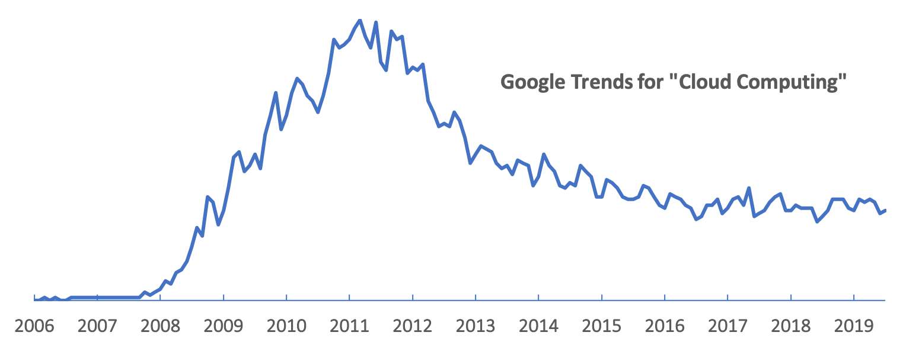
Amazon Web Services
EC2
S3
AWS deploys new services frequently and are continually reducing the prices of their resources.

Slide 3
Amazon Web Services
The first modern cloud service
Initially intended to sell their excess computing power
Quickly became a profit center for Amazon, with dedicated computing resources

Slide 4
Users
Companies
SMEs: CapEx vs. OpEx
Large Enterprises: scalability and minimum latency
Engineers & Researchers
Resources for occasional computing needs
Customized environments
Deployment of long-lived services
No management of physical hardware

Slide 5
Worries
Quality of services
Reliable, accessible, etc.
Loss of control over platform access
Increased security concerns
Data
Who owns the data in the cloud?
What are the guarantees concerning data protection?
What laws are applicable to the data?

Slide 6
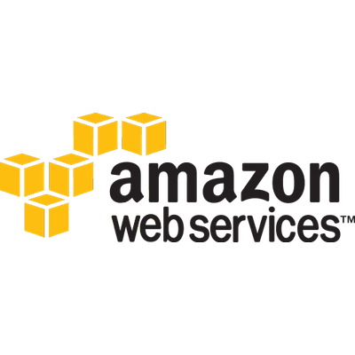
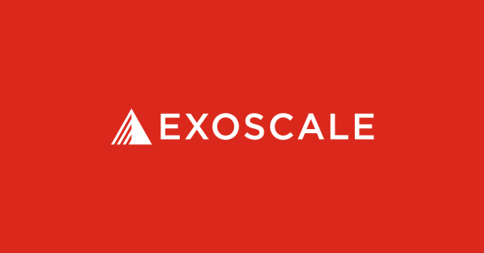

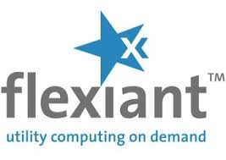
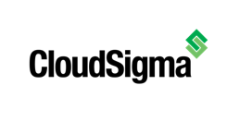
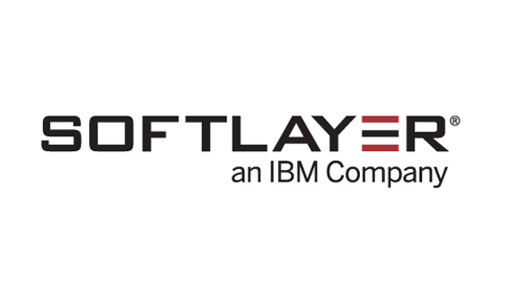


Commercial Services

Slide 7
Consolidation
We are already seeing a centralization of data centers at sites run by large companies
Questions concerning the protection of data, reliability of services, etc. continue to be relevant.
Still a large marketplace of smaller providers
How to they compete? Price, custom SLAs, location, etc.

Slide 8
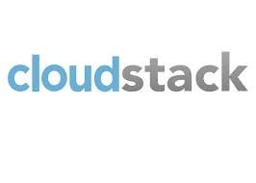


Private Cloud Distributions

Slide 9
Private Cloud Motivations
Control security aspects of cloud, particularly worries related to data protection
Take better advantage of existing hardware and personnel

Slide 10
Conclusions
Many commercial IaaS providers exist that provide reliable services at reasonable prices.
APIs and service details often vary significantly between providers, largely because of competitive pressures.
Private clouds can be deployed and maintained with either Open Source or commercial solutions.

