Slide 1
Cloud Technology
Dr. Charles (Cal) LOOMIS
Copyright © 2019 C. Loomis, YobiTrust

Slide 2

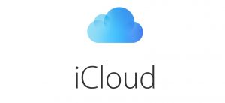






What is the Cloud?
Person on the Street
IT Professional

Slide 3
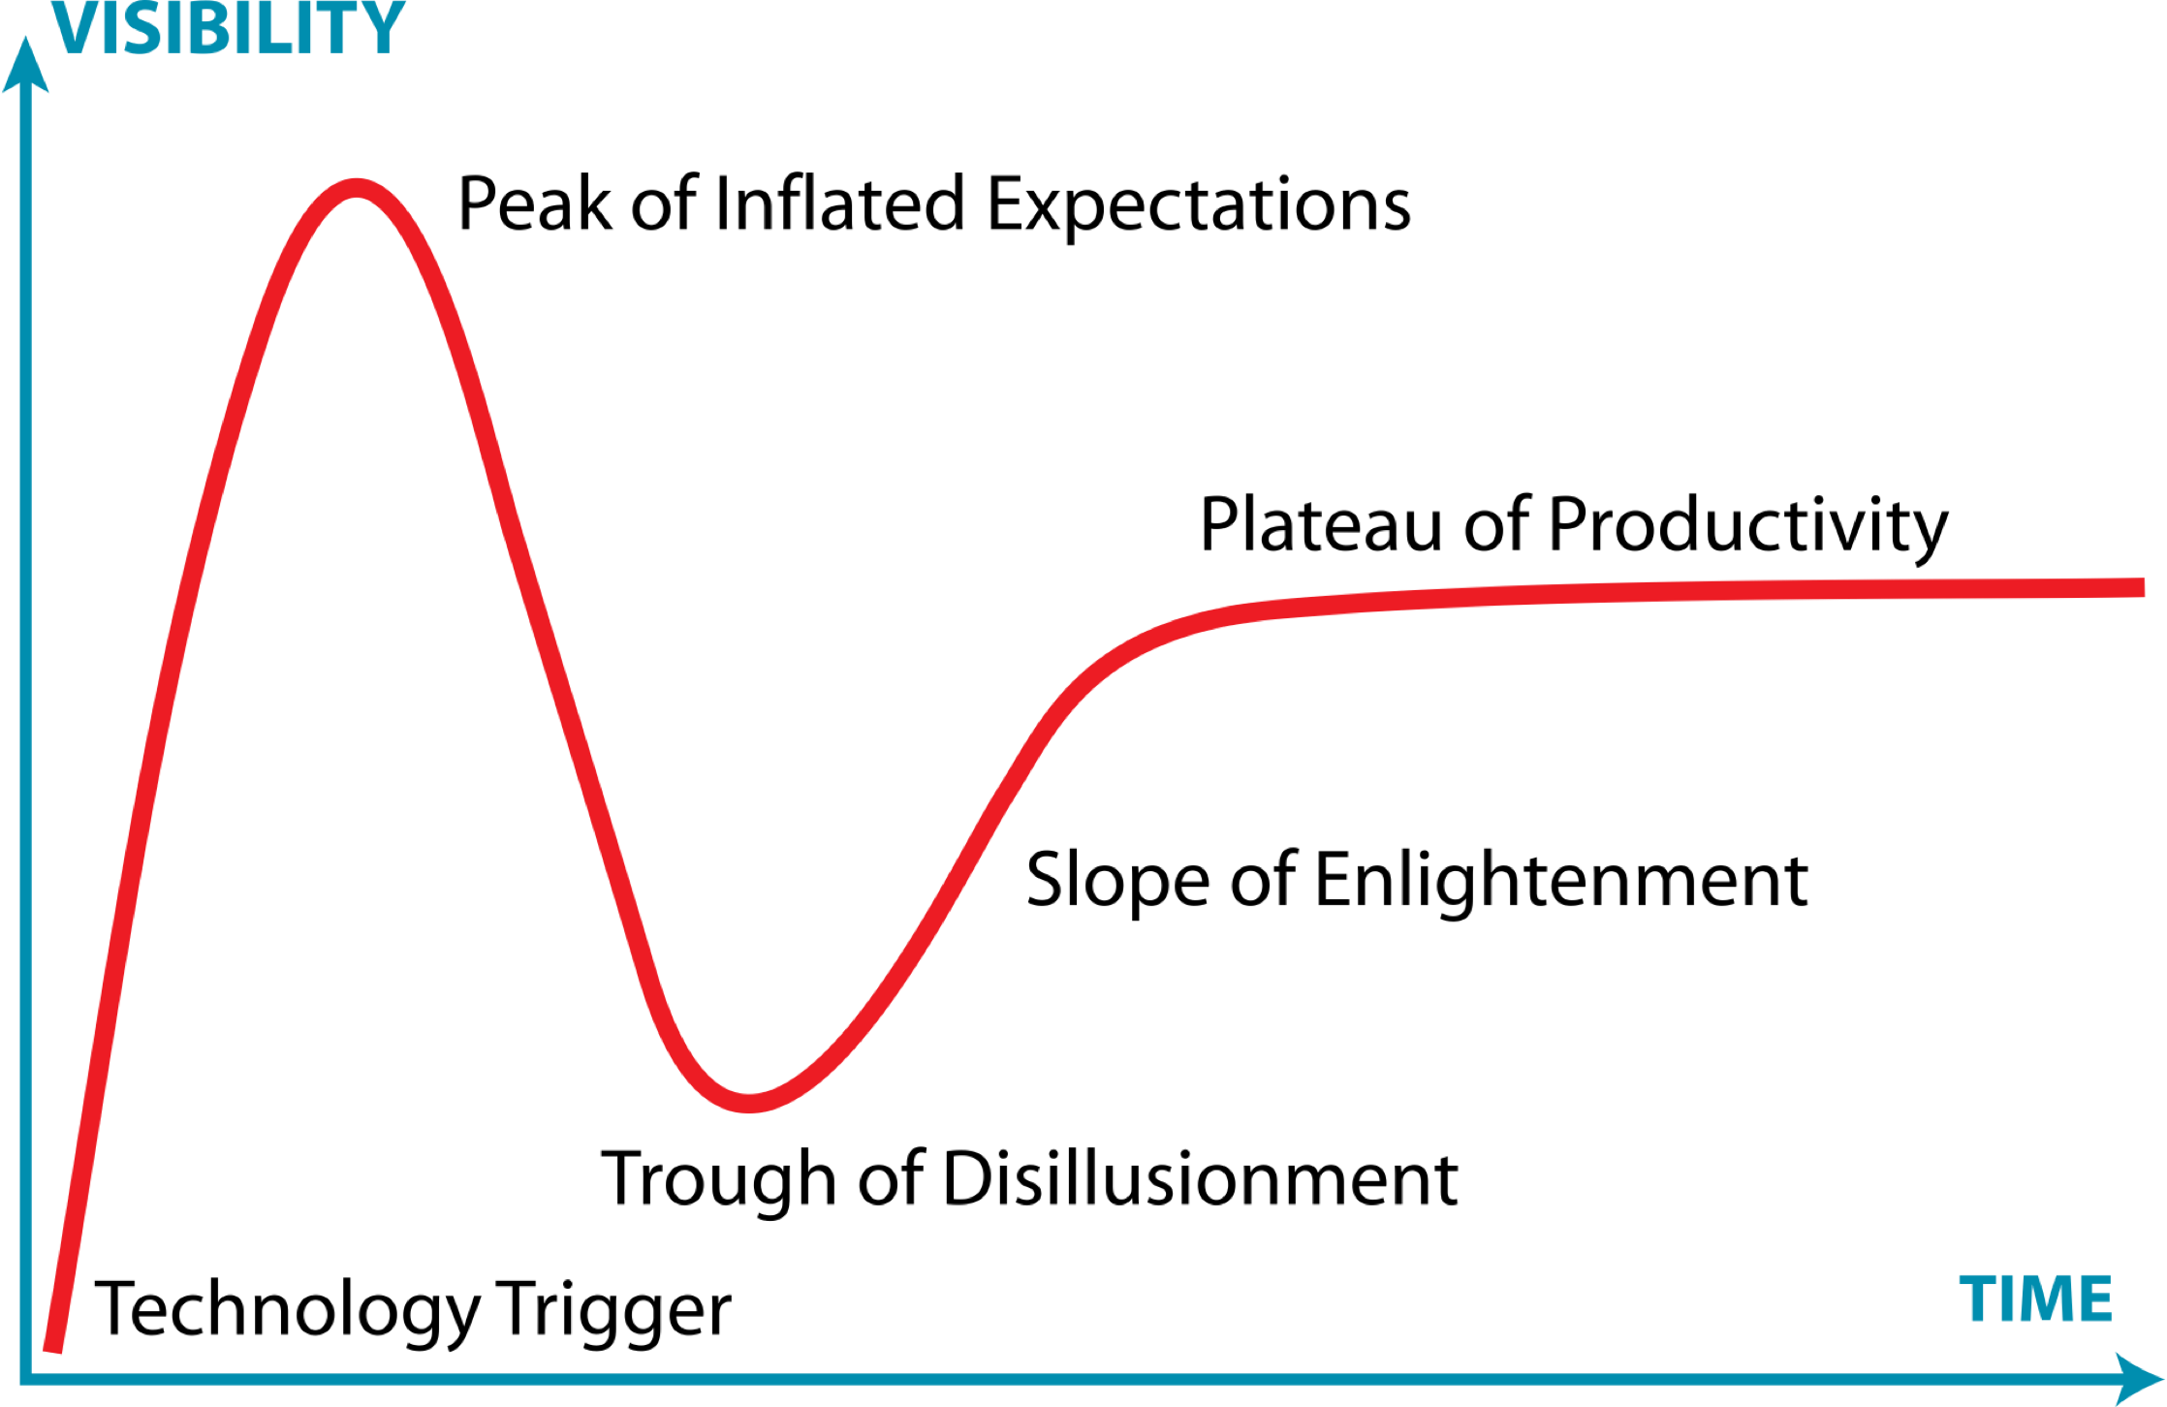
Gartner’s Hype Cycle
2006
2010
2013
2015
Since its debut in 2006, the cloud has gone through the complete hype cycle.

Slide 4
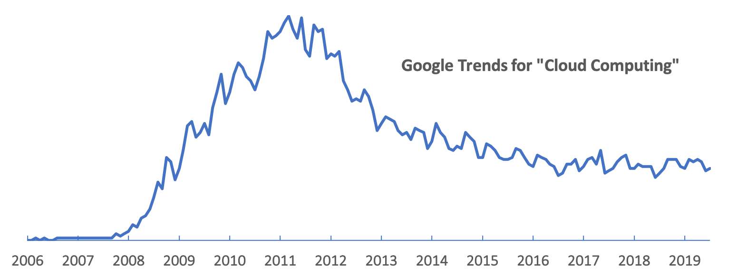
Google Trends for “Cloud Computing”
The term “cloud” frequently used to market IT software and services, regardless of whether they have anything to do with cloud computing.

Slide 5
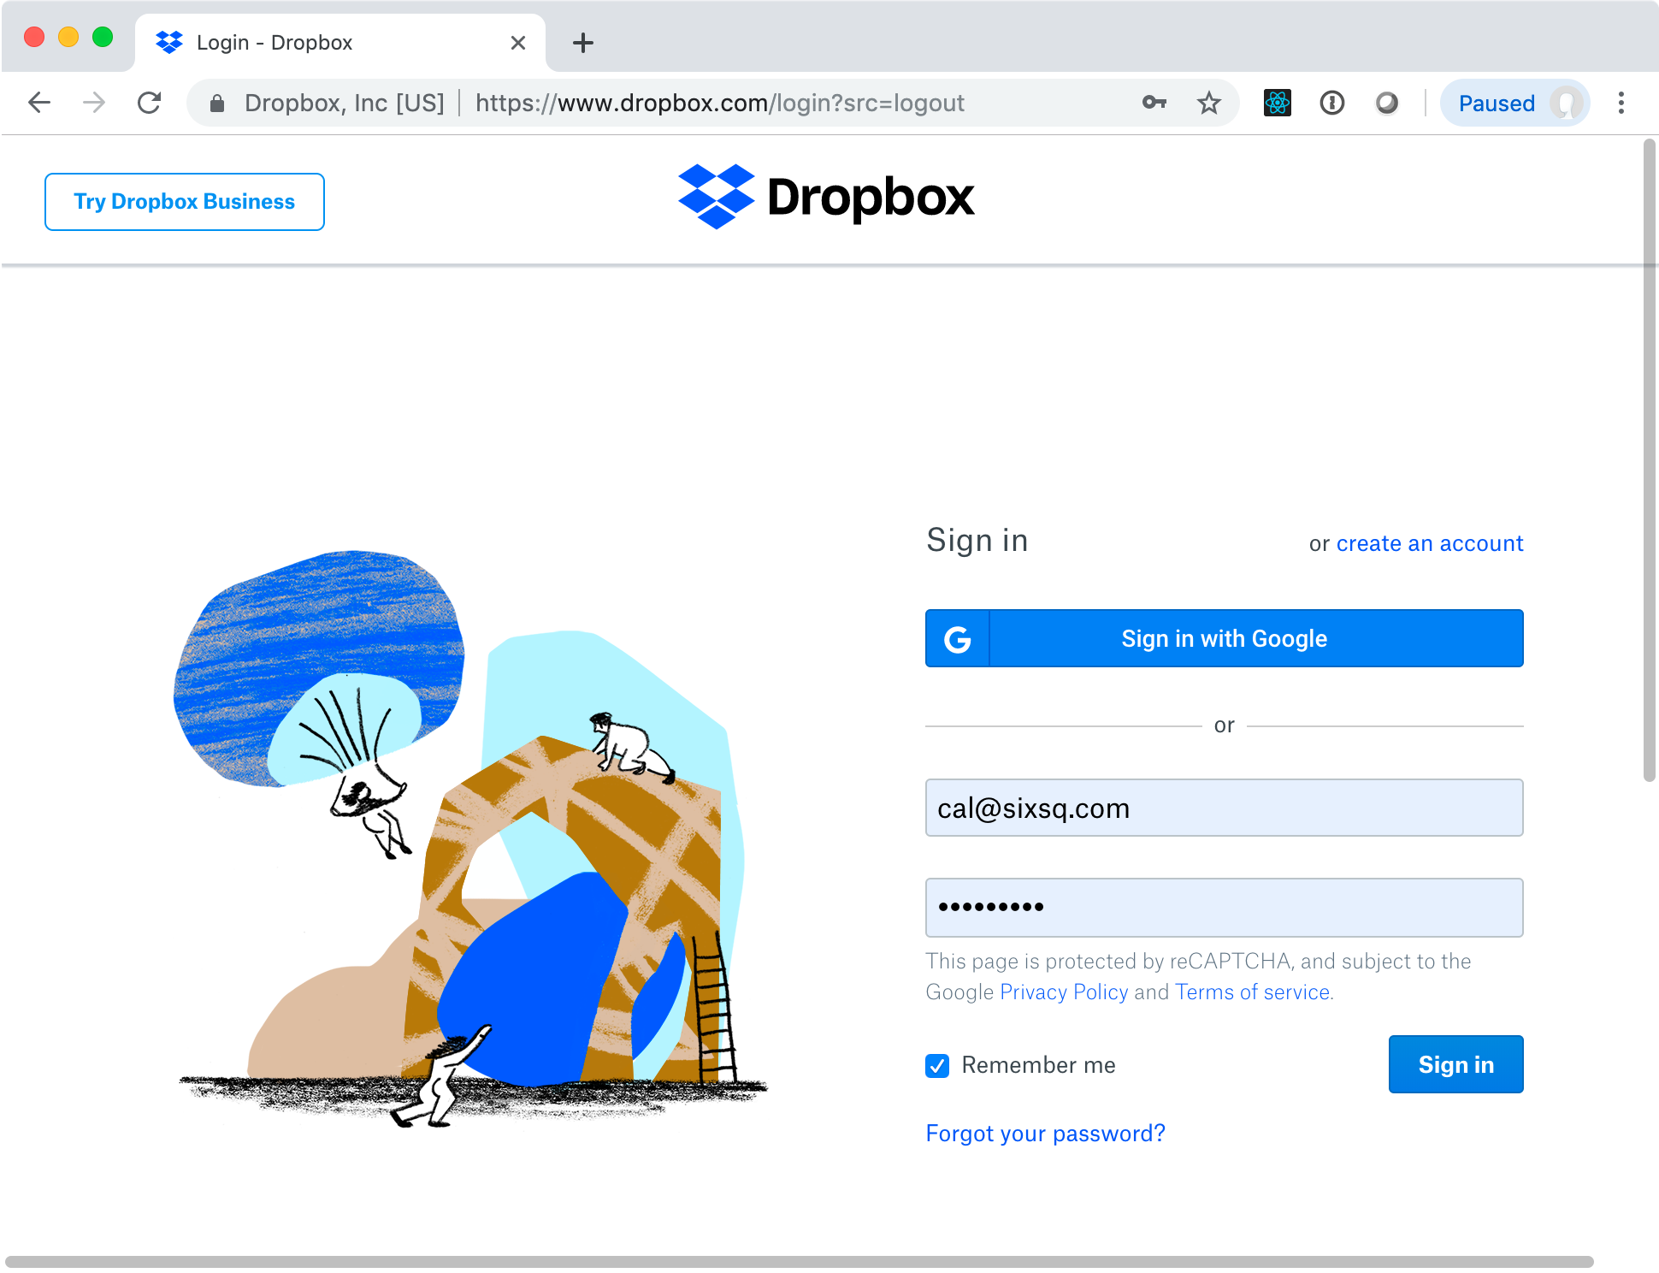
Dropbox
Distributed storage for transparent access to personal files from any device.

Slide 6
Dropbox
Simple access from laptops, phones, etc.
Offline access via local cache on device
Synchronization of changes between devices
History of file versions
Sharing of files and directories with others
Free service to 2 GB, must pay for more
Files are stored in the United States

Slide 7
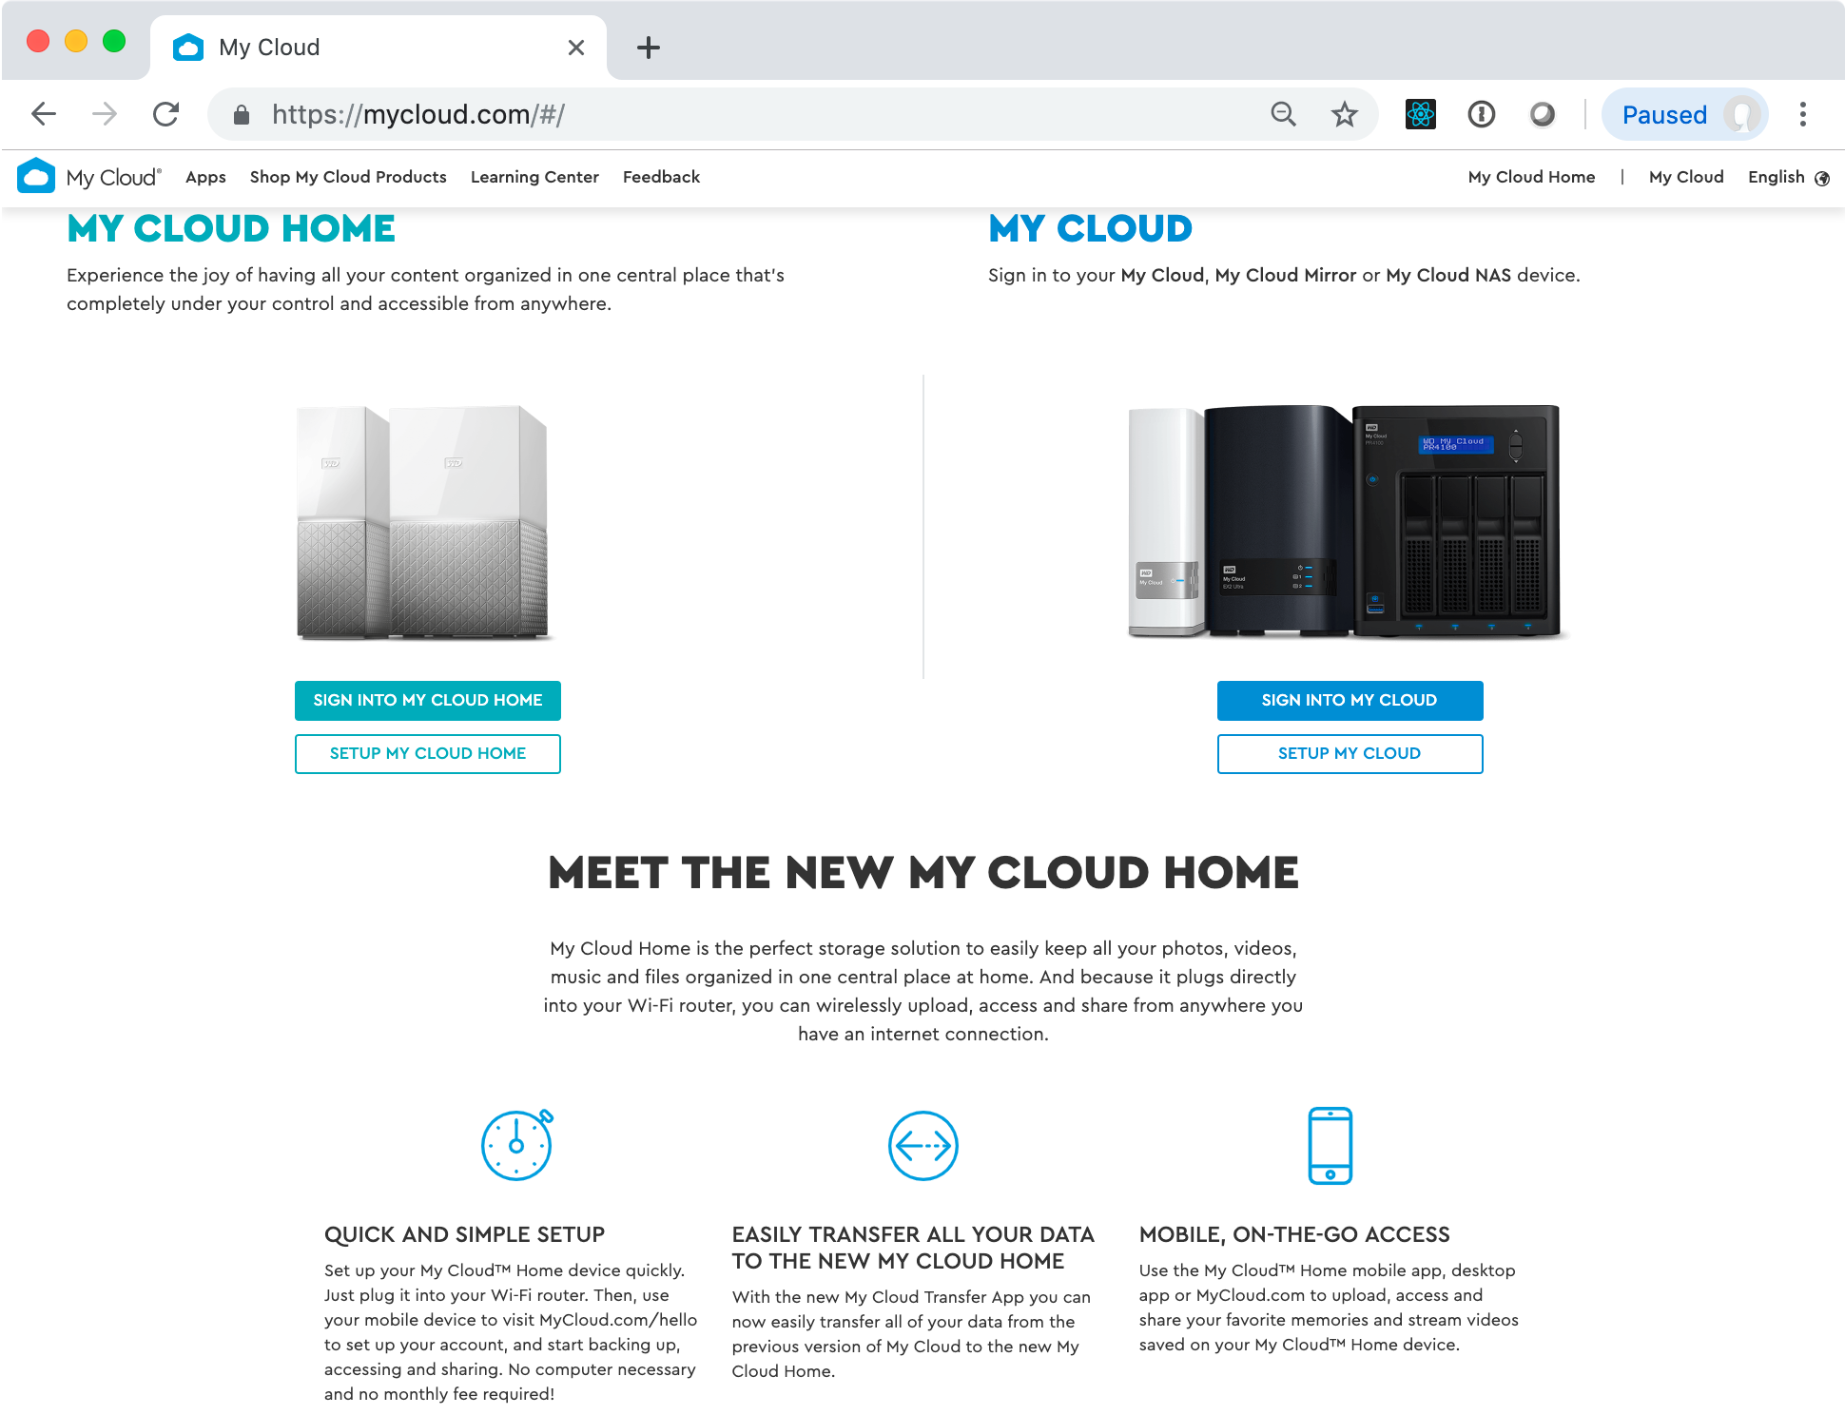
My Cloud
Storage device located in a user’s home and under the user’s control. Files accessible from anywhere.

Slide 8
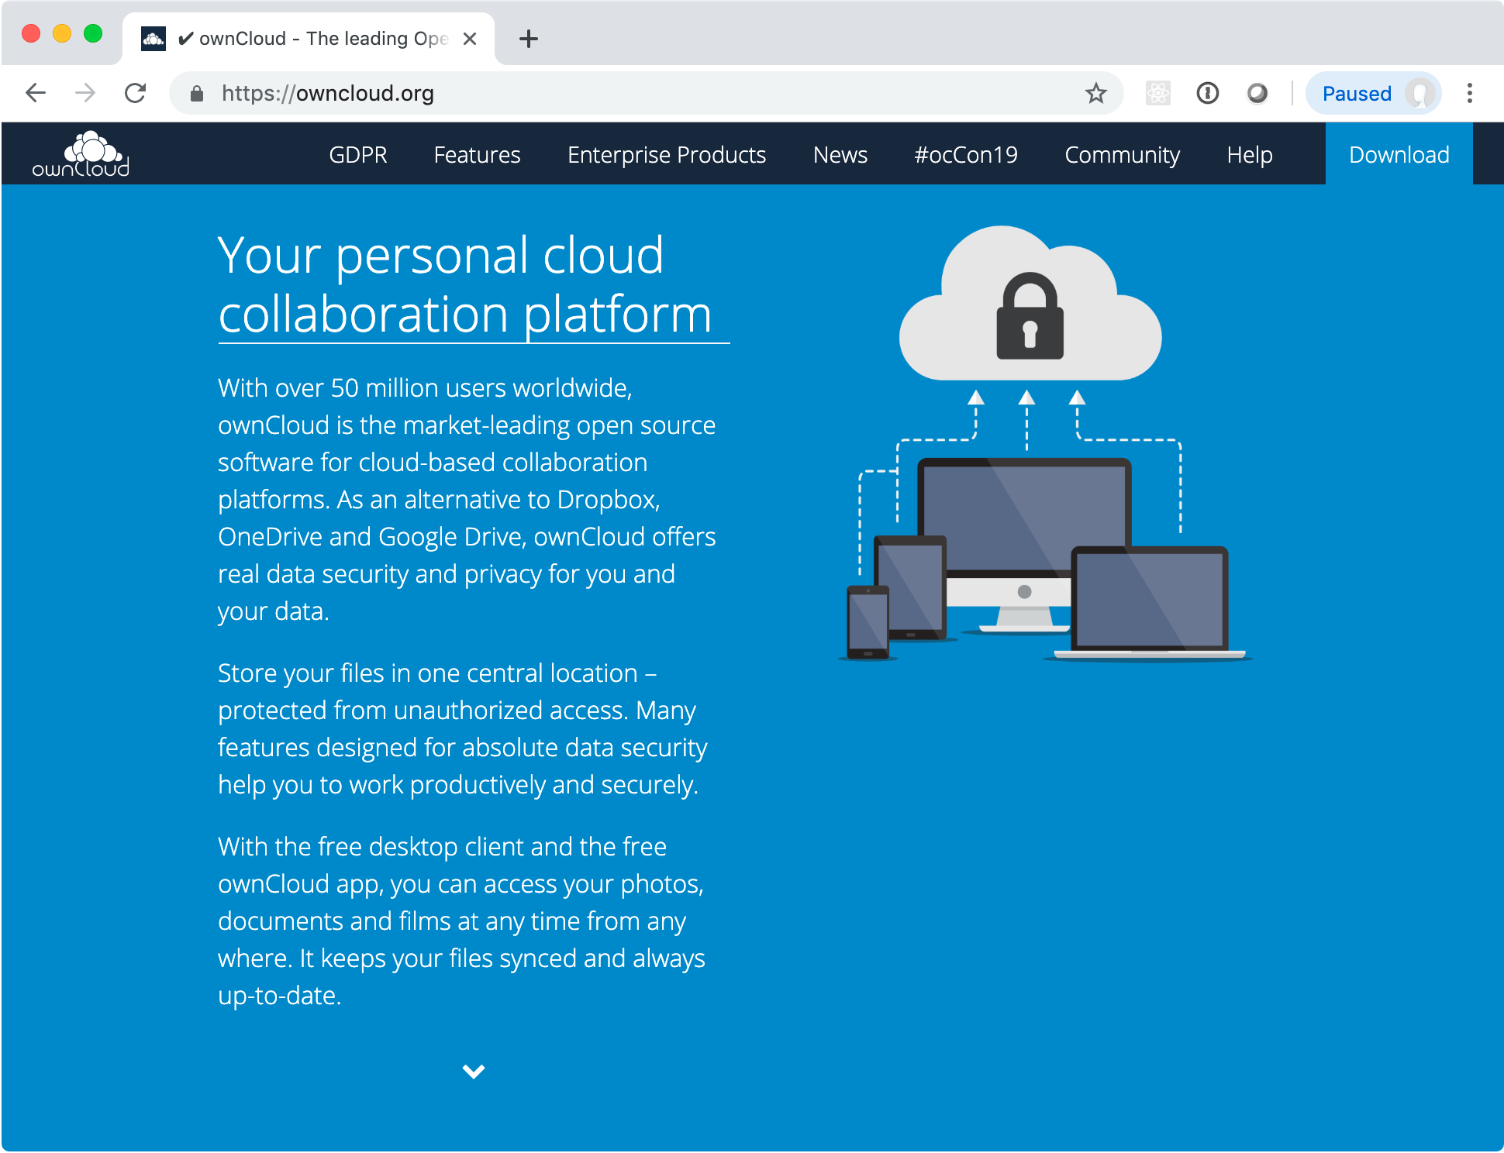
ownCloud
Storage of files, contact, and calendars for an institute or enterprise.

Slide 9
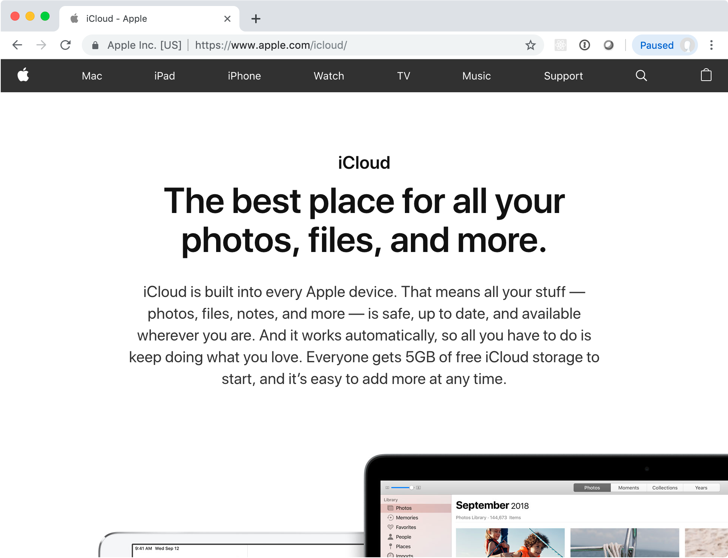
iCloud
Apple’s solution for synchronization of files, contacts, passwords, and other personal information between Apple devices.

Slide 10
Why and how?
Constant use many different devices:
Portable telephones, tablets, laptops, desktops, etc.
People are always connected:
The mobile, wireless, and wired network connections are everywhere, fast, free, and very reliable.

Slide 11
Common Characteristics
Data stored in remote data centers
Easily accessible via the Internet
Often see “free” tier of service

Slide 12


Standard Services
G Suite
If the cloud is just remotely accessible data, then there are lots of ”cloud” services.

Slide 13

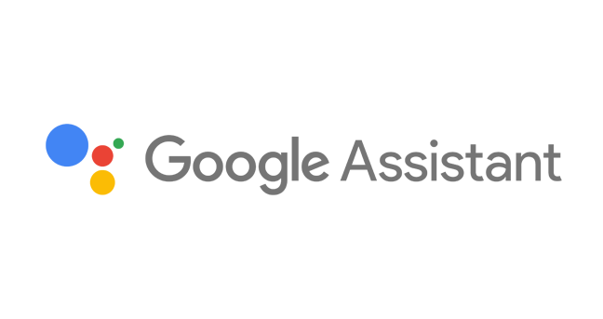
Search is a Calculation
Everyone searches for information in public and private databases
These searches require rapid calculations that are often complex
Searches via voice recognition require calculations to understand the question
Siri

Slide 14
Common Characteristics
Provides unique service
Data stored in remote data centers
Easily accessible via the Internet
Dynamic allocation of resources
Integration with other services possible

Slide 15




Communication and Social Interaction
Many of these services provide APIs that allow other applications to query their databases and interact with their services.

Slide 16
Common Characteristics
Connect people by text, chat, video, …
Expectation of instantaneous, secure, fast connection
Provide unique service for users
Provide platform for integration with other services

Slide 17
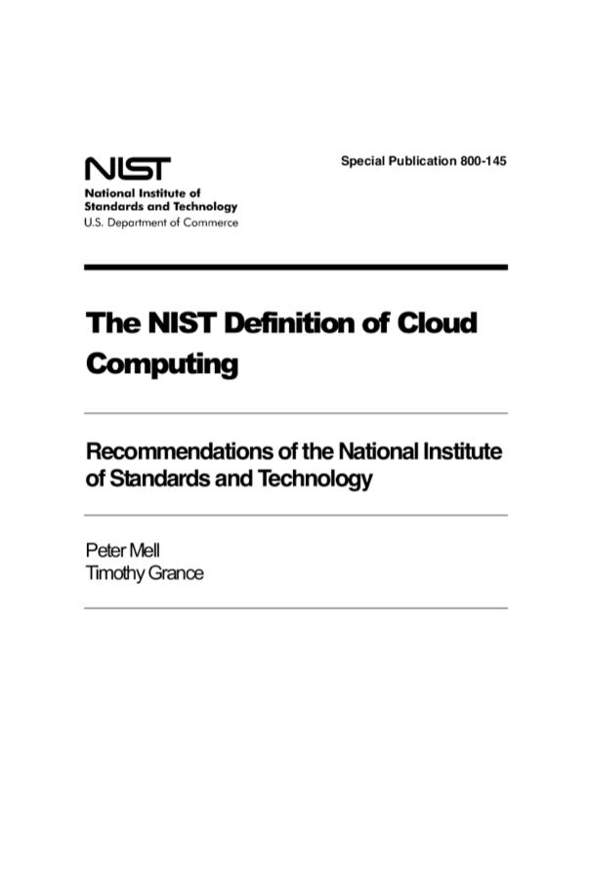
Formal Definition
NIST Definition
Essential characteristics
Service models
Deployment models

Slide 18
Service Models
Software as a Service (SaaS)
Platform as a Service (PaaS)
Infrastructure as a Service (IaaS)
G Suite

Slide 19
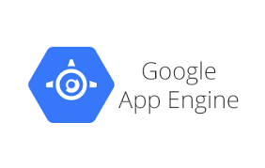
Service Models
Software as a Service (SaaS)
Platform as a Service (PaaS)
Infrastructure as a Service (IaaS)

Slide 20
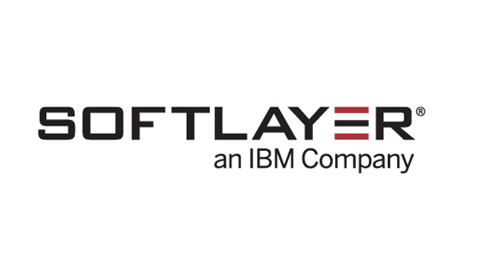


Service Models
Software as a Service (SaaS)
Platform as a Service (PaaS)
Infrastructure as a Service (IaaS)

Slide 21
Deployment Models
Public
Aimed at the general public with payment via credit card
Community
Infrastructure shared between a community of users
Private
Infrastructure intended for “local” users of an institute or enterprise
Hybrid

Slide 22
Cloud for (Data) Science
Data science needs a platform that has all these characteristics:
Accessible remotely: instantaneous, secure, and fast
Dynamic allocation: respond quickly to peak in demand
Cost effective: pay only resources that are used
Flexible: customization of the environment, application
Specific Platforms: sequencers, instruments, etc.
Infrastructure as a Service is the best fit

Slide 23
Conclusions
The cloud is an evolution of computing resources that makes them more useful, dynamic, scalable, and flexible.
Cloud services (commercial and academic) are extremely diverse and offer enormous benefits to users.

