Slide 1
BIO/CHM/CSE/MBI 466-566 Bioinformatics Computing Skills
Lab 2: DNA sequencing and
Data Format in Bioinformatics

Slide 2
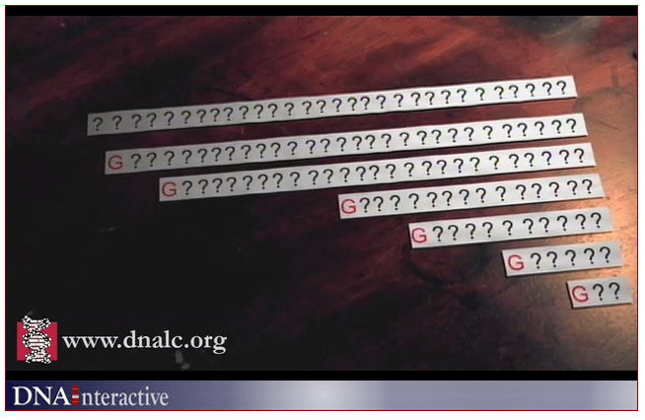
Sanger Sequencing
http://www.dnalc.org/view/15479-Sanger-method-of-DNA-sequencing-3D-animation-with-narration.html

Slide 3
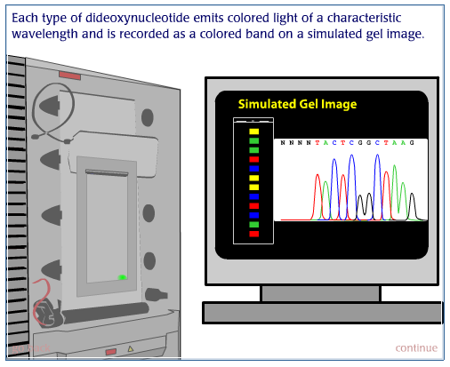
Sanger cycle sequencing
http://www.dnalc.org/resources/animations/cycseq.html

Slide 4
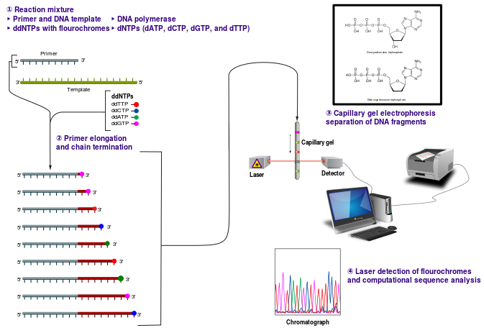
Base calling: determination of bases by chromatograph

Slide 5
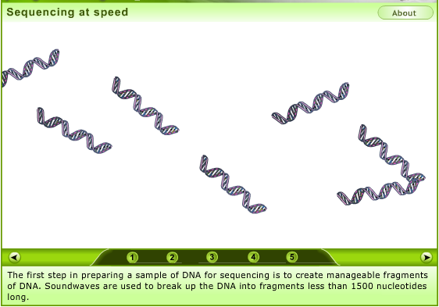
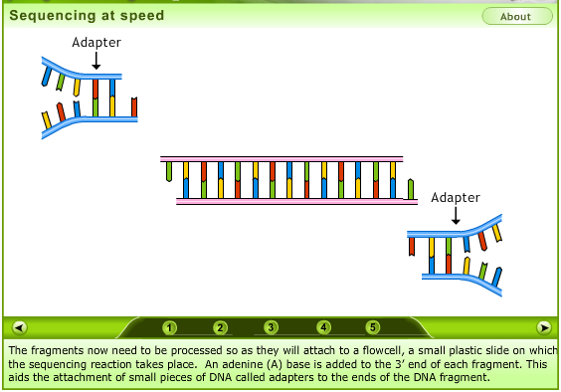
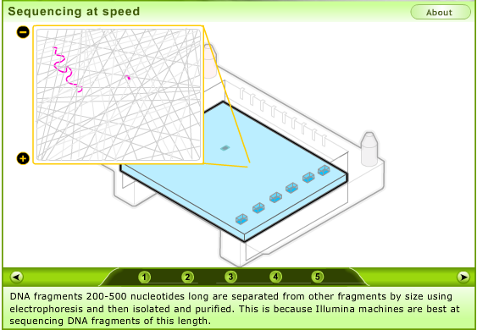
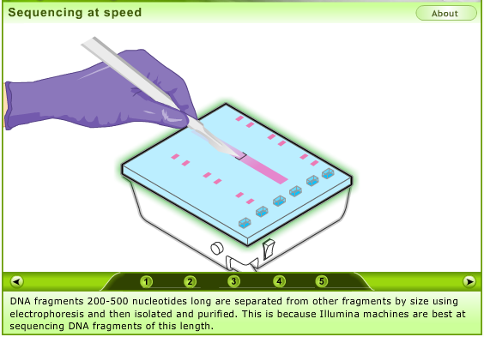
http://www.yourgenome.org/video/sequencing-at-speed

Slide 6
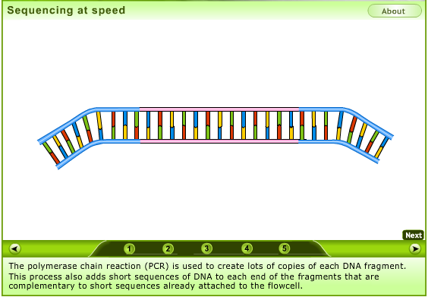
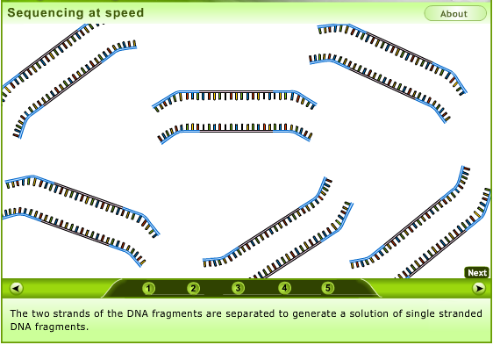
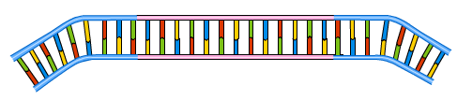
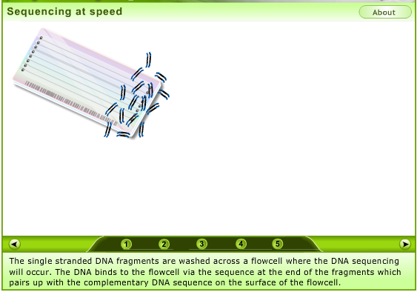
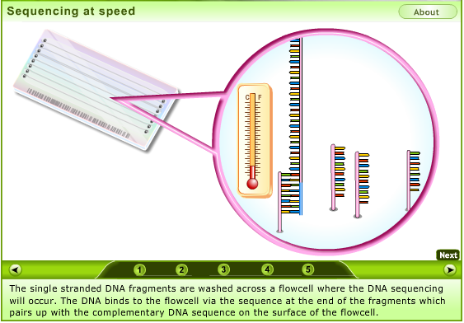

Slide 7
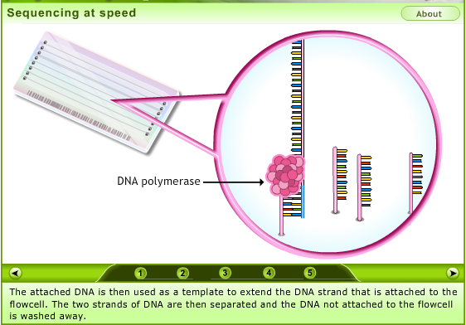
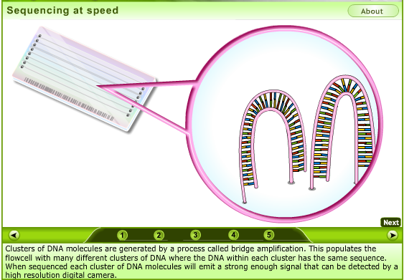
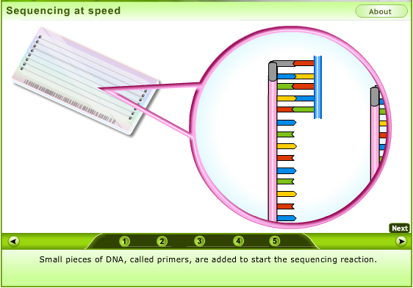
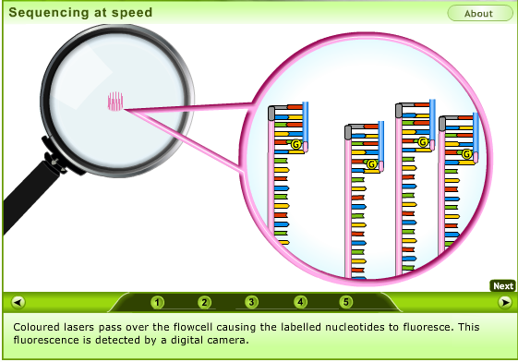

Slide 8
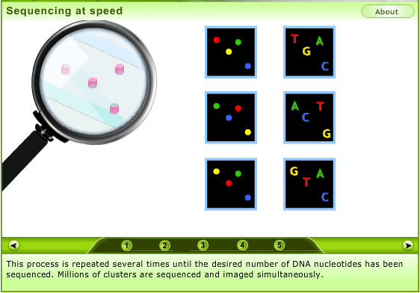
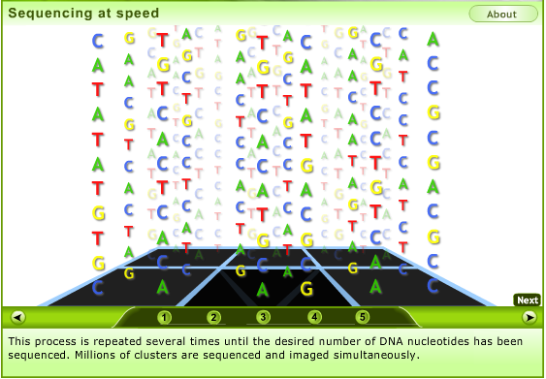

Slide 9
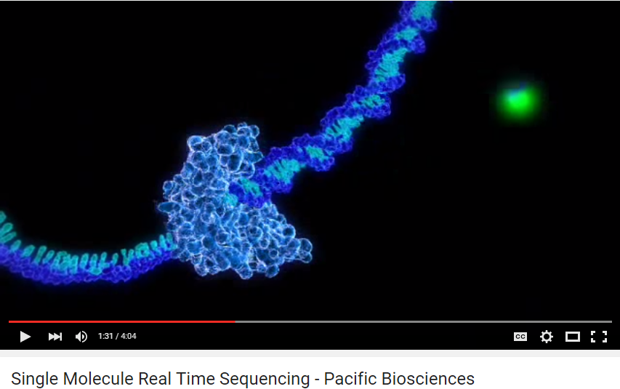
https://www.youtube.com/watch?v=v8p4ph2MAvI

Slide 10
Data format
FASTA & FASTQ format
Read tutorial 4
NCBI Trace Archive & NCBI SRA

Slide 11
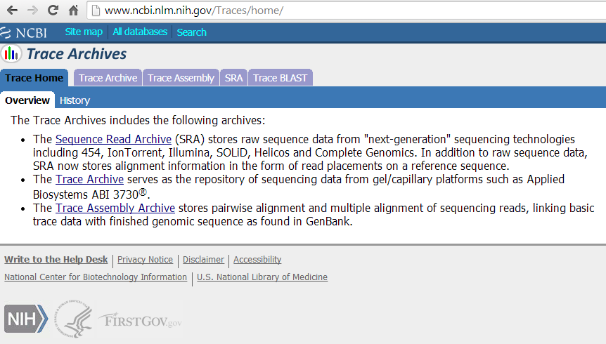

Slide 12
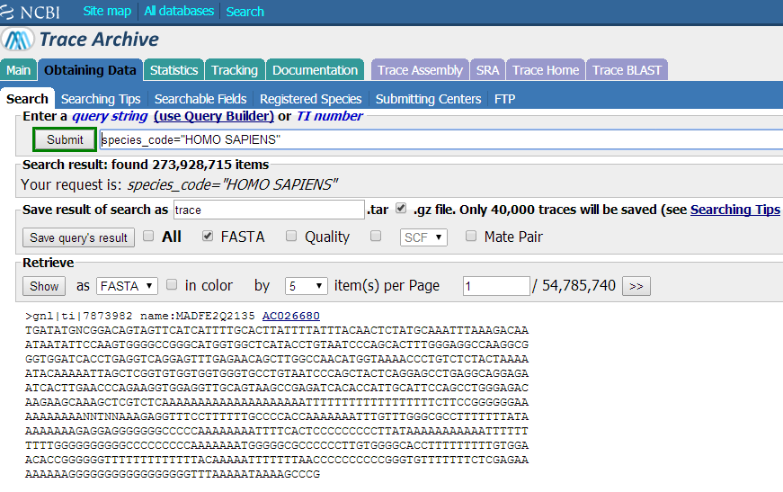

Slide 13
