Slide 1
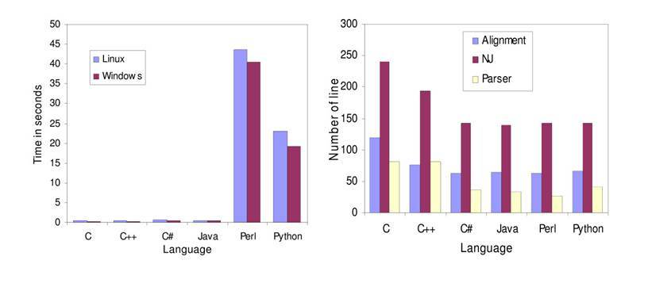
BIO/CHM/CSE/MBI 466-566 Bioinformatics Computing Skills
Week02: Perl Basics

Slide 2
Perl Programming Basics
Mechanics of writing Perl code
Variables and values
Literals and List
Operators
Functions
Statements and Blocks
Loops

Slide 3
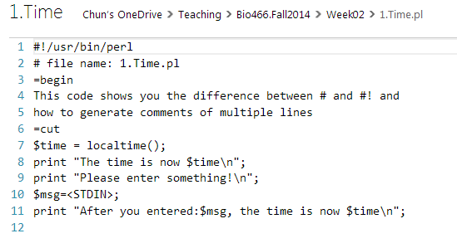
Mechanics of Writing Perl Programs
A Perl program is just a text file. Use any text (programmer's) editor.
Windows: Notepad, Wordpad
Linux: nano, gedit, eclipse
By convention, Perl program files end with the extension .pl
#! Indicates a commented line directed toward the PERL interpreter.
# single-line comment
=begin
=cut
Statement ends with ;
Sequential order in execution

Slide 4
How to run a Perl code?
Using Eclipse IDE, you can run a perl program by clicking the green button
Using command line:
perl YourProgram.pl

Slide 5
Variable and Values
In computer source code, a variable name is one way to bind a variable to a memory location; the corresponding value is stored as a data object in that location so that the object can be accessed and manipulated later via the variable's name.

Slide 6
Variable and Values
Symbolic representation denoting a quantity or expression.
$X=3;
$Y=‘ATG’;
Name: $X
Name: $Y
3
ATG
print (“Sequence $Y has $X nucleotides\n”);

Slide 7
Variable and Values
# This is a sample code;
$Y=‘ATGG’;
$X=4;
print “$Y has $X nucleotides \n”;
$Y=‘ATG’;
print “$Y has $X nucleotides \n”;

Slide 8
Perl Variables
A variable is a symbolic placeholder for a value.
Scalars: $variable_name
A single-valued variable, always preceded by a $ sign.
Arrays: @array_name
A multi-valued variable indexed by integer, preceded by an @ sign.
Hashes: %hash_name
A multi-valued variable indexed by string, preceded by a % sign.
Filehandle: FILEHANDLE_NAME
A file to read and/or write from.
Filehandles have no special prefix, but are usually written in
all uppercase.

Slide 9

Perl Literals
Literals are constant values that you embed directly in the program code. String and numeric literals.
String literals are enclosed by single quotes (') or double quotes ("):
The difference: variables and certain special escape codes are interpolated into double quoted strings, but not in single-quoted ones.

Slide 10
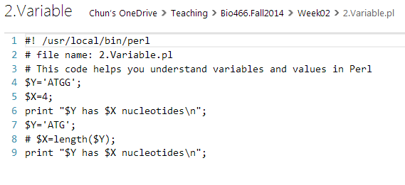
Perl string and numeric literals
You can refer to numeric values using integers,
floating point numbers, scientific notation, and so on.
$x=1.23E45; # scientific notation

Slide 11
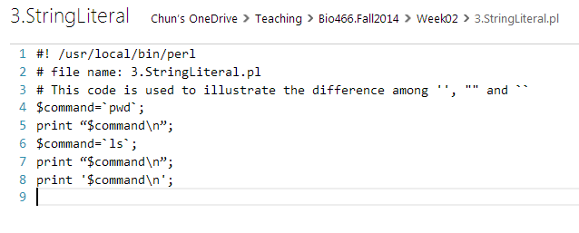
Perl Backtick Strings
You can also enclose a string in backtics (`). This has the unusual property of executing whatever is inside the string as a Linux system command, and returning its output:

Slide 12
List
The last type of literal that Perl recognizes is the list, which is multiple values strung together using the comma operator (,) and enclosed by parentheses.
('one', 'two', 'three', 1, 2, 3, 4.2);
$time=localtime(); an empty list
$X=length('ATG'); a list with one string element
$X=length($Y); a list with one string element
print ($Y); print “$Y”; print “$Y.$Y”; print ($Y.$Y);

Slide 13
Perl Programming Basics
Mechanics of writing Perl code
Variables and values
Literals and List
Operators
Functions
Statements and Blocks
Loops

Slide 14
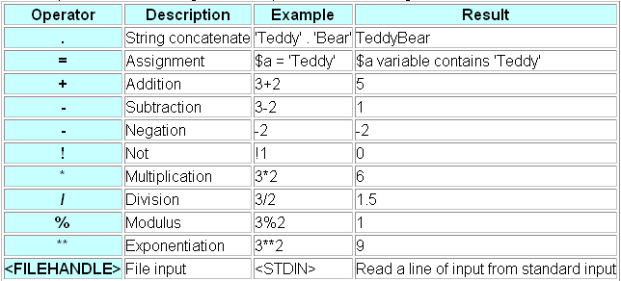
Perl Operators
Numeric and String Operators
Perl has numerous operators that perform operations on string and numeric values.
Operator Precedence

Slide 15
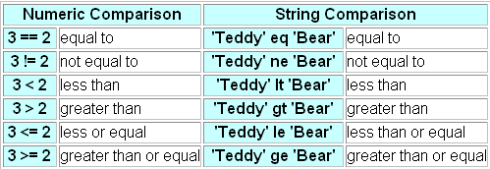
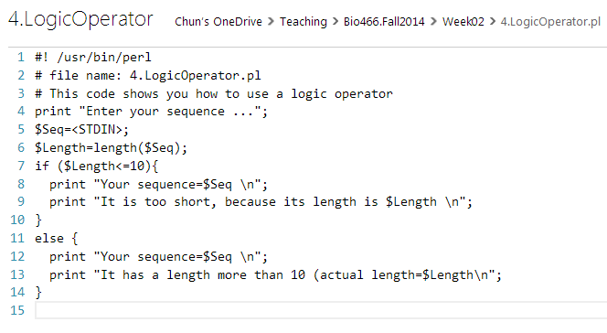
Perl Operators
Logic Operators
These operators compare strings or numbers, returning TRUE or FALSE:
A block of statements

Slide 16
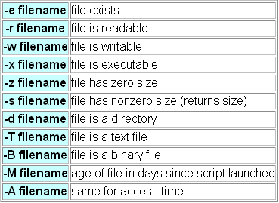
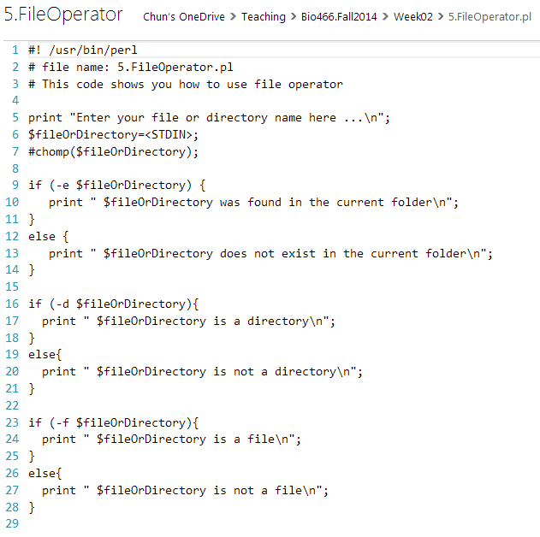
Perl Operators
File Operators
Perl has special file operators that can be used to query the file system. These operators generally return TRUE or FALSE.

Slide 17
Operations on Scalar Variables
$a++; # Increment $a by one $a=$a+1;
$a--; # Decrement $a by one $a=$a-1;
$a += $b; # Modify $a by adding $b to it. $a=$a+$b;
$a -= $b; # Modify $a by subtracting $b from it. $a=$a-$b;
$a *= $b; # Modify $a by multiplying $b to it. $a=$a*$b;
$a /= $b; # Modify $a by dividing it by $b. $a=$a/$b;
$a .= $b; # Modify the string in $a by appending $b to it.
$a=$a.$b

Slide 18
Perl Functions
Perl has many functions. Functions have a human-readable name, such as print and take one or more arguments passed as a list. A function may return no value, a single value (AKA "scalar"), or a list (AKA "array"). You can enclose the argument list in parentheses, or leave the parentheses off.

Slide 19
Example of functions
print (“I am a perl programer!\n”);
length(“ATGC”);
length($Seq);
length($Seq.“ATGC”);
substr($Seq,0,2);
substr($Seq,1,10);

Slide 20
Perl Statements and Blocks
A Perl script consists of statements and comments.
Each statement is a command that is recognized by the Perl interpreter and executed.
Statements are terminated by the semicolon character (;).
Block: A group of statements, using curly braces.
You can execute blocks conditionally.

Slide 21
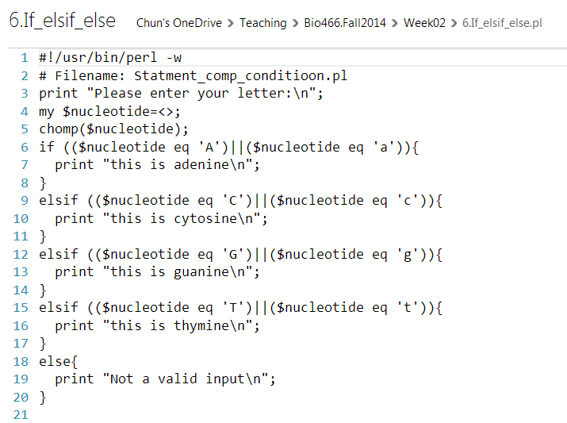
How does computer execute this?
Only one will be executed
Lines 6-8
Lines 9-11
Lines 12-14
Lines 15-17
Lines 18-20
1 -> 2 -> 3 -> 4 -> 5 ->
-> 21 (end of code)

Slide 22
Loops
Repeated execution of a certain block
A fixed number of times
Until a certain condition is met
$x=0;
while ($x<5)‏
{
print “The value of x=[“.$x.”]”;
$x++;
}
What if we use $x<0; $x<=0; $x<=5; or (1)

Slide 23
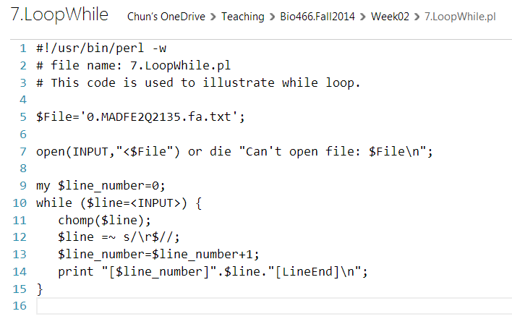
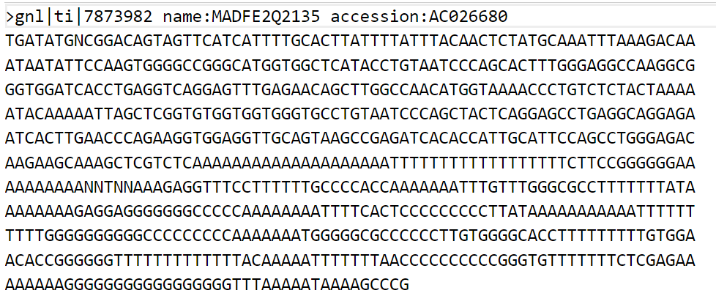
Loops (while)

Slide 24
Loops (for)
for ($x=0; $x<5; $x++)‏
{
print “The value of x=[“.$x.”]”;
}
for ($y=5; $y>0; $y--)‏
{
print “The value of y=[“.$y.”]”;
}

Slide 25
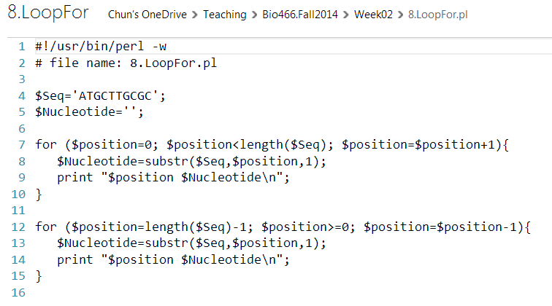
Loops (for)

Slide 26
Loops (foreach)
foreach $value (7,3,-3,5,2)‏
{
print “The value of x=[“.$x.”]”;
}
foreach $value (sort 7,3,-3,5,2)‏
{
print “The value of x=[“.$x.”]”;
}

Slide 27
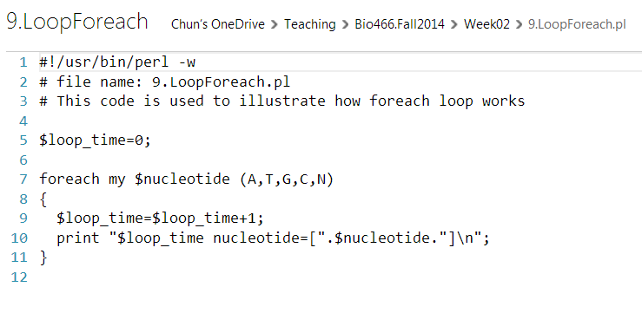
Loops (foreach)

Slide 28
Processing Command Lines
>perl argument.pl arg1 arg2 arg3
#! /usr/local/bin/perl
# file:argument.pl
my $arg1,$arg2,$arg3;
$arg1=shift;
$arg2=shift;
$arg3=shift;

Slide 29
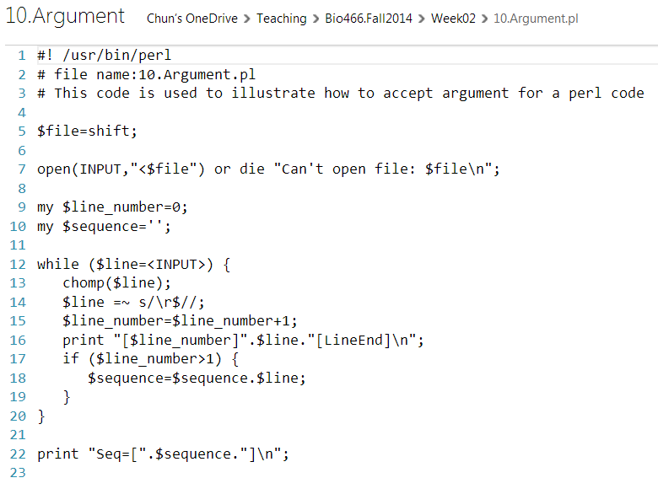

Slide 30
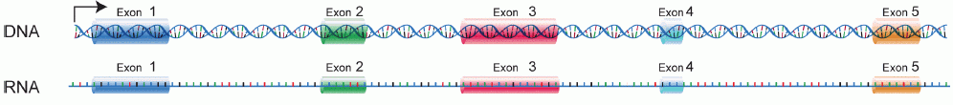

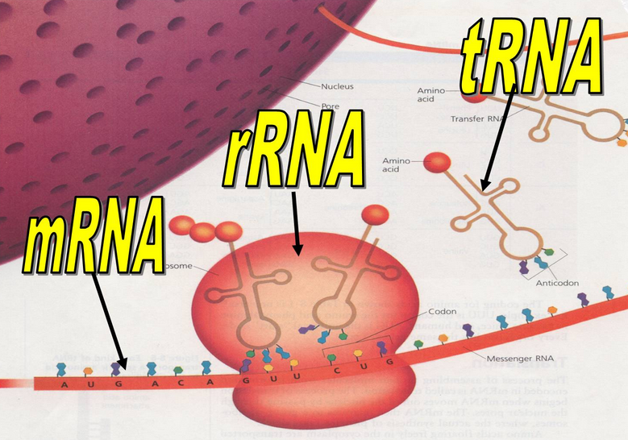
Nucleus: Prokaryotes
Eukaryotes

Slide 31

tRNA
rRNA
mRNA
pre-mRNA: precursor mRNA
RNA Splicing
https://www.dnalc.org/resources/3d/24-mrna-splicing.html
5 prime cap and 3 prime polyadenylation
https://www.youtube.com/watch?v=DoSRu15VtdM

Slide 32
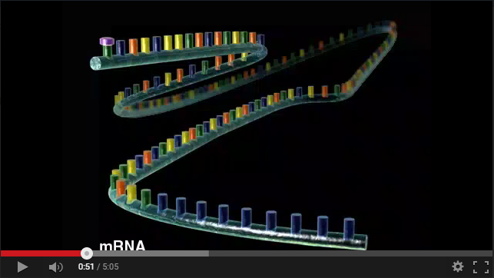
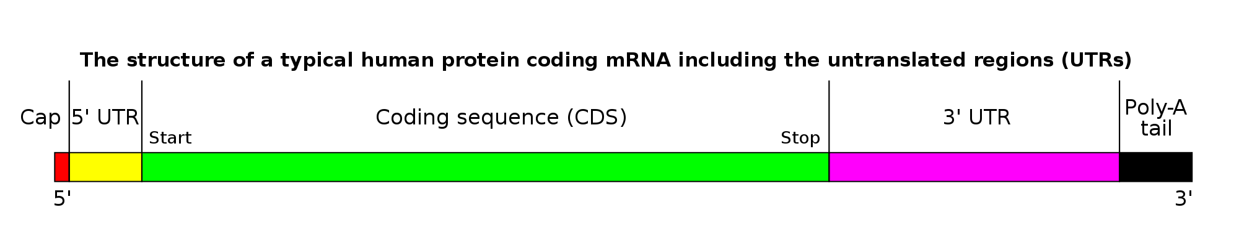
Gene expression Animation
cDNA: complementary DNA

Slide 33
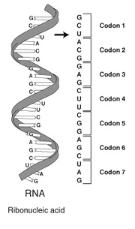
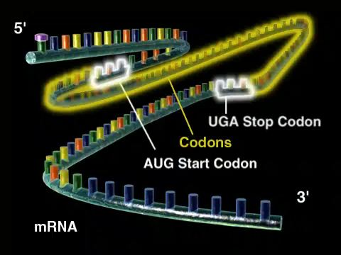
What is mRNA?
Start Codon (AUG, GUG): nucleotide triplet that acts as a signal for the beginning of translation at the ribosome
Stop Codon (UGA, UAG, UAA): nucleotide triplet that signals the end of protein translation
Protein coding regions
Untranslated regions: control how many proteins are produced

Slide 34
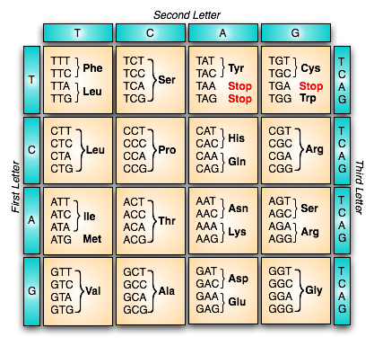
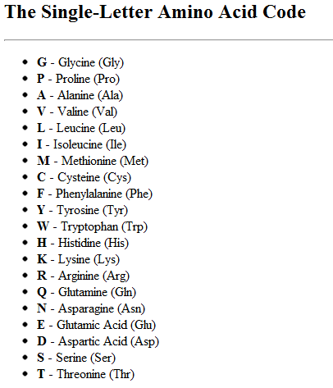
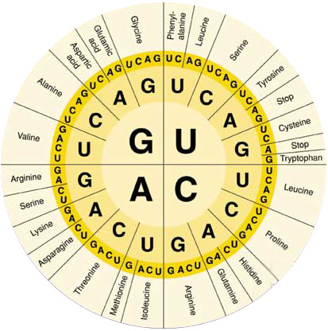
Genetic Code
Stop Codon: *

Slide 35
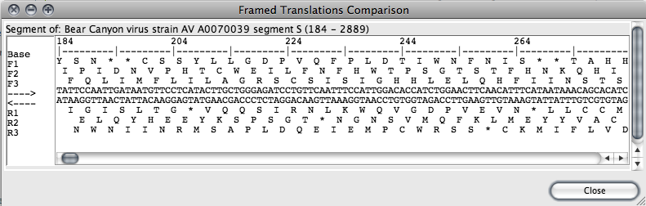
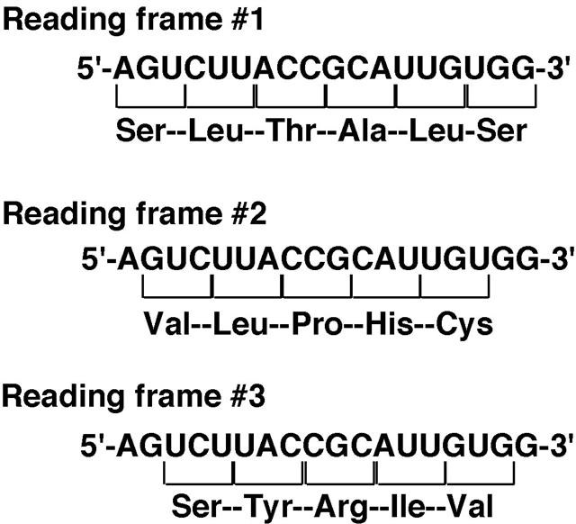
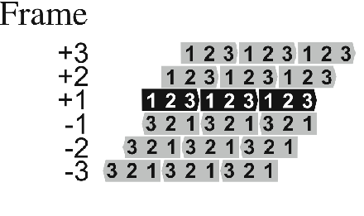
Why we need 6-frame translation?

Slide 36

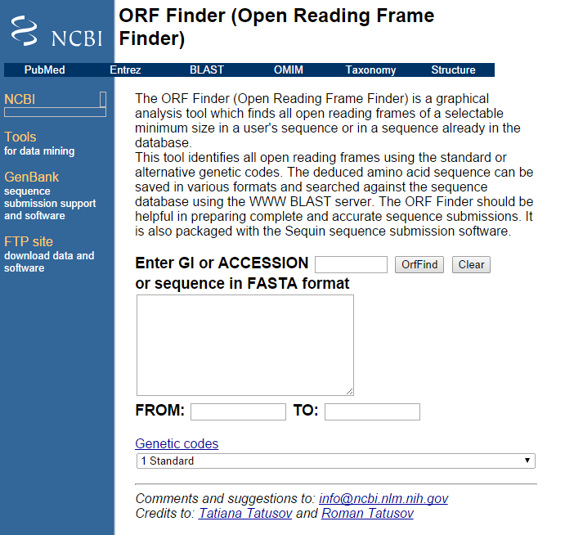
ORF (open reading frame)
>gi|237681126|ref|NR_027676.1|:1-7128

