Slide 1
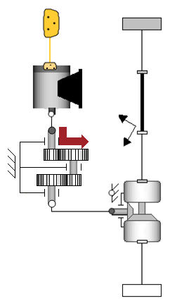
Servomotor
Fixed
rototranslation
Gearbox
Rotational joint

