Slide 1
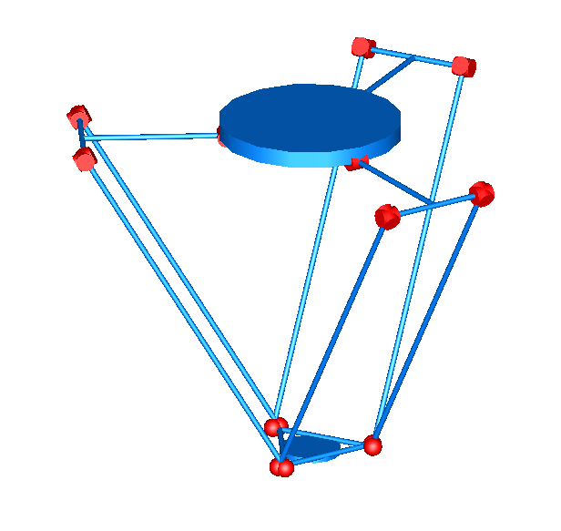
Universal joints
Fixed platform
Upper arm
Actuated joint
Parallelogram
Moving platform
Spherical joints

