Slide 1
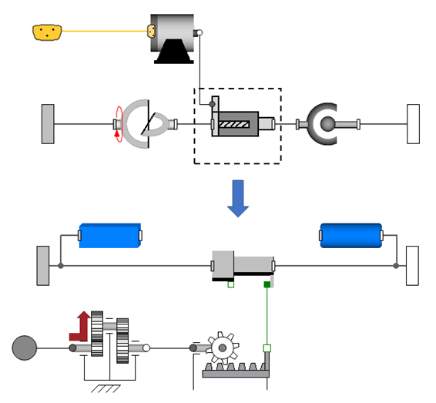
Servomotor
Universal joint
Cylinder
Spherical joint
Stator
Rod
Prismatic joint
Gearbox
Screw drive

