Slide 1
Fractal based Image Compression
NAME: ROHIT SADHU
ROLL: 002010501074
BCSE-IV [2020-2024]

Slide 2
AGENDA
Overview of Fractal Image Compression
Theorem
Why the name Fractals ?
Proposed Algorithm
Results and Compression Statistics
Conclusion
Further Advancements
References

Slide 3
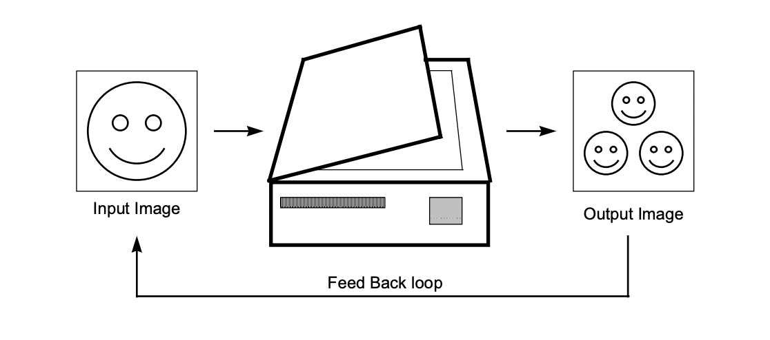
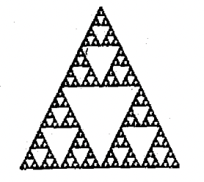
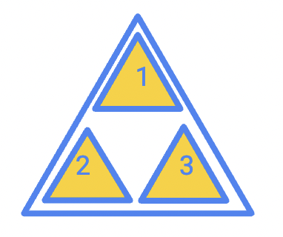
OVERVIEW
Imagine a photocopying machine that takes an input and outputs 3 copies of the input by applying some linear transformations. After several iterations, the resulting output will seem to converge to some image (appearance of self-similar groups) and the input image will get reduced to a point.
This is the concept of fractals, a geometry which exhibits self-similarity, presence of detail at any scale and usually has a fractional dimension.

Slide 4
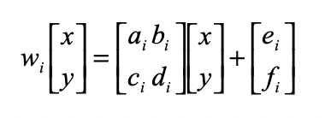
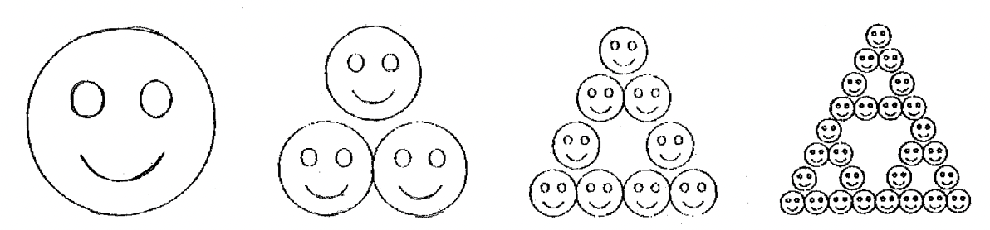
OVERVIEW
Barnsley suggested that storing these images in form of transformations would be more meaningful. (assuming images as subset of R2 space)
The transformations are formally known as affine transformations.
For this transformations should be contractive (Banach's contraction mapping principle) so that several iteration of these finally converges to a unique result (Collage theorem).

Slide 5
THEOREM
A transformation w is said to be contractive if for any two points P1, P2, the distance d(w(P1), w(P2) ) < s * d(P1, P2) [for some s < 1, where d = distance]
Hence, this formula says the application of a contractive map always brings points closer together (by some factor less than 1).
Corollary: If X is a complete metric space and W: X→X is contractive, then W has a unique fixed point. (Completeness comes from Cauchy's theorem of sequences and limit points and metric space refers to Hausdorff space in R^2).

Slide 6
CONTD.
Consequently, the theorem says that from any image (even from a small black pixel) applying W iteratively we can generate any other image only if we know the appropriate affine transformations. This is mind-blowing indeed !
Considering these, it says we can store the Sierpiński triangle image by just six numbers a, b, c, d, e, f which are the affine transformation parameters.
A 8KB image would take up 65,536bits whereas for three affine transformations consisting of six integers each we need only 3*6*32 = 576 bits.

Slide 7
Why the name Fractals ?
The scheme we will see encode an image as a collection of transforms. The decoded image has no natural size, it can be decoded at any size. The extra detail can be generated by the transformations.
Now one may ask, if we take a human image and scale it, we can see the skin cells in it right ?
No, because while encoding we are only taking the details available to us in the digitized version. The detail is not at all related to the details of the actual human body when zoomed in with a microscope. Hence the decoding at larger scales is only due to the affine transforms.

Slide 8
Proposed Algorithm
A typical image of a face, does not contain the type of self-similarity like the fern or triangle. The image does contain other type of self-similarity.
Rather than having the image be formed by whole copies of the original, here the image will be formed by properly transformed parts of the original.
These transformed parts do not fit together, in general (real life scenario), to form an exact copy of the original image, and so we must allow some error in our representation of an image as a set of transformations.

Slide 9
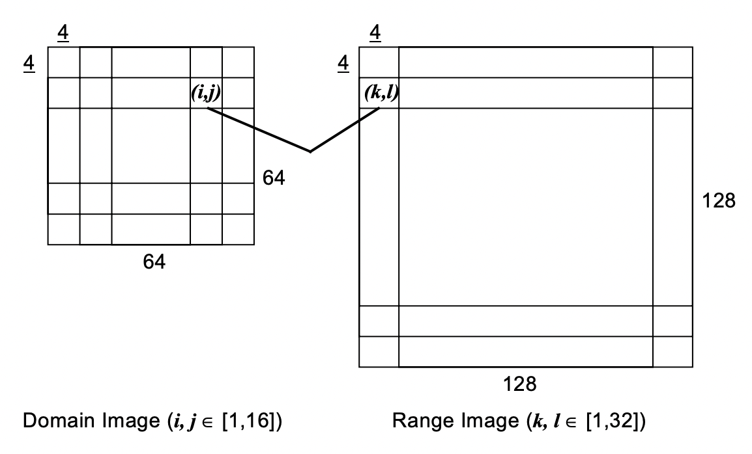
Proposed Algorithm
ENCODING: We will only consider images that are grayscale for easier understanding of calculations here. Suppose we have an 128px X 128px image with 256 levels of gray supported. We will reduce the image by down-sampling (the process of reducing the resolution) and lowpass-filtering(removing noise) it to 64px x 64px image. Now divide the images in grids of 4x4. The smaller one is the domain block and the larger one is the range block.

Slide 10
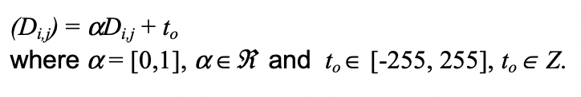

Proposed Algorithm
Now we will try to find linear transformations of our Domain Block to arrive to the best approximation of a given Range Block to find out the affine transformations that transform into the final image (in short generate the IFS) using:
and
To find the domain points approximating to range we will brute force it for each (k, l) in range block: for each a in [0,1]: for each t in [-255, 255]: map (i, j) to (i_, j_) and consider those where difference is minimized (store in a map structure)

Slide 11

Proposed Algorithm
The data structure will store something like: (k1, l1) -> (i11, j11) , (i12, j12), ….. (k2, l2) -> (i21, j21) , (i22, j22), ….. (kn, ln) -> ……
Finally we need to choose one sequence, and we will try out all possible sequences and take the one for which the square of distorting is minimed:
The final values are then stored in the file.

Slide 12
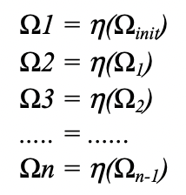
Proposed Algorithm
DECODING: The reconstruction process involves starting with a initial image Ω and applying the transformations repeatedly (upto a certain no. Of iterations provided). Experiments show that images generally converge after near about 7 iterations.

Slide 13
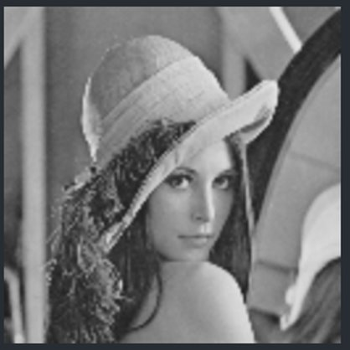
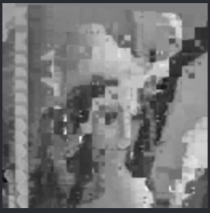
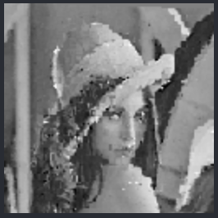
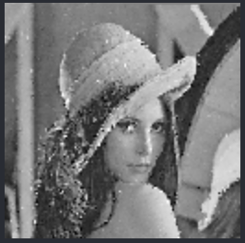
Results
Original Input Image (128px X 128px):
Output Images by various block sizes as described below:
8x8
4x4
2x2

Slide 14
Compression Statistics
Few details of previous images:
Experiments have shown that the compression can be similar to other compression algorithms like jpeg having 50:1 ratios.
Even for some specific imagery like satellites the compression ratios exceed 170:1.
 | I | II
Block size | 4x4 | 2x2
No. Of iterations | 10 | 10
Time to encode | 14.54 s | 99.61 s
Time to decode | 13 s | 33 s

Slide 15
Further Advancements
Now, for colorful pictures we can store 3 Fractal Encodings of a particular image, one representing each of Red, Blue and Green based transformations rather than doing only the grayscale part. This will be even more complex.
With advancements in research several new techniques to reduce the time complexity involved in finding the affine transformation parameters. Such as, Fast Fractal Image Compression (using Quadtree and Pruning) Dictionary Based Compression (Sparse Coding Techniques) and much more...

Slide 16
Conclusion
Pros: The most important feature of Fractal Decoding is that it can generate images at any scales. Ex: human lungs, surveillance systems to get a clear image of intruder etc.
Cons: The encoding part is the most challenging here. It is computationally complex to generate a contractive mapping for an image. This is the reason faster compression techniques like JPEG or MPEG are widely used generally. Also it is a type of lossy compression techniques where certain details get lost at lower bit rates.

Slide 17
References
[1] Guojon Lu, "Fractal image compression", Signal Processing: Image Communication 5 ( 1993), doi: 10.1016/0923-5965(93)90055-X
[2] Texas Instruments, "An Introduction to Fractal Image Compression", Oct 1997, Literature Number: BPRA065

Slide 18
THANK YOU 👋

