Slide 1

Play with WASM
ZiCheng Zhang
Notes:
大家好，我是shenyu社区的张子成，很高兴在Apache亚洲峰会2024和大家见面。首先感谢Apache基金会提供这个舞台，其次感谢帮助过我的社区小伙伴，接下来让我们进入今天的正题：玩转WASM。

Slide 2

1.Introduction
4.Example
2.Motivation
5.Extention
3.Solution
6.Q&A
Notes:
来我们分为4部分来介绍，第1点是关于shenyu及个人的介绍，第2点是shenyu引入WASM技术的动机，在第3点中我们会深入探讨多语言SDK、本地转发、动态链接库和WASM这几种方案之间的优劣，而后讲述如何在shenyu中扩展一个WASM插件，最后时间留给QA。

Slide 3
Introduction
https://github.com/loongs-zhang/ACOCA2024-PlayWithWASM
Notes:
本次分享的PPT及相关资源可以在我的github上获取。

Slide 4

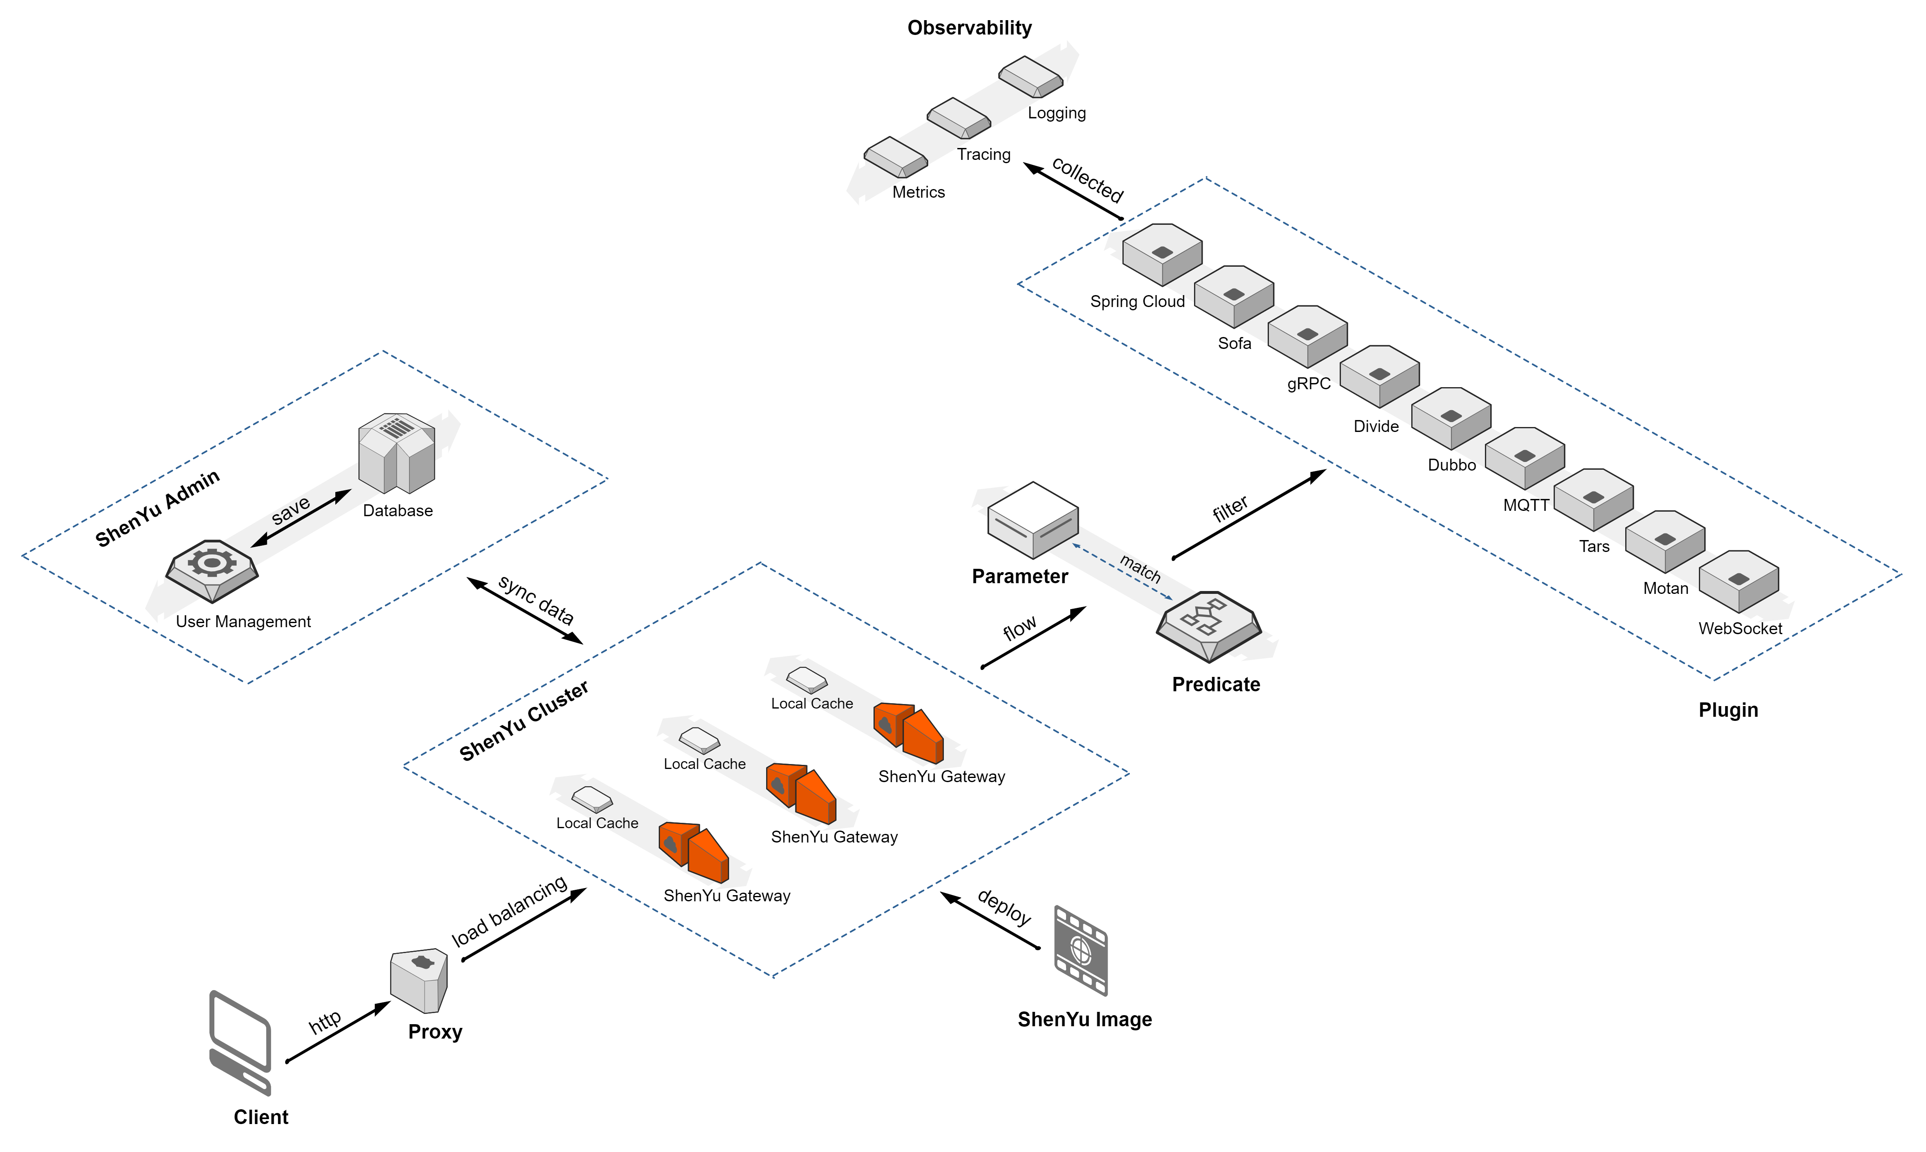
About Apache ShenYu
Apache ShenYu is a Java native API Gateway for service proxy, protocol conversion and API governance.
Notes:
网关、admin、注册中心、

Slide 5
Apache ShenYu Features
* Proxy: Support for Apache® Dubbo™, Spring Cloud, gRPC, Motan, SOFA, TARS, WebSocket, MQTT
* Security: Sign, OAuth 2.0, JSON Web Tokens, WAF plugin
* API governance: Request, response, parameter mapping, RateLimiter plugin
* Observability: Tracing, metrics, logging plugin
* Dashboard: Dynamic traffic control, visual backend for user menu permissions
* Extensions: Plugin hot-swapping, dynamic loading
* Cluster: NGINX, Docker, Kubernetes
* Language: provides .NET, Python, Go, Java client for API register

Slide 6


About Me
https://github.com/loongs-zhang
Apache ShenYu PMC
The founder of open-coroutine project
Contributes in shenyu/dynamic-tp/monoio/dubbo
Java&Rust developer
One of the creators of arthas vmtool
Created MemorySafeLinkedBlockingQueue

Slide 7
Motivation

Slide 8
Why
ShenYu has good extensibility in the Java. However, we can’t extend ShenYu plugin in languages other than Java.

Slide 9
Solution

Slide 10
Evaluation Criteria
Workload: The workload of framework developers
Difficulty: Difficulty for framework developers
User friendliness: User's learning cost
Operation complexity: The complexity of deploying service using this framework

Slide 11
Multiple Language SDKs
Example: https://github.com/apache/dubbo-go
Workload: Huge, each language has its own technology stack
Difficulty: Hard
Extention for new languages: Unsupported
User friendliness: Great
Performance: Great
Operation complexity: No

Slide 12
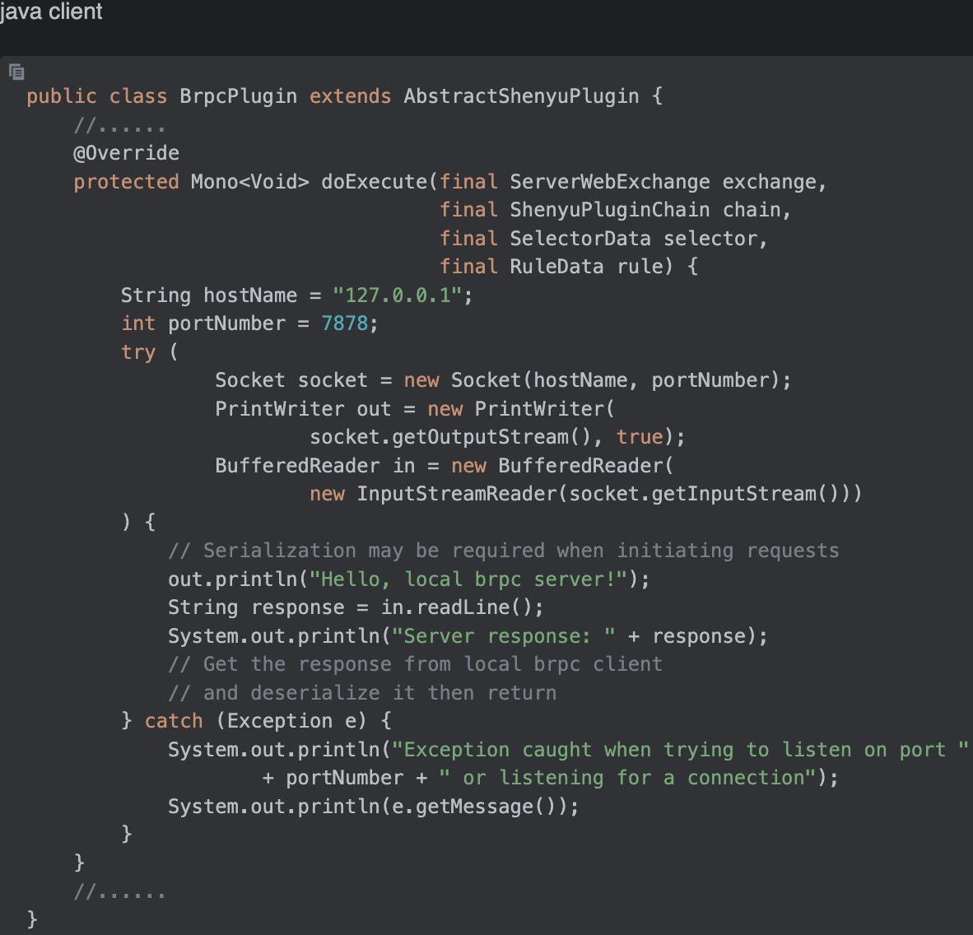
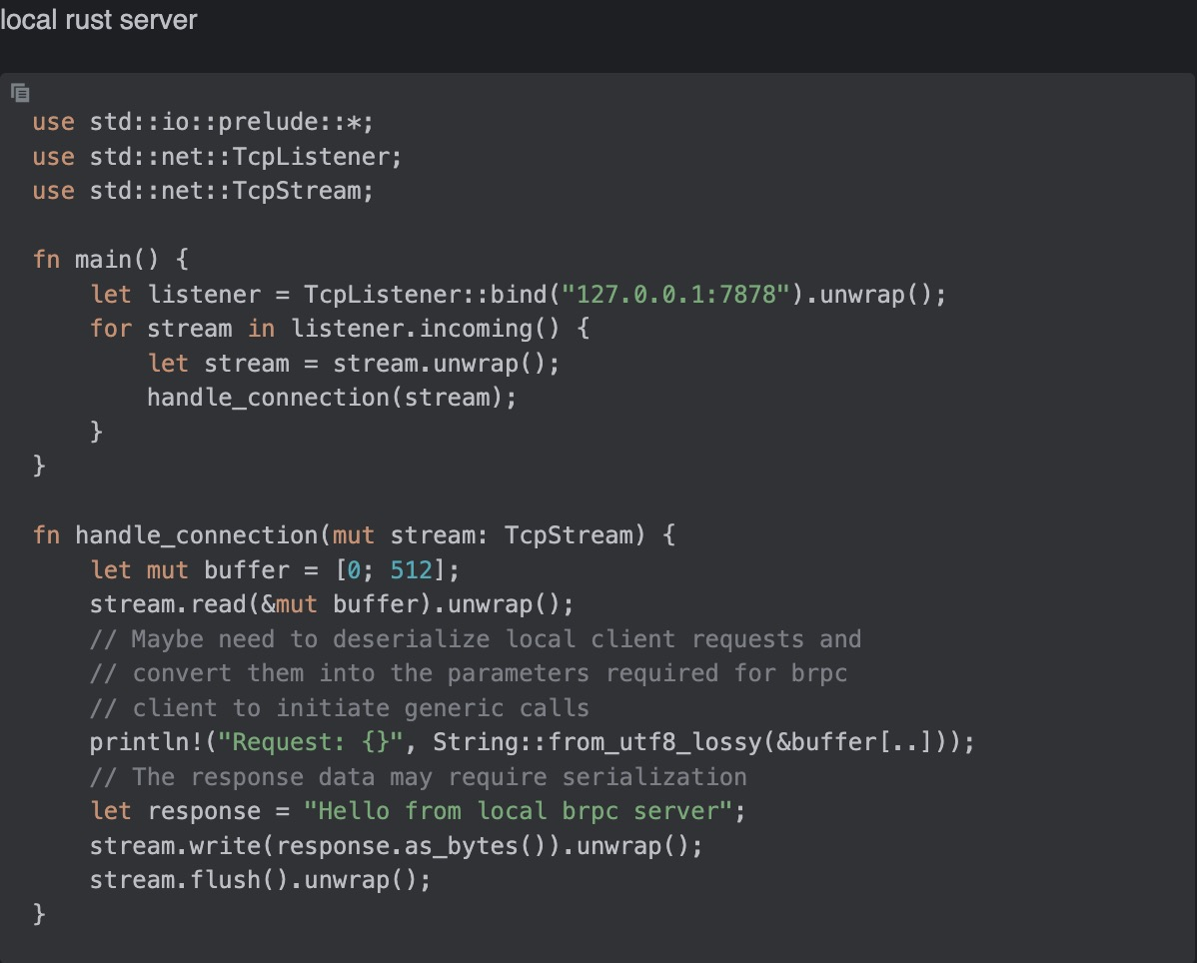
Local Forward Example
This is example for supporting the brpc protocol for shenyu

Slide 13
Local Forward
Example: https://github.com/apache/apisix
Workload: Light
Difficulty: Middle, need to be familiar with network programming
Extention for new languages: Great, no need to modify framework code
User friendliness: Middle, need to be familiar with network programming
Performance: Performance loss due to network protocol stack, serialization and deserialization, at least 20%
Operation complexity: A bit complex, multiple processes need to be started at once on a machine/container

Slide 14
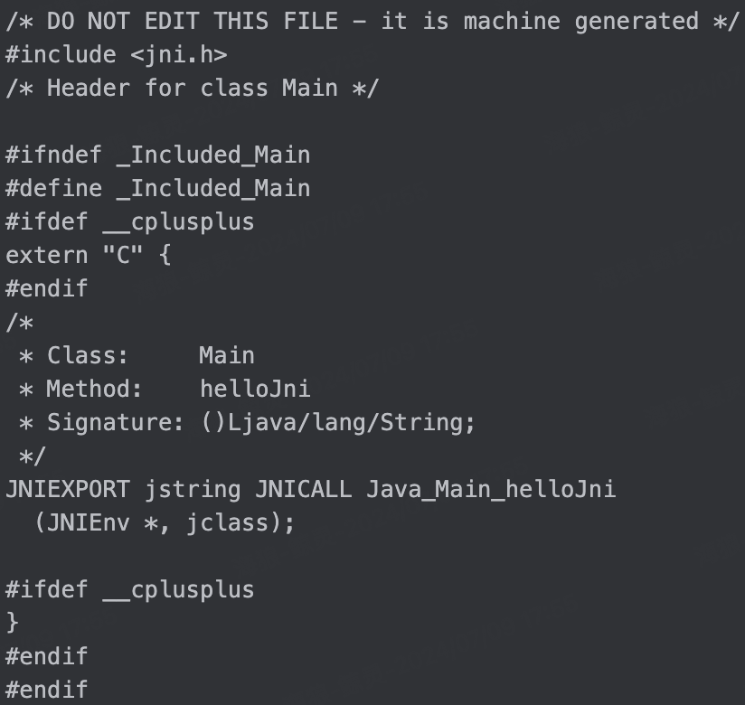
Dynamic Link Library Example
public class Main {
public static native String helloJni();
}
javac -h . Main.java
Then we got Main.h -------------->

Slide 15
Dynamic Link Library Example
// C code below
#include <jni.h>
#include <jni_md.h>
#include <jvmti.h>
#include "Main.h"
JNIEXPORT jstring JNICALL
Java_Main_helloJni (JNIEnv *env,
jclass klass) {
return env->
NewStringUTF("Hello JNI");
}
// generate the dynamic link library by g++ command in macos
g++ -I ${JAVA_HOME}/include
-I ${JAVA_HOME}/include/darwin jni-library.cpp -m64 -fPIC -shared -o jni.dylib

Slide 16
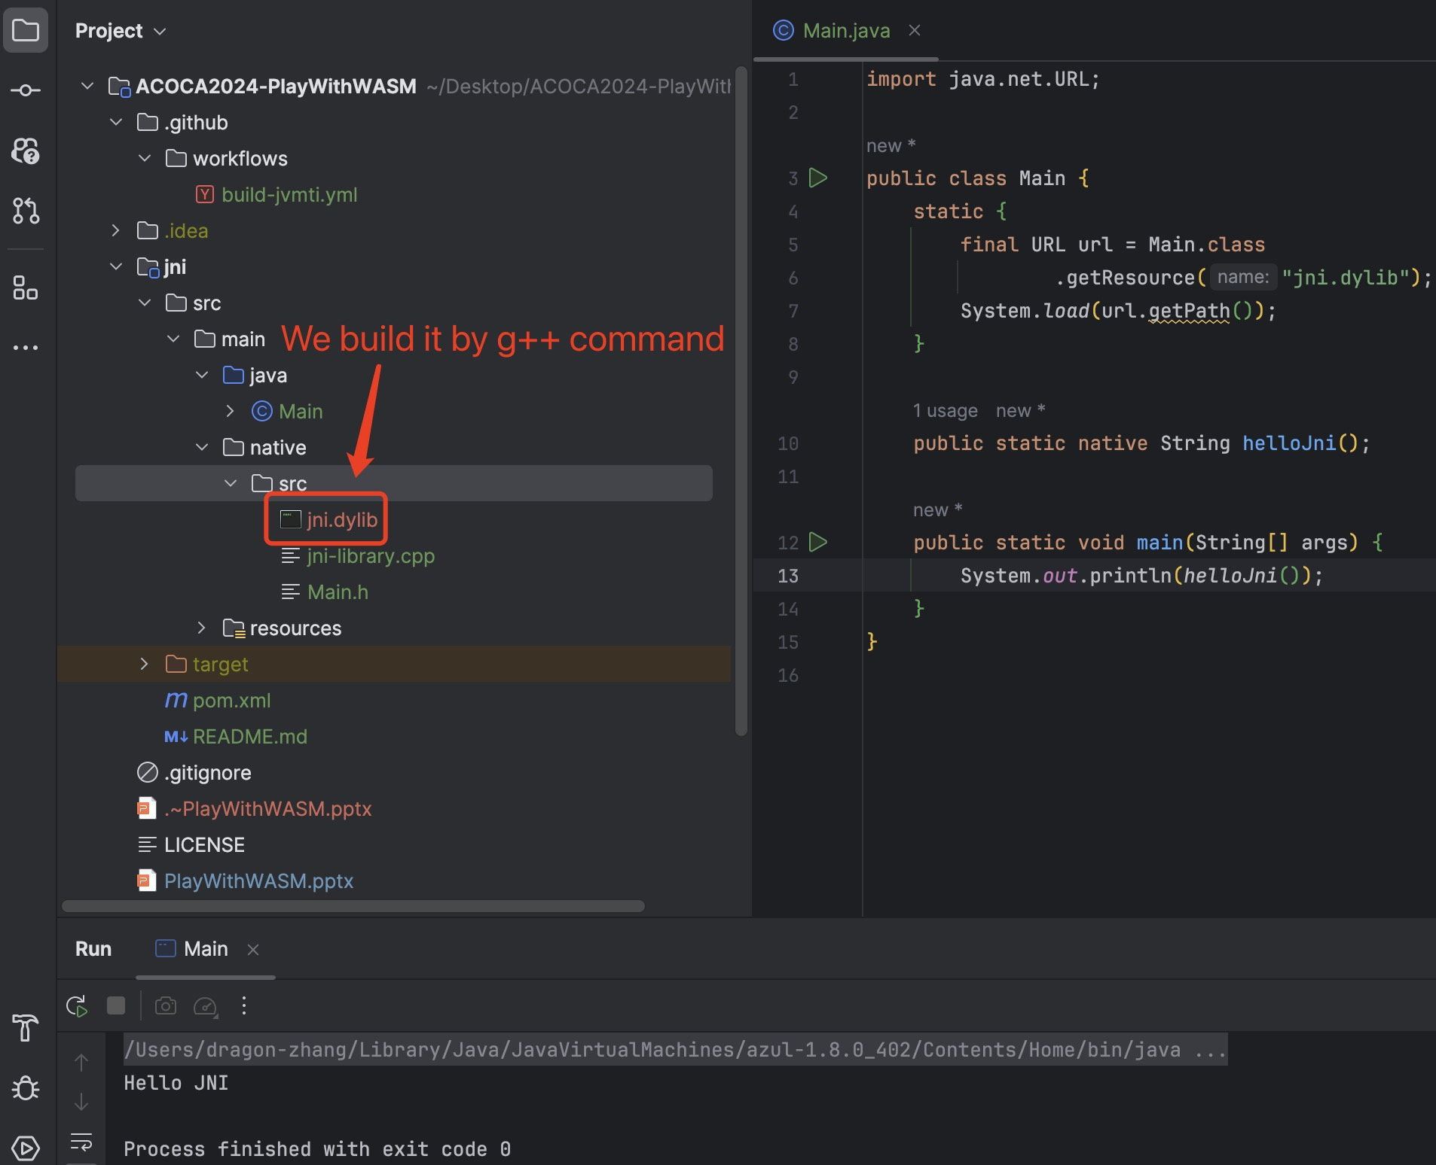
Dynamic Link Library Example
import java.net.URL;
public class Main {
static { final URL url = Main.class.getResource("jni.dylib");
System.load(url.getPath());
}
public static native String helloJni();
public static void main(String[] args) {
System.out.println(helloJni());
}
}
//

Slide 17
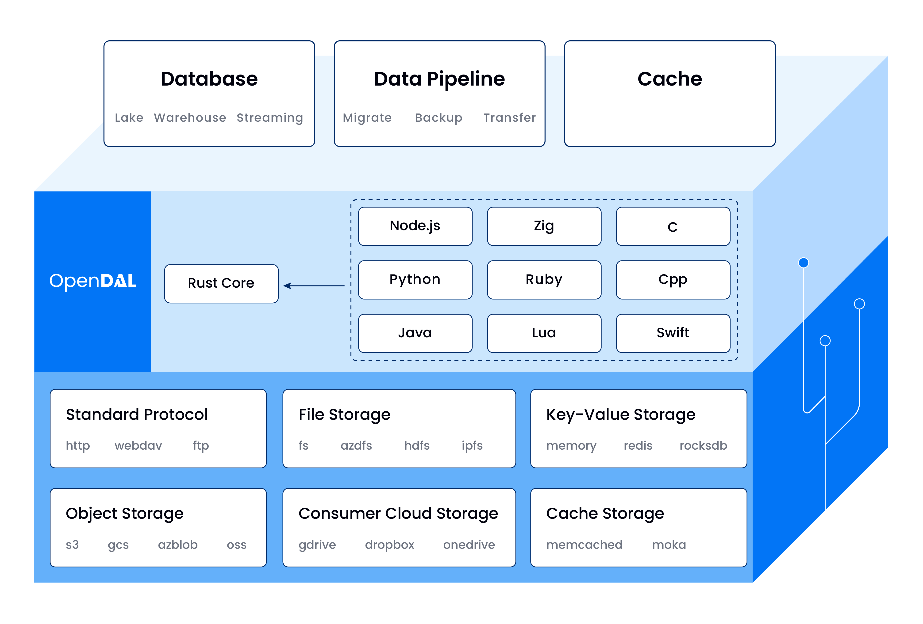
Dynamic Link Library
The low-level code needs to ensure compatibility(OS & CPU);
Each supported language is bound to .so/.dylib/.dll as the upper-level;

Slide 18
Dynamic Link Library
Example: https://github.com/apache/opendal
Workload: Middle
Difficulty: Hard, not only do you need to be familiar with cross platform development, but you also need to learn JNI knowledge in addition
Extention for new languages: Middle, need to encapsulate the dynamic link library for new languages
User friendliness: Good, there is a low probability of discovering that the CPU architecture or OS of your machine is not supported, but if it is, a disaster occurs
Performance: Great
Operation complexity: No

Slide 19
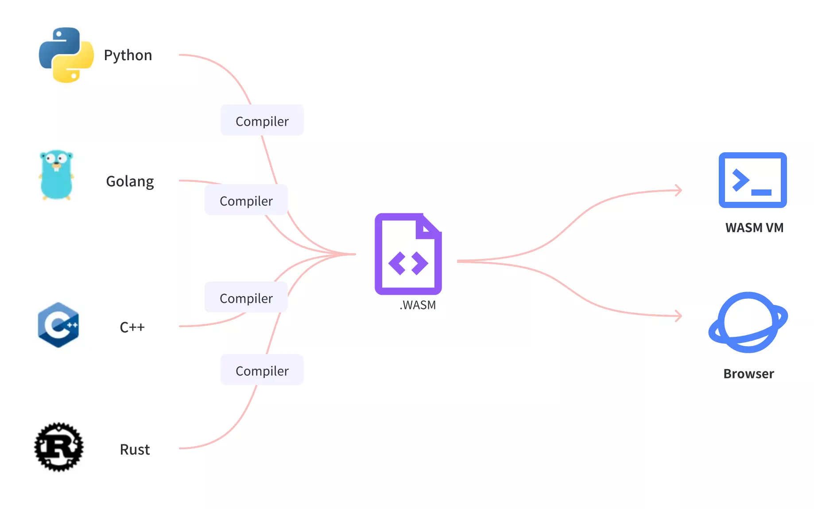
WebAssembly System Interface
WebAssembly or wasm is a new, portable, size- and load-time-efficient format suitable for compilation to the web.
WASI allows WASM to run in non browser environments such as Linux.

Slide 20
WebAssembly System Interface
Example: https://github.com/alibaba/higress
Workload: Light
Difficulty: Simple
Extention for new languages: Good, no need to modify framework code, but it's possible that the language you're good at doesn't support WASM
User friendliness: Good, only 4 basic Java types are supported due to the immaturity of the WASM ecosystem in Java
Performance: Performance loss due to serialization and deserialization
Operation complexity: No

Slide 21
Comparation
 | Example | Workload | Difficulty | Extention | Friendliness | Performance | Complexity
SDKs | dubbo-go | huge | hard | unsupported | great | great | no
Local Forward | apisix | light | middle | great | middle | network, serialization, deserialization | start processes
Native Library | opendal | middle | hard | middle | good | great | no
WASI | higress | light | simple | good | good | serialization, deserialization | no

Slide 22
Example
Notes:
接下来是一个在shenyu代理http服务的例子

Slide 23
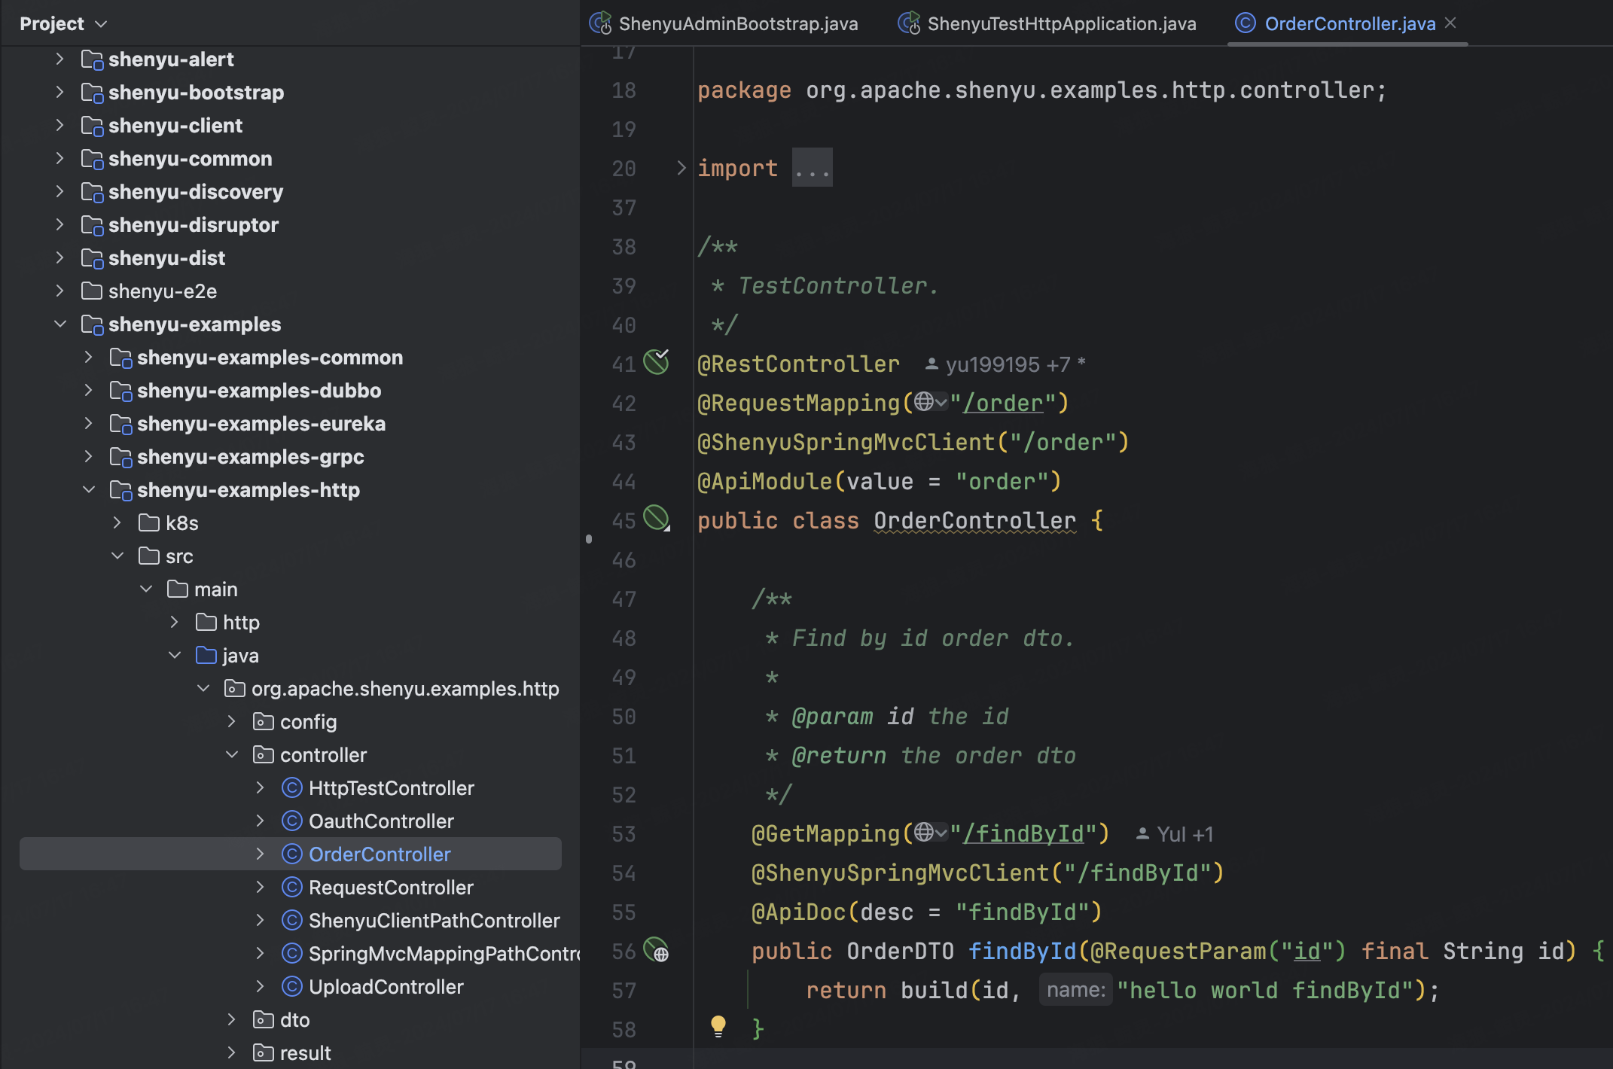
Deploy shenyu-admin&shenyu-examples-http
https://shenyu.apache.org/docs/next/deployment/deployment-before
https://shenyu.apache.org/docs/next/quick-start/quick-start-http

Slide 24
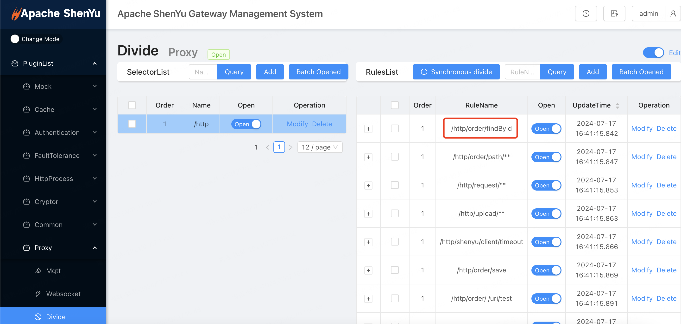
Registered selector and rules
https://shenyu.apache.org/docs/next/quick-start/quick-start-http

Slide 25
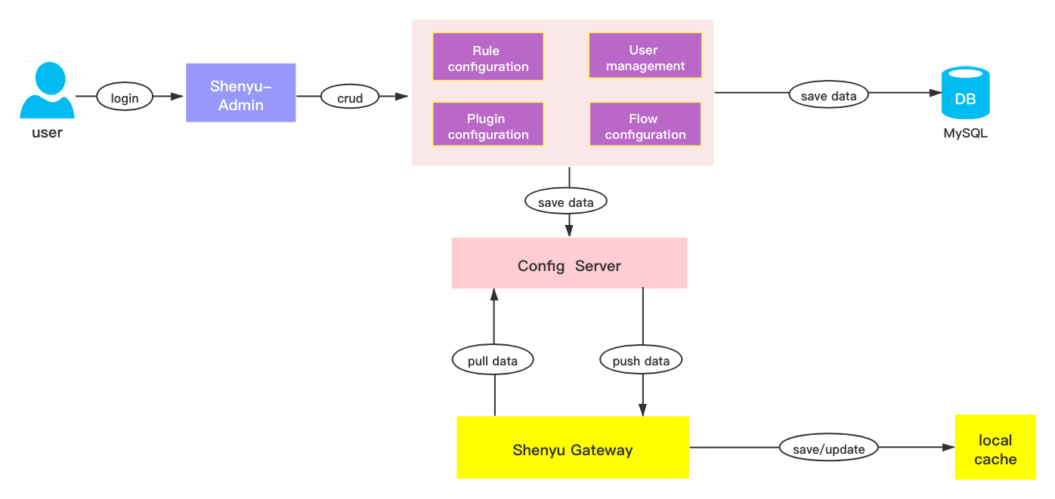
Data Sync
https://shenyu.apache.org/docs/next/quick-start/quick-start-http

Slide 26
Deploy shenyu-bootstrap
https://shenyu.apache.org/docs/next/deployment/deployment-local

Slide 27
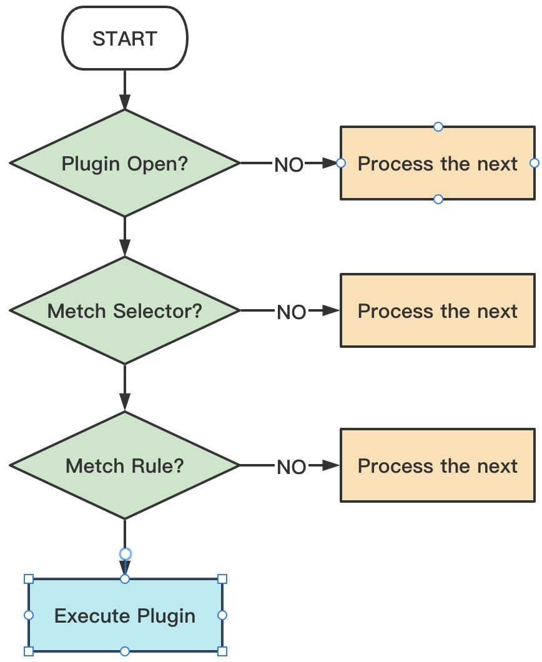
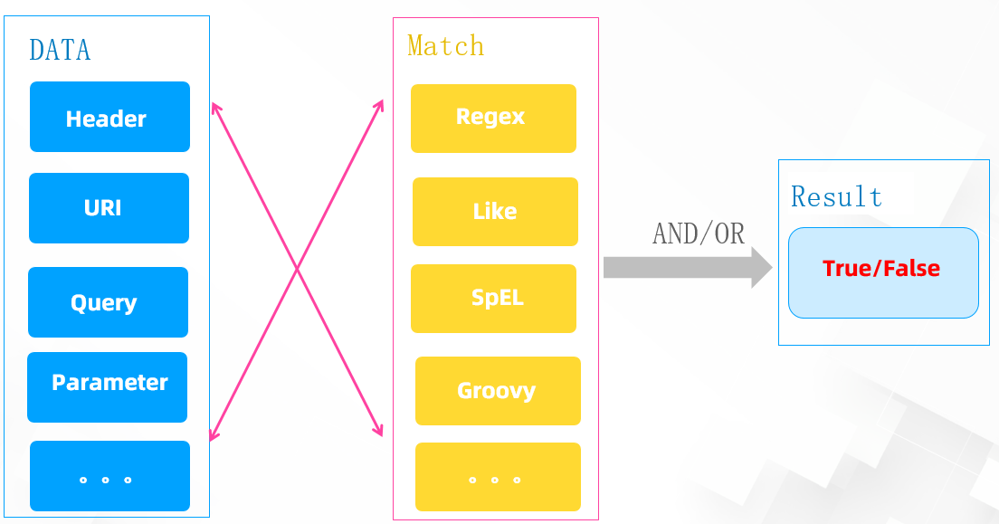
Runtime in shenyu-bootstrap

Slide 28
Collaboration between Plugins
GlobalPlugin
DividePlugin
NettyHttpClientPlugin

Slide 29
Extention

Slide 31
Step1: Add Dependency
Assuming we already have a Maven project.
<dependency>
<groupId>org.apache.shenyu</groupId>
<artifactId>shenyu-plugin-wasm-api</artifactId>
<version>${shenyu.version}</version>
</dependency>

Slide 32
Step2: Implement the Java Part

Slide 34
Question&Answer

Slide 35
Question&Answer
The friendship project link is as follows:
https://github.com/acl-dev/open-coroutine
https://github.com/acl-dev/acl
https://github.com/alibaba/arthas
https://github.com/bytedance/monoio
https://github.com/dromara/dynamic-tp
https://github.com/apache/dubbo-spi-extensions

Slide 36
Thanks
zhangzicheng@apache.org
https://github.com/loongs-zhang/ACOCA2024-PlayWithWASM

