Slide 1
Towards Trustworthy Integration of Generative AI in the MBSE Development Lifecycle
Amer Tahat, Isaac Amundson, David Hardin, Darren Cofer
^{25th}Annual High Confidence Software and Systems (HCSS 2025)
May 14, 2025
Distribution Statement “A” (Approved for Public Release, Distribution Unlimited).
© 2025 Collins Aerospace. | This document does not include any export controlled technical data.
Notes:
<number>

Slide 2










DARPA PROVERS
Pipelined Reasoning of Verifiers Enabling Robust Systems
Develop automated, scalable formal methods tools that are integrated into traditional development pipelines
Enable traditional product engineers to incrementally produce and maintain high-assurance national security systems
Barriers to formal methods adoption
Scalability to support real-world systems
The UI targets formal-methods experts, creating a learning curve for others.
Lack of commercially licensed / supported tools
Formal methods skillset required
Property specification language
Explainable counterexamples
GenAI's Potential: Accelerates system development — but trust, correctness, and consistency must be non-negotiable.
<number>
© 2025 Collins Aerospace. | This document does not include any export controlled technical data.
Notes:
<number>

Slide 3
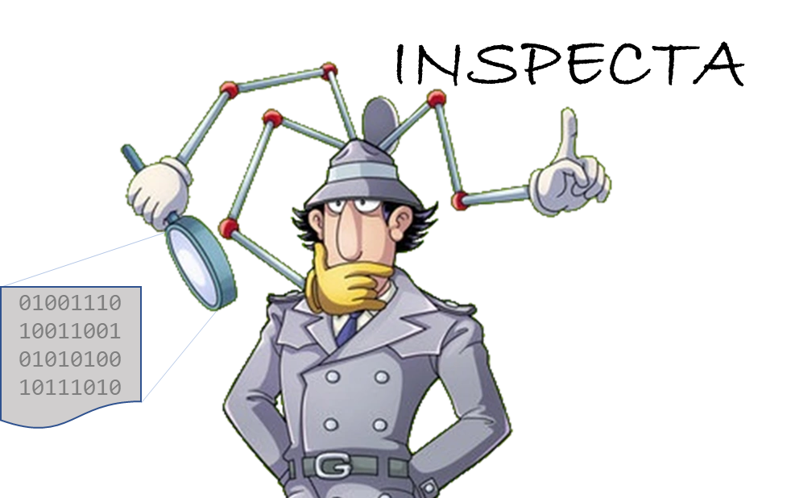
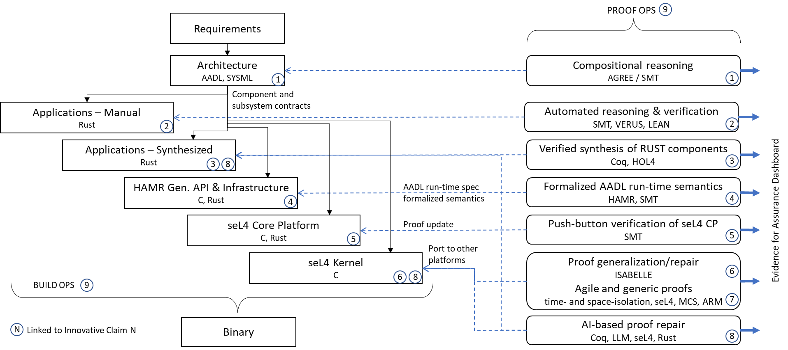
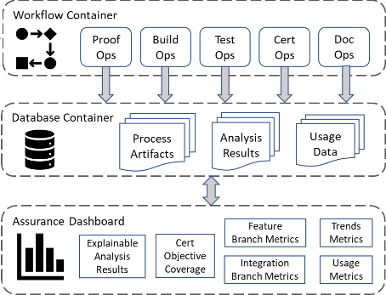

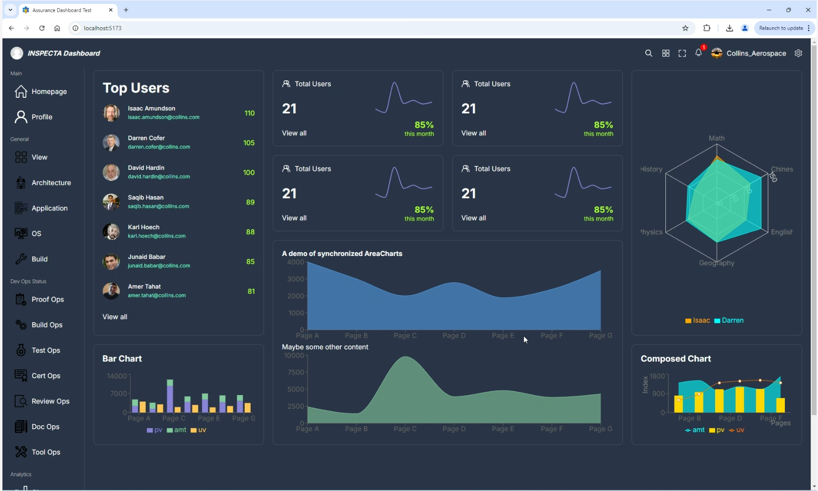
INSPECTA
Industrial-Scale Proof Engineering for Critical Trustworthy Applications
Cloud-based DevOps
Role of AGREE Copilot ( AGREE-Dog ):
→ Creates a trust fabric for AI-accelerated MBSE engineering.
<number>
© 2025 Collins Aerospace. | This document does not include any export controlled technical data.
Notes:
<number>

Slide 4
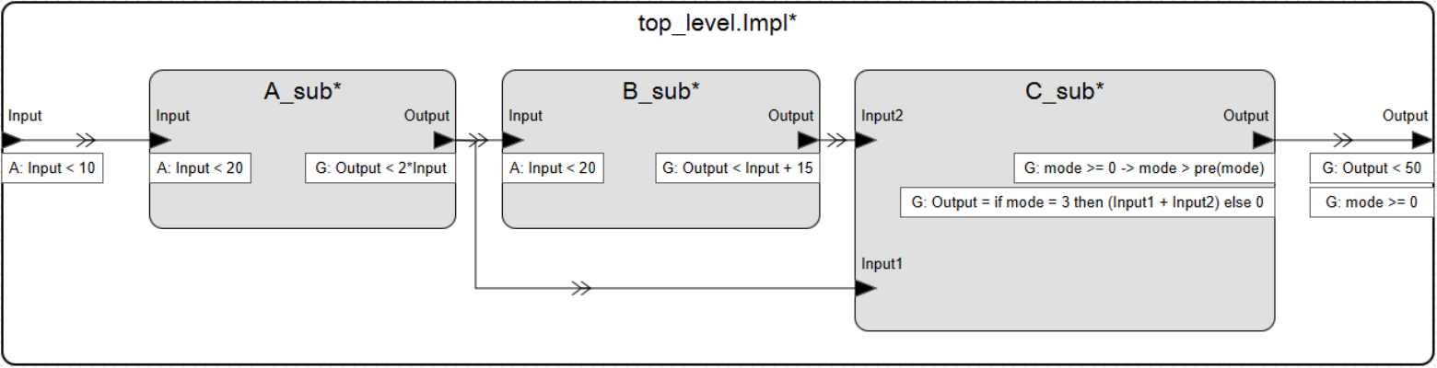


Compositional Reasoning with AGREE
Assume Guarantee Reasoning Environment
Assume-Guarantee annex for AADL architecture models
Assumptions describe the expectations that a component has on the environment
Guarantees describe bounds on the behavior of the component when assumptions are valid
Compositional analysis to prove correctness of:
Component interfaces (component assumptions are satisfied by upstream guarantees)
Component implementations (component assumptions and subcomponent guarantees satisfy guarantees)
Input < 10 → Output < 18
Input < 20 → Output < 38
<number>
© 2025 Collins Aerospace. | This document does not include any export controlled technical data.

Slide 5
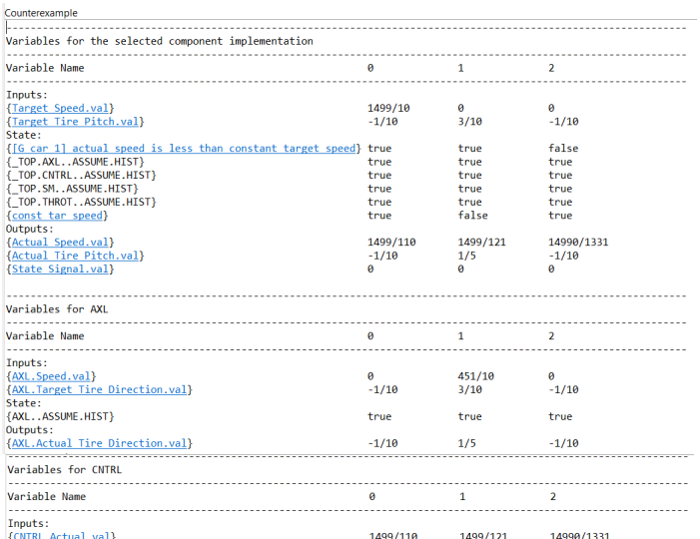
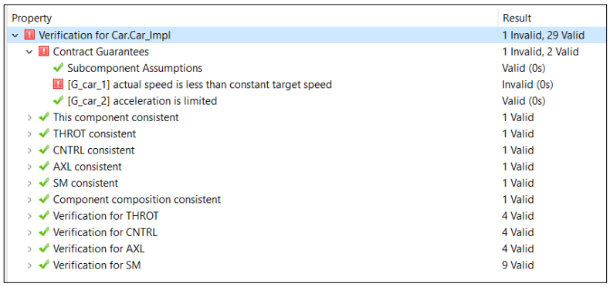
AGREE Counterexamples
Before AgreeDog: costly and error-prone manual interpretation of counterexamples, requirements, logs, and models — sometimes taking days or weeks to complete repairs!
<number>
© 2025 Collins Aerospace. | This document does not include any export controlled technical data.

Slide 6
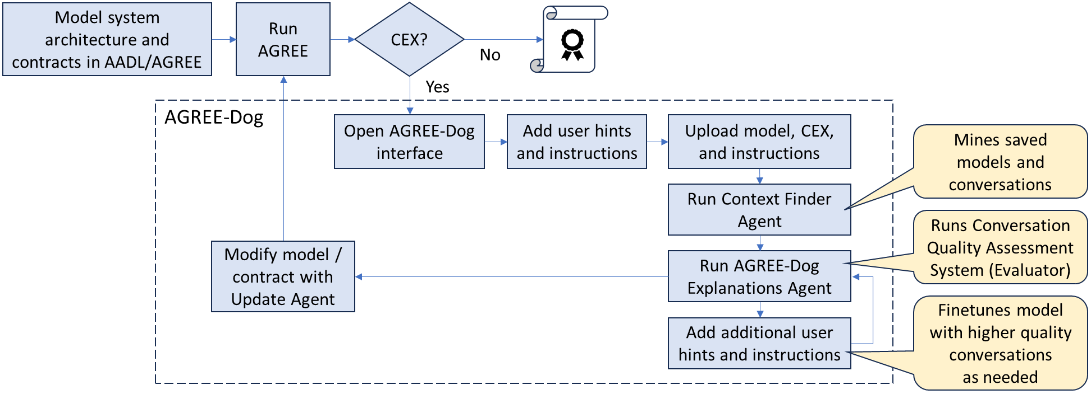
Toward Trusted Gen AI in the MBSE Lifecycle
Early trials of AGREE-Dog—have reduced system-level repair cycles from days/weeks to minutes/seconds, delivering substantial time savings.
Powered by GPT-4o, O3, and GPT-4.1 multimodal models.
Valid?
<number>
© 2025 Collins Aerospace. | This document does not include any export controlled technical data.
Notes:
GPT-4o multi-modal model
<number>

Slide 8
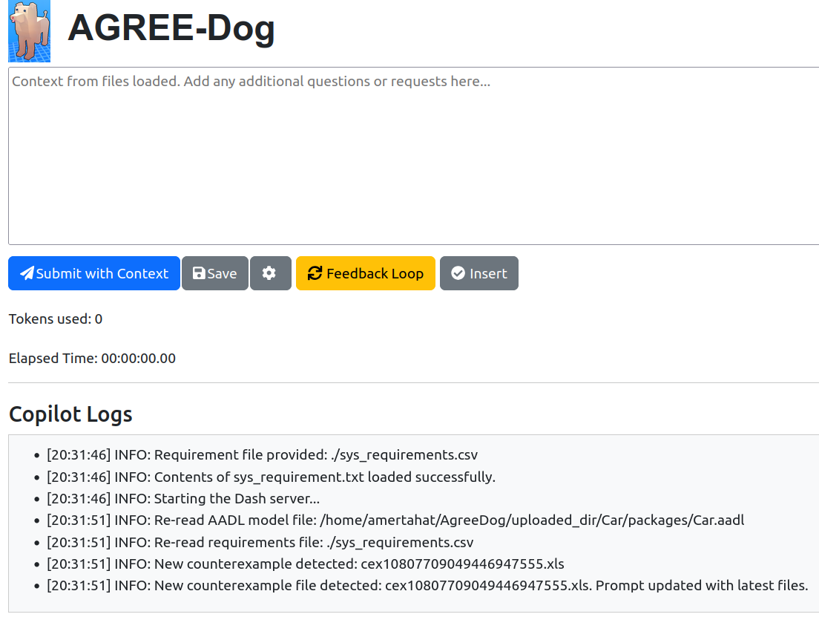
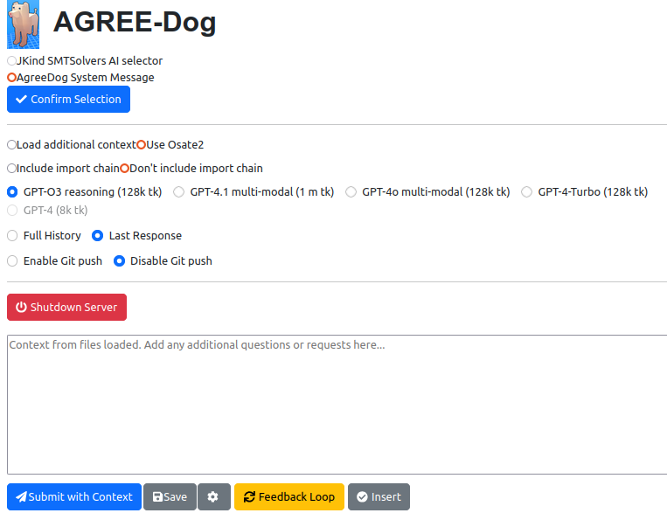
Toward Trusted Gen AI in the MBSE Lifecycle
Advanced settings menu
This document does not include any export-controlled technical data.
<number>
© 2025 Collins Aerospace. | This document does not include any export controlled technical data.
Notes:
GPT-4o multi-modal model
<number>

Slide 9
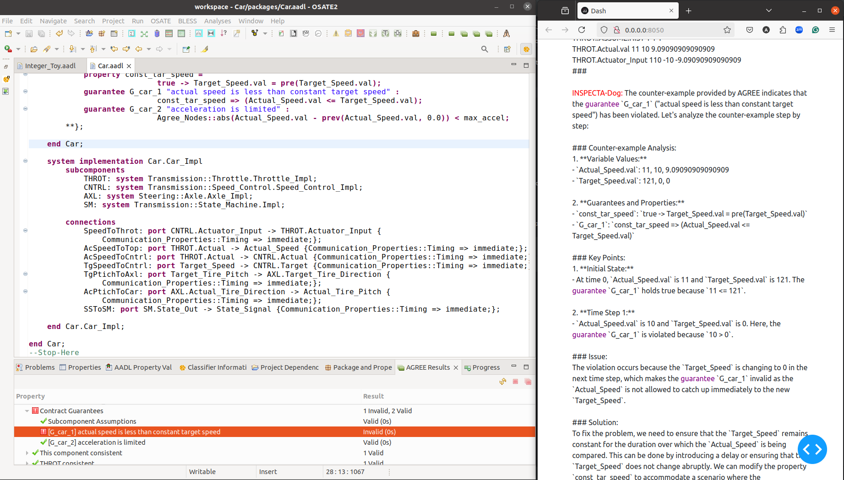

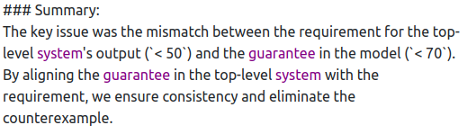
AGREE-Dog: Counterexample Analysis and Resolution
Analysis
Detection
Repair
<number>
© 2025 Collins Aerospace. | This document does not include any export controlled technical data.

Slide 10
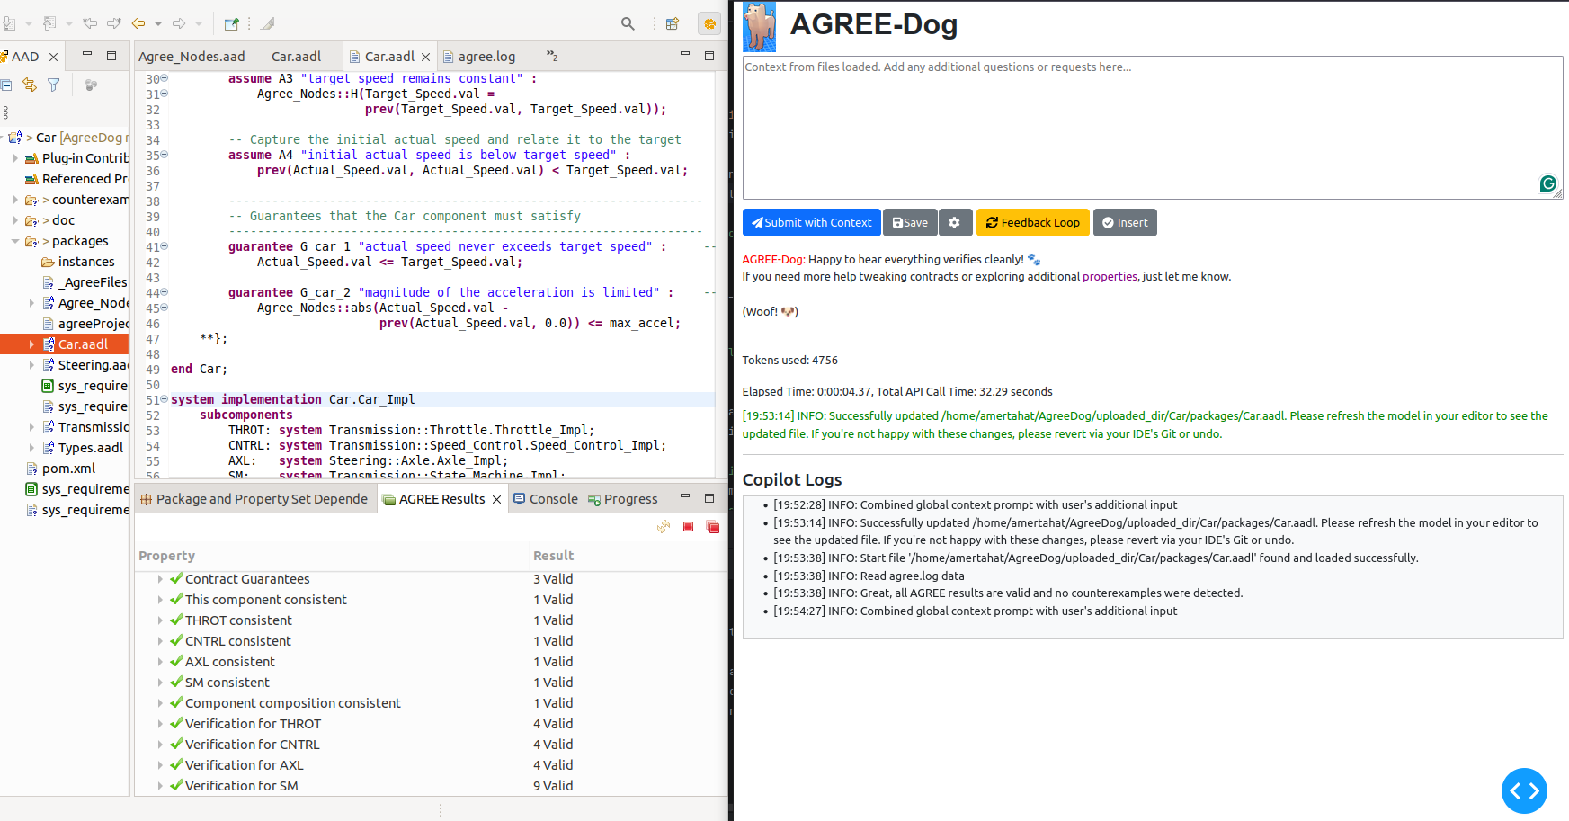

Toward Trusted Gen AI in the MBSE Lifecycle
– Reads project + NL sys requirements + CEX + agree.log
– Explains violation in natural language
– Suggests repairs
– 1–Click application → full AGREE re-check → Git push
This document does not include any export-controlled technical data.
<number>
© 2025 Collins Aerospace. | This document does not include any export controlled technical data.
Notes:
GPT-4o multi-modal model
<number>

Slide 11
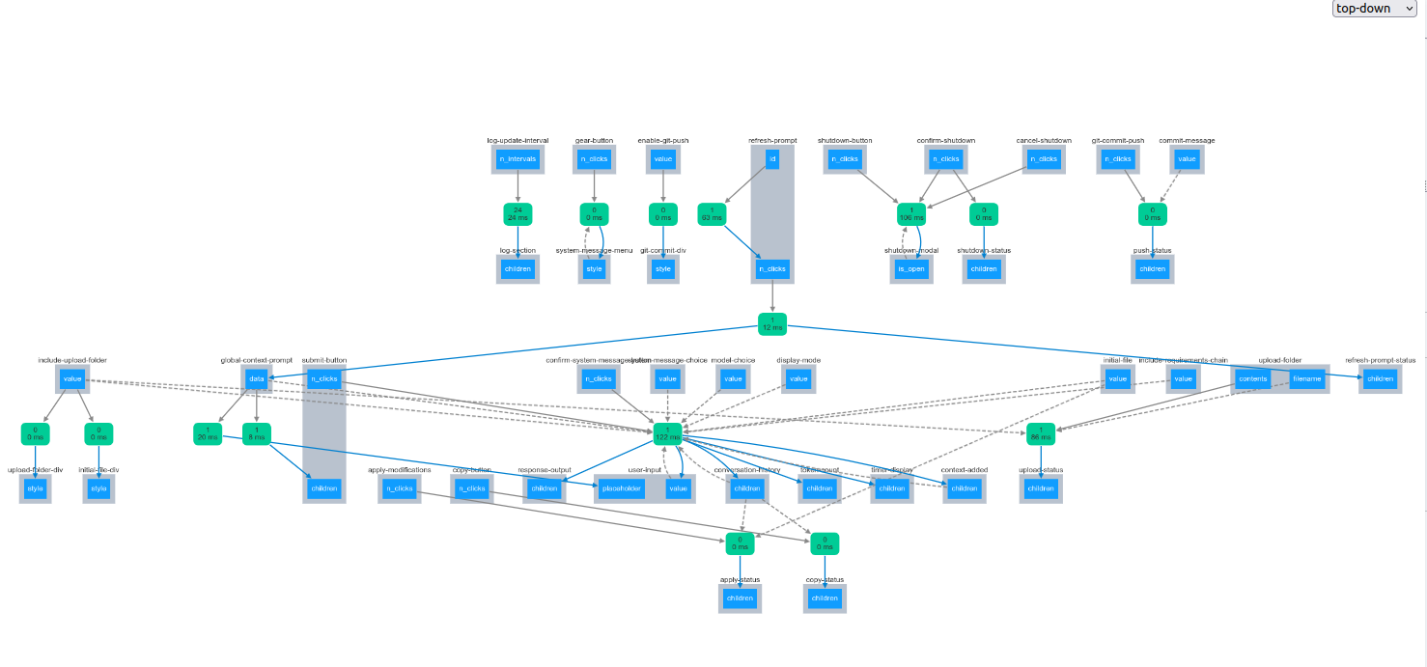
AgreeDog System Call-Graph Complexity
Traditional Workflow: Tens of interdependent calls & manual back-and-forth
AGREE-Dog Approach:
Collapses complex interactions into a single recommendation step
Minimizes manual navigation of call-graphs and dependencies
→ Dramatic reduction in user effort via push-button UI.
AGREE-Dog significantly automates 16 DevOp and ProofOp ➔ drastic user effort reduction
This document does not include any export-controlled technical data.
<number>
© 2025 Collins Aerospace. | This document does not include any export controlled technical data.
Notes:
GPT-4o multi-modal model
<number>

Slide 12
Ongoing Experimental Evaluations:
Test bed: We created 13 test scenarios for an autonomous‐vehicle (Car) AADL model—each scenario comprising 400 LoC models, <100 LoC CEX, <100 LoC sys requirements, and agree Logs. Total ∼10,000 LoC
Fault Injection: We injected faults into three key components (Top-level Control System, Steering, and Transmission) and ran a full AGREE-Dog repair “conversation” for each.
<number>
© 2025 Collins Aerospace. | This document does not include any export controlled technical data.

Slide 13
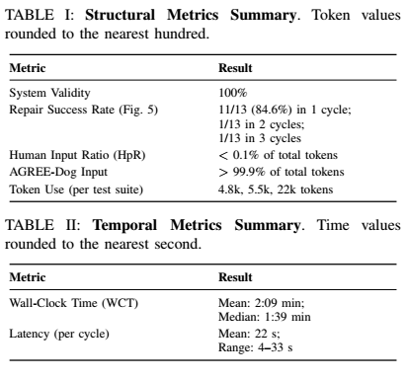
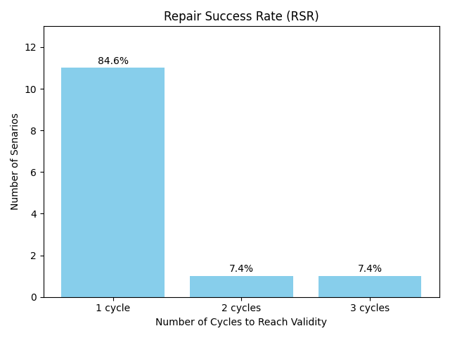

Key Impact & Scalability
Key Observation: Human input dropped below 0.1% of the workflow—yet we still achieved 100% system-wide validity, demonstrating a dramatic reduction in manual effort.
<number>
© 2025 Collins Aerospace. | This document does not include any export controlled technical data.

Slide 14
Challenges
Contextual constraints
GenAI struggles with accurate AGREE model explanations due to limited context, causing hallucinations
AGREE-Dog Retrieval-Augmented Generation (RAG) System adjusts context dynamically, reducing hallucinations and improving explanation accuracy.
Model repair
Repairs can generate multiple solutions, some of which violate system requirements
AGREE-Dog deploy Agree.log validity analysis and follows predefined requirements to ensure repairs respect system constraints.
Evaluation
Manual evaluation limits scalability for large models
A Conversational Quality Assessment System (CQAS) automates performance tracking
<number>
© 2025 Collins Aerospace. | This document does not include any export controlled technical data.

Slide 15
Current Limitations
Manual Solver Selection
Users must still choose between JKind, SMT solvers.
We are developing a multi-agent router that intelligently selects solvers based on context, performance, and explainability.
Model repair
We are testing multiple-root causes for cex generation, across more complex systems.
The AGREE-Dog plugin is being developed, enabling more automated navigation between system files.
RL Integration In Progress
Repair adaptation via reinforcement learning is in early stage.
We are incorporating conversation history into our recommendation system and fine-tuning datasets.
<number>
© 2025 Collins Aerospace. | This document does not include any export controlled technical data.

Slide 16
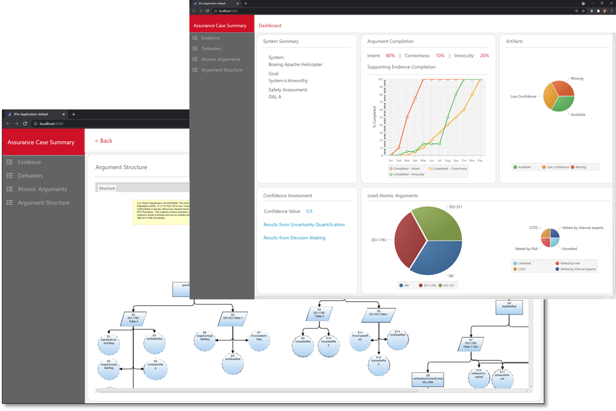
Conclusions
Summary
AGREE-Dog: Push-Button • System-Wide Formally Valid Repairs • Explainable
Traceable • Rapid • Human-in-the-Loop
Validation cycles reduced from days/weeks to minutes/hours
Up Next:
Federated/Organizational agents & solver orchestration
CQAS (evaluation metrics)
SysMLv2 migration: Embed AGREE-Dog
like Copilot into next-gen modeling environments
Assurance patterns dashboard
<number>
© 2024 Collins Aerospace. | This document does not include any export controlled technical data.

Slide 17
Resources
AGREE-Dog Video Demo:
▶️ https://www.youtube.com/watchv=2cKRm9fuifs
INSPECTA project page:
🌐 https://loonwerks.com/projects/inspecta.html
AGREE-Dog source code:
💻 https://github.com/loonwerks/AgreeDog
AGREE-Dog-Plugin source code:
💻 https://github.com/loonwerks/AgreeDog-plugin.git
<number>
© 2025 Collins Aerospace. | This document does not include any export controlled technical data.

Slide 18
Thank You!
This work was funded by DARPA contract FA8750-24-9-1000.
The views, opinions and/or findings expressed are those of the authors and should not be interpreted as representing the official views or policies of the Department of Defense or the U.S. Government.
<number>
© 2025 Collins Aerospace. | This document does not include any export controlled technical data.
Notes:
<number>

