Slide 1
Goals
(Sub)system functional properties reasoning about port/state input and output behavior across multiple components
Same specification language used for verification used for system testing and run-time montoring
Compatible with our current static scheduling approach, but extendable in the future to support sporadic (event-based) centric systems (must be able prove that execution results in certain causality chains or trace shapes)
Works by generating verification conditions (start with Slang-based VCs, then try Rust/Verus)
Supports hierarchical refinement (subsystem to enclosed components)
Supports notions of composition (e.g., combining independent subsystems)

Slide 2
Note
Will be “more manual” than AGREE
  Requires developers to specify “system assertions” – properties that should hold at different points in the execution
  System assertions will be placed by developers in an abstract execution flow graph representing possible execution orders of system components
  We will need to make sure that the flow graph and assertion notation is developer friendly
Current development
  Isabelle formalization (simplified setting)
  Prototyping of VC generation in Slang/Logika
  We know enough to start developing full version that can work on toy examples, and I am confident that we can support systems like the open platform in 4-6 months

Slide 3
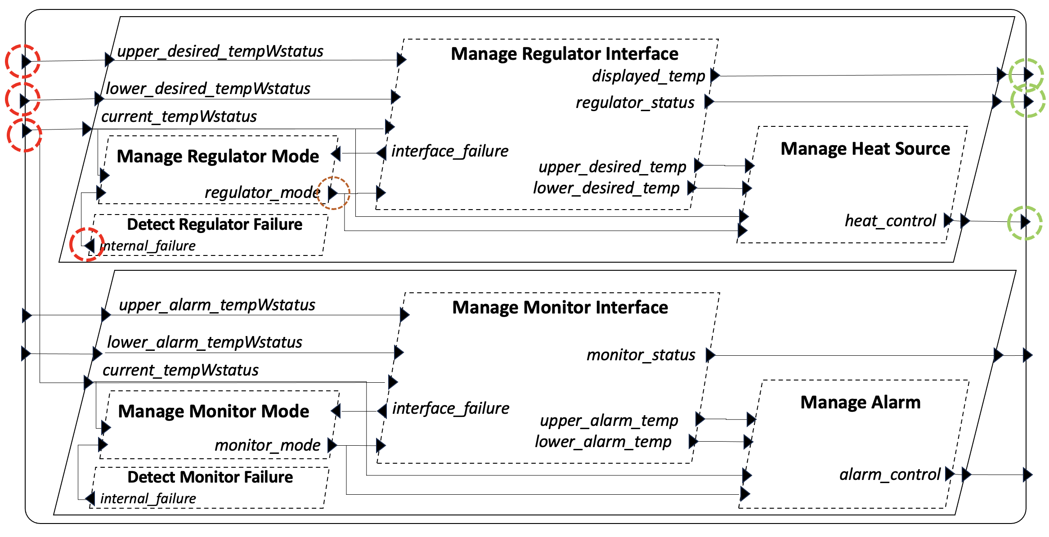
Static Schedule (Intuition)
Intuitive representation of static cyclic schedule (from HAMR System Testing paper)
Subsytem Inputs
0
Operator Interface
Manage Interface
Manage Heat Source
3
10
Manage Mode
4
5
Heat
Controller
Internal Failure Detection
2
8
1
9
7
Temp
Sensor
6
Each thread within a subsystem appears one or more times in a static schedule (open question: what is the relationship between subsystem task set and schedule task set? These notions are not spelled out in AADL)
There is some notion of relating the schedule of a subsystem with the schedule of its context (e.g., steps 0, 1, 10 above) and I don’t know what this should be yet.
To support reasoning, the subsystem will need to understand the points in time (in the static schedule) in which: input values are acquired from the context, output values are delivered to the context

Slide 4
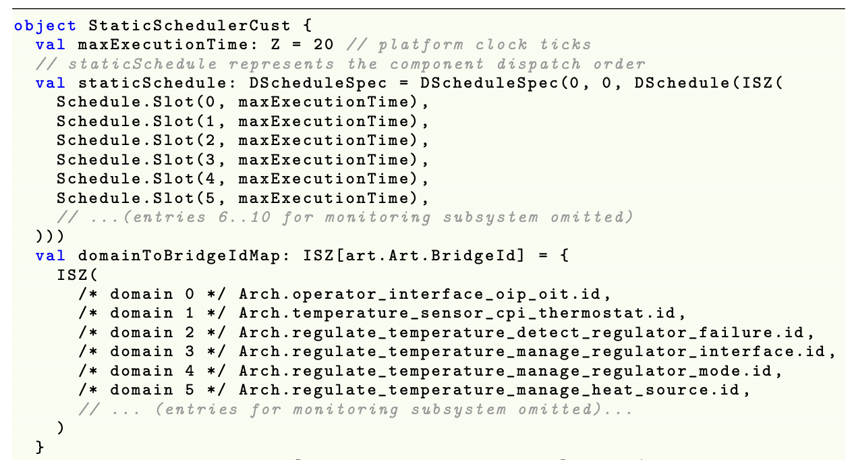
Static Schedule Declaration
Using a scheduling approach that aligns with seL4 domain scheduler and Collins Aerospace strategies – static cyclic scheduling
0
..
3
4
5
..
Scheduling slots that include a thread identifier and the absolute execution time associated with that thread…
Excerpts
Manage Heat Source allocated to slot # 5

Slide 5
Schedule Abstractions (Intuition)
Well-established notions of action independence (commutativity of task actions), e.g., when there is no notion of data dependence between tasks will be important for us (connected to the notions of partial order reductions in model-checking)
0
Operator Interface
Regulate
3
10
4
5
Heat
Controller
2
7
1
9
8
Temp
Sensor
6
Monitor
For example, from the structure and data dependence determined by connections above, we can see that the Regulate components are independent of the Monitor (safety) components.
Theoretically, this indicates that Regulate components can be commuted with Monitor components without changing the semantics of the abstract functions computed by the subsystem
Takeaway: This indicates that we may want to work with an abstraction of a static schedule (e.g., a partial ordering) that only indicates dependences between task execution. Intuitively, we will key on determining which predecessor task post-conditions are relevant for determining pre-conditions for a task. Such predecessor tasks may not be the immediate predecessors of the successor task in the static schedule.

Slide 6
Control Points (States?)
A set of control points and control constraints together form a control graph (structure?) that abstractly indicates designed ordering on atomic and aggregate components that is relied on to achieve functional behavior
A HAMR schedule must conform to the control graph; the control graph serves as an abstraction of a schedule.
  Example: control graphs control constraints are a partial order and a static schedule is a total order that conforms to the partial order
Compositional verification is carried out wrt the control graph. This enables verification wrt an ordering abstraction, allowing the verification to be sound for all schedules that conform to the control graph
The absence of constaints (including transitive constraints) between components in the control graph indicates independence – the ability of executions of the components to be reordered without impacting the property-observed functionality of the system
Note: some aspects of this were prototyped in the “may follow” and “may proceed” relations and associated verification framework in HAMR Micro 2 models

Slide 7
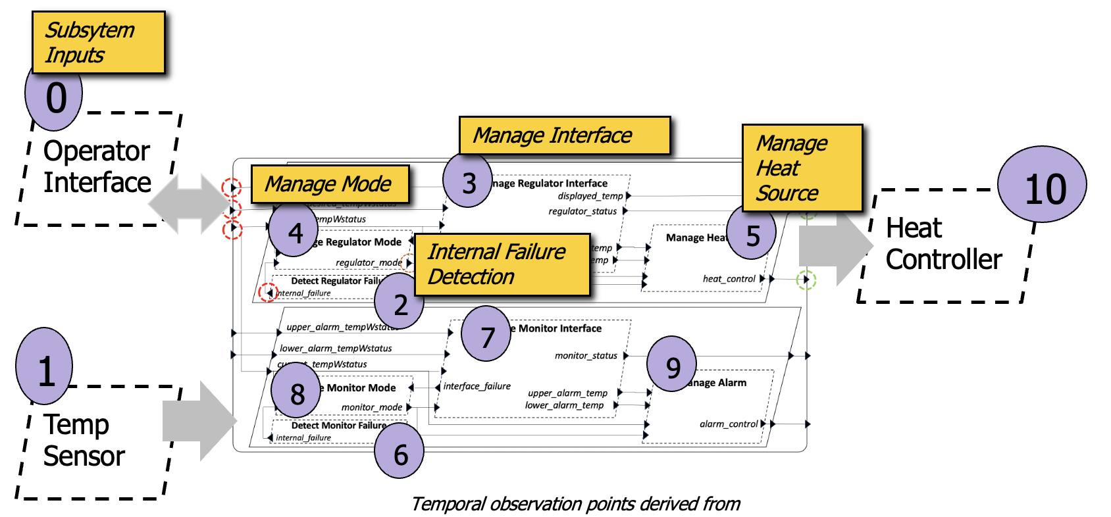
Control Graph - Intuition
A control graph is always predicated on the notion of major frame – there is always a notion of cyclicness, and stating constraints across cycle boundaries requires extra notation.
Components can be organized into (possibly nested) schedule groups to support modular specification of constraints. Each component is assumed to execute exactly once in the schedule group. If there are “inner cycles” (repetition of one or more components), these must be declared in a separate subgroup (analogous to a nested loop). This notion can be potentially supported via the AADL notion of thread group.
Regulate Subsystem Group
Monitor Subsystem
DRF < MRM
MRI < MRM
MRM < MHS
DMF < MMM
MMI < MMM
MMM < MA
Absence of constraints between components in these subgroups (and/or the fact that the components are in different subgroups) indicates “independence” between the components in the respective groups, i.e., a concrete schedule may the subgroups in any order or may interleave components from the subgroup in any order.
DRF must precede MRM,
MRI must precede MRM, MRM must precede MHS

Slide 8
Abstract Control Points
Reg_begin
Reg_end
Thermostat_begin
Thermostat_end
Mon_begin
Mon_end
To support composition of control groups and to manage verification of composition, control graphs may include abstract control points that are not thread ids, but are symbols introduced by the designer to represent symbolic points in time that may used in the constraint specification.
Some abstract control points are automatically generated from the architecture structure and control group declarations. For example, every architecture composite component C (process, system, thread group) introduces C_begin and C_end abstract control points.
Thermostat_begin < Reg_begin
Thermostat_begin < Mon_begin
Reg_end < Thermostat_end
Mon_end < Thermostat_end
Note: if we wanted to state that the Regulate subsystem must come before the monitor subsystem, we could specify that by saying Reg_end < Mon_begin
Implicit constraints are introduced, e.g., C_begin must precede every component within C ???

Slide 9
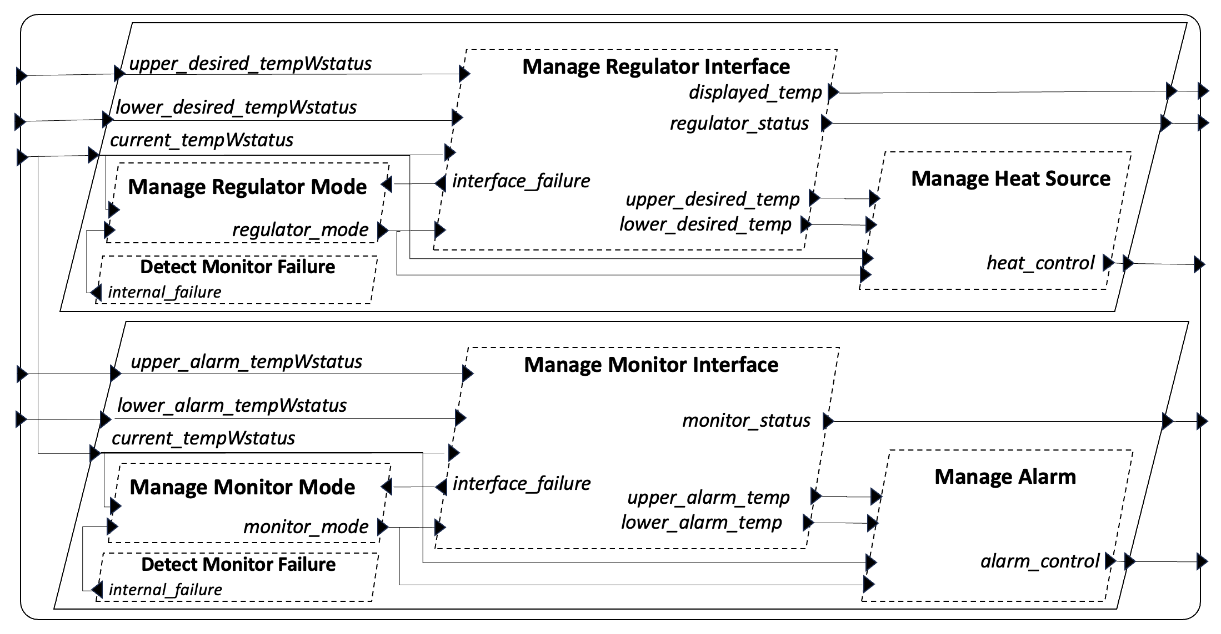
Properties for Abstract Functions
Display Temp function
Often, a subsystem will realize multiple functions that can be reasoned about independently (even though the components that compute the functions are not independent). For example, the Regulate subsystem computes three independent functions, as indicated on the right.
Regulator Status function
Heat Control function
AADL flows can be used to indicate which inputs are used to compute outputs associated with each functions (this can be extended to also include which local state is used to support which outputs)
When the system is refined to actual threads, we can map the abstract functions onto the interfaces and state of the threads (using AADL end-to-end flows)
The above would provide the ability to decompose and organize the functionality of a subsystem in terms of functions, which probably corresponds to how requirements would be stated in any case.
Can we organize the lower-level system assertions (used for reasoning about component composition) and component contracts themselves in terms of these functions?
Can we develop rules that allow the verification results of abstract functions to be composed?

Slide 10
Example: Abstract Component Spec
Abstract Sub-system Component Spec (consisting of all features mentioned in requirements allocated to this component)
Regulate
upper_desired_tempWstatus
lower_desired_tempWstatus
display_temp
regulator_mode
previous_heat_control
regulator_status
internal_failure
current_tempWstatus
heat_control

Slide 11
Example: Abstract Functional Specification
Overlaying the Display Temp function using notation similar to AADL Flows
Regulate
upper_desired_tempWstatus
lower_desired_tempWstatus
display_temp
regulator_mode
previous_heat_control
regulator_status
internal_failure
current_tempWstatus
heat_control
Like a thread interface and contract, each functional spec indicates
  boundary port inputs
  boundary port outputs
  Local state read (as necessary for requirements)
  Local state updated (as necessary for requirements)
Note: potential source of ambiguity – does regulator_mode in the example above refer to the previous mode (mode from the previous cycle) or newly computed mode
  In the actual implementation, it depends on the previous mode computed in the previous cycle

Slide 12
Example: (Regulate) Display Temp Function
Abstract Sub-system behavior element specification
Regulate
regulator_mode
display_temp
current_tempWstatus
Associated requirements (note: these are not in original REMH, they are proposed by John H, reverse-engineered from lower-level requirements)
Req-REG-DisplayTemp-1: If the mode is normal in the subsystem pre-state, then the display temp = current temp value in the subsystem post-state (in full system, display temp is current temp rounded to the closest integer).
Req-REG-DisplayTemp-2: If the mode is not normal in the subsystem pre-state, then the display temp is unspecified (unconstrained) in the subsystem post-state.
Note: to specify a function that is computed over time, we need to indicate the temporal points for the input and output. In the above requirements, by writing “pre-state” and “post-state” we are indicating that there are temporal points in the system trace in which input values are acquired and in which outputs are produced. This needs to be formally represented in some way (which can be refined later to specific points in system scheduling). In this case, we have the simplistic situation in which there is only one input and one output (so there is no issue of inputs/outputs at different times). Moreover, we also talk about the internal state (regulator) mode as being available in the pre-state.

Slide 13
Example: Abstract Functional Specification
Overlaying the Heat Control function using notation similar to AADL Flows
Regulate
upper_desired_tempWstatus
lower_desired_tempWstatus
display_temp
regulator_mode
previous_heat_control
regulator_status
internal_failure
current_tempWstatus
heat_control

Slide 14
Types of Properties (Phase I)
Component Contract
  Pre-condition
    Constraint on component input ports (application port view) and local variables
    always holds when the component is executed
  Post-condition
    Constraint on component input ports (application port view), pre-state local variables, output ports (application port view), post-state local variables
System Assertion
  Constraint on system state including communication substrate, component input and output infrastructure ports, component local variables
    Invariant can also be conditioned on control points. The simplest form of this is to condition it on the schedule state (e.g., different positions in the static schedule), but it could also be conditioned on more abstract notions (e.g., component X just finished executing).
Pre
SysAssert1
SysAssert2
Post

Slide 15
VC Structure (Phase 1)
Pre
SysAssert1
SysAssert2
Post
SysAssert1 implies Pre
SysAssert1 & Post implies SysAssert2

Slide 16
Types of Properties (Phase X?)
C1@end
…
Cn@end
Pre
SysAssert
SysAssert1
SysAssert2
Sched@begin
Post
Sched@end
Infra
For practicality, it is like that the invariant will be broken down into “useful pieces” that are intuitive to engineers
This means that the full invariant would not have to be treated by the user at each component, but only the parts that are established (proven in the meta-theory) to be relevant for that component

Slide 17
Example: (Regulate) Display Temp Function
Display Temp is a particularly simple subsystem function that is actually componented by a single refining component, and that component occurs first in the subsystem schedule
Regulate
regulator_mode
display_temp
The choice for refinement of the mode is not as simple as there are multiple state elements in the refinement where mode is stored. Moreover, a change in mode is computed during the execution of the subsystem. We choose the input to MRI as that is what is used directly to compute display_temp. Note that this value was computed on the previous cycle. It should be equal to the pre-state value of the MRM local state variable. Reasoning about this would be part of the reasoning associated with composing cycles or composing abstract functions for computing the mode and for computing the display temp.
current_tempWstatus
?
Refinement…
This is essentially defining the refinement for the abstract boundary ports
MRI
display_temp
display_temp
MRM
mode
MHS
mode
current_tempWstatus
DRF
mode
Recall that boundary ports are essentially aliases for internal ports. Their observable state is the observable state of the internal port. Things work out more easily if there is only one internal port per one boundary port.
DRF < MRM
MRI < MRM
MRM < MHS

Slide 18
Example: (Regulate) Display Temp Function
Display Temp is a particularly simple subsystem function that is actually componented by a single refining component, and that component occurs first in the subsystem schedule
Regulate
regulator_mode
display_temp
current_tempWstatus
Refinement… (with proof concepts)
MRI
display_temp
display_temp
MRM
mode
MHS
mode
current_tempWstatus
DRF
mode
Verification note: rely directly on the contract for MRI
DRF < MRM
MRI < MRM
MRM < MHS
Verification note: rely on frame conditions for display_temp for MRM and MHS components

Slide 19
Example: (Regulate) Display Temp Function
DRF < MRM
MRI < MRM
MRM < MHS
MRI
@Reg_end
display_temp
@Reg_begin
display_temp
MRM
mode
MHS
mode
Note: Refinement also requires a temporal refinement – an association of the refined state to a refined temporal point associated with temporal points in the refinement subsystem
current_tempWstatus
DRF
@Reg_begin
mode
Temporal view
Warning: This is only intuition, I can’t figure out the exact semantics for the temporal precedence relation
There are no frame preconditions relevant for the DISPLAY TEMP function .. BUT MRI and MHS have pre-conditions on lower/upper desired that must be established
Frame: Display Temp not modified; mode is modified (but our requirement references logged mode at beginning of cycle.
DisplayTemp
DRF
MRM
MHS
DisplayTemp_post
Reg_begin
DisplayTemp_pre
?
Log post-state values displayTemp
Reg_end
Log pre-state values current_tempWstatus and last_regulator_mode
MRI
MRM_end_SA
MHS_end_SA
..& Display_Temp_Fun
..& Display_Temp_Fun
Reg_begin_SA
..& Display_Temp_Fun
MRI_Pre
MRI_Post
Reg_end_SA
Display_Temp_Fun property is established from MRI contract here…
Display_Temp_Fun property is preserved via component frame conditions here…
Display_Temp_Fun property holds at the end of the cycle

Slide 20
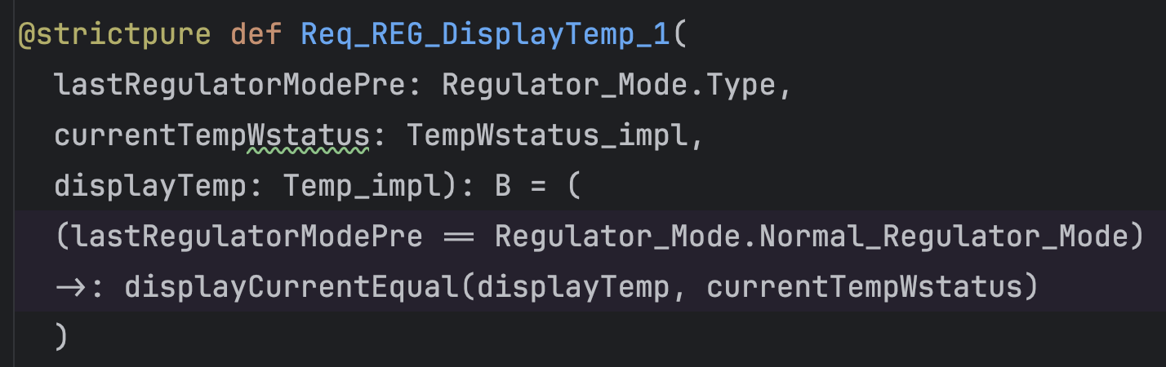
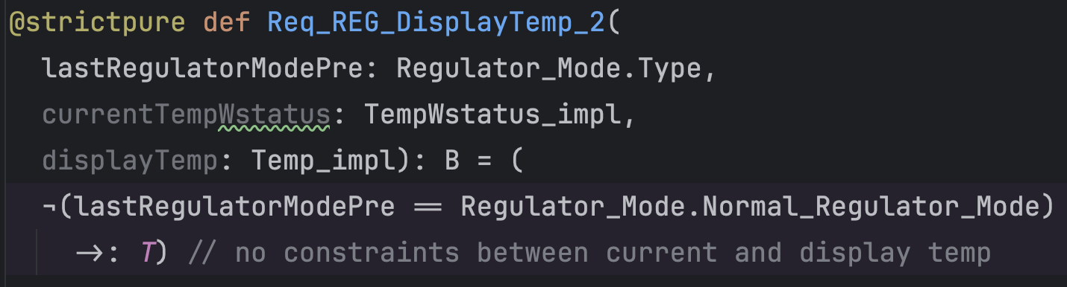
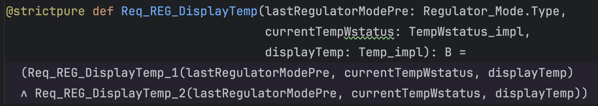
Example: (Regulate) Display Temp Function
Formalize predicates corresponding to abstract subsystem requirements
Req-REG-DisplayTemp-1: If the mode is normal in the subsystem pre-state, then the display temp = current temp value in the subsystem post-state
Req-REG-DisplayTemp-2: If the mode is not normal in the subsystem pre-state, then the display temp is unspecified (unconstrained) in the subsystem post-state.
Req-REG-DisplayTemp: (Conjunction of the two properties above). Intuitively, this is the predicate representing the logic of the contract for the abstract DisplayTemp function allocated to the REG subsystem.
…but we still need to map/refine the function contract logic above to particular temporal points

Slide 21
Example: (Regulate) Display Temp Function
Display Temp is a particularly simple subsystem function that is actually componented by a single refining component, and that component occurs first in the subsystem schedule
Regulate
regulator_mode
display_temp
current_tempWstatus
Req_REG_DisplayTemp(
current_tempWstatus@Reg_begin,
regulator_mode@Reg_begin
display_temp@Reg_end
)
These must be refineable to observable/loggable aspects of the system state. Documentation of the refinement (e.g., down to seL4) is key for supporting appropriate audits
Stefan: To provide the “logging” concept or the notion of a state element, they can be mark “dirty”.

