Slide 1
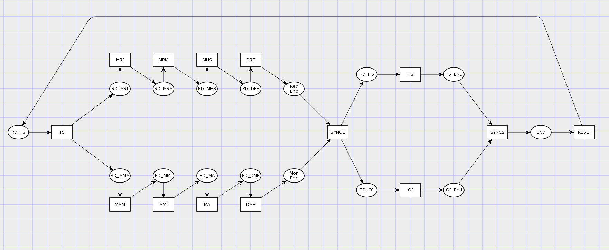
Isolette Petri Net

Slide 2
Systems
THERMOSTAT
REGULATOR
HEAT SOURCE
TEMP SENSOR
OPERATOR INTERFACE
MONITOR

Slide 3
Constraints and Properties
Synchronization Constraint
Synchronization Constraint
Schedule Loops

Slide 4
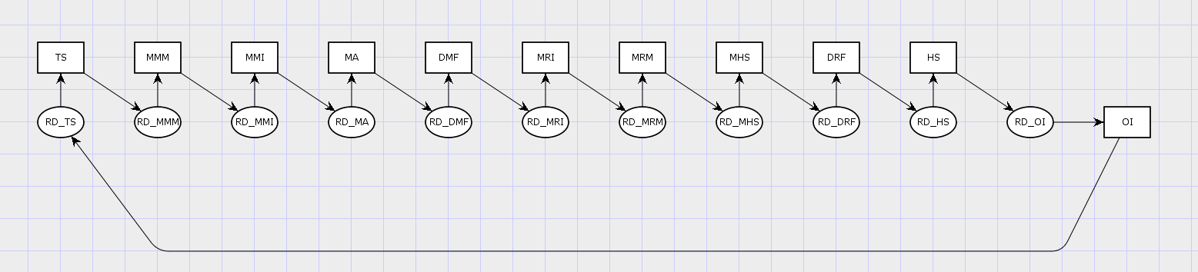
Concrete Schedule Example
TEMP SENSOR
REGULATOR
OPERATOR
INTERFACE
MONITOR
HEAT
SOURCE
TS => MMM => MMI => MA => DMF => MRI => MRM => MHS => DRF => HS => OI

Slide 5
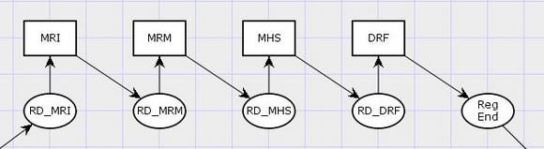
System Assertions
We can match up system assertion with specific places within the petri net
These assertions can align with pre and post conditions of a system or as facts that should hold true at certain points in the execution of a system
The petri net can later be analyzed to automatically produce VC conditions that verify the system assertions along with pre and post condition of subsystems/tasks
In this example, MRI, MRM, MHS, and DRF represent tasks in the Regulator, and each system assertion labeled [Task]_REG_END corresponds to something that should hold true after the respective task. REG_END and REG_PRE represent the pre and post conditions of the regulator system
MRI_REG_END
MHS_REG_END
REG_PRE
MRM_REG_END
. DRF_REG_END
. REG_END

