Slide 1
Ph3 Demo Platform : Baseline
Collins Common Avionics Architecture System (CAAS)
Goal : Extend (securely) to add wireless connectivity
VPM
ADSB
VDTU
MC1
Other CAAS
Soldier
Tablet2
Pilot
Tablet1
Wireless
Router
Switch
Digital switch
on PSM1
Wireless device access

Slide 2
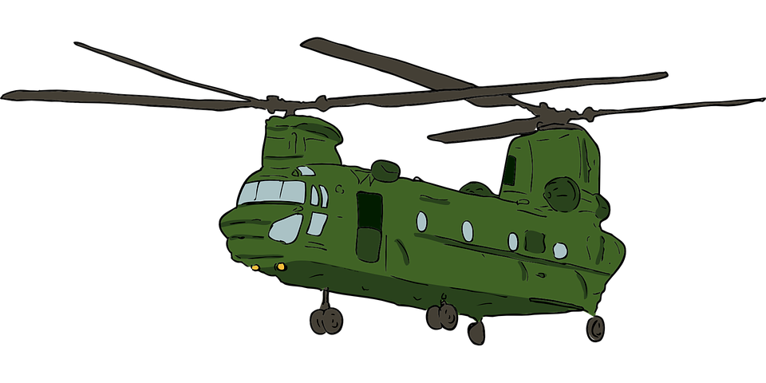
Monitor ADS-B traffic for spoofing
Filter messages to/from tablets
Attestation of tablets
seL4 hosting Linux virtual machine
Remote attestation
Soldier
Tablet
Pilot
Tablet
VPM
ADS-B
DATABASE
Other CAAS
components
Wireless
Router
Network Switch
Change network topology to use Video Processing Module (VPM) as secure gateway between lower assurance wireless network/components and rest of CAAS
Wireless device access

Slide 3
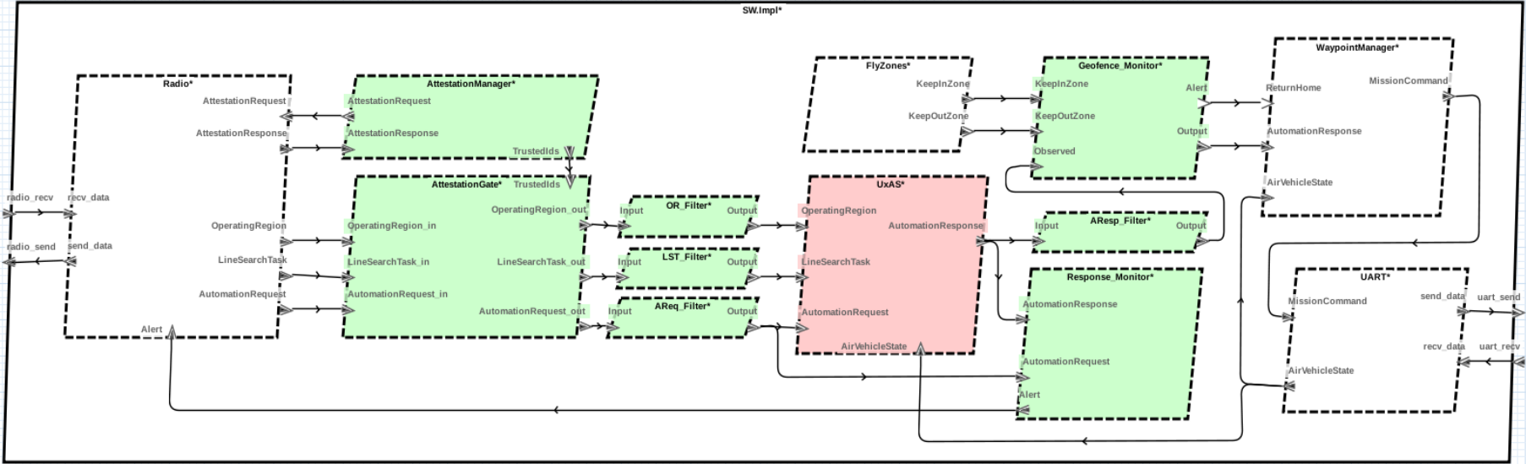
GroundStation
FlightController
GroundStationApp
UserAM
PlatformAM
MissionSoftware

Slide 4
GroundStation
PlatformAM
FlightController
Radio
GroundStationApp
UserAM
MissionSoftware

Slide 5
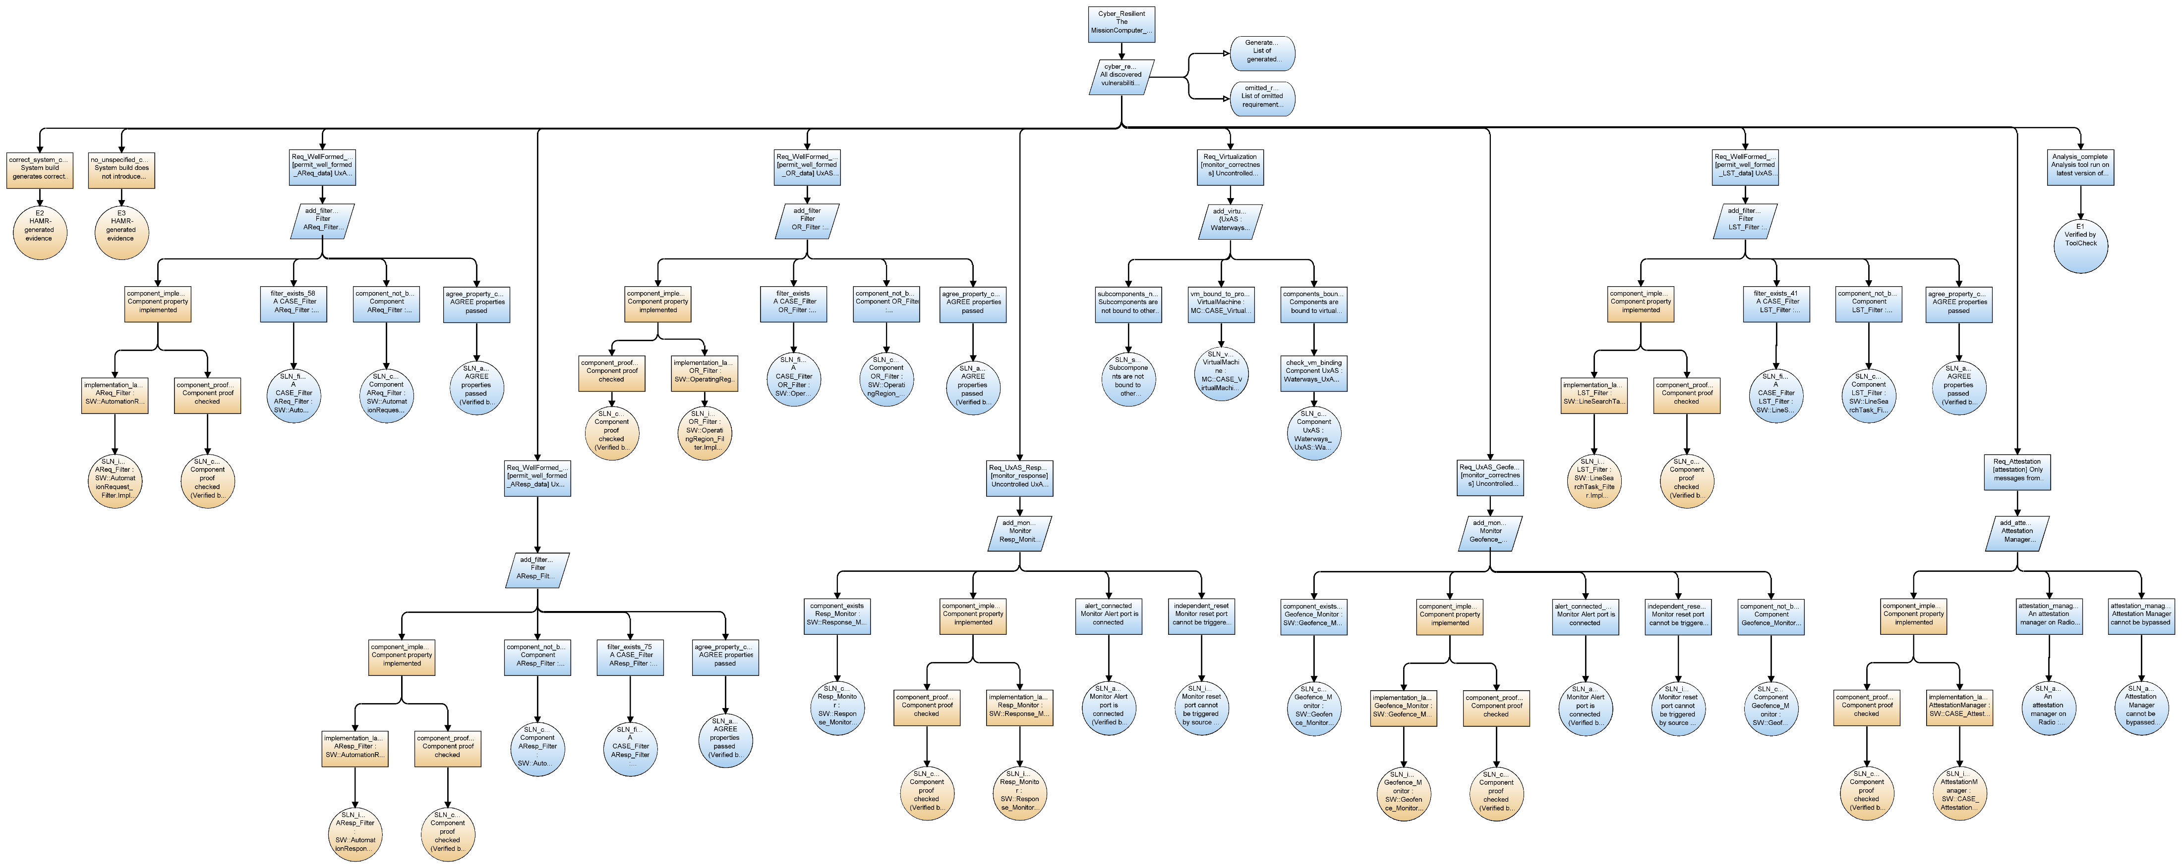
HAMR code generation
Filter: Well-formed Operating Region
AGREE Analysis
Virtualization
Attestation
Blue nodes:
Evidence derived from AADL model analysis
Orange nodes:
Evidence based on verified code synthesis
Monitor: Planner Response

Slide 6
Blue nodes:
Evidence derived from AADL model analysis
Orange nodes:
Evidence based on verified code synthesis
Filter: Well-formed Operating Region

Slide 7
Filter:
Well-formed
Operating Region
Blue nodes:
Evidence derived from AADL model analysis
Orange nodes:
Evidence based on verified code synthesis

Slide 8
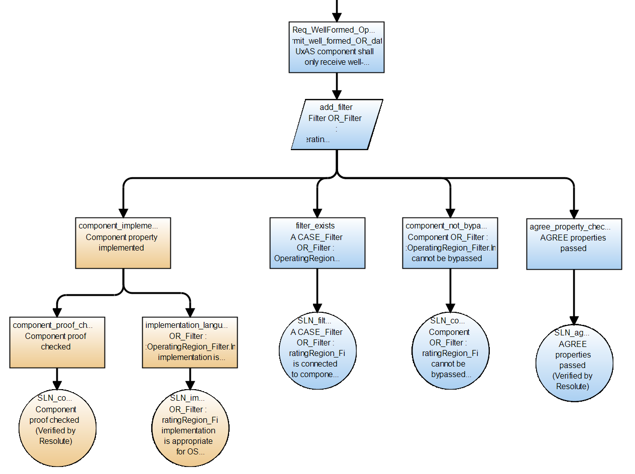
Filter:
“Operating Region” requests
are well-formed with respect to
message specification
Blue nodes:
Evidence derived from AADL model analysis
Orange nodes:
Evidence based on verified code synthesis

Slide 9
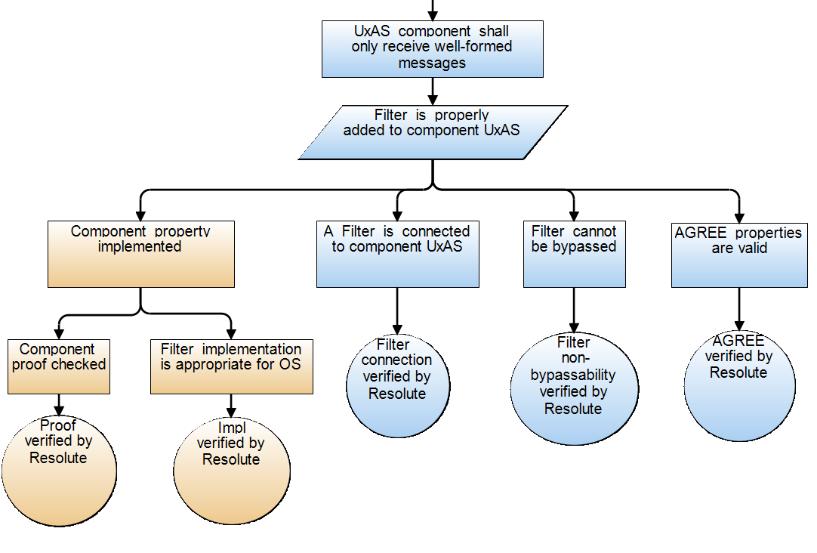
Filter:
“Operating Region” requests
are well-formed with respect to
message specification
Blue nodes:
Evidence derived from AADL model analysis
Orange nodes:
Evidence based on verified code synthesis

Slide 10
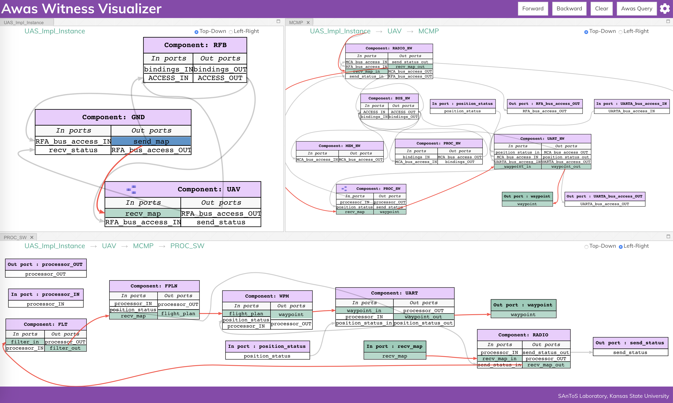
How does map information propagate from Ground Station through UAV Mission Software to produce a waypoint?
Compute “forward propagation” from GS “send_map” output port
Resulting information flows displayed for different subsystems

Slide 11
How does map information propagate from Ground Station through UAV Mission Software to produce a waypoint?
Compute “forward propagation” from GS “send_map” output port
Resulting information flows displayed for different subsystems

Slide 12
System
Modeling
Environment
OSATE
AADL model
HAMR plugin
TA1 plugin
Solvers
Cyber Reqts plugins
Cyber Transform plugin
AGREE
Resolute
High-Assurance
Code Generation
Tools
System Build evidence
Component implementation
and glue
*.c files
SPLAT
Component implementation
and glue
CakeML files
CAmkES input model
C compiler
CAmkES
CakeML compiler
UAV exe
UAV exe
Linux
seL4
capDL

Slide 13
OSATE
AADL model
Awas Info Flow
HAMR
Requirements Analysis
Cyber Transforms
AGREE
Assurance Case
Resolute
Hand-written component code
Generated code
CAmkES
config files
SPLAT
Synthesized
code
Pre-verified component code (Attestation)
Pre-verified code (seL4)
C compiler
CAmkES
CakeML
compiler
Executable code

Slide 14
OSATE
MODELING
ENVIRONMENT
AADL model
Awas Info Flow
HAMR
Requirements Analysis
Cyber Transforms
AGREE
Resolute
Assurance Case
BUILD ENVIRONMENT
Hand-written component code
Generated code
CAmkES
config files
SPLAT
Synthesized
code
Pre-verified component code (Attestation)
Pre-verified code (seL4)
C compiler
CAmkES
CakeML
compiler
Executable code

Slide 15
OSATE
MODELING
ENVIRONMENT
AADL model
Awas Info Flow
HAMR
Requirements Analysis
Cyber Transforms
AGREE
Resolute
Assurance Case
BUILD ENVIRONMENT
Hand-written component code
Generated code
CAmkES
config files
SPLAT
Synthesized
code
Pre-verified component code (Attestation)
Pre-verified code (seL4)
C compiler
CAmkES
CakeML
compiler
System executable

Slide 16
OSATE
MODELING
ENVIRONMENT
AADL model
Awas Info Flow
HAMR
Requirements Analysis
Cyber Transforms
AGREE
Resolute
Assurance Case
BUILD ENVIRONMENT
Hand-written component code
Generated code
CAmkES
config files
Synthesized
code
SPLAT
Pre-verified code (seL4)
C compiler
CAmkES
CakeML
compiler
Pre-verified component code (Attestation)
System executable

Slide 17
