Slide 1
Ph3 Demo Platform : Baseline
Collins Common Avionics Architecture System (CAAS)
Goal : Extend (securely) to add wireless connectivity
VPM
ADSB
VDTU
MC1
Other CAAS
Soldier
Tablet2
Pilot
Tablet1
Wireless
Router
Switch
Digital switch
on PSM1
Wireless device access

Slide 2

Monitor ADS-B traffic for spoofing
Filter messages to/from tablets
Attestation of tablets
seL4 hosting Linux virtual machine
Remote attestation
Soldier
Tablet
Pilot
Tablet
VPM
ADS-B
DATABASE
Other CAAS
components
Wireless
Router
Network Switch
Change network topology to use Vision Processing Module (VPM) as secure gateway between lower assurance wireless network/components and rest of CAAS
Wireless device access

Slide 3
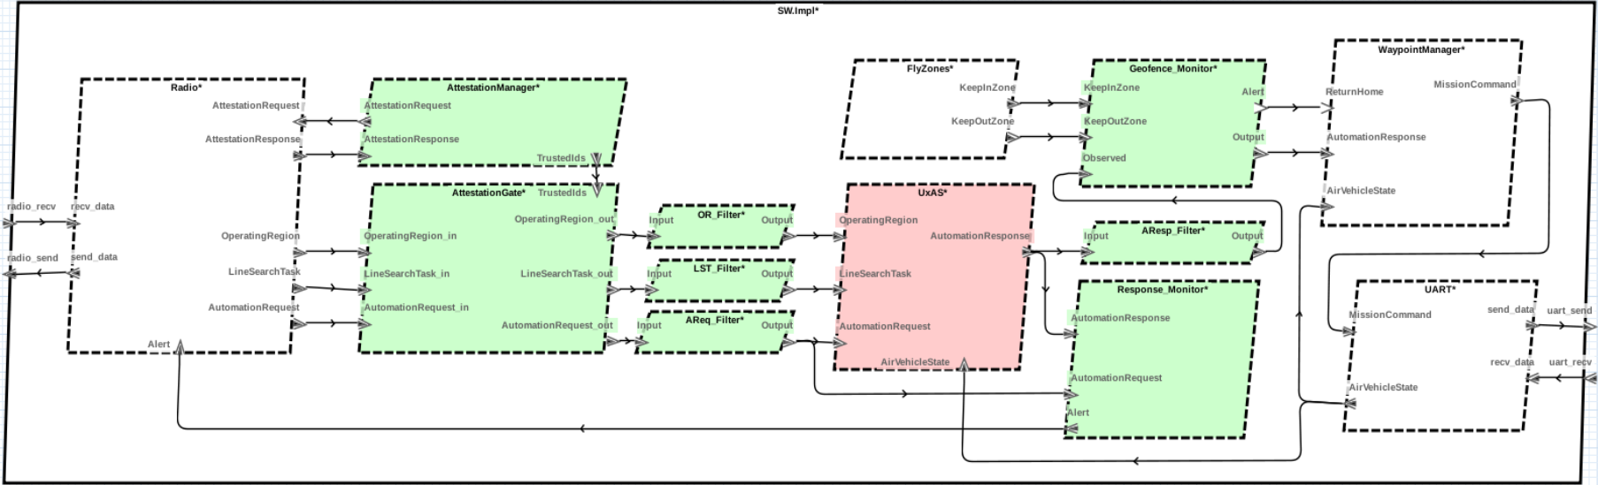
GroundStation
FlightController
GroundStationApp
UserAM
PlatformAM
MissionSoftware

Slide 4
GroundStation
PlatformAM
FlightController
Radio
GroundStationApp
UserAM
MissionSoftware

Slide 5
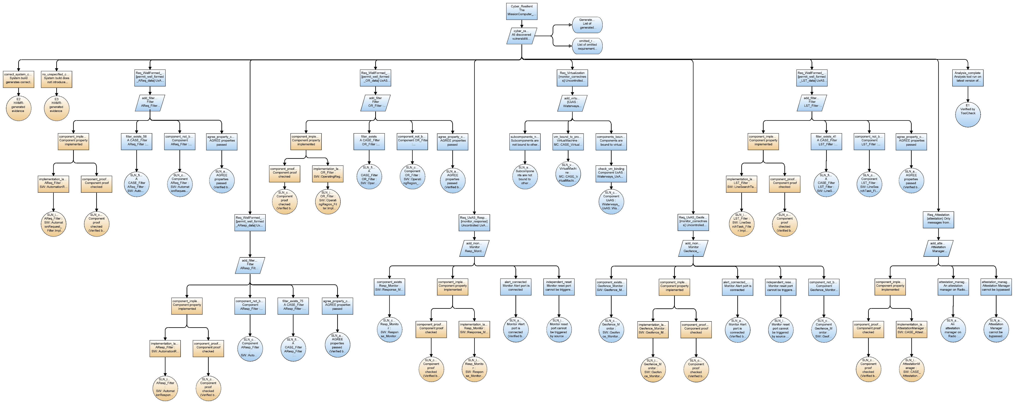
HAMR code generation
Filter: Well-formed Operating Region
AGREE Analysis
Virtualization
Attestation
Blue nodes:
Evidence derived from AADL model analysis
Orange nodes:
Evidence based on verified code synthesis
Monitor: Planner Response

Slide 6
Blue nodes:
Evidence derived from AADL model analysis
Orange nodes:
Evidence based on verified code synthesis
Filter: Well-formed Operating Region

Slide 7
Filter:
Well-formed
Operating Region
Blue nodes:
Evidence derived from AADL model analysis
Orange nodes:
Evidence based on verified code synthesis

Slide 8
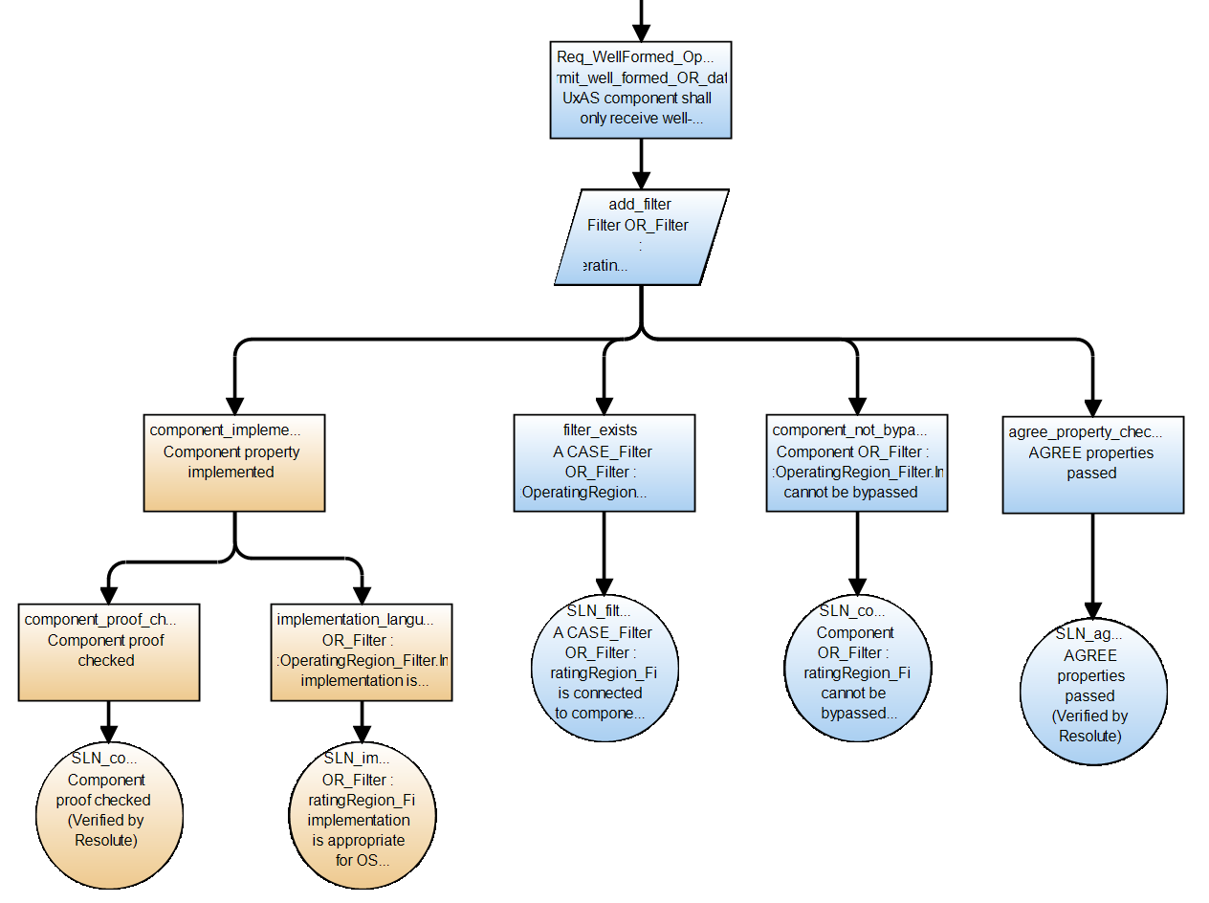
Filter:
“Operating Region” requests
are well-formed with respect to
message specification
Blue nodes:
Evidence derived from AADL model analysis
Orange nodes:
Evidence based on verified code synthesis

Slide 9
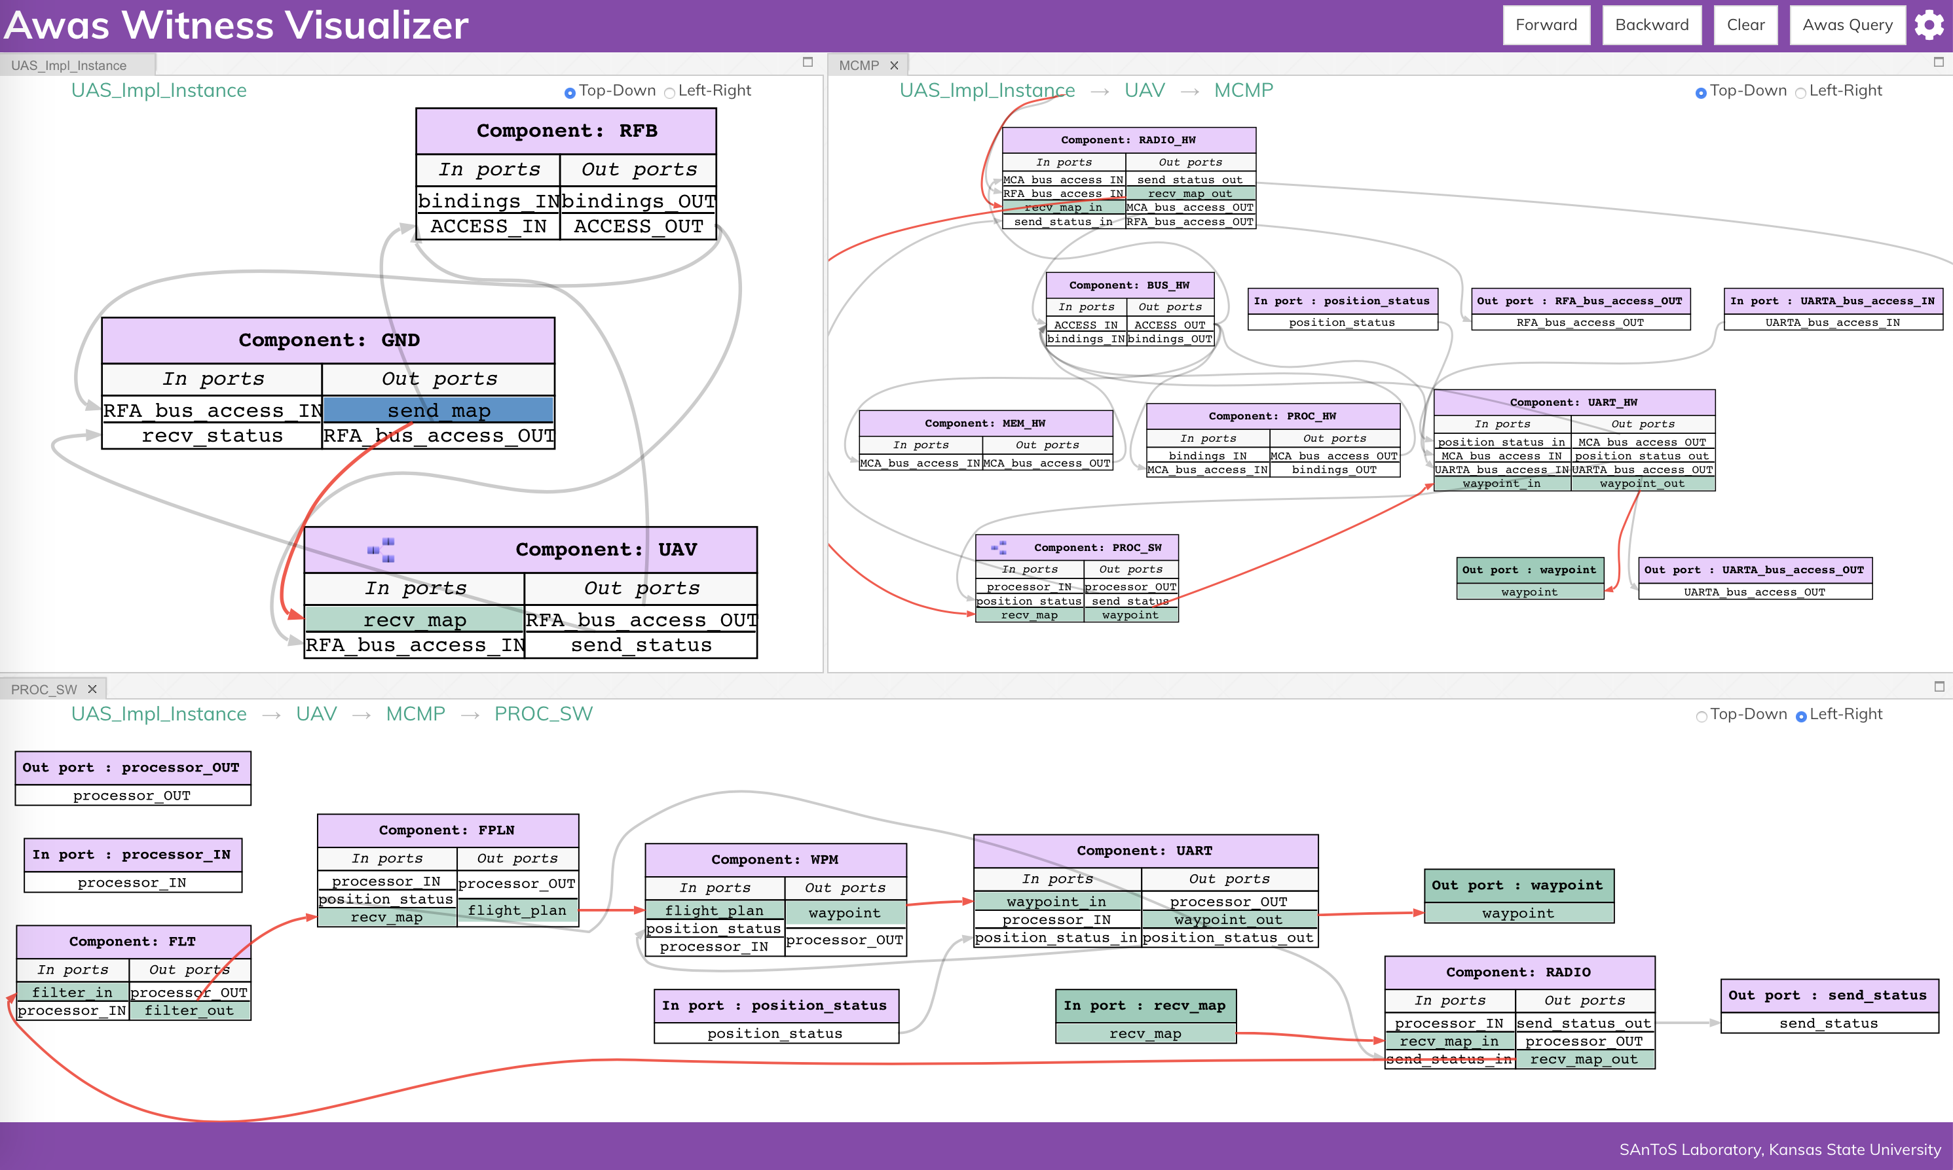
How does map information propagate from Ground Station through UAV Mission Software to produce a waypoint?
Compute “forward propagation” from GS “send_map” output port
Resulting information flows displayed for different subsystems

Slide 10
How does map information propagate from Ground Station through UAV Mission Software to produce a waypoint?
Compute “forward propagation” from GS “send_map” output port
Resulting information flows displayed for different subsystems

