Slide 1

The Synthesis of Cyclic Circuits with SAT and Interpolation
By John Backes and Marc Riedel
ECE University of Minnesota

Slide 2
Outline
Motivation For Cyclic Circuits
General Method
Old Approach
New Approach
Results

Slide 3
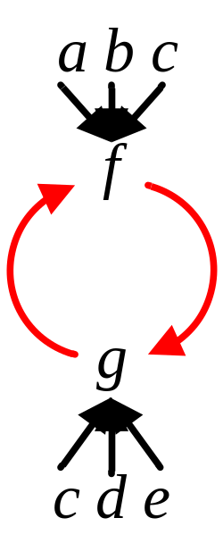

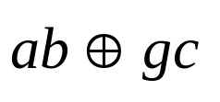
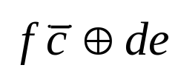
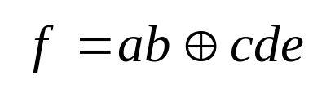
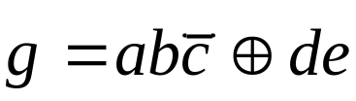
Motivation
Cyclic Circuit: 2 functions, 5 variables, 2 fan-in 4 gates.
a
c
b
d
c
e
Acyclic Circuit: at least 3 fan-in 4 gates.

Slide 4
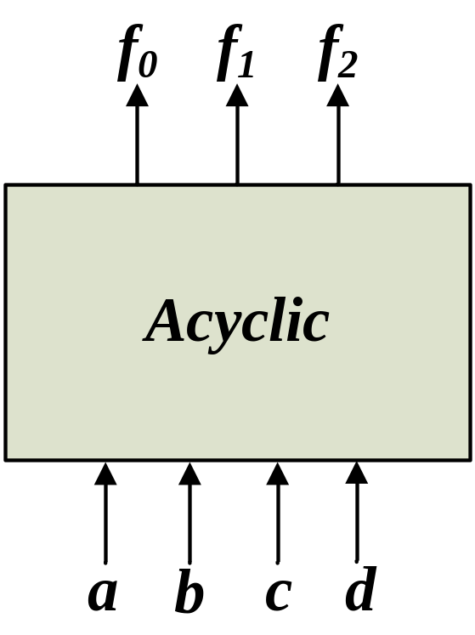
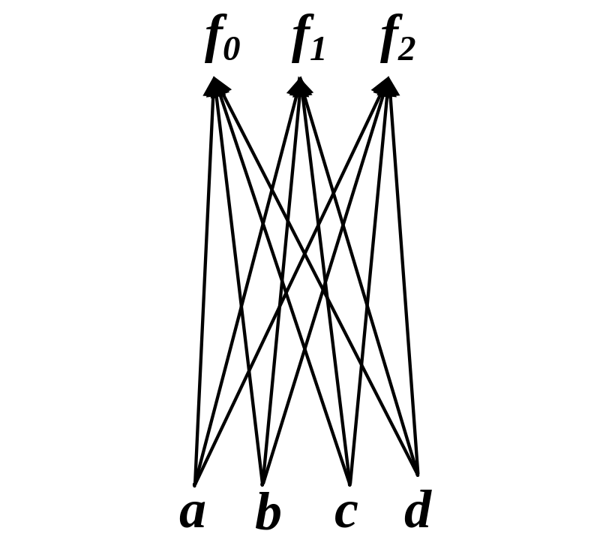
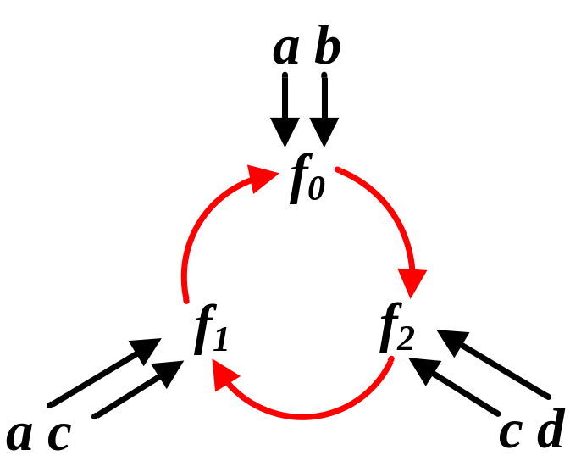
How can one make a cyclic circuit?
Consder some acyclic circuit
Pick support variables
Pick target support sets in a cyclic fashion

Slide 5
What is wrong with the old approach?
Even if a solution exists at a functional level, the gate representation may not be combinational.
Old method uses BDDs.
  These do not scale well with the size of the circuit.
Old method for functional dependencies relies on algebraic manipulation.
  Also not very robust and doesn’t scale well.

Slide 6
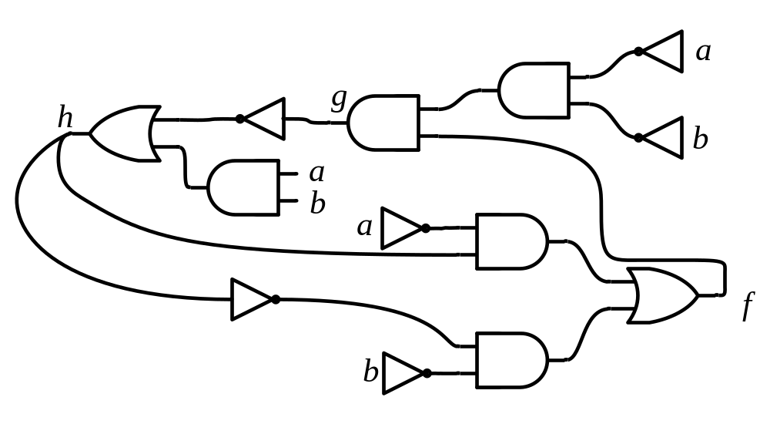
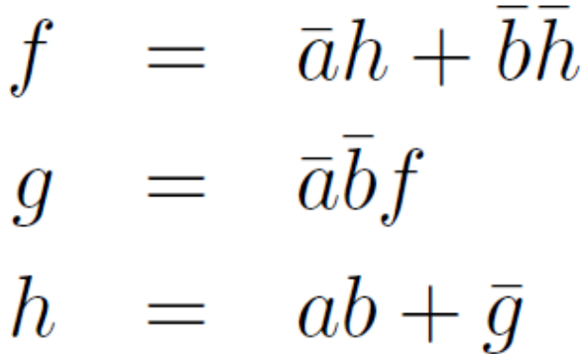
Combinational on Functional Level
Jiang, Mishenko, Brayton, “On Breakable Cyclic Definitions”, ICCAD04

Slide 7
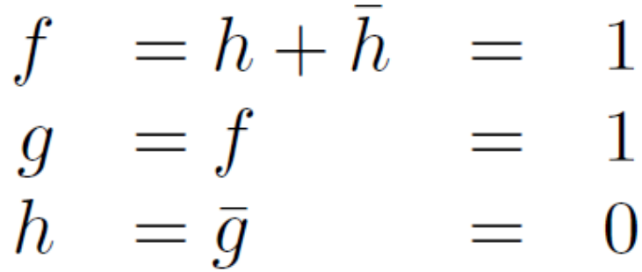

Combinational on Functional Level
Jiang, Mishenko, Brayton, “On Breakable Cyclic Definitions”, ICCAD04

Slide 8
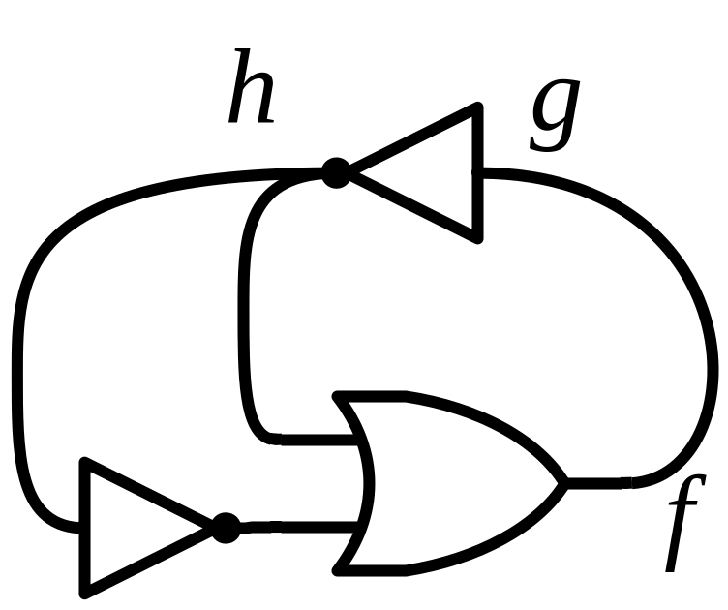
Combinational on Functional Level
Jiang, Mishenko, Brayton, “On Breakable Cyclic Definitions”, ICCAD04

Slide 9
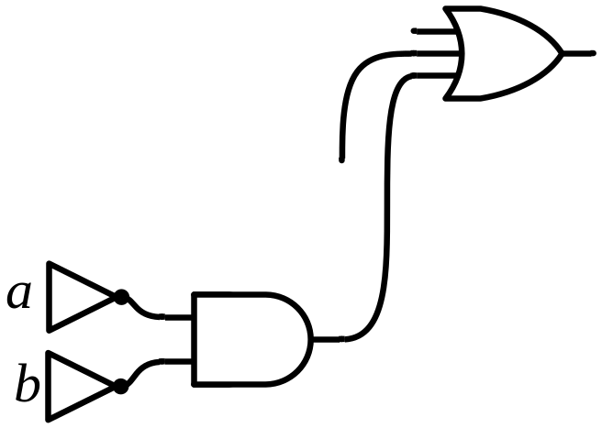
Combinational on Functional Level
a
g
h
b
a
b
a
f
b
Jiang, Mishenko, Brayton, “On Breakable Cyclic Definitions”, ICCAD04

Slide 10
What is better with the new approach
Uses SAT-based method for functional dependency.
SAT-based cyclic analysis during synthesis.
  This scales better for larger benchmarks.
Checks to see if functions are combinational at the functional level.
  If the solution is combinational at the functional level, there must exist a combinational mapping to gates.

Slide 11
The Notion of Dependency
We say a function f is dependent on a function g (for some assignment of the variables in f ’s support set) if the value of g toggles the value of f.
If g is a don’t-care for this input assignment, then f does not depend on g.

Slide 12

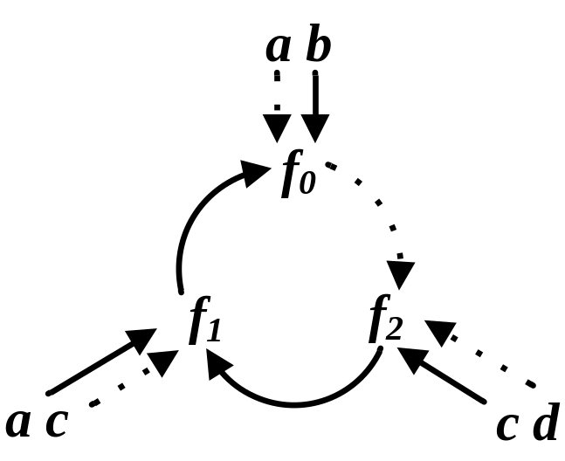
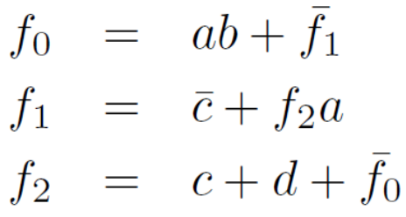
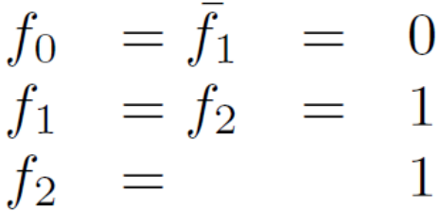
The Notion of Dependency
If there exists a cycle in any induced dependency graph for a circuit, then the circuit is not combinational.
If every induced dependency graph is acyclic, then the circuit is combinational.

Slide 13
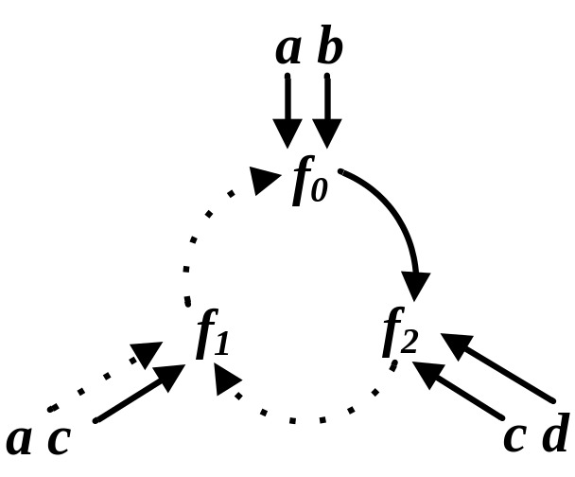
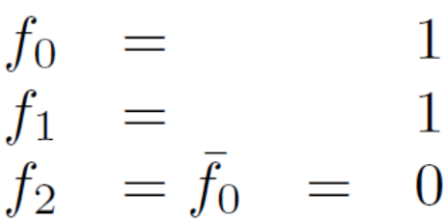
The Notion of Dependency
If there exists a cycle in any induced dependency graph for a circuit, then the circuit is not combinational.
If every induced dependency graph is acyclic, then the circuit is combinational.

Slide 14
Checking Cyclic Dependency With SAT
Consider some function f (x₀, x₁, … , x_{n}) and a copy of the same function with disjoint support f* (x₀*, x₁*, … , x_{n}*).
The satisfiability of the following clauses indicates if function f is dependent on function x_{i} for some assignment of the support variables of f.

Slide 15
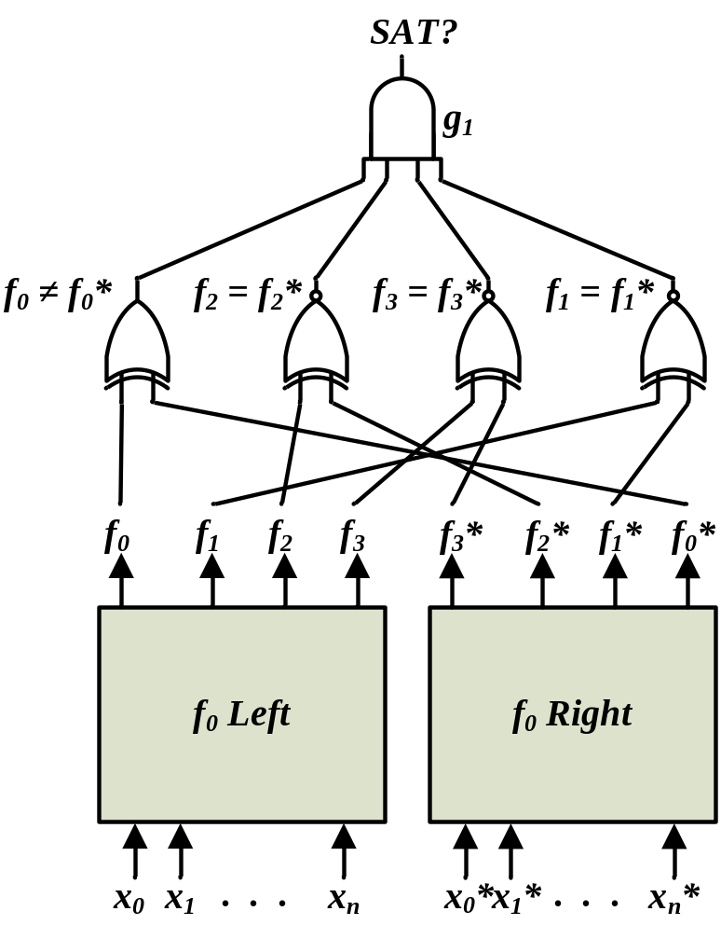
Functional Dependency
C.-C. Lee, J.-H. R. Jiang, C.-Y. Huang, and A. Mishchenko, “Scalable exploration of functional dependency by interpolation and incremental SAT solving”, ICCAD ‘07
Tells us if f₀ (x₀, x₁, … , x_{n}) can be expressed in terms of some function h (f₀, f₁, f₂, f₃)
If SAT, the dependency function h does not exist.
If UNSAT, Craig Interpolation can be used to derive an expression for h.

Slide 16
Combining Functional Dependency with Cyclic Dependencies
Functional dependency tells us if a function can be represented with a specific support set.
  Does not tell us if functions can be represented in a cyclic fashion.
We can combine the SAT instances for functional dependencies and cyclic dependencies to determine if a dependency graph is combinational.
  Allows us to consider a functional representation that may be more compact than an acyclic representation.

Slide 17
General Steps of Algorithm
Choose a dependency graph.
Locate all the cycles.
For each target function, create SAT instance to assert that a dependency function exists.
For each dependency in each cycle, create a SAT instance that asserts the dependency holds for some PI assignment.
Create the logical OR of the instances in steps 3 and 4.
If the instance created in step 5 is unsatisfiable, then the dependency graph is combinational.

Slide 18
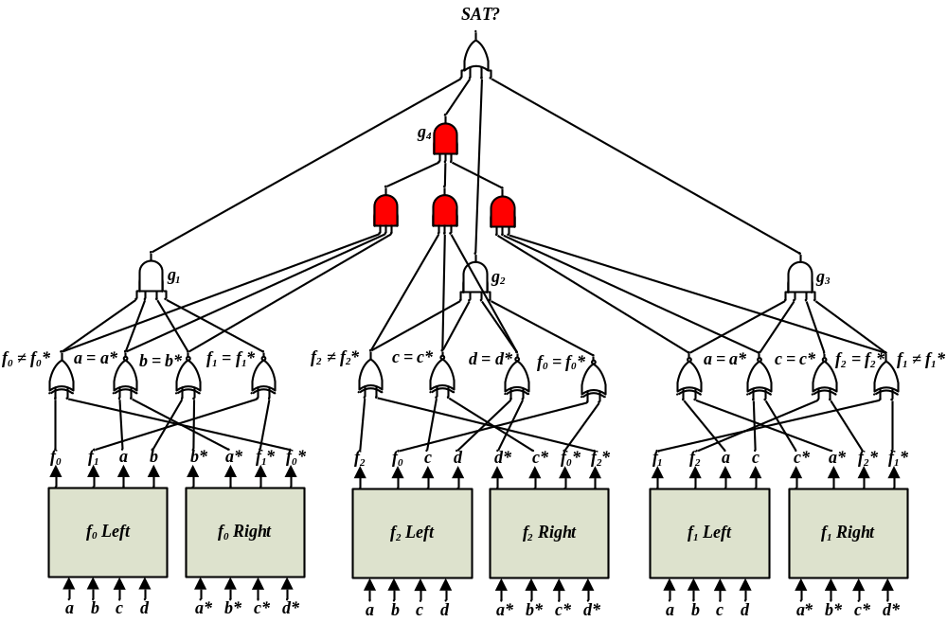
g₁, g₂, and g₃ check for functional dependencies
g₄ checks to see if there is an induced cyclic dependency

Slide 19
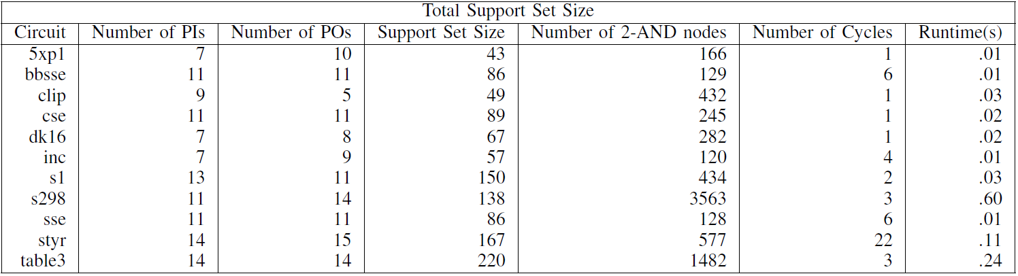
Results

Slide 20
Further work
Develop good technology mapping strategy.
  Some ideas based on work in ICCAD08.
Integrate into full synthesis methodology.
  Branch and bound.
  Dynamic programming.
  Partially completed:
    Biggest problem is searching for good heuristic for candidate functions.

Slide 21

Acknowledgements
Alan Mishchenko
ABC: A System for Sequential Synthesis and Verification was used to along with MiniSat to implement the SAT Based algorithm
Research funding was provided by FENA

