Slide 1

The Analysis of Cyclic Circuits with Boolean Satisfiability
John Backes, Brian Fett, and Marc Riedel
Electrical Engineering, University of Minnesota

Slide 2

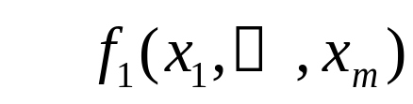

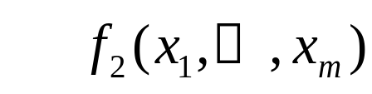

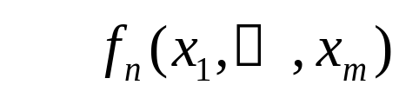

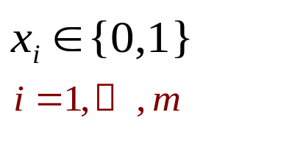
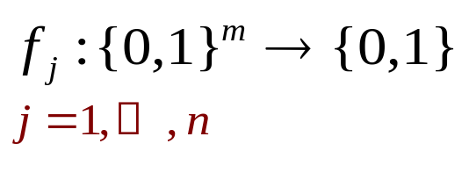
Combinational Circuits
The current outputs depend only on the current inputs.
inputs
outputs
combinational
logic

Slide 3
Circuits with Cycles
0
0
x
AND
a
OR
f
=
b
(
a
+
0
+
0
+
x
(
d
c
(
x
f
)))
1
1
b
AND
0
x
OR
c
AND
d
OR

Slide 4
Circuits with Cycles
1
x
AND
a
OR
f
=
b
(
a
+
1
+
1
+
x
(
d
c
(
x
f
)))
1
1
b
AND
1
1
x
OR
c
AND
d
OR

Slide 5
Circuits with Cycles
Circuit is cyclic yet combinational;
computes functions f₁ and f₂ with 6 gates.
1
x
AND
An acyclic circuit computing these functions requires 8 gates.
a
OR
f
=
b
(
a
+
x
(
d
+
c
))
1
b
AND
1
1
x
OR
c
AND
f
=
d
+
c
(
x
+
b
a
)
2
d
OR

Slide 6

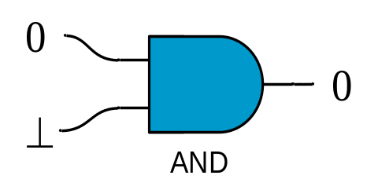
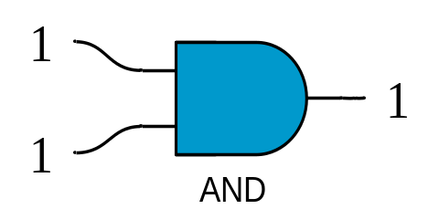

Circuit Model
Perform analysis in the “floating-mode”. At the outset:
all wires are assumed to have unknown/undefined values ( ).
the primary inputs assume definite values in {0, 1}.
a “controlling” input
full set of
“non-controlling” inputs
unknown/undefined
output

Slide 7
Circuit Model
Perform analysis in the “floating-mode”. At the outset:
all wires are assigned to have unknown/undefined values ( ).
the primary inputs assigned definite values in {0, 1}.
⊥
⊥
⊥
⊥
1
⊥
AND
OR
During the analysis, we propagate controlling values.

Slide 8
Exhaustive Analysis
Assign values to every wire
Step through all primary inputs values
Propagate all known values
1
1
x
AND
1
a
0
OR
0
0
b
AND
1
1
x
OR
1
1
c
1
AND
0
d
OR

Slide 9
Exhaustive Analysis
Assign values to every wire
Step through all primary inputs values
Propagate all known values
0
0
x
AND
1
1
a
OR
1
1
b
AND
1
0
x
OR
0
0
c
0
AND
0
d
OR

Slide 10
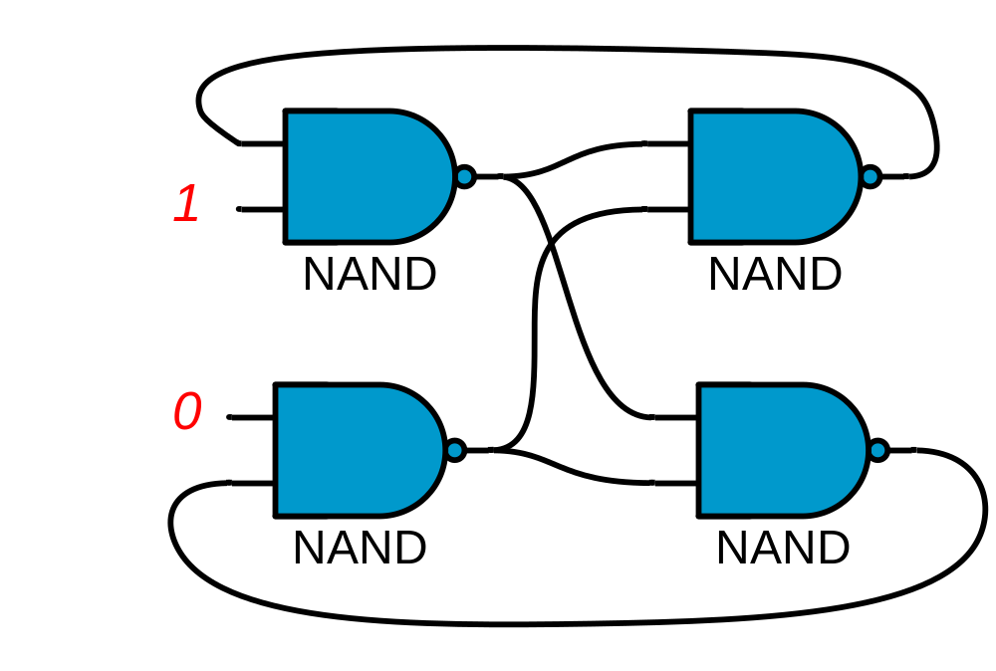
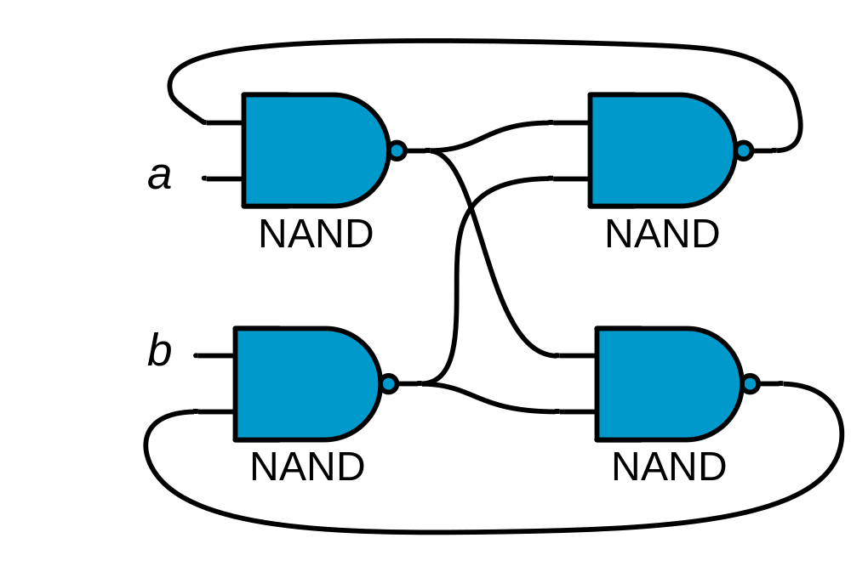
Exhaustive Analysis
Assign values to every wire
Step through all primary inputs values
Propagate all known values
1
1

Slide 11
Previous Work
S. Malik, Analysis of Cyclic Combinational Circuits. 1994
M. Riedel, J. Bruck, The Synthesis of Cyclic Combinational Circuits, DAC03: Design Automation Conference. 2003
  Best Paper Award at DAC03
M. Riedel, J. Bruck, Timing Analysis of Cyclic Combinational Circuits.

Slide 12
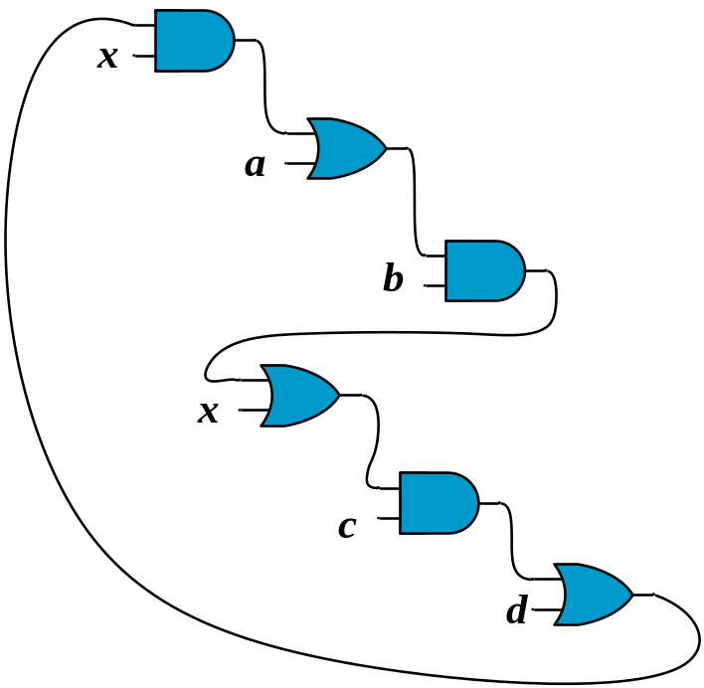
Analysis
Analysis
Combinational

Slide 13

Analysis
Analysis
Not
Combinational

Slide 14
Why use Boolean Satisfiability (SAT)?
BDD-based analysis is slow for large problem sizes
SAT-based methods are known to be a good solution for large problem sizes in practice

Slide 15
SAT-Based Analysis
SAT-Based
Analysis
UNSAT
(Combinational)

Slide 16
SAT-Based Analysis
SAT-Based
Analysis
SAT
(Not Combinational)

Slide 17
SAT Based Analysis of Cyclic Circuits
Find feedback arc set
Introduce dummy variables
Encode the circuit computation for ternary-valued logic (0, 1, )
SAT Question: Is there any input assignment that produces values somewhere in the circuit?
┴
┴

Slide 18
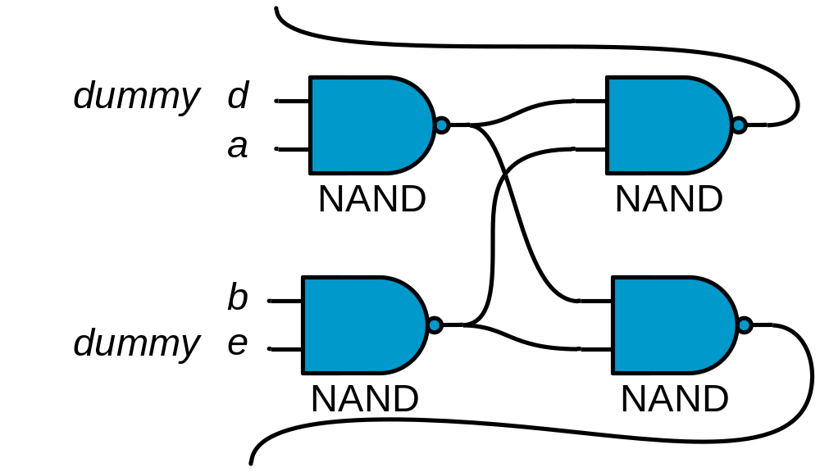
Feedback and Dummy Variables

Slide 19
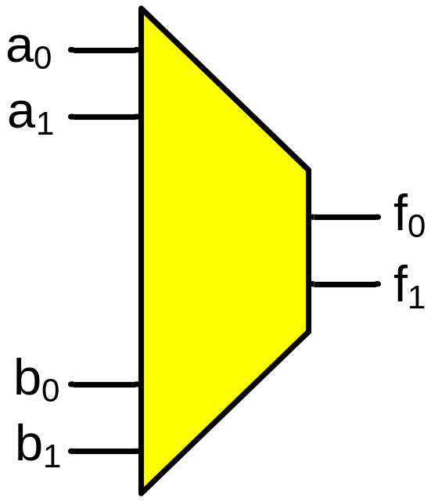
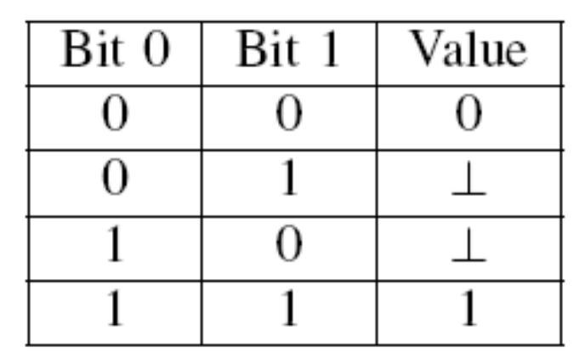
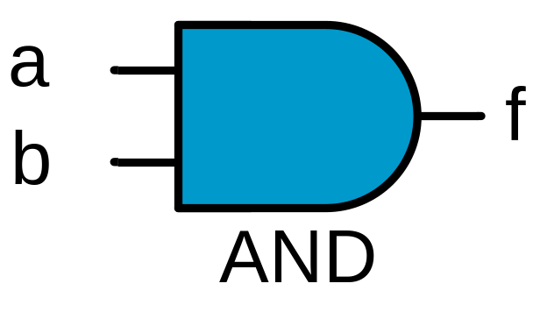
Ternary Logic Conversion
Binary AND
Ternary AND
Encoding Scheme
f₀ = a₀b₀ + a₁b₀b₁
f₁ = a₁b₁ + a₀b₁b₀

Slide 20
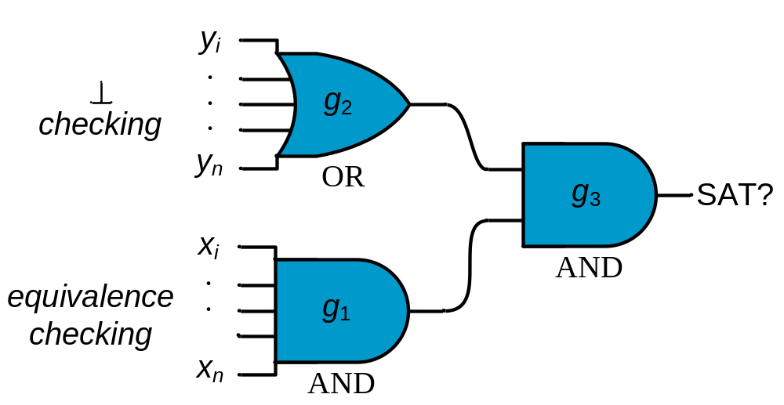
The SAT Question
“For any input assignment (where all dummy variables are assigned their correct values) does a value persist?”
┴

Slide 21
Previous Example
1
1

Slide 22
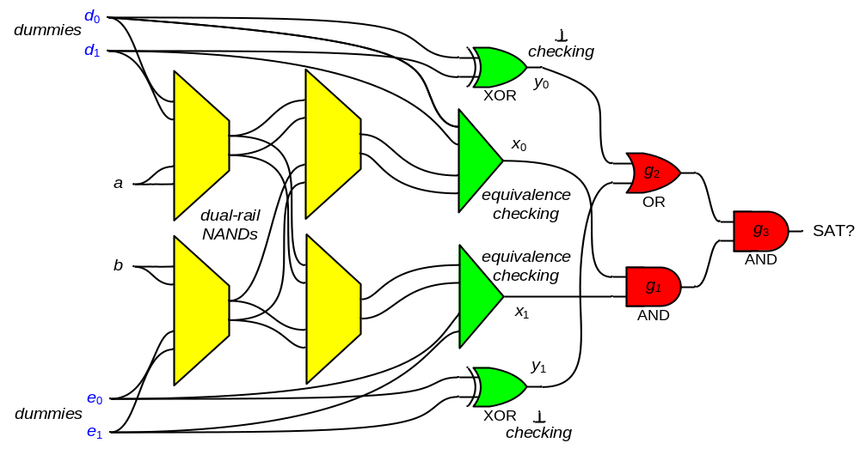
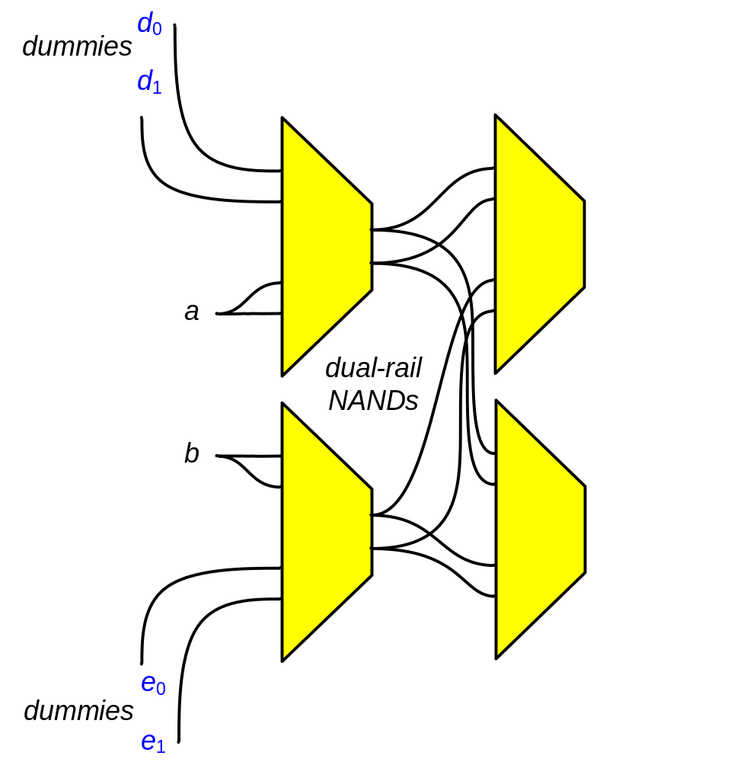
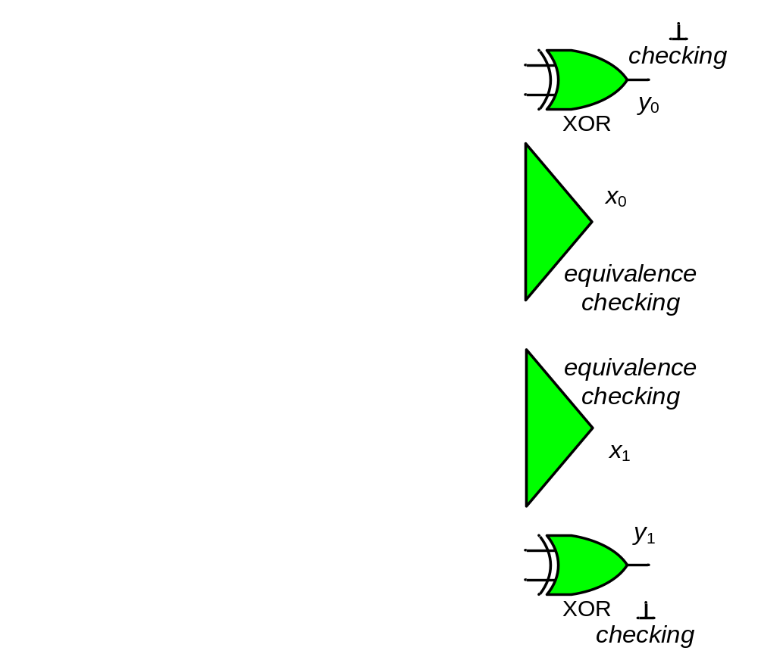
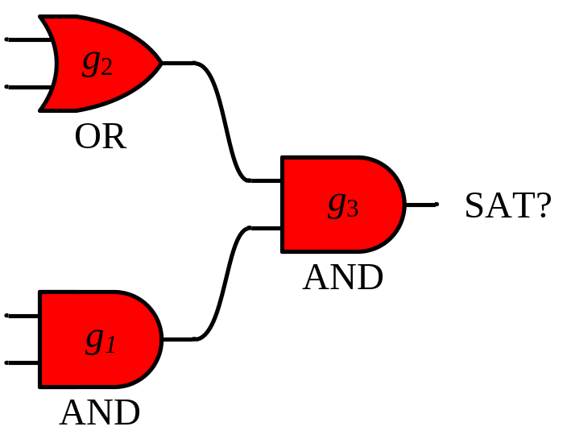
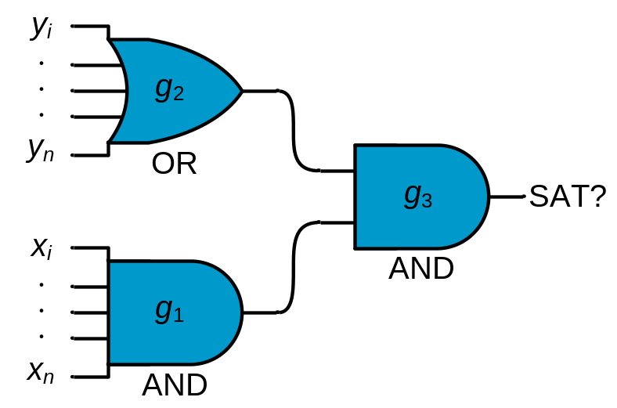
The Final SAT Instance

Slide 23
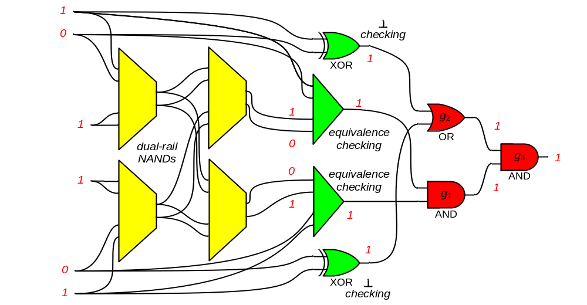
The Final SAT Instance

Slide 24
Runtimes (seconds)
Circuit | Area | BDD Based | SAT Based | Ratio
5xp1 | 218 | 0.10 | 0.01 | 10.00
bbara | 135 | 0.01 | < 0.01 | 1.00
clip | 292 | 0.09 | 0.01 | 9.00
cse | 346 | 0.13 | 0.03 | 4.33
dk16 | 426 | 0.09 | 0.03 | 3.00
duke2 | 664 | 2.35 | 0.07 | 33.57
ex1 | 514 | 0.36 | 0.07 | 5.14
keyb | 401 | 0.24 | 0.03 | 8.00
misex3 | 1065 | 19.05 | 0.16 | 119.00
planet | 890 | 1.03 | 0.08 | 12.88
planet1 | 882 | 1.40 | 0.11 | 12.73
pma | 388 | 0.13 | 0.02 | 6.50
s1 | 555 | 0.56 | 0.06 | 9.33
s1488 | 1036 | 1.43 | 0.13 | 11.00
s386 | 224 | 0.02 | 0.02 | 1.00
sand | 807 | 3.15 | 0.07 | 45.00
average | 552 | 1.88 | 0.06 | 18.22

Slide 25
Further Work
Synthesis
  Implement new synthesis algorithm using Craig interpolation
  Builds off of algorithm proposed in:
    C.-C. Lee, J.-H. R. Jiang, C.-Y. Huang, and A. Mishchenko, “Scalable exploration of functional dependency by interpolation and incremental SAT solving”, ICCAD07: International Conference on Computer Aided Design. 2007.

Slide 26
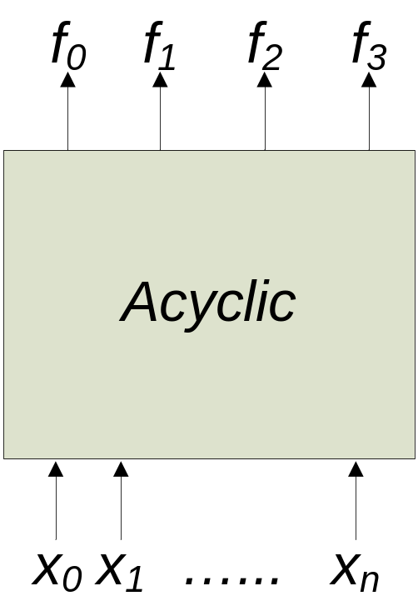
Further Work
f₀ f₁ f₂ f₃
f₀ f₁
f₂ f₃
x₀ x₁ ...... x_{n}
x₀ x₁ ...... x_{n}

Slide 27

Acknowledgements
Alan Mishchenko
ABC: A System for Sequential Synthesis and Verification was used to along with MiniSat to implement the SAT Based algorithm
Research funding was provided by FENA

