Slide 1
Reduction of Interpolants for Logic Synthesis
John Backes (back0145@umn.edu)
Marc Riedel (mriedel@umn.edu)
University of Minnesota Dept. ECE

Slide 2
Craig Interpolation
Given formulas A and B such that A → B, there exists I such that A → I → B
  I only contains variables that are present in both A and B.
I
B
A

Slide 3
Craig Interpolation Cont.
For an instance of unsatisfiablity, if the clauses are divided into sets A and B then A → ¬B.
  An interpolant I can be generated from a proof of unsatisfiability of A and B.
  The structure of this proof influences the structure of I

Slide 4
Applications
Model Checking¹
  Interpolants are used to over approximate the set of reachable states in a transition relation.
Functional Dependencies²
  Interpolants are used to generate a dependency function in terms of a specified support set.
  The size of the interpolant directly correlates to the size of the circuit implementation.
¹(K. L. McMillan. Interpolation and SAT-based model checking. ICCAV, 2003.)
²C.-C. Lee, J.-H. R. Jiang, C.-Y. Huang, and A. Mishchenko. Scalable exploration of functional dependency by interpolation and incremental SAT solving. ICCAD, 2007.

Slide 5
Generating Interpolants
A method was proposed by P. Pudlák et al. ¹
A similar method was proposed by K. L. McMillan²
  In this work we build off this procedure
¹P. Pudlak. Lower bounds for resolution and cutting plane proofs and monotone computations. Journal of Symbolic Logic, 62:981–998, 1997.
²(K. L. McMillan. Interpolation and SAT-based model checking. In International Conference on Computer Aided Verification, pages 1–13, 2003.)

Slide 6
Resolution Proofs
A proof of unsatisfiability for an in instance of SAT forms a graph structure.
The original clauses are called the roots and the empty clause is the only leaf.
Every node in the graph (besides the roots) is formed via Boolean resolution.
  I.e.: (c + d)(¬c + e) → (d + e)
  Here “c” is referred to as the pivot variable.

Slide 7
A Resolution Proof
Clauses of A are shown in red, and clauses of B are shown in blue
(
a
+
¬
c
+
d
)(
¬
a
+
¬
c
+
d
)(
a
+
c
)(
¬
a
+
c
)(
¬
d
)
(
d
+
¬c
)(
a
+
b
)
(
c
) (
¬
c
)
( )

Slide 8
Generating Interpolants
Interpolants are generated by calling a recursive function on the empty clause.
Logic gates are created on the intermediate nodes.
  The function of the gate depends on which set of root nodes the pivot variable is present in.
The procedure terminates on root nodes.

Slide 9
Generating I Example
(
a
+
¬
c
+
d
)(
¬
a
+
¬
c
+
d
)(
a
+
c
)(
¬
a
+
c
)(
¬
d
)
(
d
+
¬c
)(
a
+
b
)
(
c
) (
¬
c
)
( )

Slide 10
Generating I Example
(
a
+
c
)(
¬
a
+
c
)(
¬
d
)
(
d
+
¬c
)
(
c
) (
¬
c
)
( )

Slide 11
Generating I Example
a c ¬a c
(
a
+
c
)(
¬
a
+
c
)(
¬
d
)
(
d
+
¬c
)
(
c
) (
¬
c
)
( )

Slide 12
Generating I Example
a c ¬a c
)(
¬
d
)
(
d
+
¬c
)
(
c
) (
¬
c
)
( )

Slide 13
Generating I Example
a c ¬a c
(
¬
d
)
(
c
) (
¬
c
)
( )

Slide 14
Generating I Example
a c ¬a c
(
¬
d
)
¬d
( )

Slide 15
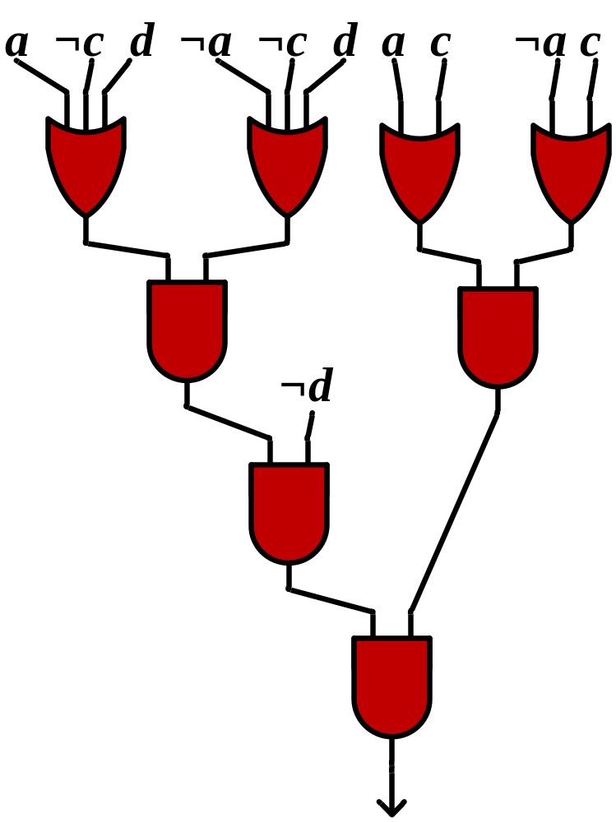
Generating I Example
(
a
+
¬
c
+
d
)(
¬
a
+
¬
c
+
d
)(
a
+
c
)(
¬
a
+
c
)(
¬
d
)
(
d
+
¬c
)(
a
+
b
)
(
d
+
¬c
)
(
¬
c
)
(
c
)
( )

Slide 16
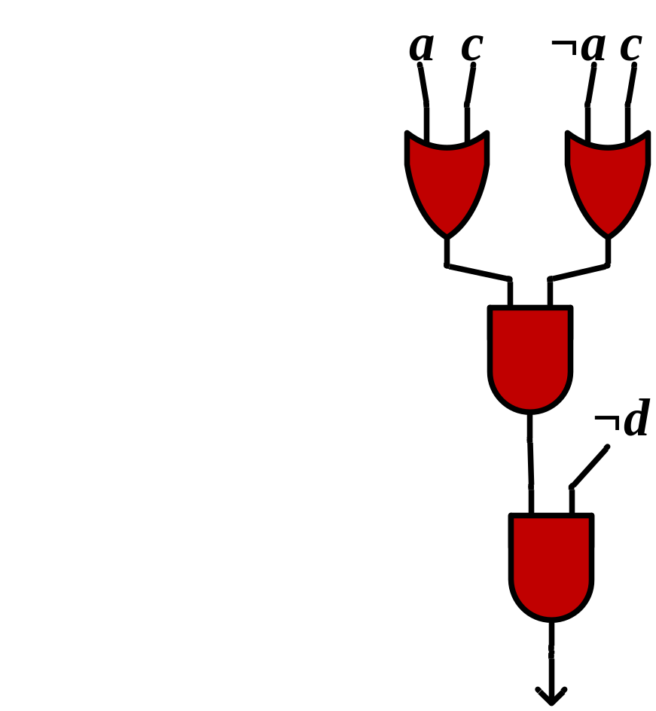
Generating I Example
>

Slide 17
Draw Backs
Model Checking
  Interpolants that are large over approximations can trigger false state reachability.
Functional Dependencies
  In many cases the structure of the interpolant may be very redundant and large.

Slide 18
Proposed Solution
Goal: reduce size of an interpolant generated from a resolution proof.
  Change the structure of a proof with the aim of reducing interpolant size.
  In general, the less intermediate nodes in the proof, the smaller then interpolant.

Slide 19
Proposition 1
Nodes resolved only from A (or B) can be considered as roots of A (or B).
Proof: Given clauses C, D, and E such that (C)(D) → (E), (C)(D) ≡ (C)(D)(E).
I
B
A

Slide 20
Example
(
a
+
¬
c
+
d
)(
¬
a
+
¬
c
+
d
)(
a
+
c
)(
¬
a
+
c
)(
¬
d
)
(
d
+
¬c
)(
a
+
b
)
(
c
) (
¬
c
)
( )

Slide 21
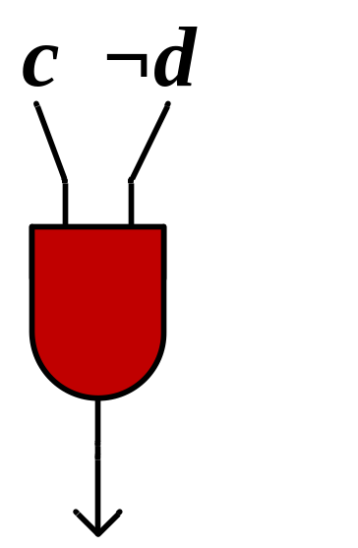
Example
(
a
+
¬
c
+
d
)(
¬
a
+
¬
c
+
d
)(
a
+
c
)(
¬
a
+
c
)(
¬
d
)
(
d
+
¬c
)(
a
+
b
)
(
c
) (
¬
c
)
( )

Slide 22
Example
(
a
+
¬
c
+
d
)(
¬
a
+
¬
c
+
d
)(
a
+
c
)(
¬
a
+
c
)(
¬
d
)
(
d
+
¬c
)(
a
+
b
)
(
d
+
¬c
)
(
¬
c
)
(
c
)
( )

Slide 23
Example
(
a
+
¬
c
+
d
)(
¬
a
+
¬
c
+
d
)(
a
+
c
)(
¬
a
+
c
)(
¬
d
)
(
d
+
¬c
)(
a
+
b
)
(
d
+
¬c
)
0
(
¬
c
)
(
c
)
( )

Slide 24
Observation
Proofs with few resolutions between clauses of A and B will tend to have smaller interpolants.
  We refer to nodes that have ancestors for A and B as mixed nodes.
  We refer to proofs with few mixed nodes as being more disjoint.
Our goal: find a more disjoint proof before generating the interpolant.

Slide 25
Proposition 2
If node c in a proof is implied by root nodes R, then all assignments that satisfy the clauses of R also satisfy c.
Proof: since R → c, whenever R = 1, c = 1.

Slide 26
SAT Based Methods
Since R → c the SAT instance (R)(¬c) will be unsatisfiable.
R. Gershman used this observation to find Minimum Unsatisfiable Cores (MUCs) for resolution proofs¹.
¹R. Gershman, M. Koifman, and O. Strichman. An approach for extracting a small unsatisfiable core. Formal Methods in System Design, 2008.

Slide 27
Example
(
a
+
¬
c
+
d
)(
¬
a
+
¬
c
+
d
)(
a
+
c
)(
¬
a
+
c
)(
¬
d
)
(
d
+
¬c
)(
a
+
b
)
What if we want to know if (¬c) can be implied by A?
Check the satisfiability of:
(
c
) (
¬
c
)
Root of A?
( )
(a + ¬c + d)(¬a + ¬c + d)(a+ c)(¬a + c)(¬d)(c)
=
UNSAT!

Slide 28
Example
(
a
+
¬
c
+
d
)(
¬
a
+
¬
c
+
d
)(
a
+
c
)(
¬
a
+
c
)(
¬
d
)
(
d
+
¬c
)(
a
+
b
)
What if we want to know if ( ) can be implied by A?
Check the satisfiability of:
(
c
) (
¬
c
)
( )
Root of A?
(a + ¬c + d)(¬a + ¬c + d)(a+ c)(¬a + c)(¬d)
=
UNSAT!

Slide 29
Example
(
a
+
¬
c
+
d
)(
¬
a
+
¬
c
+
d
)(
a
+
c
)(
¬
a
+
c
)(
¬
d
)
(
d
+
¬c
)(
a
+
b
)
What if we want to know if ( ) can be implied by A?
Check the satisfiability of:
(
c
) (
¬
c
)
( )
Root of A?
(a + ¬c + d)(¬a + ¬c + d)(a+ c)(¬a + c)(¬d)
=
UNSAT!

Slide 30
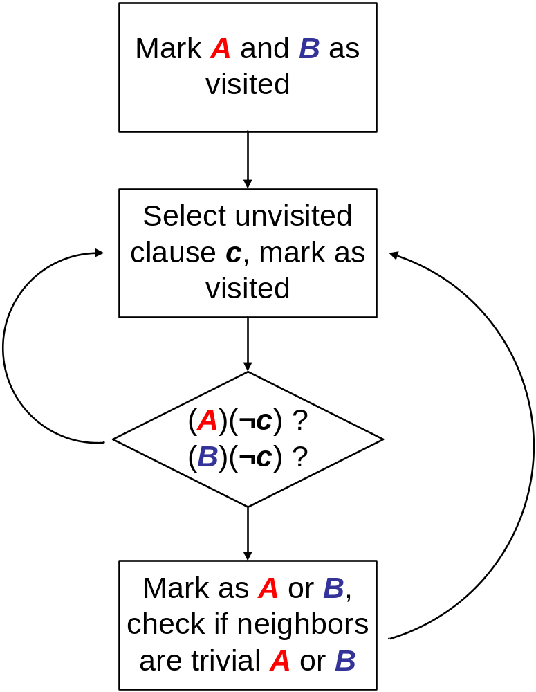
Proposed Method

Slide 31
Optimizations
The complexity of this approach is dominated by solving different SAT instances.
We can reduce the number of calls to the SAT solver by checking mixed nodes in specific orders.

Slide 32
Optimization 1
...( )( )( )( )
( )( )( )...
……
..
If node 1 is a root of A (B) then we don’t need to check node 3.
(
3
) (
4
) (
5
)
(
1
) (
2
)
( )

Slide 33
Optimization 1
...( )( )( )( )
( )( )( )...
……
..
If node 1 is a root of A (B) then we don’t need to check node 3.
(
3
) (
4
) (
5
)
(
1
) (
2
)
( )

Slide 34
Optimization 1
...( )( )( )( )
( )( )( )...
……
..
If nodes 1 and 2 are roots of A (B) then we don’t need to check nodes 3 4 or 5.
(
3
) (
4
) (
5
)
(
1
) (
2
)
( )

Slide 35
Optimization 1
...( )( )( )( )
( )( )( )...
……
..
If nodes 1 and 2 are roots of A (B) then we don’t need to check nodes 3 4 or 5.
(
3
) (
4
) (
5
)
(
1
) (
2
)
Checking nodes near the leaf first is a backward search
( )

Slide 36
Optimization 2
...( )( )( )( )
( )( )( )...
……
..
If nodes and 3 and 4 are roots of A (B) then node 1 can be considered a root of A (B)
(
3
) (
4
) (
5
)
(
1
) (
2
)
( )

Slide 37
Optimization 2
...( )( )( )( )
( )( )( )...
……
..
If nodes and 3 and 4 are roots of A (B) then node 1 can be considered a root of A (B)
(
3
) (
4
) (
5
)
(
1
) (
2
)
( )

Slide 38
Optimization 2
...( )( )( )( )
( )( )( )...
……
..
If nodes and 3 and 4 are roots of A (B) then node 1 can be considered a root of A (B)
(
3
) (
4
) (
5
)
(
1
) (
2
)
Checking nodes near the roots first is a forward search
( )

Slide 39
Forward vs. Backward Search
Backward Search
  Eliminates many mixed nodes at once
  May take many SAT checks before we prove a node to be a root.
Forward Search
  Nodes toward the beginning are more likely to be roots
  May require more checks then backward search.

Slide 40
Incremental Techniques
Each call to the SAT solver is very similar.
  Each instance is in the form (A)(¬c) or (B)(¬c).
The negated literals of clause c can be set as unit assumptions to the SAT Solver.
  We then just solve the same instance repeatedly with different assumptions.
Variables a_{off} and b_{off} can be added to the clauses of A and B respectively.

Slide 41
Example
(
a
+
¬
c
+
d
)(
¬
a
+
¬
c
+
d
)(
a
+
c
)(
¬
a
+
c
)(
¬
d
)
(
d
+
¬c
)(
a
+
b
)
What if we want to know if (d + ¬c) can be implied by A?
Assume a_{off} = 0, b_{off} = 1, d = 0, and c = 1. Then check the satisfiability of:
Root of A?
(
c
) (
¬
c
)
( )
(a + ¬c + d + a_{off})(¬a + ¬c + d + a_{off})(a+ c + a_{off})(¬a + c + a_{off}) (¬d + a_{off})(d + ¬c + b_{off})(a + b + b_{off})
= UNSAT!

Slide 42
Experiment
Searched for different functional dependencies in benchmark circuits.
  Found small support sets for POs expressed in terms of other POs and PIs.
Performed forward and backward search on the resolution proofs.
  The number of SAT checks was limited to 2500.
  This limit was reached for the larger proofs.

Slide 43
Experiment Cont.
After the new interpolants from the modified resolution proofs are. generated, the size is compared to the un modified proofs.
The size after running logic minimization on the modified and non modified interpolants is also compared.

Slide 44
Results (table3 benchmark)
table3 Benchmark: Forward Search
Function | # Nodes | Orig Size | New Size | Checked | Found | Time (s) | Orig Reduced | New Reduced | Ratio
0 | 32262 | 277 | 267 | 2500 | 61 | 80.85 | 105 | 93 | 0.89
1 | 128654 | 1254 | 1254 | 2500 | 0 | 281.31 | 328 | 329 | 1.00
2 | 95042 | 638 | 630 | 2500 | 283 | 218.25 | 248 | 226 | 0.91
3 | 71647 | 682 | 648 | 2500 | 423 | 157.66 | 273 | 215 | 0.79
4 | 57015 | 776 | 743 | 2500 | 432 | 126.26 | 380 | 364 | 0.96
5 | 47285 | 657 | 657 | 2500 | 0 | 106.23 | 251 | 233 | 0.93
6 | 43884 | 268 | 245 | 2500 | 578 | 94.67 | 91 | 104 | 1.14
7 | 26714 | 287 | 271 | 2500 | 335 | 64.37 | 144 | 126 | 0.88
8 | 31715 | 116 | 90 | 2500 | 48 | 79.4 | 55 | 34 | 0.62
9 | 13182 | 43 | 36 | 1090 | 65 | 17.25 | 22 | 18 | 0.82
10 | 70964 | 867 | 850 | 2500 | 576 | 146.85 | 413 | 397 | 0.96
11 | 31772 | 253 | 229 | 2500 | 67 | 80.12 | 86 | 107 | 1.24
12 | 45784 | 376 | 360 | 2500 | 404 | 98.61 | 172 | 184 | 1.07
13 | 29078 | 408 | 373 | 2500 | 757 | 64.73 | 130 | 55 | 0.42

Slide 45
Results (table3 benchmark)
table3 Benchmark: Backward Search
Function | Nodes | Orig Size | New Size | Checked | Found | Time (s) | Orig Reduced | New Reduced | Ratio
0 | 32262 | 277 | 129 | 2500 | 20 | 85.88 | 105 | 58 | 0.55
1 | 128654 | 1254 | 1238 | 2500 | 5 | 287.62 | 328 | 346 | 1.05
2 | 95042 | 638 | 574 | 2500 | 8 | 225.37 | 248 | 217 | 0.88
3 | 71647 | 682 | 469 | 2500 | 45 | 179.96 | 273 | 177 | 0.65
4 | 57015 | 776 | 490 | 2500 | 26 | 144.83 | 380 | 193 | 0.51
5 | 47285 | 657 | 611 | 2500 | 8 | 114.33 | 251 | 242 | 0.96
6 | 43884 | 268 | 224 | 2500 | 8 | 107.96 | 91 | 106 | 1.16
7 | 26714 | 287 | 87 | 2500 | 27 | 76.61 | 144 | 51 | 0.35
8 | 31715 | 116 | 76 | 2500 | 15 | 85.23 | 55 | 34 | 0.62
9 | 13182 | 43 | 36 | 1017 | 3 | 16.55 | 22 | 18 | 0.82
10 | 70964 | 867 | 349 | 2500 | 41 | 179.22 | 413 | 192 | 0.46
11 | 31772 | 253 | 191 | 2500 | 8 | 82.38 | 86 | 50 | 0.58
12 | 45784 | 376 | 203 | 2500 | 34 | 120 | 172 | 117 | 0.68
13 | 29078 | 408 | 112 | 2500 | 32 | 84.29 | 130 | 37 | 0.28

Slide 46
Results (Summarized)
Forward Search
Benchmark | Nodes | Checked | Found | % Change | % Change Reduced | Time (s)
apex1 | 28279 | 2413 | 30 | -4.89% | -2.73% | 69.48
apex3 | 68585 | 1494 | 21 | -2.12% | -1.47% | 140.99
styr | 9373 | 2143 | 88 | -8.71% | -5.71% | 18.3
s1488 | 5748 | 824 | 29 | -9.24% | -8.41% | 7.62
s1494 | 10488 | 1266 | 21 | -6.69% | -4.43% | 15.51
s641 | 46416 | 1886 | 39 | -26.67% | -2.33% | 97.45
s713 | 42412 | 1910 | 89 | -36.00% | -3.70% | 89.16
table5 | 35373 | 2500 | 252 | -13.83% | -4.08% | 48.05
vda | 12951 | 2011 | 120 | -18.78% | -17.33% | 27.34
sbc | 13951 | 1094 | 8 | -1.46% | -1.08% | 19.09

Slide 47
Results (Summarized)
Backward Search
Benchmark | Nodes | Checked | Found | % Change | % Change Reduced | Time (s)
apex1 | 28279 | 2384 | 6 | -8.95% | -5.84% | 72.03
apex3 | 68585 | 1485 | 5 | -8.41% | -5.24% | 145.63
styr | 9373 | 2124 | 10 | -11.57% | -10.14% | 19.36
s1488 | 5748 | 797 | 5 | -9.92% | -9.59% | 7.98
s1494 | 10488 | 1241 | 7 | -6.93% | -5.19% | 15.83
s641 | 46416 | 1820 | 14 | -42.22% | -2.78% | 95.37
s713 | 42412 | 1724 | 17 | -43.90% | -6.20% | 82.86
table5 | 35373 | 2358 | 7 | -26.67% | -15.83% | 81.16
vda | 12951 | 1850 | 7 | -21.72% | -19.72% | 27.07
sbc | 13951 | 1087 | 1 | -1.46% | -0.92% | 19.09

Slide 48
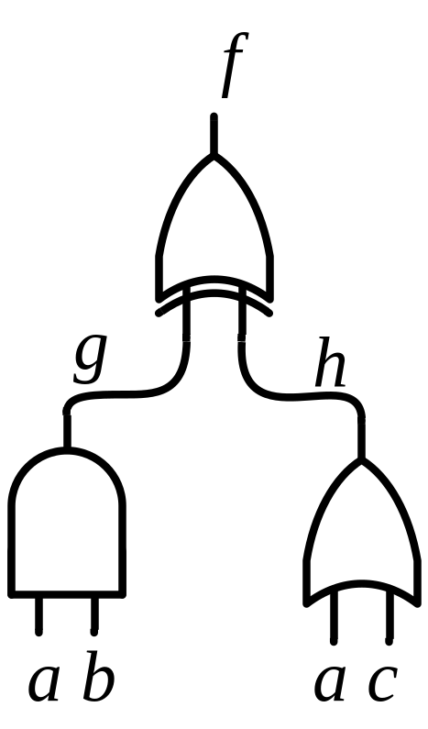
Discussion
Why are some interpolants significantly reduced and others not?
  Don’t care conditions that exist can be simplified.
  Function f can be either 0 or 1 for the assignment g = 1, h = 0.

Slide 49
Summary
The new method finds a lot of variability in some of the interpolants.
  After running logic minimization the results are less significant but still better then the size of the interpolants for the non altered proofs.

Slide 50
Future Work
Applications in model checking
  Can these techniques be used to generate interpolants that are less of an over approximation?
SAT solver decision heuristics
  This approach is still somewhat biased by the initial proof.
New data structure for synthesis?
  Can the incremental techniques be more refined to allow changes to a resolution proof correspond to changes to an entire circuit?

Slide 51


Questions?
Thanks to FENA and NSF Career Award

