Slide 1
Resolution Proofs as a Data Structure for Logic Synthesis
John Backes (back0145@umn.edu)
Marc Riedel (mriedel@umn.edu)
Electrical and Computer Engineering
University of Minnesota

Slide 2
Data Structures
Sum of Products (SOPs)
  Advantages: explicit, readily mapable.
  Disadvantages: not scalable.
Binary Decision Diagrams (BDDs)
  Advantages: canonical, easily manipulated.
  Disadvantages: not readily mapable, not scalable.

Slide 3
Data Structures
And Inverter Graphs (AIGs)
  Advantages:
    Compact.
    Easily convertible to CNFs.
    Scalable, efficient.
  Disadvantages:
    Hard to perform large structural changes.

Slide 4
Resolution Proofs
Implicitly extracted from SAT solvers; converted to logic via Craig Interpolation.
Utilize as a data structure to perform logic manipulations.
Advantages:
  Scalable, efficient.
  Can effect large structural changes.

Slide 5
AIG Synthesis
Re-writing
  Cuts are replaced by pre-computed optimal structures (Mishchenko ’06).
SAT Sweeping
  Nodes of an AIG can be merged by proven equivalence (Zhu ‘06).
SAT-Based Resubstitution
  Target nodes are recomputed from other nodes (Lee ‘07).

Slide 6
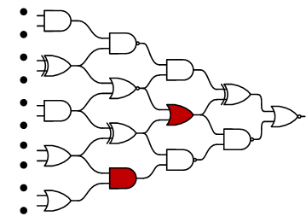
AIG Synthesis
SAT-Sweeping (merging equivalent nodes)

Slide 7
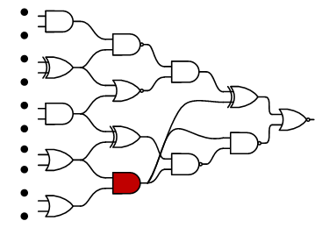
AIG Synthesis
SAT-Sweeping (merging equivalent nodes)

Slide 8
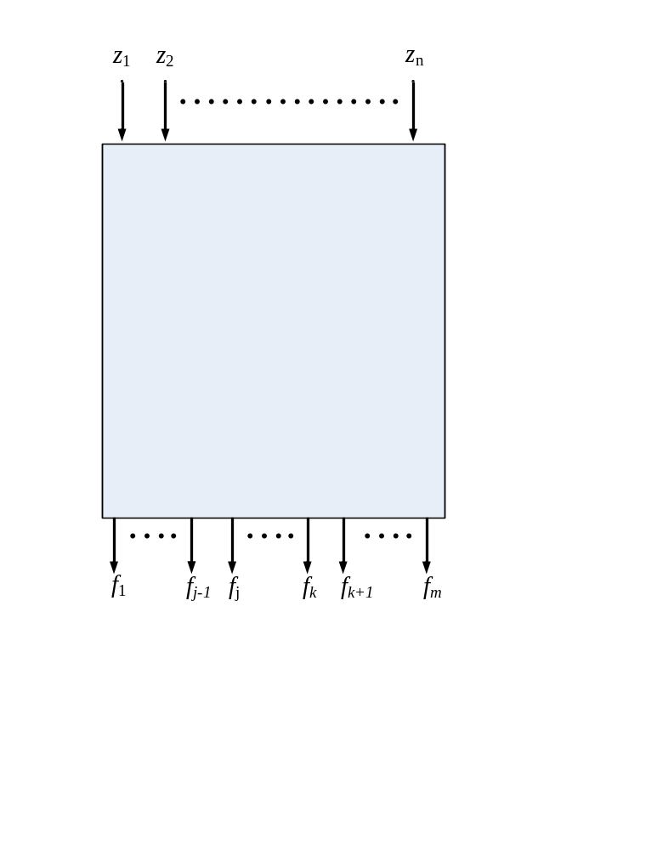
AIG Synthesis
AIG re-writing
  Local manipulations performed on windows
  Local minimums can be reached

Slide 9
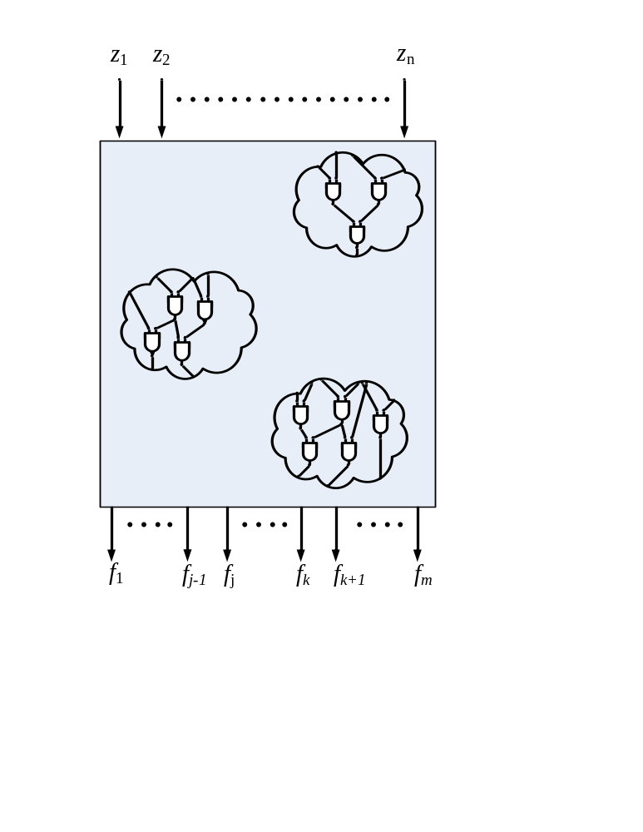
AIG Synthesis
AIG re-writing
  Local manipulations performed on windows
  Local minimums can be reached

Slide 10
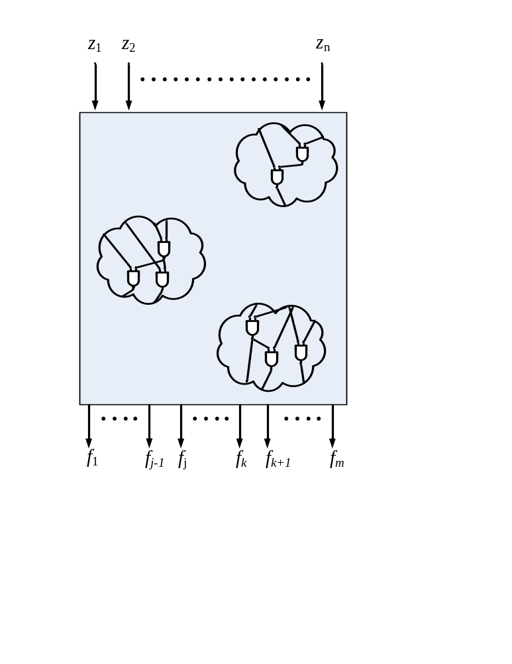
AIG Synthesis
AIG re-writing
  Local manipulations performed on windows
  Local minimums can be reached

Slide 11
Resubstitution a.k.a. Functional Dependencies
Given target:
f (z₁,z₂,…,z_{n}),
Given candidates:
x₁(z₁,z₂,…,z_{n}), x₂(z₁,z₂,…,z_{n}), …, x_{m}(z₁,z₂,…,z_{n})
is it possible to implement f (x₁,x₂,…,x_{m})?

Slide 12

Aig Synthesis
Resubstitution
  f (x₁,x₂)?

Slide 13
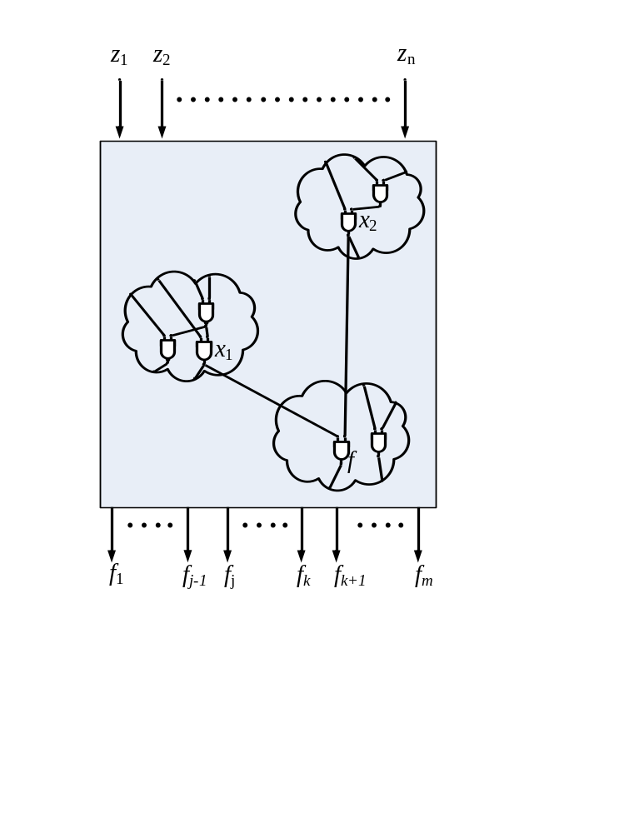
Aig Synthesis
Resubstitution
  f (x₁,x₂)?
  Large changes
  This question is formulated as a SAT instance.
  Craig Interpolation provides implementation.

Slide 14
Craig Interpolation
Given formulas A and B such that A → ¬B, there exists I such that A → I → ¬B
I only contains variables that are present in both A and B.
I
B
A

Slide 15
Craig Interpolation
SAT?: ( f )(CNF_{Left})( f *)(CNF_{Right})(x₁ = x₁*)(x₂ = x₂*)…(x_{m} = x_{m}*)
A
B
f (x₁,x₂,…,x_{m})?
If UNSAT, a proof of unsatisfiablility is generated.
An implementation of f is generated from the proof.
(Lee ‘07)

Slide 16
Resolution Proofs
A proof of unsatisfiability for an instance of SAT forms a graph structure.
The original clauses are called the roots and the empty clause is the only leaf.
Every node in the graph (besides the leaves) is formed via Boolean resolution.
  E.g.,: (c + d)(¬c + e) → (d + e)

Slide 17
A Resolution Proof
Clauses of A are shown in red, and clauses of B are shown in blue.
(
a
+
¬
c
+
d
)(
¬
a
+
¬
c
+
d
)(
a
+
c
)(
¬
a
+
c
)(
¬
d
)
(
d
+
¬c
)(
a
+
b
)
(
c
) (
¬
c
)
( )

Slide 18
Example: Generating I
(
a
+
¬
c
+
d
)(
¬
a
+
¬
c
+
d
)(
a
+
c
)(
¬
a
+
c
)(
¬
d
)
(
d
+
¬c
)(
a
+
b
)
(
c
) (
¬
c
)
( )

Slide 19
Example: Generating I
(
a
+
c
)(
¬
a
+
c
)(
¬
d
)
(
d
+
¬c
)
(
c
) (
¬
c
)
( )

Slide 20
Example: Generating I
a c ¬a c
(
a
+
c
)(
¬
a
+
c
)(
¬
d
)
(
d
+
¬c
)
(
c
) (
¬
c
)
( )

Slide 21
Example: Generating I
a c ¬a c
)(
¬
d
)
(
d
+
¬c
)
(
c
) (
¬
c
)
( )

Slide 22
Example: Generating I
a c ¬a c
(
¬
d
)
(
c
) (
¬
c
)
( )

Slide 23
Example: Generating I
a c ¬a c
(
¬
d
)
¬d
( )

Slide 24
Generating Multiple Dependencies
Often, goal is to synthesize dependencies for multiple functions with overlapping support sets.
In this case, multiple proofs are generated and then interpolated.

Slide 25
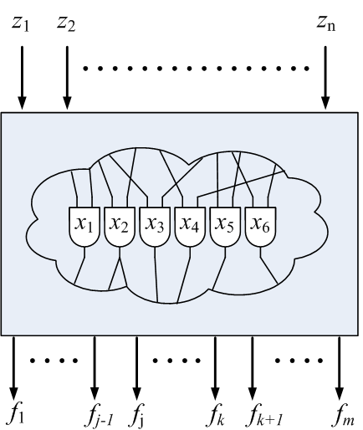
Example
Large portions of a network can be converted to a resolution proof.
f_{j} (x₁,x₂,x₃,x₄,x₅,x₆)?
f_{k} (x₁,x₂,x₃,x₄,x₅,x₆)?

Slide 26
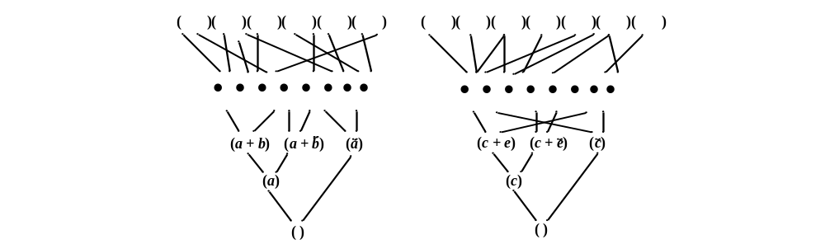
Example
f_{j} (x₁,x₂,x₃,x₄,x₅,x₆)?
f_{k} (x₁,x₂,x₃,x₄,x₅,x₆)?

Slide 27
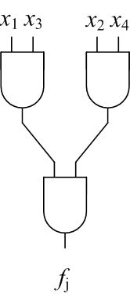
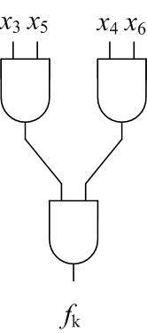
Example
f_{j} (x₁,x₂,x₃,x₄,x₅,x₆)?
f_{k} (x₁,x₂,x₃,x₄,x₅,x₆)?

Slide 28
Observation
There are often many ways to prove a SAT instance unsatisfiable.
Same/similar nodes shared between different proofs.

Slide 29
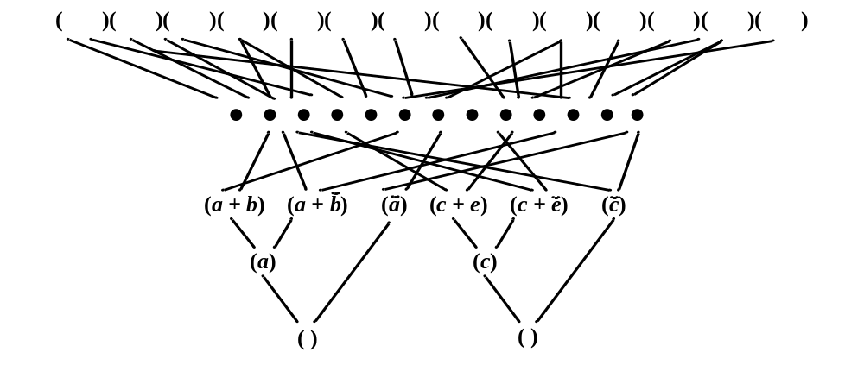
Example
f_{j} (x₁,x₂,x₃,x₄,x₅,x₆)?
f_{k} (x₁,x₂,x₃,x₄,x₅,x₆)?

Slide 30
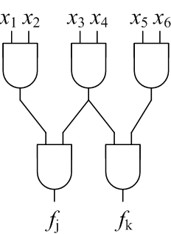
Example
f_{j} (x₁,x₂,x₃,x₄,x₅,x₆)?
f_{k} (x₁,x₂,x₃,x₄,x₅,x₆)?

Slide 31
Restructuring Mechanism
Some clause c can be resolved from some set of clauses W iff (W)(c) is unsatisfiable.
The resolution proof of (W)(c) can be altered to show how c can be resolved from W.
(Gershman ‘08)

Slide 32
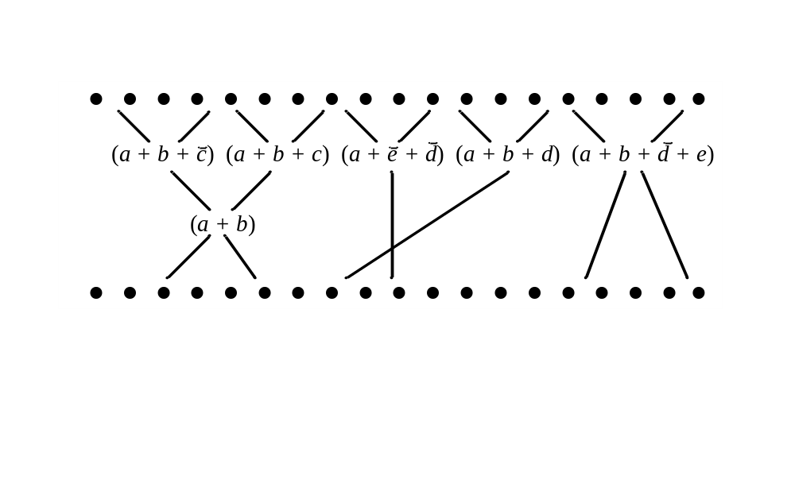
Example
Can (a + b) be resolved from (a + e + d)(a + b + d) (a + b + d + e)?
(Gershman ‘08)

Slide 33
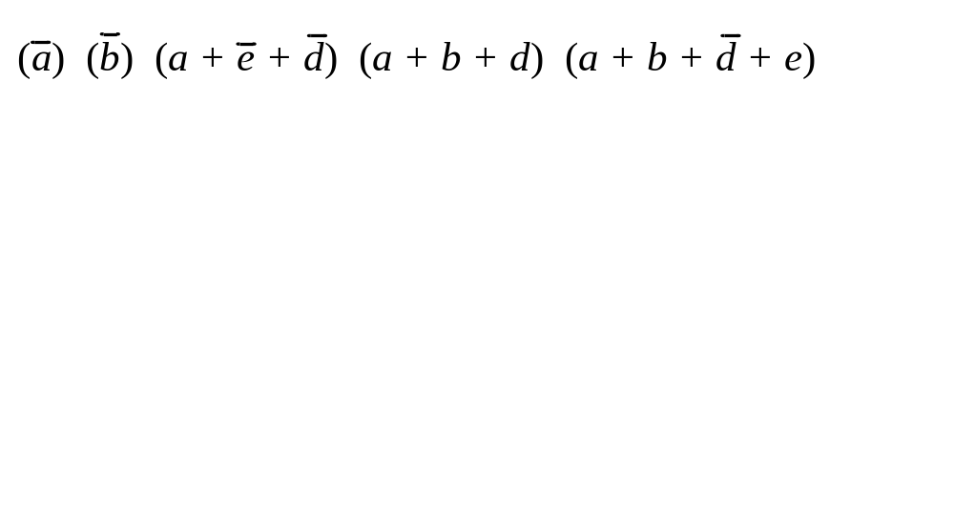
Example
Can (a + b) be resolved from (a + e + d)(a + b + d) (a + b + d + e)?
(Gershman ‘08)

Slide 34
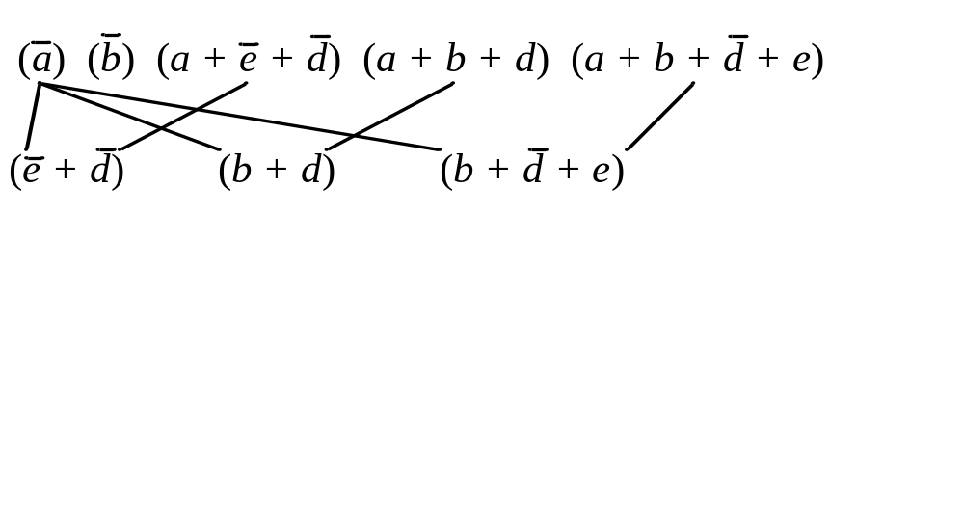
Example
Can (a + b) be resolved from (a + e + d)(a + b + d) (a + b + d + e)?
(Gershman ‘08)

Slide 35
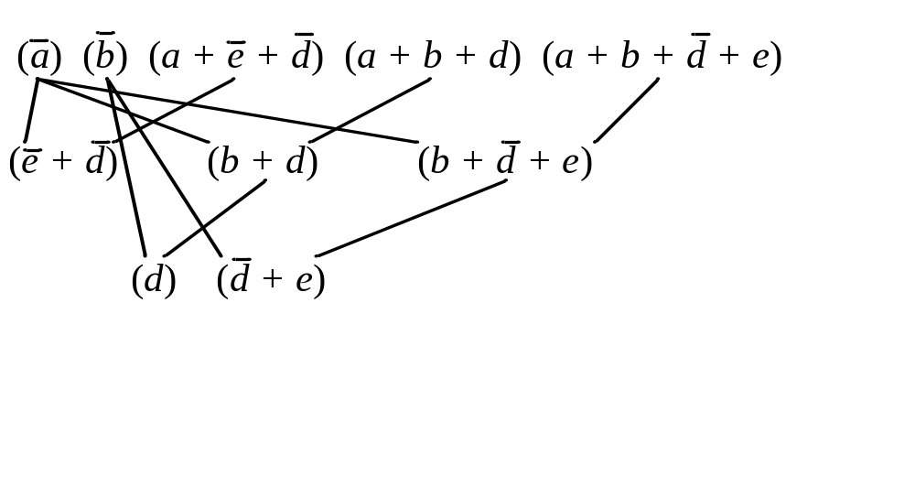
Example
Can (a + b) be resolved from (a + e + d)(a + b + d) (a + b + d + e)?
(Gershman ‘08)

Slide 36
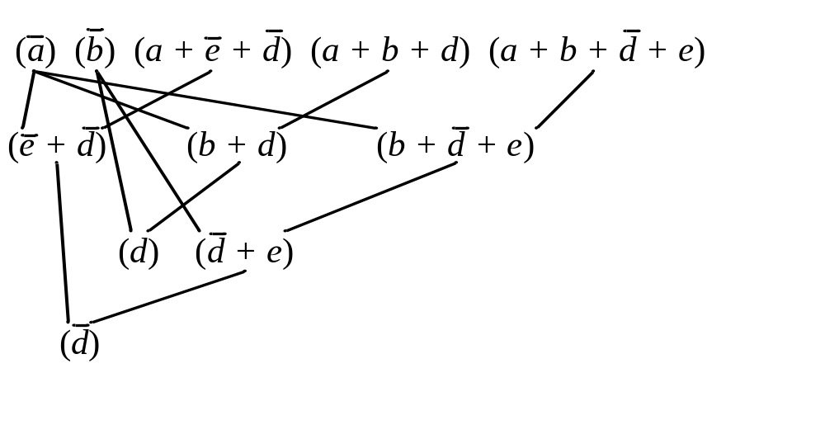
Example
Can (a + b) be resolved from (a + e + d)(a + b + d) (a + b + d + e)?
(Gershman ‘08)

Slide 37
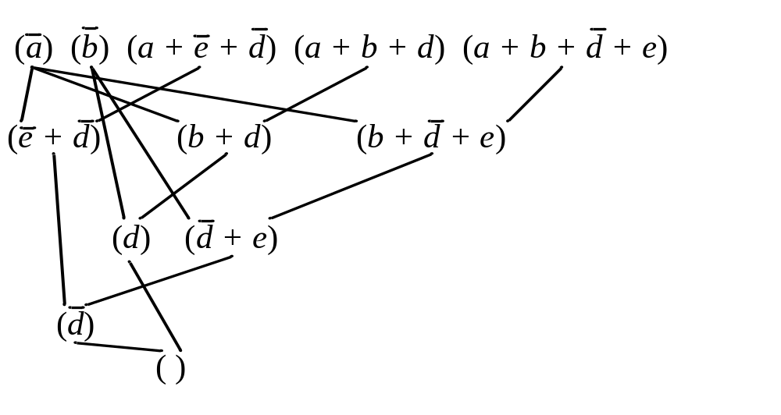
Example
Can (a + b) be resolved from (a + e + d)(a + b + d) (a + b + d + e)?
(Gershman ‘08)

Slide 38
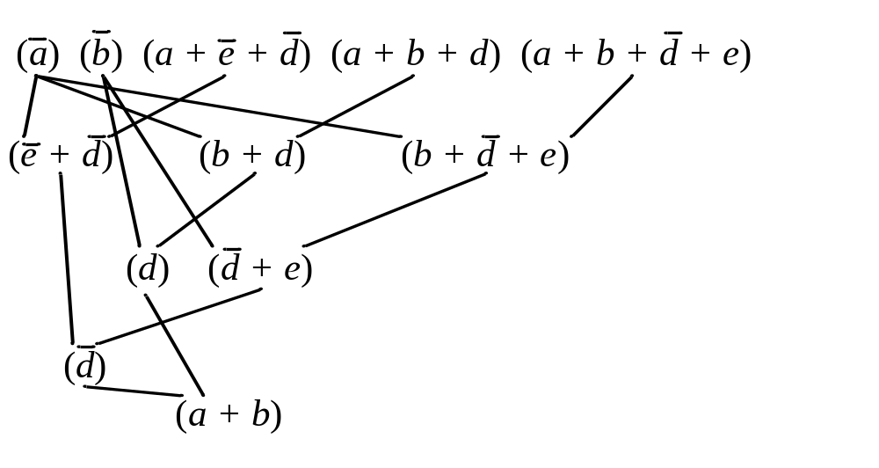
Example
Can (a + b) be resolved from (a + e + d)(a + b + d) (a + b + d + e)?
(Gershman ‘08)

Slide 39
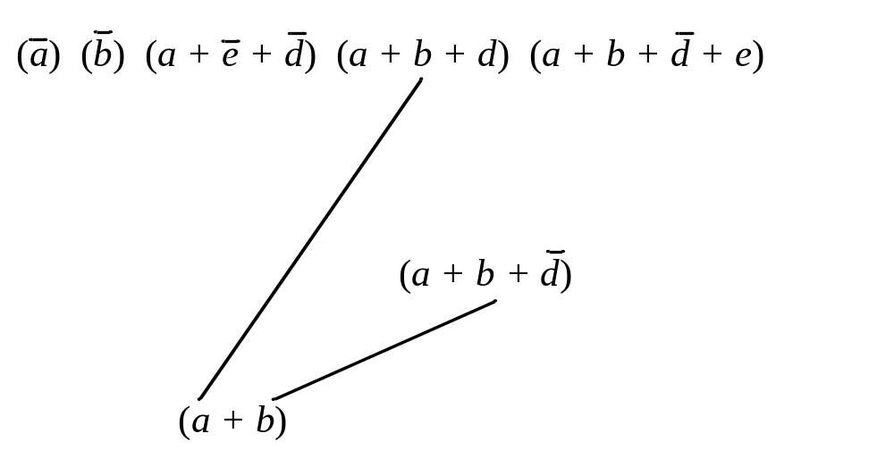
Example
Can (a + b) be resolved from (a + e + d)(a + b + d) (a + b + d + e)?
(Gershman ‘08)

Slide 40
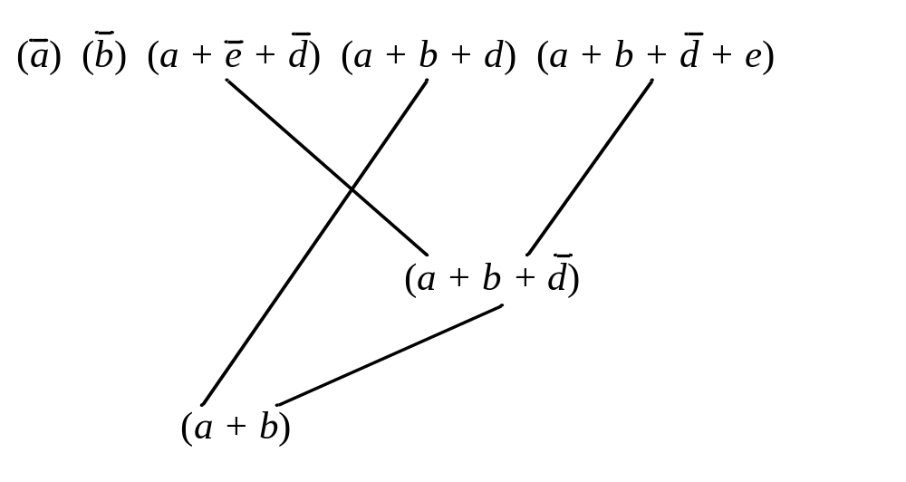
Example
Can (a + b) be resolved from (a + e + d)(a + b + d) (a + b + d + e)?
(Gershman ‘08)

Slide 41
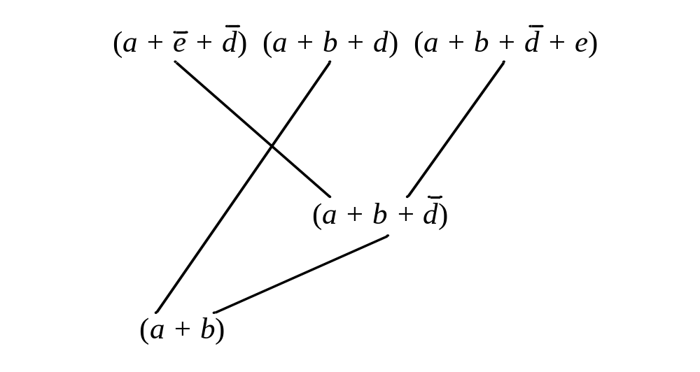
Example
Can (a + b) be resolved from (a + e + d)(a + b + d) (a + b + d + e)?
(Gershman ‘08)

Slide 42
Example
Can (a + b) be resolved from (a + e + d)(a + b + d) (a + b + d + e)?
(Gershman ‘08)

Slide 43
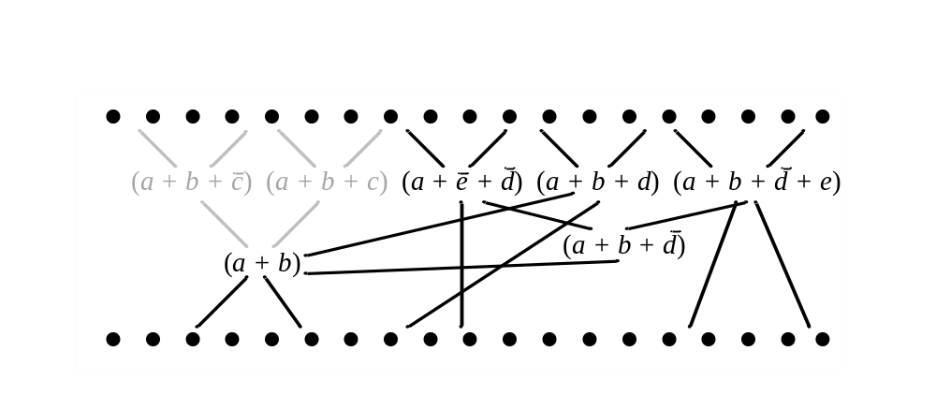
Example
Can (a + b) be resolved from (a + e + d)(a + b + d) (a + b + d + e)?
(Gershman ‘08)

Slide 44
Proposed method
Select potential target functions with the same support set:
  f₁(x₁,x₂,…,x_{m}), f₂(x₁,x₂,…,x_{m}), … , f_{n}(x₁,x₂,…,x_{m})
Generate collective resolution proof.
Structure the proofs so that there are more shared nodes.

Slide 45
Which nodes can be shared?
For the interpolants to be valid:
  The clause partitions A and B must remain the same.
  The global variables must remain the same.

Slide 46
Which nodes can be shared?
f (x₁,x₂,…,x_{m}):
( f )(CNF_{Left})( f *)(CNF_{Right})(x₁ = x₁*)(x₂ = x₂*)…(x_{m} = x_{m}*)
A
B
g (x₁,x₂,…,x_{m}):
( g)(CNF_{Left})( g *)(CNF_{Right})(x₁ = x₁*)(x₂ = x₂*)…(x_{m} = x_{m}*)
A
B

Slide 47
Which nodes can be shared?
f (x₁,x₂,…,x_{m}):
( f )(CNF_{Left})( f *)(CNF_{Right})(x₁ = x₁*)(x₂ = x₂*)…(x_{m} = x_{m}*)
A
B
Only the assertion clauses differ
g (x₁,x₂,…,x_{m}):
( g)(CNF_{Left})( g *)(CNF_{Right})(x₁ = x₁*)(x₂ = x₂*)…(x_{m} = x_{m}*)
A
B

Slide 48
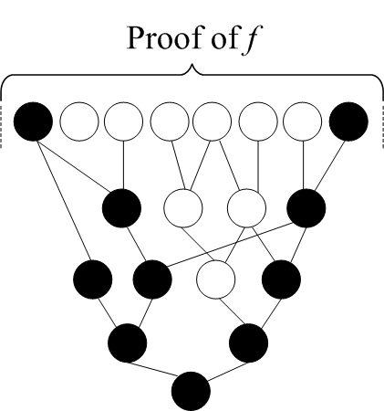
Restructuring Proofs
Color the assertion clauses and descendants black.
Color the remaining clauses white.
Resolve black nodes from white nodes.

Slide 49
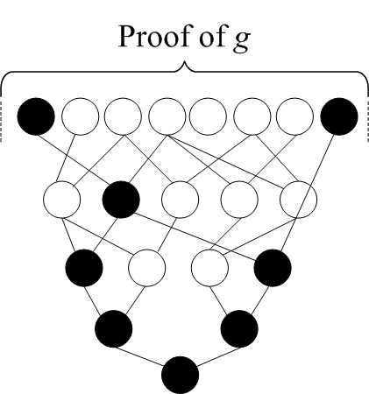
Restructuring Proofs

Slide 50
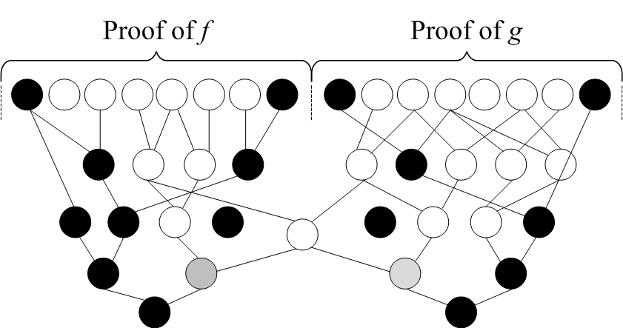
Restructuring Proofs

Slide 51
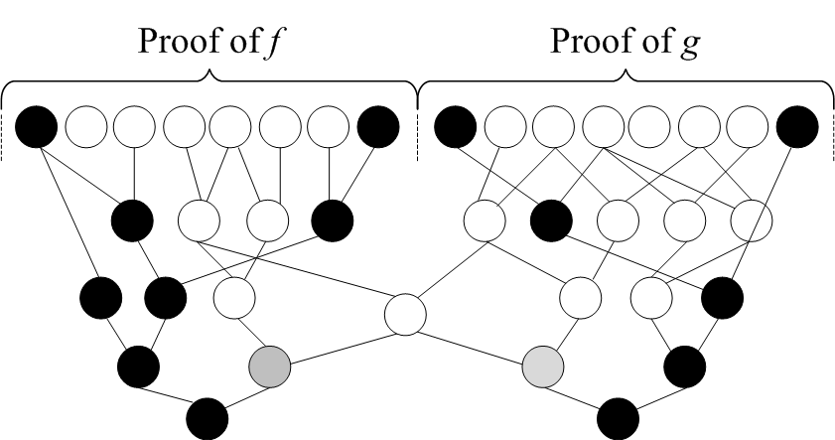
Restructuring Proofs

Slide 52
Proposition
The interpolants from restructured proofs are equivalent.
Proof:
The roots of all white clauses are present in the original SAT instance.
The global variables are the same for each SAT instance.

Slide 53
Experiment
Test to see to what extent proofs can be restructured.
  How many black nodes can be resolved from white nodes?
Generated resolution proofs from benchmark circuits.
  POs specified in terms of all PIs.

Slide 54
Benchmark | Orig. Num. White | Orig. Num. Black | Num. Checked | Num. Sharable | % Sharable | Time (s)
dk15 | 1743 | 581 | 581 | 175 | 30.12 | 0.04
5xp1 | 3203 | 1636 | 1636 | 275 | 16.81 | 0.18
sse | 3848 | 2650 | 2650 | 563 | 21.25 | 0.28
ex6 | 4055 | 2731 | 2731 | 588 | 21.53 | 0.29
s641 | 6002 | 5148 | 5148 | 2269 | 44.08 | 0.46
s510 | 7851 | 5092 | 5092 | 1155 | 22.68 | 0.74
s832 | 15359 | 14826 | 14826 | 3358 | 22.65 | 3.67
planet | 40516 | 43387 | 43387 | 10640 | 24.52 | 26.39
styr | 44079 | 54128 | 54128 | 16578 | 30.63 | 33.88
s953 | 49642 | 46239 | 46239 | 12252 | 26.5 | 31.99
bcd | 96385 | 109167 | 103514 | 34349 | 33.18 | 200
table5 | 137607 | 288461 | 69070 | 27848 | 40.32 | 200
table3 | 177410 | 283066 | 47279 | 24454 | 51.72 | 200

Slide 55
Discussion
Can effect large structural changes.

Slide 56
Discussion
Preliminary results show that there is significant potential for node sharing.
Techniques are highly scalable.
  Calls to SAT solver are incremental.
  Heuristics could improve scalability.

Slide 57
Future Work
Implement full synthesis routine.
Improve conversion of resolution proofs to circuits (Backes and Riedel ICCAD’10).
Try different decision variable orderings.
Explore more general restructuring operations with resolution proofs.

Slide 58

Questions?
Acknowledgments

