Slide 1
TEAM DECRYPTERS
POORVAM PITCH DECK
KJSSE AFTERMATH ‘26
WWW.POORVAM.AI

Slide 2
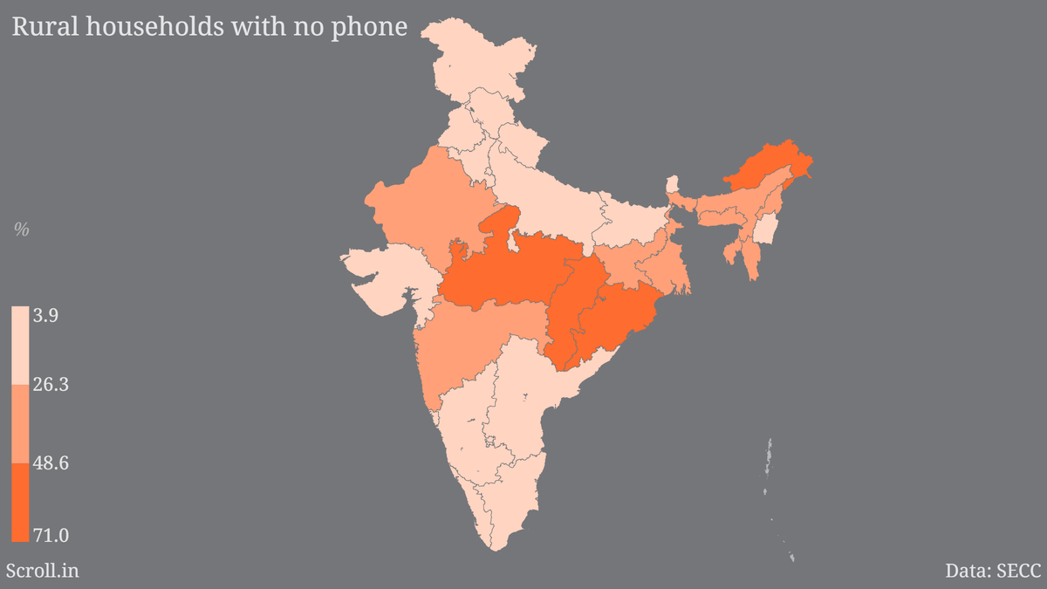
THE 450M PROBLEM
TEAM DECRYPTERS
The blue-collar market in India is super disorganized, we wanted to fix that by making a super cool app, but we ran into some problems....
Problem 1: Over 450M blue collar workers in India do not own a smartphone. That’s almost all of them!
Problem 2: They don’t know how to speak English, how would they use the app or interact with the user?
PAGE 02

Slide 3

SO WE FIXED ALL THREE
TEAM DECRYPTERS
The App: For clients, the MERN app enables them to find help instantly, by connecting them to the closest expert in the area.
No Smartphones? The experts directly get an interactive phone call updating them about the nearest jobs, which they can choose from.
No English? The call can be in any one of 25 regional languages, our AI can give info and answer questions.

Slide 4
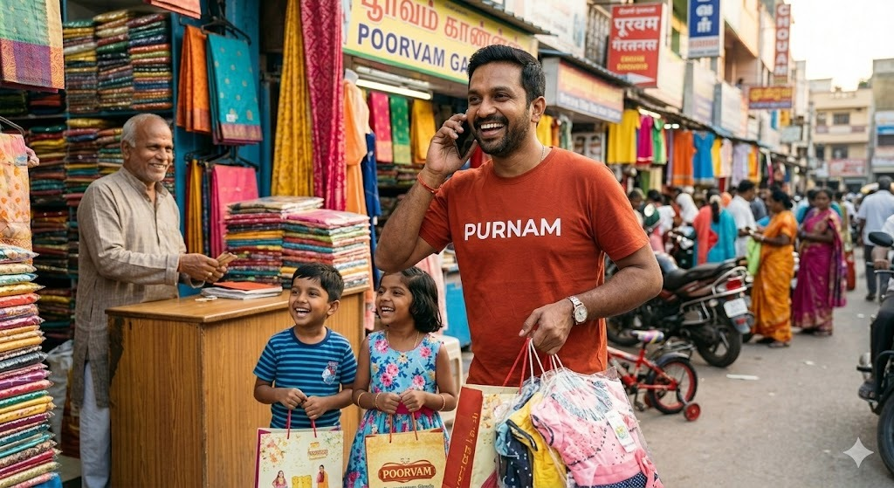
FEASABILITY AND SOCIAL GOOD
TECHNICAL FEASIBILITY •
• LIVEVOICE™ IN 25+ INDIAN LANGUAGES
• REAL-TIME MONGODB CALL SYNC
• CAN DIRECTLY TRANSFER CALL TO CLIENT
SOCIAL IMPACT
ELIMINATING UNNECESSARY COMMISIONS TO MIDDLE MAN
FULL WORK HISTORY DATABASE
ECONOMIC UPLIFMENT FOR LOCAL GIG WORKERS

Slide 5
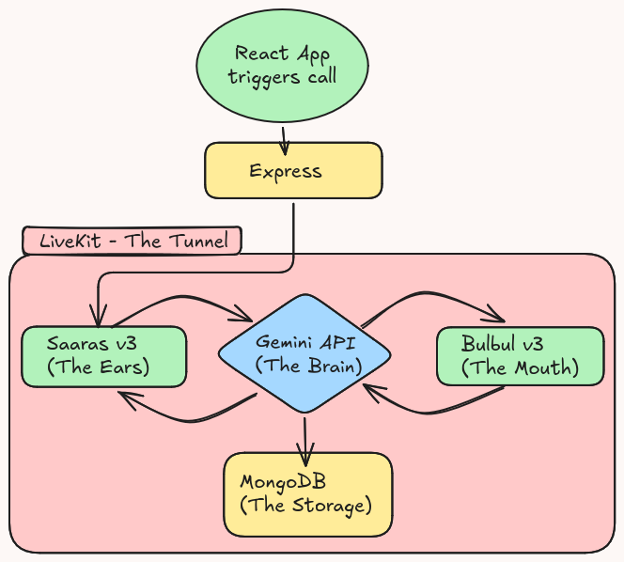
HOW DID WE MAKE IT?
We are using an ear-brain-mouth model for automation of the voice agent.
The Brain (here, Gemini) will automatically alter the database (MongoDB) after the call.
We used LiveKit as the tunnel to put it all together.
And of course, ol’ reliable React for the frontend and Express for the backend.

Slide 6
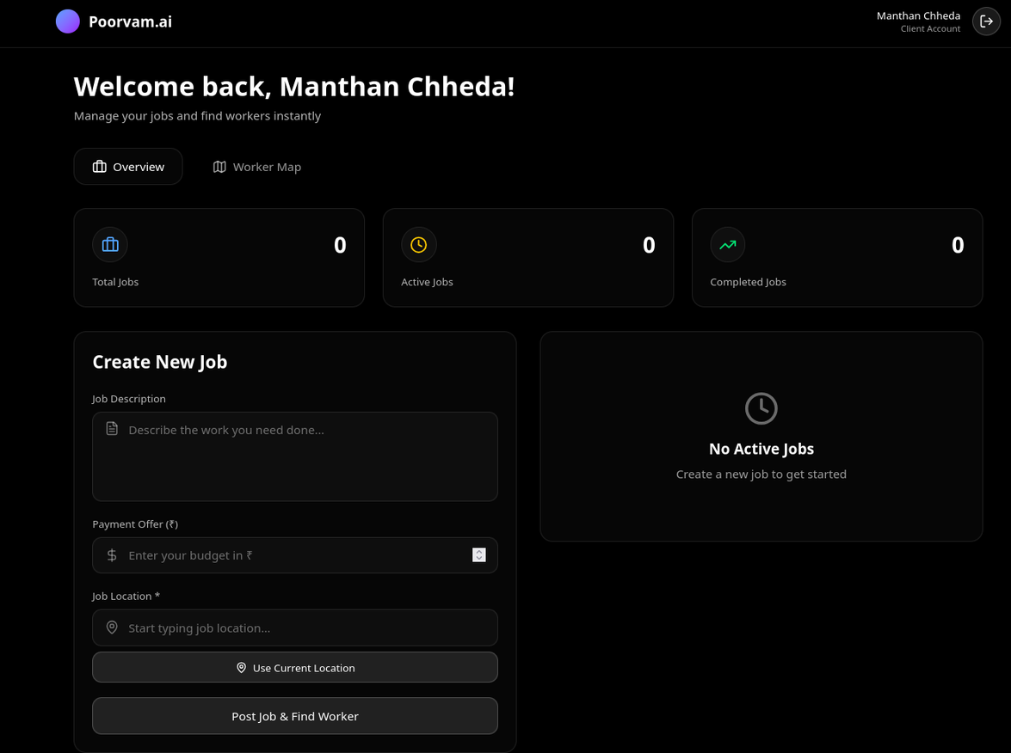
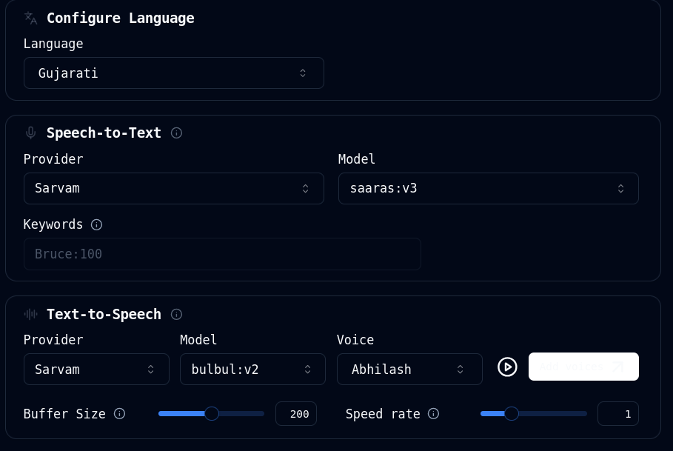
DEMO TIME ! !

