Slide 1
Functional Therapeutics Classification
FTC

Slide 2
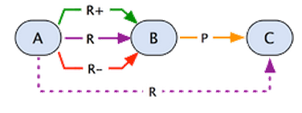
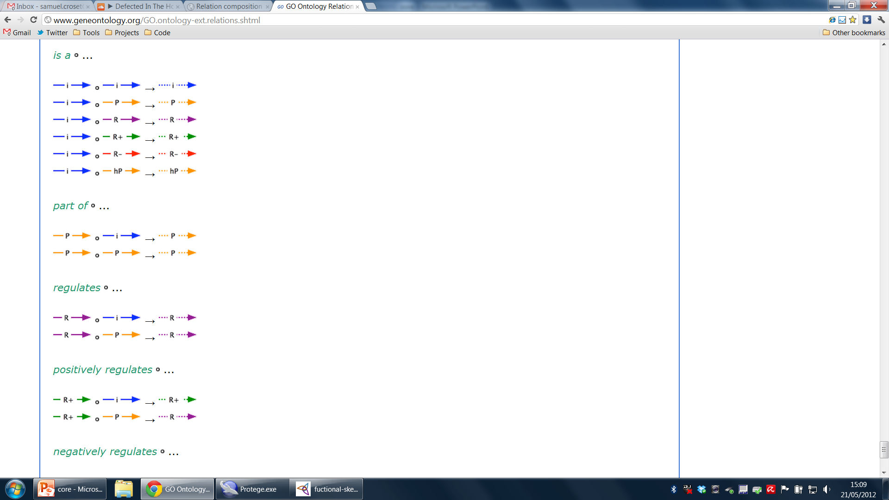
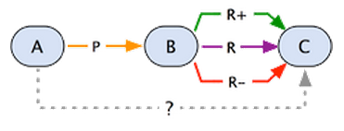
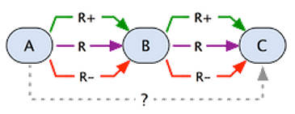
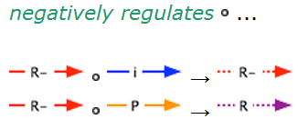
Go Relations
The regulation of the mechanism is assumed to be un-uncoupled to the mechanism, in other words: The mechanism can happen without the regulation

Slide 3
ftc:involved-in
Range: Gene products (Activity)
Domain: Bio-Process
Comment: Coming from GOA, annotation of a gene product with a bio-process
Chain Properties:
ftc:involved-in o ro:is_a → ftc:involved-in
(ro:is_a o ftc:involved-in → ftc:involved-in)
ftc:involved-in o ro:part-of → ftc:involved-in
ftc:involved-in o ro:regulates → ???
Other combinations are impossible due to range and domain restrictions.

Slide 4
ftc:involved-in o ro:is_a → ftc:involved-in
positive regulation of blood coagulation (GO:0030194)
Prothrombin (P00734)
involved-in some
is_a
involved-in some
regulation of blood coagulation (GO:0030193)

Slide 5
ftc:involved-in o ro:part-of → ftc:involved-in
platelet activation (GO:0030168)
Prothrombin (P00734)
involved-in some
part_of some
involved-in some
blood coagulation (GO:0007596)

Slide 6
ftc:involved-in o ro:regulates → ???
regulation of blood coagulation (GO:0030194)
Prothrombin (P00734)
involved-in some
regulates some
???
blood coagulation (GO:0007596)
The protein is involved in the regulation process, not the process itself. A bit ambiguous, but inline with GO.

Slide 7
ftc:has-function
Range: Gene products (Activity)
Domain: Molecular Function
Comment: Coming from GOA, annotation of a gene product with a function.
Chain Properties:
ftc:has-function o ro:is_a → ftc:has-function
(ro:is_a o ftc:has-function → ftc:has-function )
ftc:has-function o ro:part-of → ftc:involved-in
Other combinations are impossible due to range and domain restrictions.

Slide 8
ftc:has-function o ro:is_a → ftc:has-function
serine-type endopeptidase activity (GO:0004252)
Prothrombin (P00734)
has-function some
is_a
has-function some
catalytic activity (GO:0003824)

Slide 9
ftc:has-function o ro:part-of → ftc:involved-in
catalytic activity (GO:0003824)
Prothrombin (P00734)
has-function some
part_of some
involved-in some
metabolic process (GO:0008152)

Slide 10
ftc:perturbs
Range: Chemical Compounds (Activity)
Domain: Gene Product (Activity)
Comment: Coming from a chemical (drug), reflects the action on the gene product.
Chain Properties:
(ftc:pertubs o ro:is_a → ftc:pertubs)
(ro:is_a o ftc:pertubs → ftc:pertubs )
ftc:pertubs o ro:involved-in → ftc:pertubs
ftc:positively-pertubs o ro:involved-in → ftc:pertubs
ftc:negatively-pertubs o ro:involved-in → ftc:pertubs
ftc:pertubs o ro:part-of → ftc:pertubs
ftc:pertubs o ro:regulates → ???
Other combinations are impossible due to range and domain restrictions.

Slide 11
ftc:pertubs o ro:involved-in → ftc:pertubs
Lepirudin (DB00001)
Prothrombin (P00734)
perturbs some
involved-in some
perturbs some
regulation of blood coagulation (GO:0030194)

Slide 12
ftc:positively-pertubs o ro:involved-in → ftc:pertubs
Lepirudin (DB00001)
Prothrombin (P00734)
positively perturbs some
involved-in some
perturbs some
regulation of blood coagulation (GO:0030194)

Slide 13
ftc:negatively-pertubs o ro:involved-in → ftc:pertubs
Lepirudin (DB00001)
Prothrombin (P00734)
negatively perturbs some
involved-in some
perturbs some
regulation of blood coagulation (GO:0030194)

Slide 14
ftc:pertubs o ro:part-of → ftc:pertubs
Lepirudin (DB00001)
regulation of blood coagulation (GO:0030194)
perturbs some
part_of some
perturbs some
wound healing (GO:0042060)

Slide 15
ftc:pertubs o ro:regulates → ???
Lepirudin (DB00001)
regulation of blood coagulation (GO:0030194)
perturbs some
regulates some
???
blood coagulation (GO:0007596)

Slide 16
ftc:Agent
ftc:Anti-Biological-Process-Agent:
Drug and (positively-perturbs some (Protein and (involved-in some negative_regulation_of_biological_process)))
Drug and (negatively-perturbs some (Protein and (involved-in some positive_regulation_of_biological_process)))
ftc:Pro-Biological-Process-Agent:
Drug and (positively-perturbs some (Protein and (involved-in some positive_regulation_of_biological_process)))
Drug and (negatively-perturbs some (Protein and (involved-in some negative_regulation_of_biological_process)))

Slide 17
ftc:Therapeutic_Compound
Drugs from DrugBank are subclasses of that class

Slide 18
ftc:Gene_Product
Gene products (proteins) are sub-classes of this class
What about non gene-products that are targets of drugs?

Slide 19
Classes from GO
Go:Biological_Process and go:molecular_function are also top level

Slide 20
Anti/Pro Patterns
Anti-blood-coagulation-agent
is_a
is_a
Therapeutic Compound
Lepirudin (DB00001)
negatively-perturbs some
positive regulation of blood coagulation (GO:0030194)
Prothrombin (P00734)
involved-in some
is_a
Anti-blood-coagulation-agent = Therapeutic_Compound and (negatively-pertubs some (Gene-Product and involved-in some positive-regulation-of-blood-coagulation))
Gene Product

Slide 21
Problems
Proteins with multiple functions (multiple domains) that are the target of the drug. Only part of the functions are perturbed, not everything.
At the moment deal only with human proteins
What about other organisms, like bacteria, etc…?

Slide 22
Pseudo-Code
Foreach(drug){
Foreach(target){
foreach(getAllAnnotations()){
if(annot is BP r+/r- regulating){
create class
}
if(annot is MF){
create class
}
}
}
}

