Slide 1
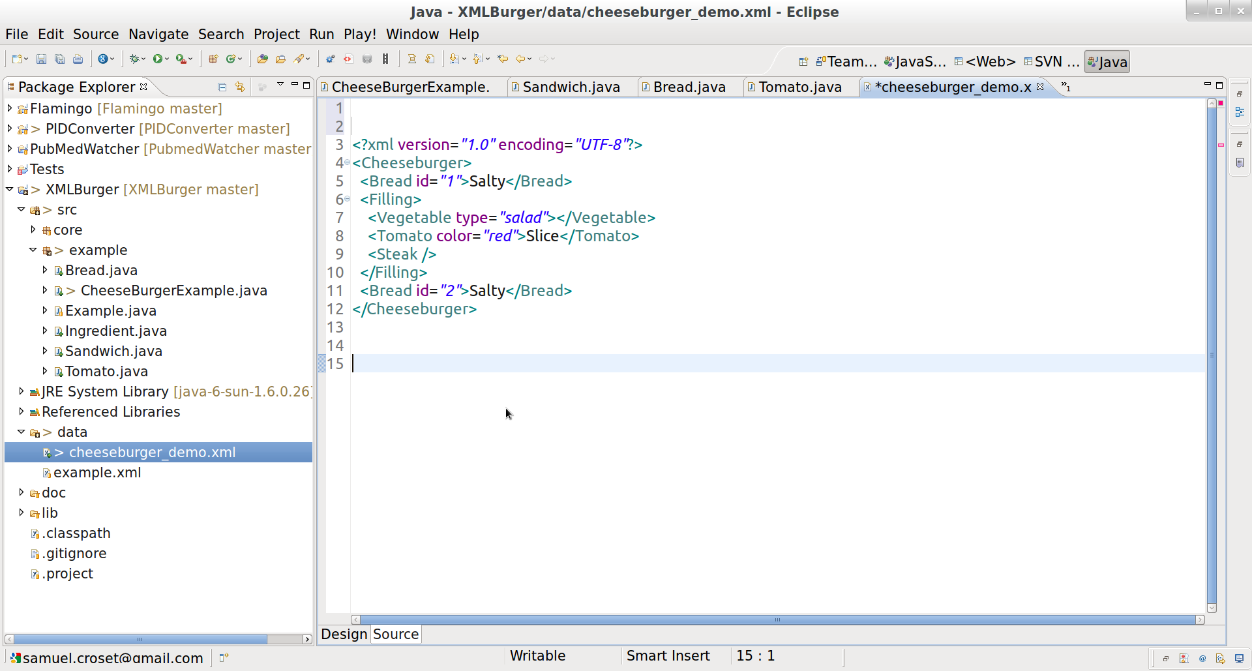

The junky XML:
The Java Objects you want to populate:
Sandwich
ArrayList<Ingredient>
Ingredient
Part of
Is a
Is a
Bread
Id
Tomato
Format
Color

Slide 2
