Slide 1
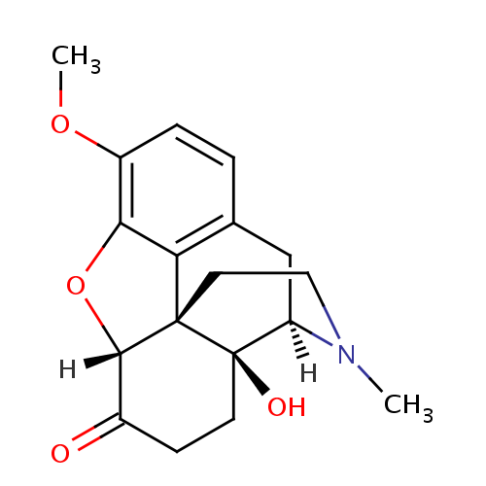
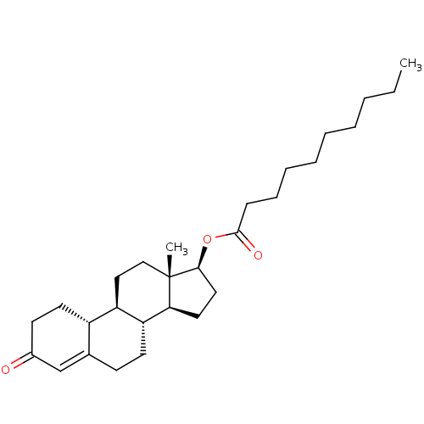
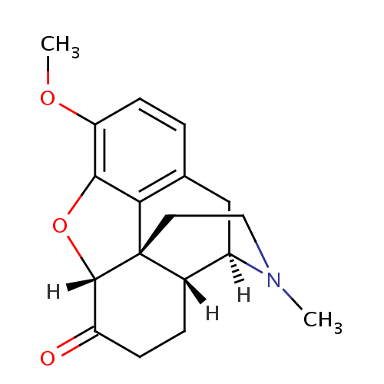
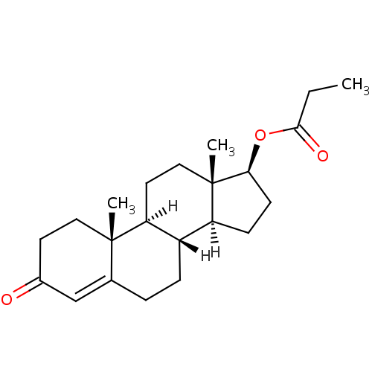
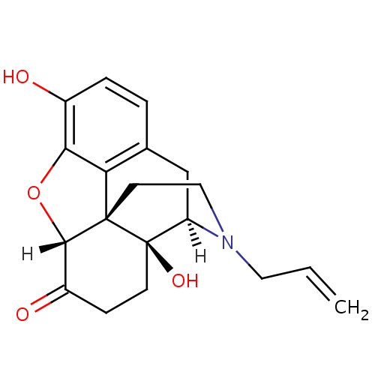
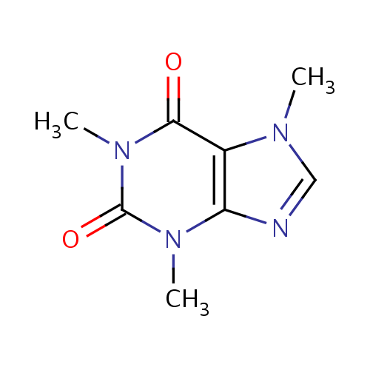
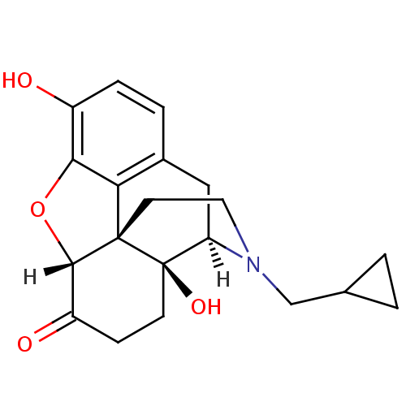
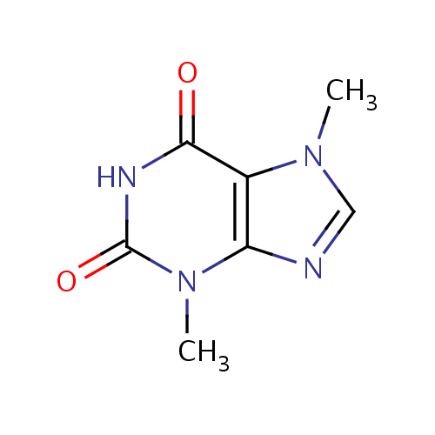
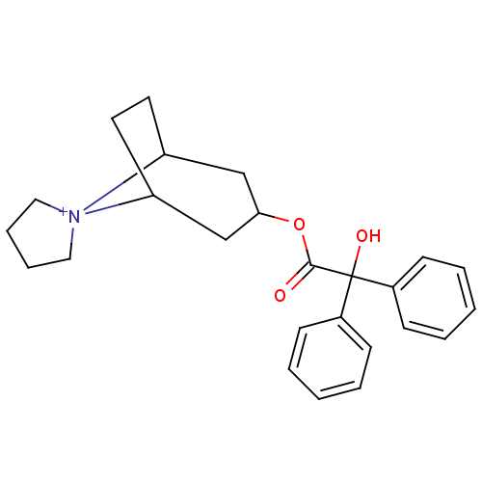
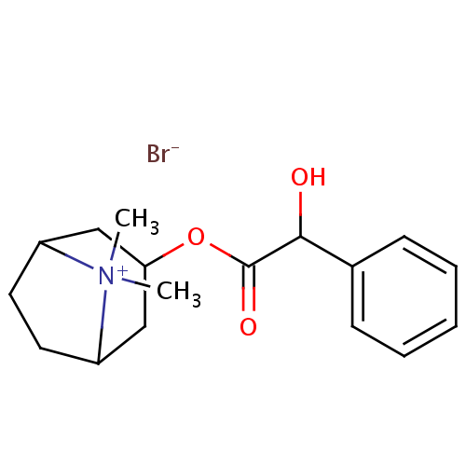
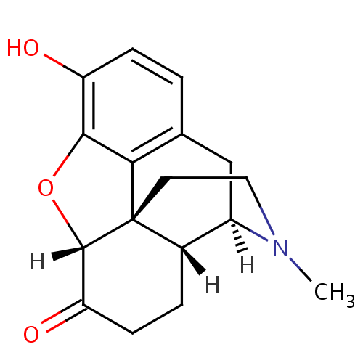
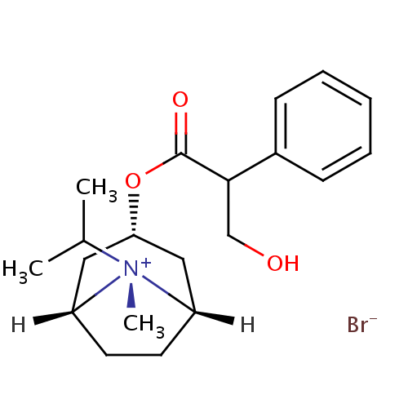
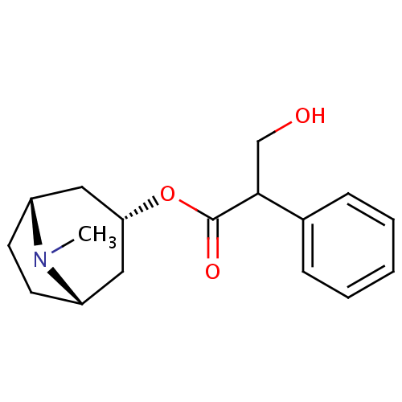
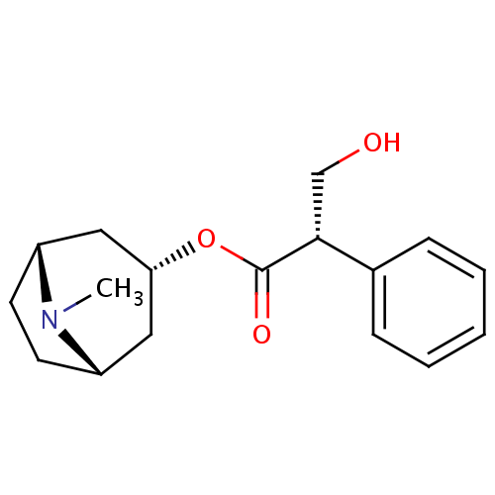
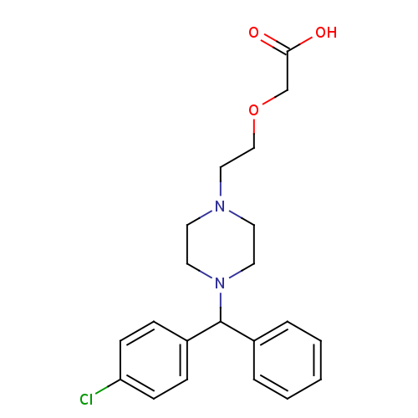
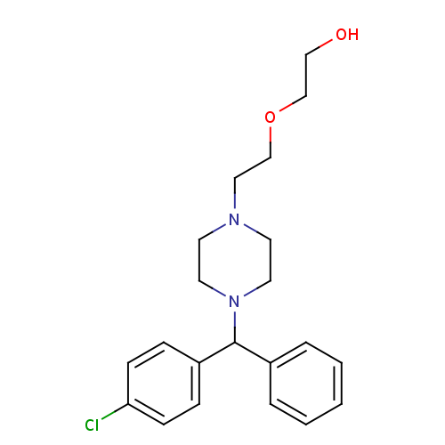
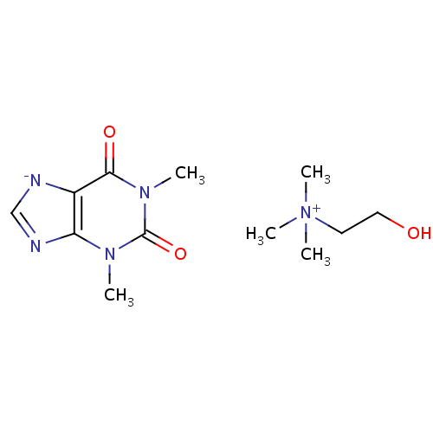
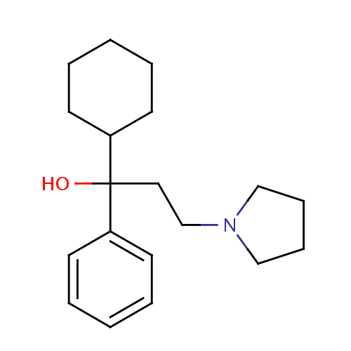
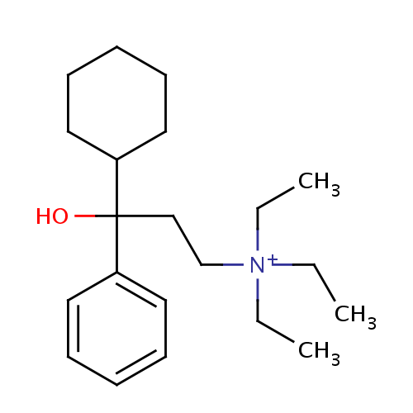
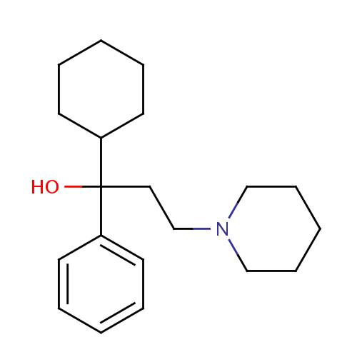
Nandrolone decanoate
Caffeine
Hydrocodone
Oxycodone
Naloxone
Naltrexone
Testosterone Propionate
Theobromine
Trospium
Homatropine Methylbromide
Hydromorphone
Hydrocodone
Hyoscyamine
Ipratropium bromide
Atropine
Ipratropium bromide
Cetirizine
Tridihexethyl
Procyclidine
Trihexyphenidyl
Oxtriphylline
Hydroxyzine
Caffeine

Slide 2
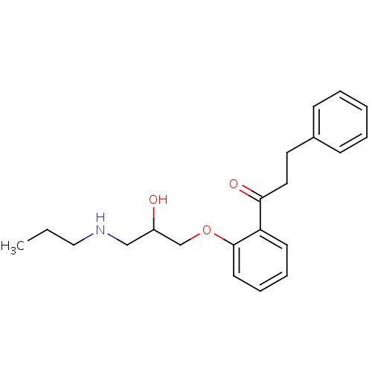
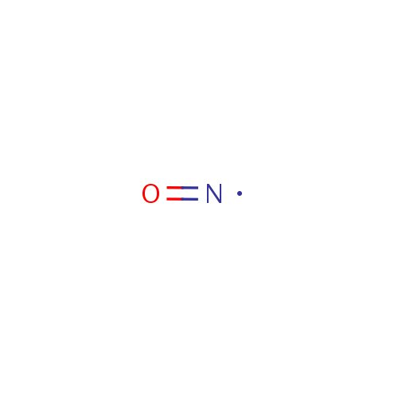
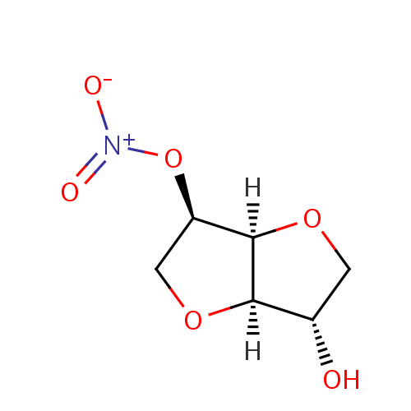
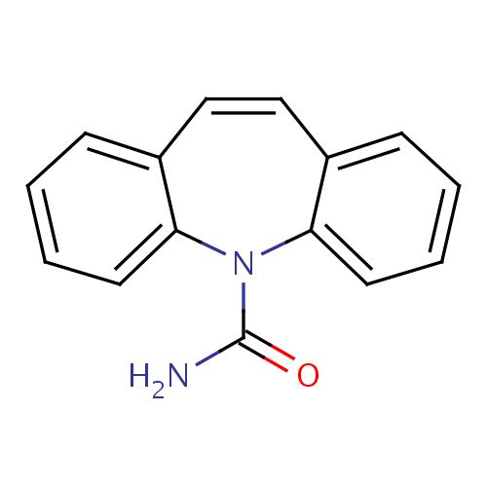
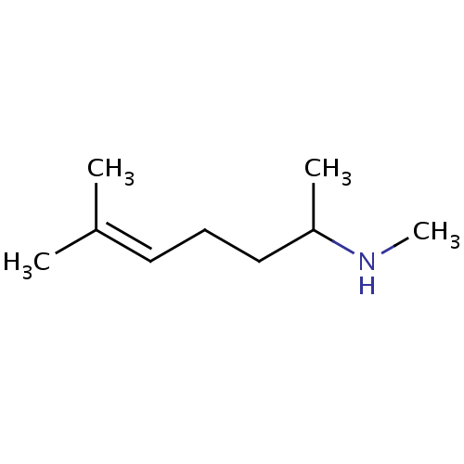
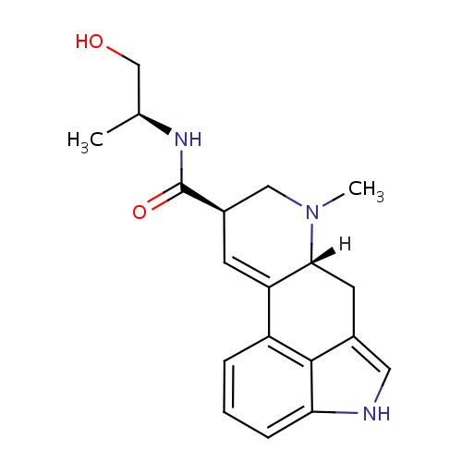
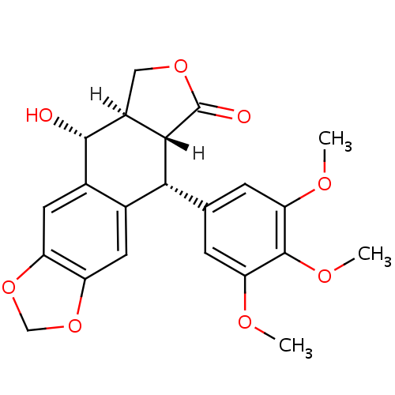
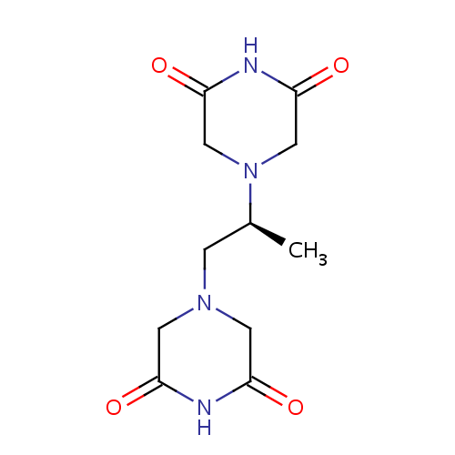
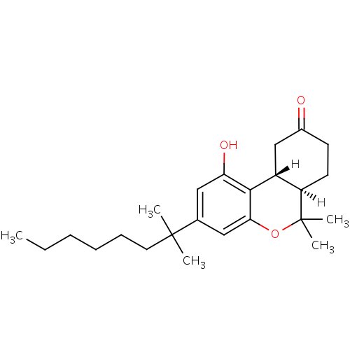
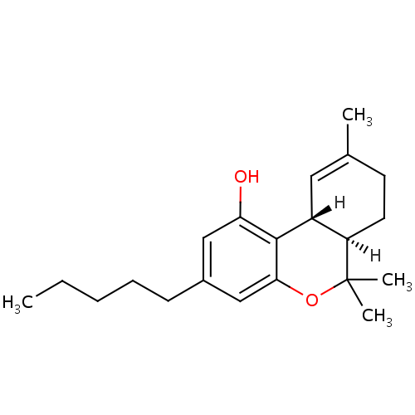
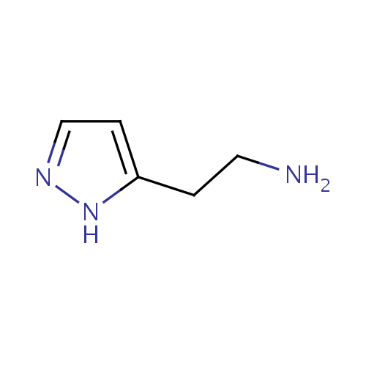
Carbamazepine, an anticonvulsant s used to treat seizures (antiarrhythmic activity mentionned). Propafenone is a antiarrhythmic drug with local anesthetic effects. Both Anti-sodium ion transport agent.
DB00564 - 'Carbamazepine'
DB00435 - Nitric Oxide
Isosorbide Mononitrate - DB01020
Both agents active on the same receptor – Different indication, yet both involved in vasodilatation – Nitric oxide as prophylactic for angina pectoris. Isosorbide mononitrate is converted into NO in the body
DB01182 - 'Propafenone'
DB06706 - 'Isometheptene'
DB01253 - 'Ergonovine'
Both compounds have vasoconstrictive properties. Ergonovine directly stimulates the uterine muscle to increase force and frequency of contractions. Isometheptene is a sympathomimetic drug which causes vasoconstriction. It is used for treating migraines and tension headaches. Different system, same effects, yet same targets.
Only one category of receptor assigned to, impossible to tell, moa similarity artificially high.
DB01179 - 'Podofilox'
DB00380 - 'Dexrazoxane'
Dexrazoxane - Detoxifying agents for antineoplastic treatment. An antimitotic agent with immunosuppressive properties. Podofilox: Antiviral - A lignan (lignans) found in podophyllin resin from the roots of podophyllum plants. It is a potent spindle poison, [...] and may have antineoplastic properties, as do some of its congeners and derivatives. Same targets but not only, different systems, antimitotic activity would be confirmed.
DB00470 - 'Dronabinol'
DB00272 - 'Betazole'
DB00486 - 'Nabilone'

Slide 3
Compounds similar based on MoA and indication – yet not identified as similar based on the structure – less obvious cases, not following the rule similar structure leads similar activity
Compounds respecting the rule: similar structure leads to similar indication and function
- Means → overall = rule respected
- clouds, outliers, interesting cases not respecting the rule
Compounds similar based on structure and indication – yet not identified by the FTC – flaws of the FTC
Control graph – look the respect of the rule – for level 4 – if rule holds, then compounds with similar indication should have same structure and same MoA for the level 4

Slide 4
Similar functionality, different structures, and different indications – unexpected ones (because structure is different), repurposing hypotheses
Weirds cases – compounds have high similar structures and high MoA, yet different categories – to investigate – otherwise highly likely cases
Means → expected
Cloud → outliers, they could be interesting or not
Compounds with similar structure yet different indications – makes sense, it's not because you have same structure that you have similar indication
Predictions - outliers

